Slide 1
Project: Analysis of Airbnb Data Using Power BI
Assignment : 01
ABADS Batch 12

Slide 2
Introduction:
Airbnb, headquartered in San Francisco, California, operates a popular online marketplace specializing in short-term accommodations and experiences. Established in 2008 by founders Brian Chesky, Nathan Blecharczyk, and Joe Gebbia, the name Airbnb is derived from its original moniker, Air-Bed and Breakfast.com. iVision analytics firm has been provided with datasets related to Airbnb listings and reviewer scores worldwide.
The objective is to gain a deeper understanding of Airbnb's operations and draw meaningful insights from the data. As a PowerBI Analyst at iVision, your role is to create informative reports by conducting a thorough analysis of the data using powerful tools like Power BI.

Slide 3
What is Power BI?
Microsoft Power BI is a data visualization and reporting platform that is used by businesses and professionals every day. While the platform is commonly used by business analysts, it is also designed to be easily accessible for those without any specialized data knowledge

Slide 4
Business Objective
The primary objective is to analyze Airbnb data to reveal insights into user experiences and satisfaction levels with the numerous listed stays, all accomplished using Power BI.
Software / Tools: Power BI

Slide 5
Data Description
The necessary data and data dictionaries are available as CSV files.
The Reviews (Reviews.csv) dataset contains information about reviews left for Airbnb listings, while the Listings (Listings.csv) dataset contains all relevant details about the listed stays. Comprehensive descriptions of each column can be found in their respective data dictionary files (Listings_data_dictionary.csv and Reviews_data_dictionary.csv)

Slide 6
Project Goals
Assessing District Location Scores: The aim is to pinpoint the location in the district with the least favorable location scores.
Examining Host Response Time Impact: The goal is to delve into the relationship between host response times and the overall ratings of Airbnb listings providing valuable insights.
Visualizing Airbnb Listing Prices: The objective is to create visual representations of Airbnb listing prices across different cities and summarize any noteworthy trends or variations.
Analyzing Composite Scores: The task involves creating a composite score that integrates check-in experience and host communication for various districts with subsequent analysis and insights.
Calculating Listing Age and Host Tenure: This objective entails computing the age of Airbnb listings and identifying hosts who have accumulated more than 10 years of hosting expertise.

Slide 7
Project Goals
Property Type Price Analysis: The task involves the creation of a visual tree map that displays average prices for various room and property types with specific attention given to the property type associated with the highest prices for entire places.
Crafting a Comprehensive City Insights Report: This objective entails the creation of a comprehensive report that presents listing prices, guest ratings, and visitor trends for multiple cities, with a particular focus on assessing changes in visitor trends in 2020 in contrast to earlier years.

Slide 8
Steps Involved in Report Making:
Data Cleaning :
The raw data given to me was in distributed in four .CSV files. There were two datasheets namely Reviews.csv , Listing.csv, Listing and two comprehensive data directory files namely Listing_data_dictionary.csv and Reveiws_data_dictionary.csv.
Step 1 - Loaded these .csv files into Power BI
Step 2 – Combined, Transformed and loaded at Power BI
Step 3 – Loaded to Power Query

Slide 9
Step 4- Cleaning procedure started in Table View which includes:
Editing of names such as host_since to Date of Registration and changing into data type to date
Changed Price from text to Currency
Overall Rating and other numerical data were given in text and uncategorized format. They were changed to appropriate formats.
Step 5 – After cleaning Reports were made in Report Veiw

Slide 10
Question No.1
Assessing District Location Scores: The aim is to pinpoint the location in the district with the least favorable location scores.
Steps involved :
Changed map setting in Options >Global>Security>Map and Filled Map visuals.
Selected Map Graph toolbar
Ploted Latitude and Longitude in respective locations
Used Bubblesized Points for representing Locations with least score.
Hence the map below :

Slide 11
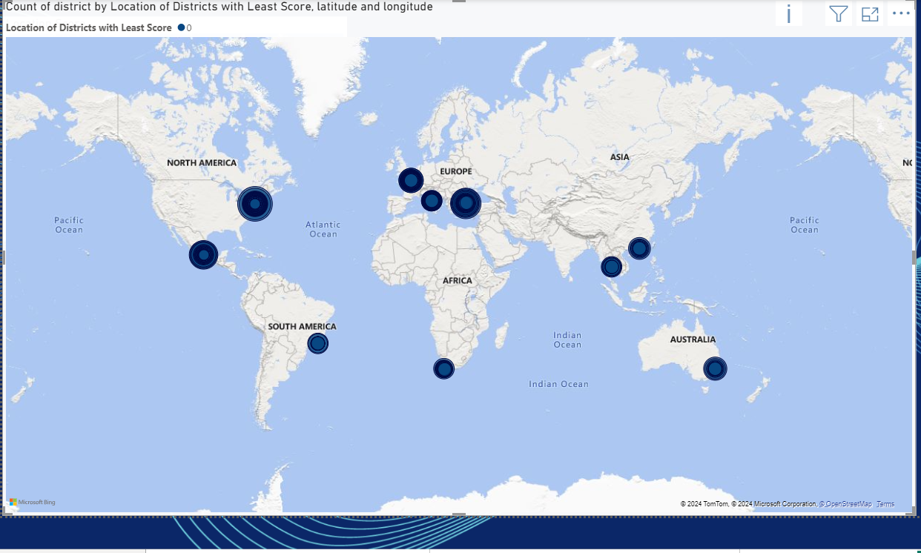

Slide 12
Question No.2
Examining Host Response Time Impact: The goal is to delve into the relationship between host response times and the overall ratings of Airbnb listings providing valuable insights
Steps involved :
Overall Rating vs Respose Time of Host graph was prepared with Verified Host Identinfication as filter
Overall rating vs Host_Response_Rate graph prepared
Sum of Overall rating vs Response Time graph
Sum of Overall rating vs Verified Host Identity graph were made
All four graphs were connected with a slider filtered by city column.
Hence the chart below :

Slide 13
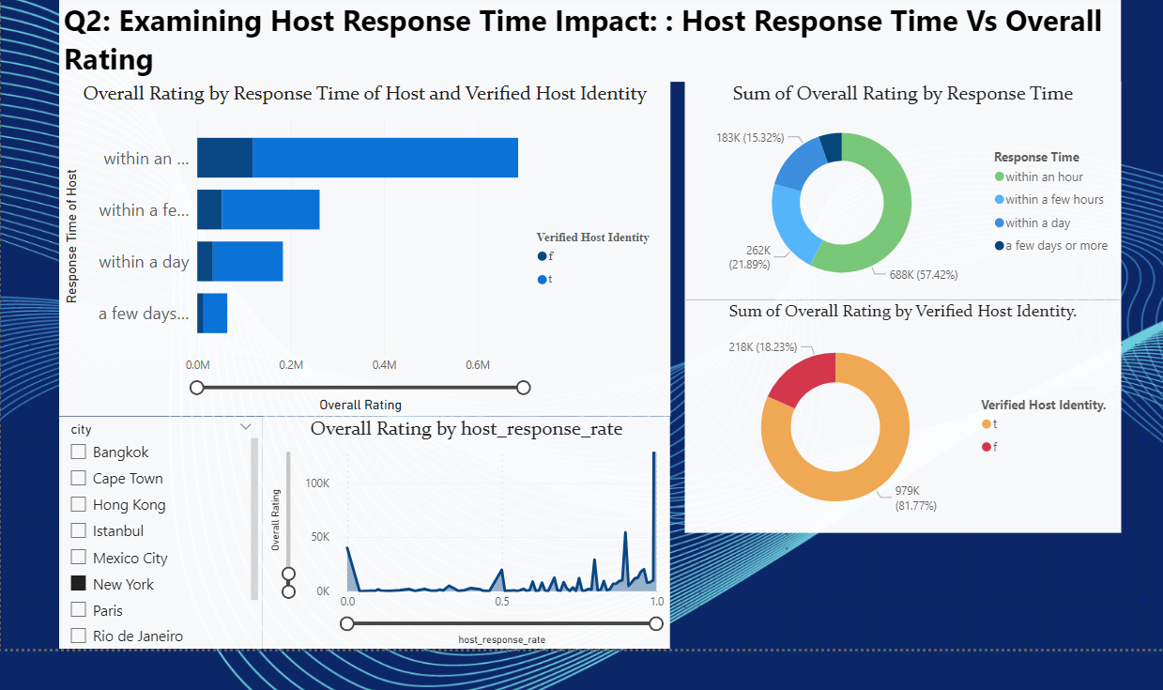

Slide 14
Question No.3
Visualizing Airbnb Listing Prices: The objective is to create visual representations of Airbnb listing prices across different cities and summarize any noteworthy trends or variations
Steps involved :
To create visualization for Price Listing following graphs were used.
Maximum Price Vs City
Maximum Price vs Room Type
Maximum Price board
List of city showing Maximum Price, Property Type & Room type was also added along with these charts
Hence the chart below :

Slide 15
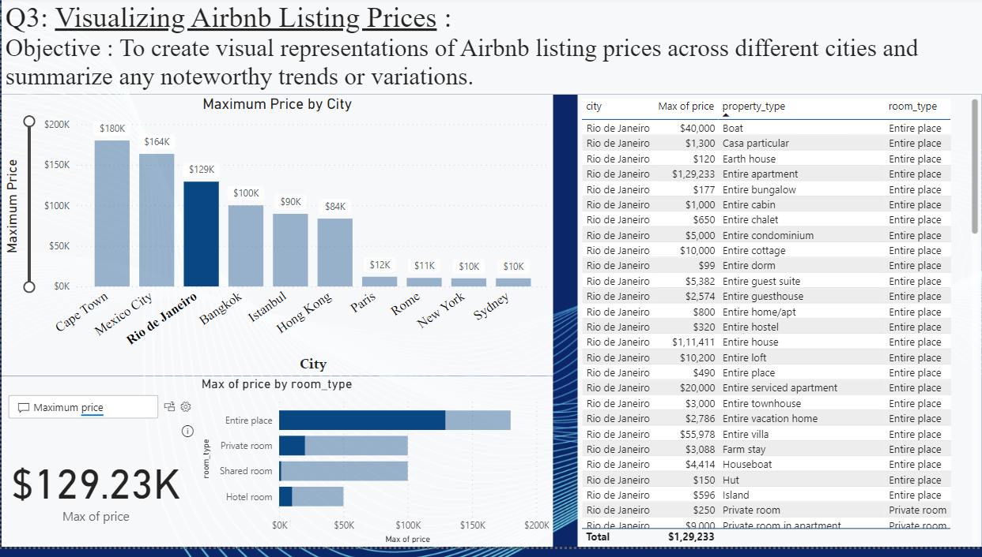

Slide 16
Question No.4
Analyzing Composite Scores: The task involves creating a composite score that integrates check-in experience and host communication for various districts with subsequent analysis and insights.
Steps involved : District-wise details were available for New York city only. Hence graphs are based on New York city only.
Prepared graphs Count of check-in Experience score vs District
Prepared Count of Host – Communication Score by District
A table showing various apartment, based on its property type,Room type, Number of Bedroom , amendities,etc was also included.
Hence the chart below :

Slide 17
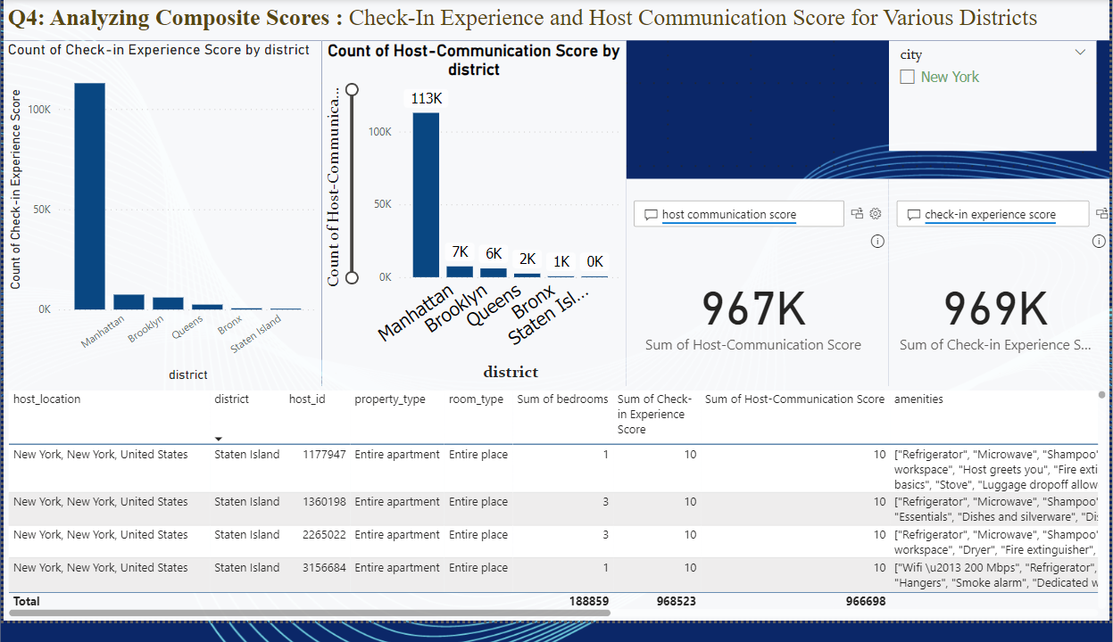

Slide 18
Question No.5
Calculating Listing Age and Host Tenure: This objective entails computing the age of Airbnb listings and identifying hosts who have accumulated more than 10 years of hosting expertise.
Steps involved :
Prepared Graph based on Number of Hotels vs City and District
Used filter for getting information about list of hotels registrated more that 10 years ago.
Hence the chart below :

Slide 19
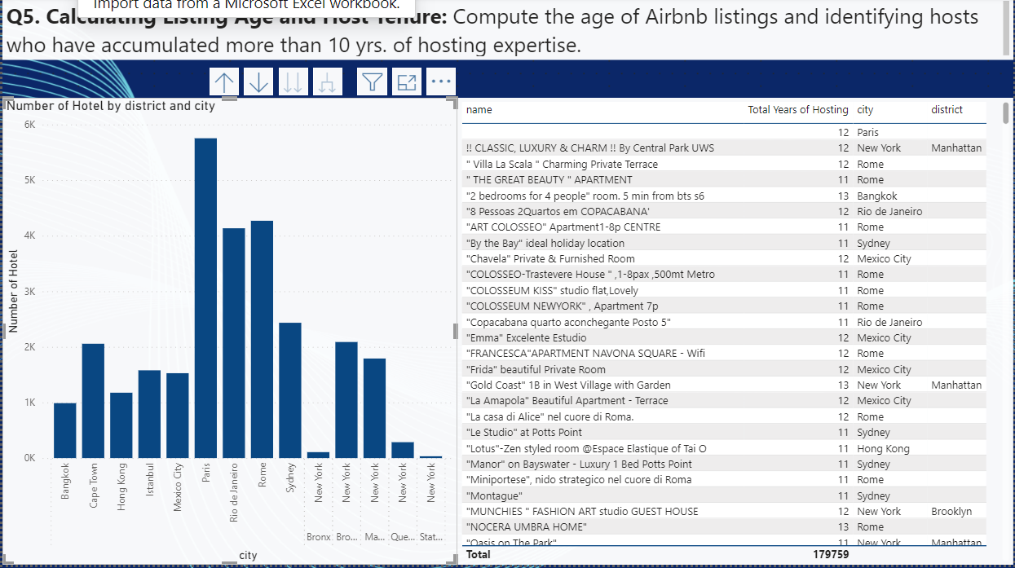

Slide 20
Question No.6
Property Type Price Analysis: The task involves the creation of a visual tree map that displays average prices for various room and property types with specific attention given to the property type associated with the highest prices for entire places
Steps involved :
Objective was to prepare Tree Map Average Price vs City.
Included a bar graph along with that for better understanding
Average Price vs Room type graph included.
A table showing City, Maximum Price and Property Type also included.
Hence the chart below :

Slide 21
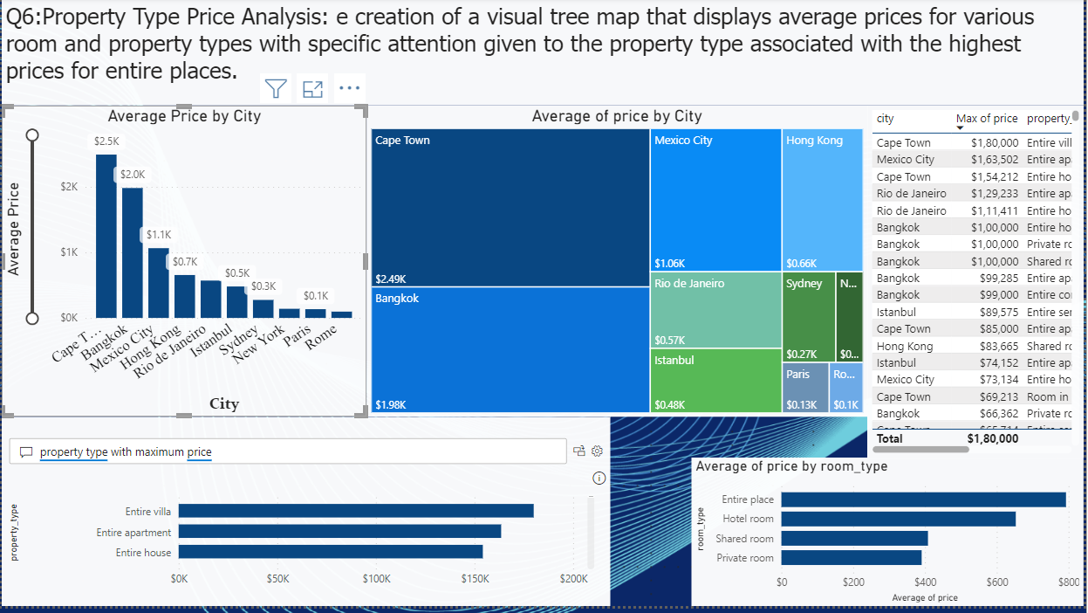

Slide 22
Question No.7.A
Crafting a Comprehensive City Insights Report: Objective to entails Change in Price and Room Type after 2020 changes in visitor trends in contrast to earlier years
Steps involved :
This report include two parts
Fig 7.A show the graph showing the change in Price and Room Type after 2020
Hence the chart below :

Slide 23
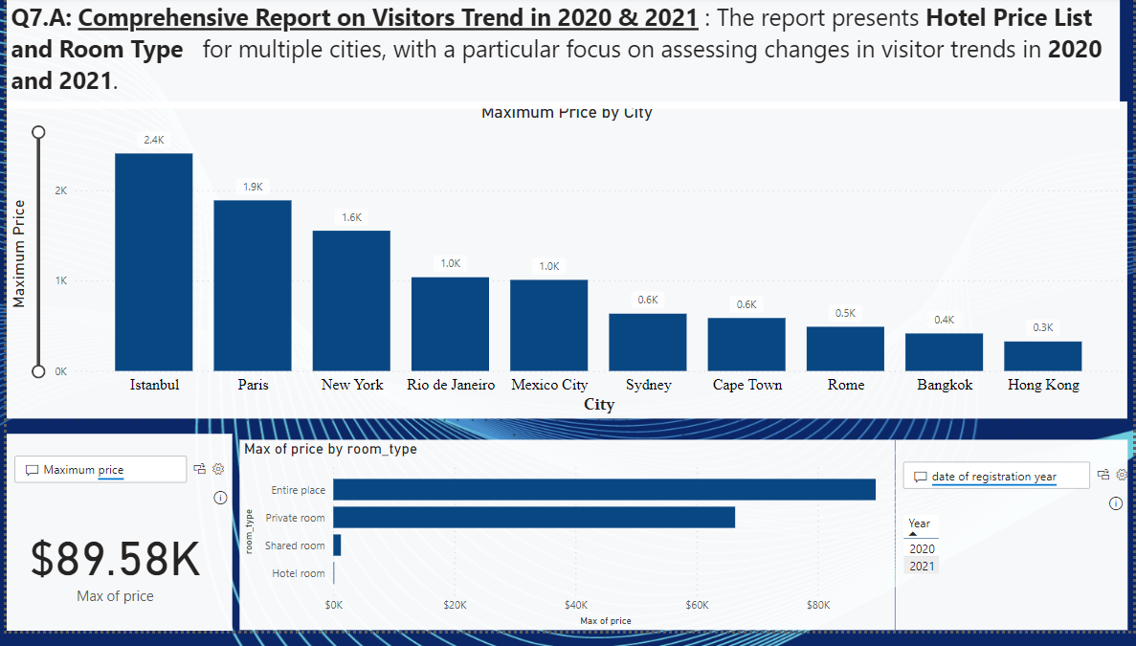

Slide 24
Question No.7.B
Crafting a Comprehensive City Insights Report: Change in Visitors Trend after 2020 in contrast to earlier years
Steps involved :
This report include two parts
Fig 7.B show the graph showing the change in Price and Room Type after 2020
Hence the chart below :

Slide 25
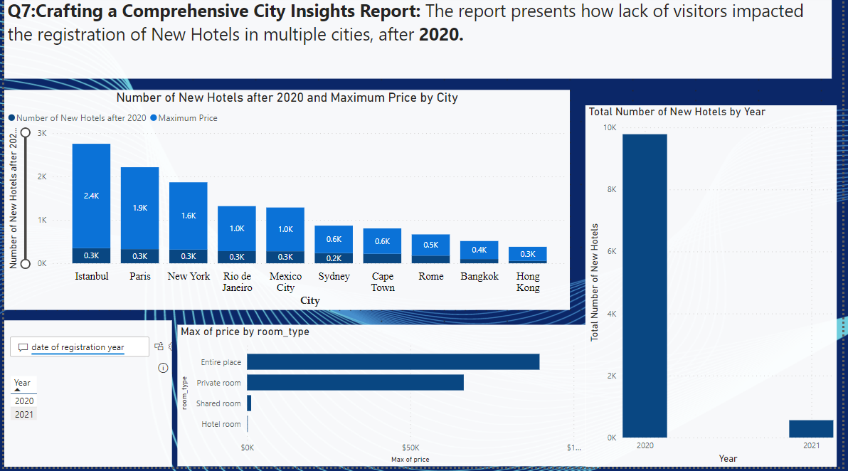

Slide 26
Thank You

