Slide 1
AWS Lambda
Serverless Compute — Run Code Without Managing Servers
Presented by:
K. Arunsai
DevOps | AWS Infrastructure

Slide 2
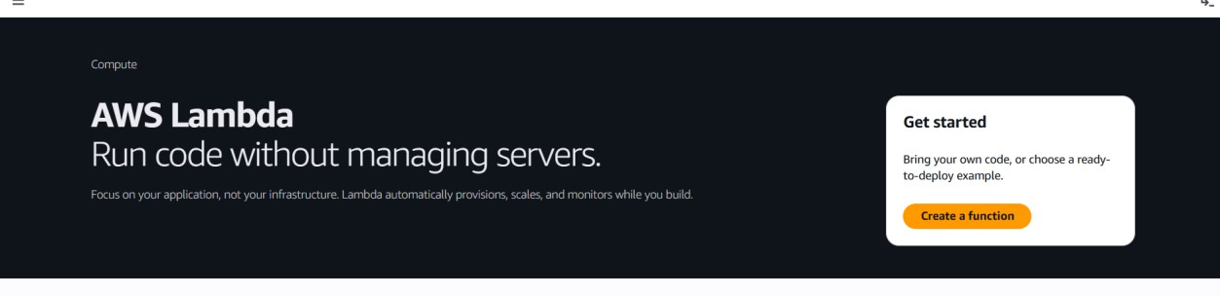
01
AWS Lambda
Serverless Compute Service
What is it?
AWS Console Preview
AWS Lambda is a serverless compute service that lets you run code without provisioning or managing servers. You upload your code and Lambda handles everything required to run and scale it with high availability. You pay only for the compute time you consume.
Key Highlights
No server provisioning or management
Auto-scales from a few requests to thousands/sec
Supports Python, Node.js, Java, Ruby & more
Event-driven: triggers from S3, SQS, API Gateway
Integrated CloudWatch monitoring & logging
K. Arunsai | DevOps
Max 15 min execution, 10 GB memory

Slide 3
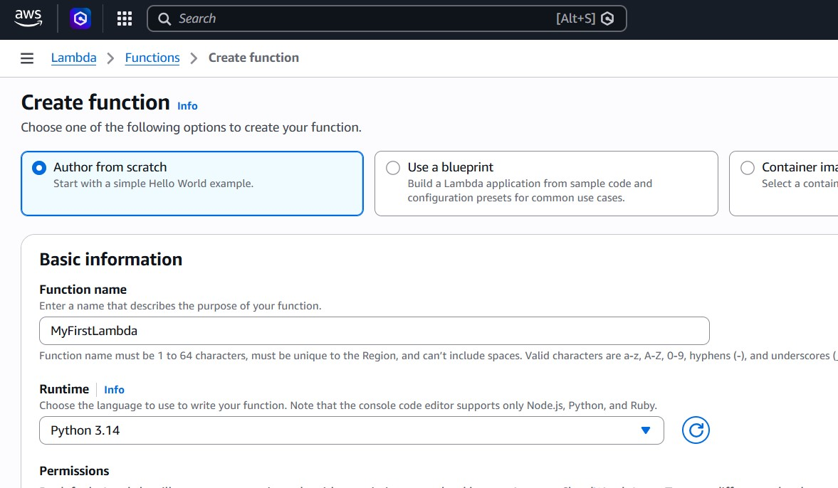
01
AWS Lambda
Serverless Compute Service
Steps 1–5: Create Function
1
Login to AWS Management Console
2
Navigate to Lambda service (under Compute)
3
Click 'Create a function'
4
Select 'Author from Scratch'
5
Enter Function Name: MyFirstLambda
AWS Lambda — Console Home & Create Function
K. Arunsai | DevOps T

Slide 4
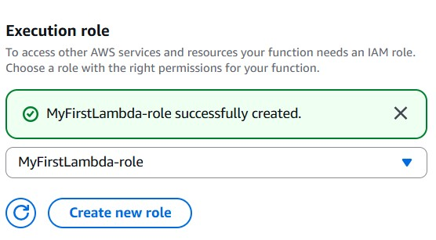
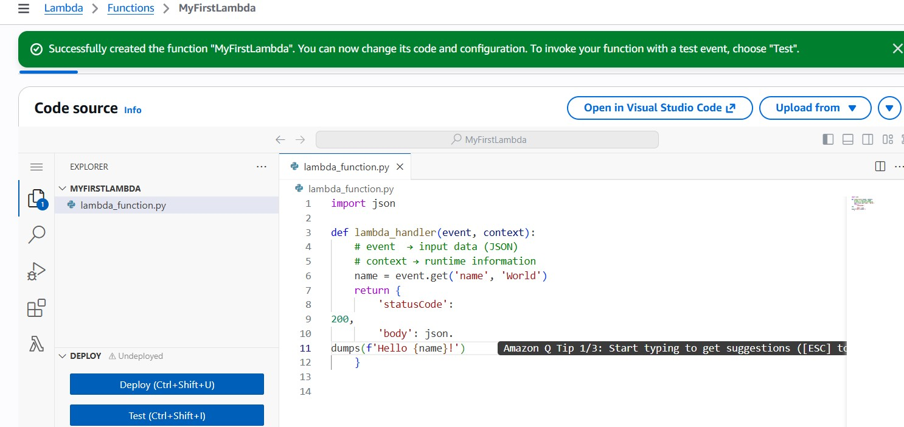
01
AWS Lambda
Serverless Compute Service
Steps 6–10: Code, Deploy & Test
1
Select Runtime: Python 3.14
2
Create a new execution IAM role (MyFirstLambda-role)
3
Write your handler code in the inline editor
4
Click Deploy to publish the function
5
Create a test event and click Test to execute
Lambda Code Editor & Execution Role
K. Arunsai | DevOps

Slide 5
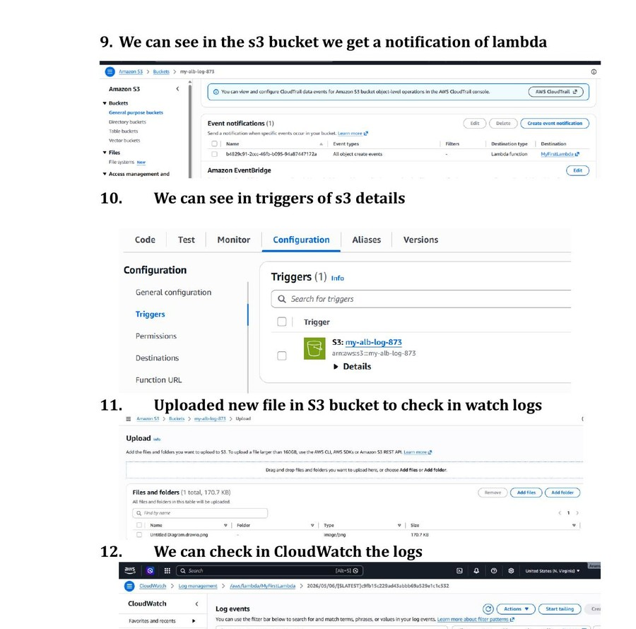
01
AWS Lambda
Serverless Compute Service
Steps 11–12: S3 Trigger & CloudWatch
1
Add an S3 bucket as a trigger for the Lambda
2
Upload a file to the S3 bucket
3
Lambda is invoked automatically on upload
4
Open CloudWatch → Log Groups → MyFirstLambda
5
Verify the log events showing function execution
Lambda Trigger from S3 & CloudWatch Logs
K. Arunsai | DevOps

