Slide 1
AWS API Gateway
Managed API Creation, Publishing & Monitoring
Presented by:
K. Arunsai
DevOps | AWS Infrastructure

Slide 2
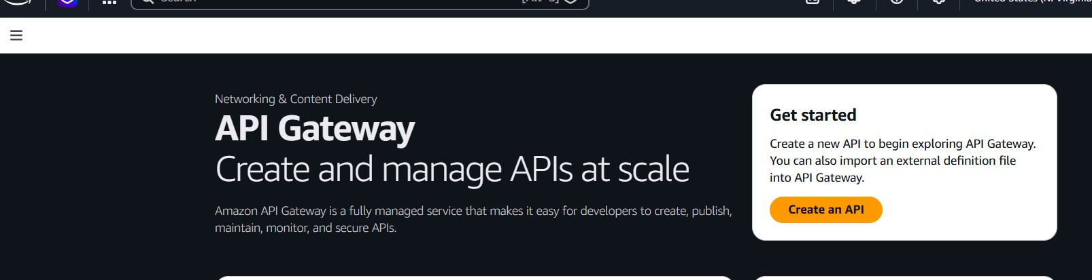
02
AWS API Gateway
Managed API Service
What is it?
AWS Console Preview
Amazon API Gateway is a fully managed service for creating, publishing, maintaining, monitoring and securing REST, HTTP and WebSocket APIs at any scale. It acts as the 'front door' — routing incoming requests to backend services like Lambda, EC2, or any HTTP endpoint.
Key Highlights
Supports REST, HTTP, and WebSocket APIs
Native Lambda & EC2 backend integration
Built-in OIDC, OAuth2 & CORS support
Automatic deployments and stage management
CloudWatch metrics & access logging
K. Arunsai | DevOps
Pay-per-request pricing model

Slide 3
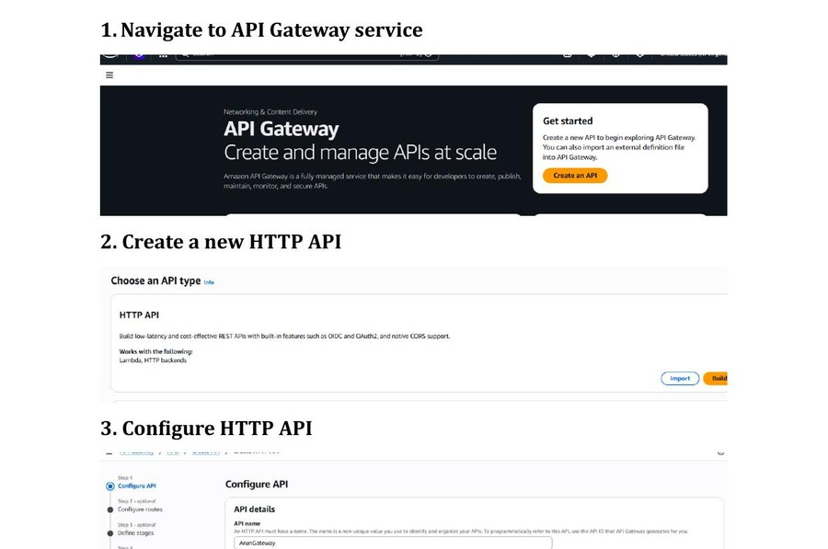
02
AWS API Gateway
Managed API Service
Steps 1–4: Create & Configure HTTP API
1
Navigate to API Gateway in AWS Console
2
Click 'Create API'
3
Select API type: HTTP API (low-latency, cost-effective)
4
Enter API name: ArunGateway, IP type: IPv4
5
Add integration pointing to MyFirstLambda
API Gateway — Service Home & API Type Selection
K. Arunsai | DevOps

Slide 4
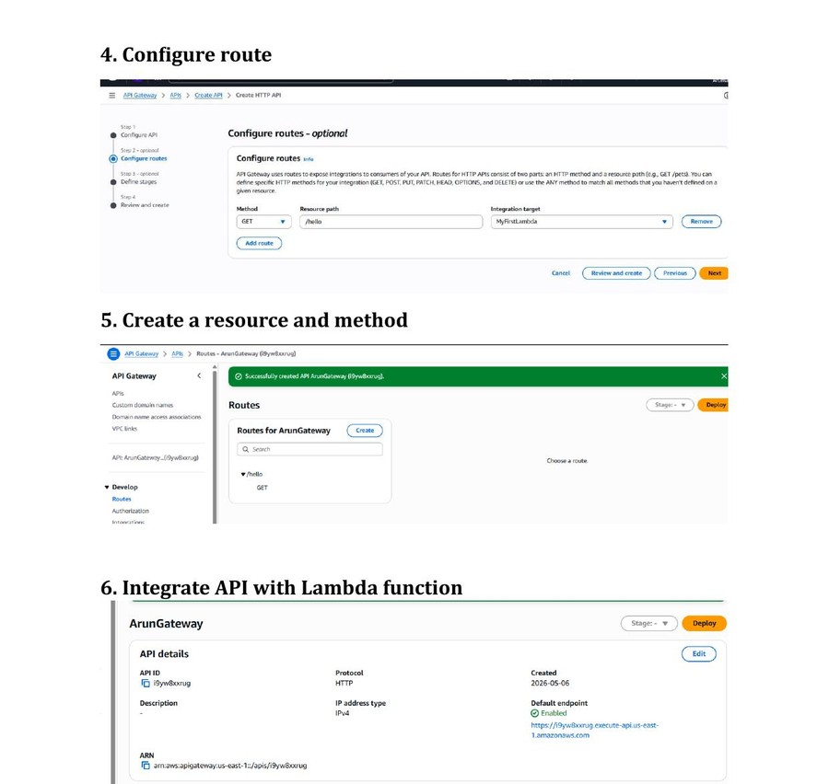
02
AWS API Gateway
Managed API Service
Steps 5–8: Configure Route & Deploy
1
Configure route: Method=GET, Path=/hello
2
Set integration target to MyFirstLambda function
3
Define stages (e.g., default stage)
4
Review and click Create
5
API is created — note the Default Endpoint URL
Route Configuration & Lambda Integration
K. Arunsai | DevOps

Slide 5
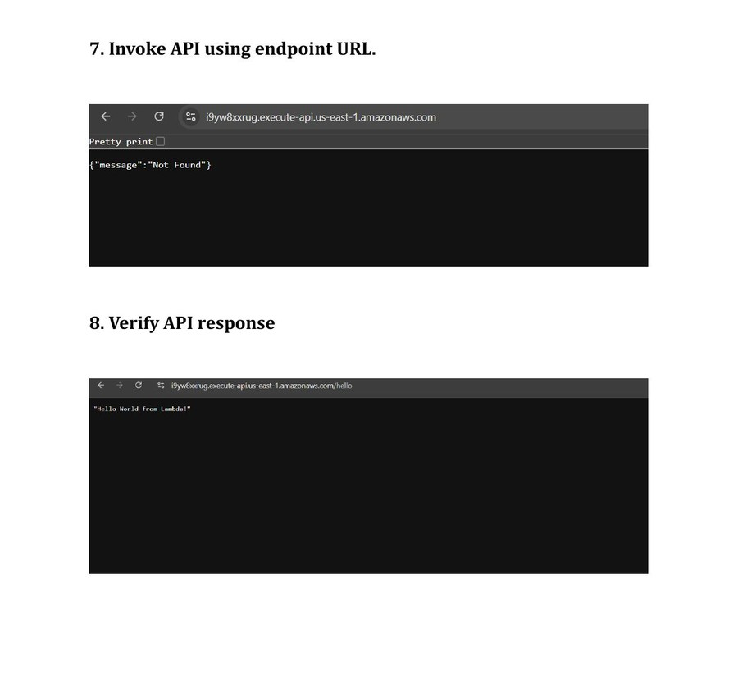
02
AWS API Gateway
Managed API Service
Steps 9–10: Test & Verify Response
1
Copy the Default Endpoint URL from API details
2
Open browser and navigate to: <endpoint>/hello
3
Verify JSON response: "Hello World from Lambda!"
4
Check CloudWatch for invocation logs
5
API Gateway successfully routes to Lambda!
API Endpoint Invocation & Response Verification
K. Arunsai | DevOps

