Slide 1
AWS KMS
Key Management Service — Cryptographic Key Control
Presented by:
K. Arunsai
DevOps | AWS Infrastructure

Slide 2
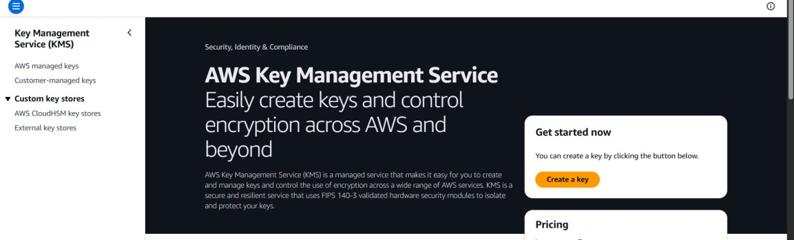
03
AWS KMS
Key Management Service
What is it?
AWS Console Preview
AWS Key Management Service (KMS) is a managed service that makes it easy to create and control cryptographic keys used to protect your data. KMS integrates with S3, RDS, EBS, Lambda, Secrets Manager and more to encrypt data at rest automatically.
Key Highlights
FIPS 140-2 validated hardware security modules
Symmetric & asymmetric key types
Centralized key policy & access control (IAM)
Automatic annual key rotation
Audit key usage via AWS CloudTrail
K. Arunsai | DevOps Training
Integrates with most AWS services

Slide 3
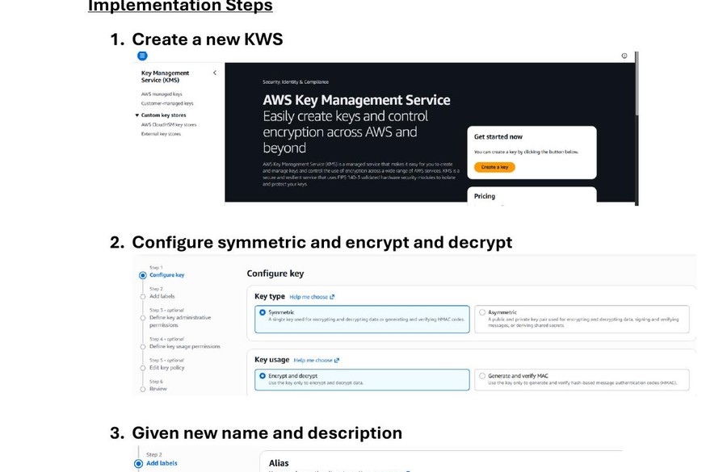
03
AWS KMS
Key Management Service
Steps 1–4: Create & Configure Key
1
Open AWS Console → Search 'Key Management Service'
2
Click 'Create a key'
3
Key type: Symmetric
4
Key usage: Encrypt and Decrypt
5
Enter alias: my-ecommerce-kws
6
Add description: KMS key for encrypting ecommerce app data
KMS Console — Key Type & Usage Configuration
K. Arunsai | DevOps

Slide 4
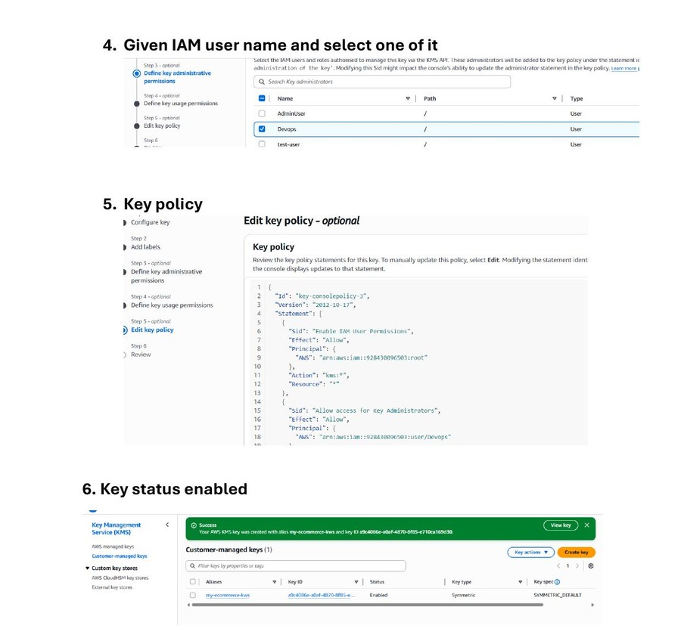
03
AWS KMS
Key Management Service
Steps 5–8: Permissions & Activation
1
Define key administrators — select IAM user (e.g. Devops)
2
Define key usage permissions for consumers
3
Review and optionally edit the JSON key policy
4
Click Finish to create the key
5
Verify key status shows: Enabled (Symmetric, SYMMETRIC_DEFAULT)
IAM Permissions, Key Policy & Key Enabled Status
K. Arunsai | DevOps

