Slide 1
AWS SQS
Simple Queue Service — Decouple & Scale Microservices
Presented by:
K. Arunsai
DevOps | AWS Infrastructure

Slide 2
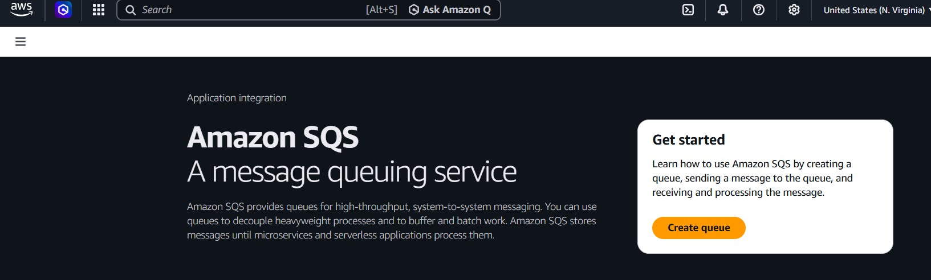
04
AWS SQS
Simple Queue Service
What is it?
AWS Console Preview
AWS Simple Queue Service (SQS) is a fully managed message queuing service that enables you to decouple and scale microservices, distributed systems, and serverless applications. SQS eliminates the complexity and overhead of managing messaging middleware.
Key Highlights
Standard (best-effort) & FIFO (exactly-once) queues
Unlimited message throughput
Message size up to 256 KB
Retention period: 1 minute to 14 days
Dead-Letter Queue (DLQ) support
K. Arunsai | DevOps
Server-side encryption with KMS

Slide 3
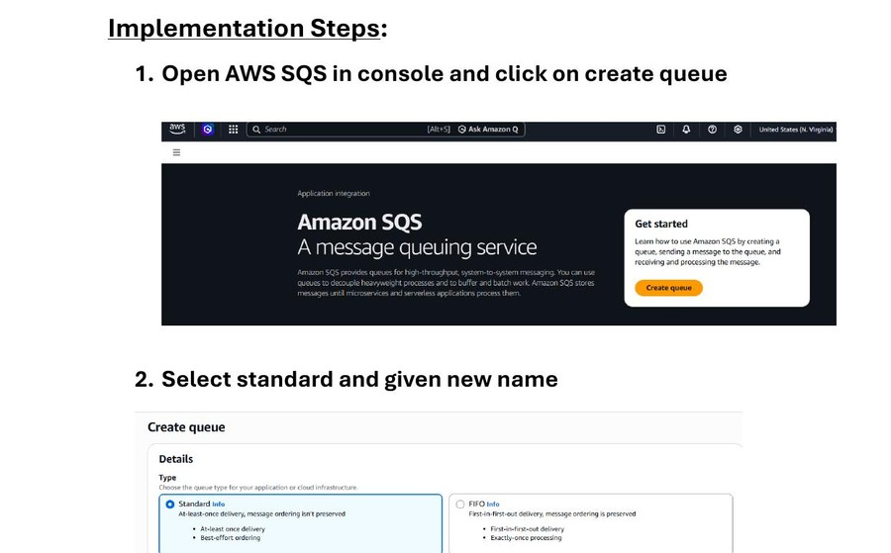
04
AWS SQS
Simple Queue Service
Steps 1–4: Create Queue
1
Open AWS Console → Search 'SQS'
2
Click 'Create queue'
3
Select type: Standard Queue
4
Enter queue name: First_queue
5
Keep Configuration settings as default
6
Click 'Create Queue'
SQS Console — Queue Type & Name Configuration
K. Arunsai | DevOps

Slide 4
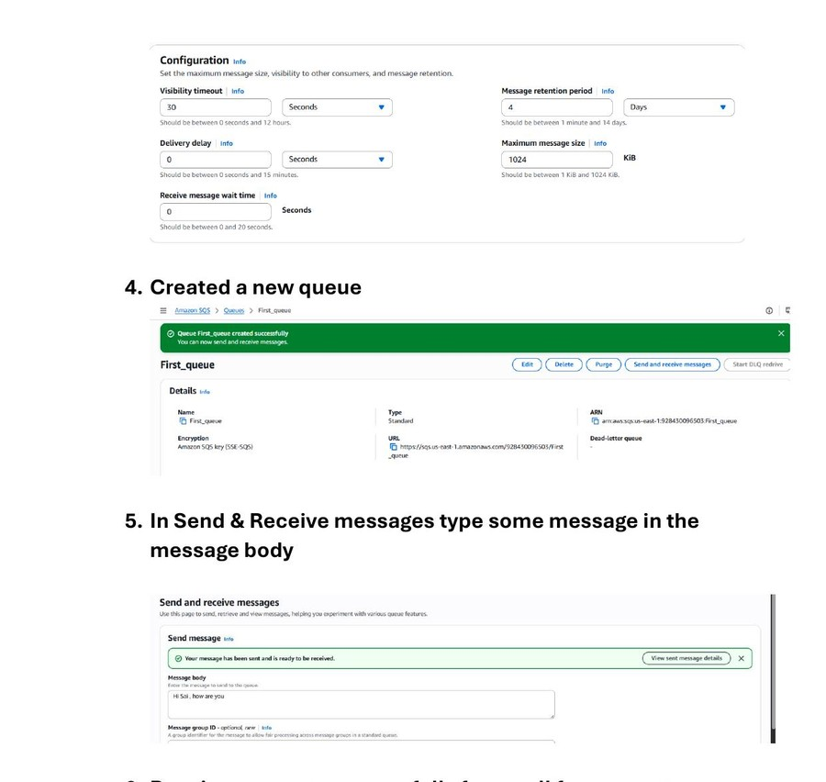
04
AWS SQS
Simple Queue Service
Steps 5–6: Send & Receive Messages
1
Click 'Send and receive messages'
2
In 'Send message': enter body text (e.g. 'Hi Sai, how are you')
3
Click 'Send message' — confirmation shown
4
Scroll to 'Receive messages' section
5
Click 'Poll for messages'
6
Message appears in the Messages list
Sending a Message & Polling for Messages
K. Arunsai | DevOps

Slide 5
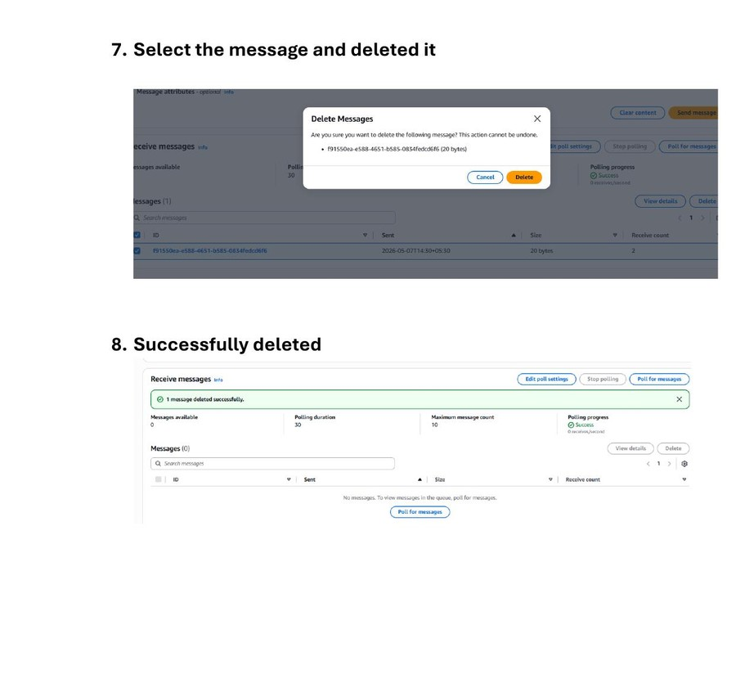
04
AWS SQS
Simple Queue Service
Steps 7–8: Delete Message & Verify
1
Select the message from the list
2
Click 'Delete' — confirm deletion
3
Message count returns to 0
4
Queue successfully demonstrates full send/receive/delete cycle
5
SQS is ready to be integrated with Lambda or other services
Message Deletion & Confirmation
K. Arunsai | DevOps

