Slide 1
Amazon MQ
Managed Message Broker for AMQP & MQTT Protocols
Presented by:
K. Arunsai
DevOps | AWS Infrastructure

Slide 2
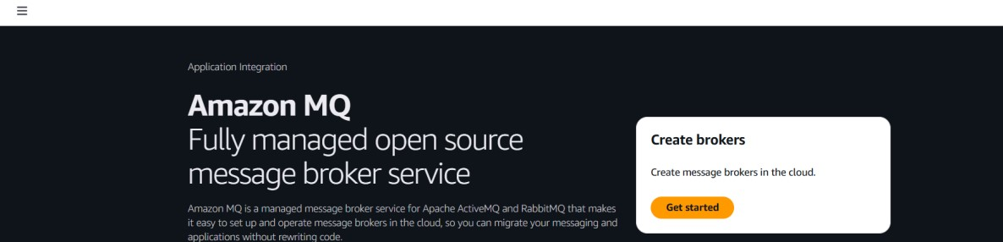
05
Amazon MQ
Managed Message Broker
What is it?
AWS Console Preview
Amazon MQ is a managed message broker service for Apache ActiveMQ and RabbitMQ. It is ideal for migrating existing applications that already use standard messaging protocols like AMQP or MQTT — you connect using the same protocol without rewriting code.
Key Highlights
Supports RabbitMQ & Apache ActiveMQ engines
Standard protocols: AMQP, MQTT, STOMP, OpenWire
Single-instance or cluster deployment modes
Persistent storage on Amazon EBS
Built-in RabbitMQ web management console
K. Arunsai | DevOps
VPC isolation & OAuth2/IAM/LDAP auth support

Slide 3
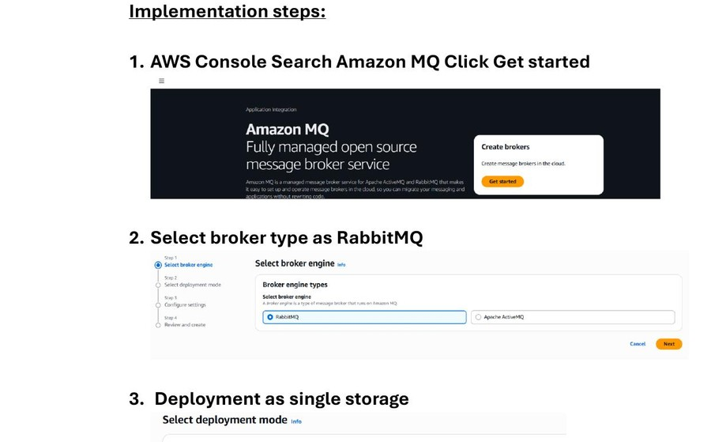
05
Amazon MQ
Managed Message Broker
Steps 1–4: Select Engine & Deployment
1
Open AWS Console → Search 'Amazon MQ'
2
Click 'Get started'
3
Select broker engine: RabbitMQ
4
Choose deployment mode: Single-instance broker
5
(Single-instance is suitable for dev/testing)
Amazon MQ — Engine Selection & Deployment Mode
K. Arunsai | DevOps

Slide 4
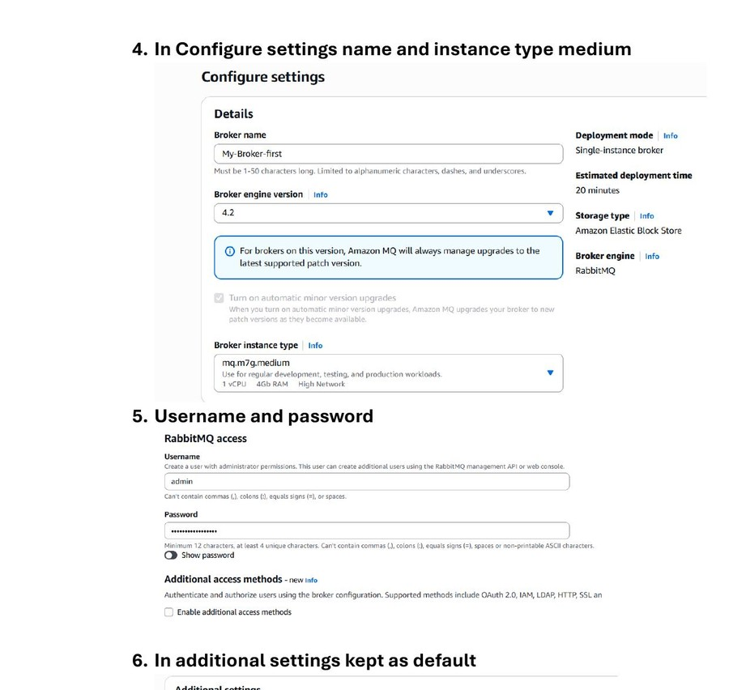
05
Amazon MQ
Managed Message Broker
Steps 5–7: Configure Broker Settings
1
Enter broker name: My-Broker-first
2
Select instance type: mq.m7g.medium (1 vCPU, 4GB RAM)
3
Set RabbitMQ username: admin and a strong password
4
Additional settings: keep defaults (VPC, subnets, encryption)
5
Click 'Create broker' — takes ~20 minutes to activate
Broker Configuration — Name, Instance, Credentials
K. Arunsai | DevOps

Slide 5
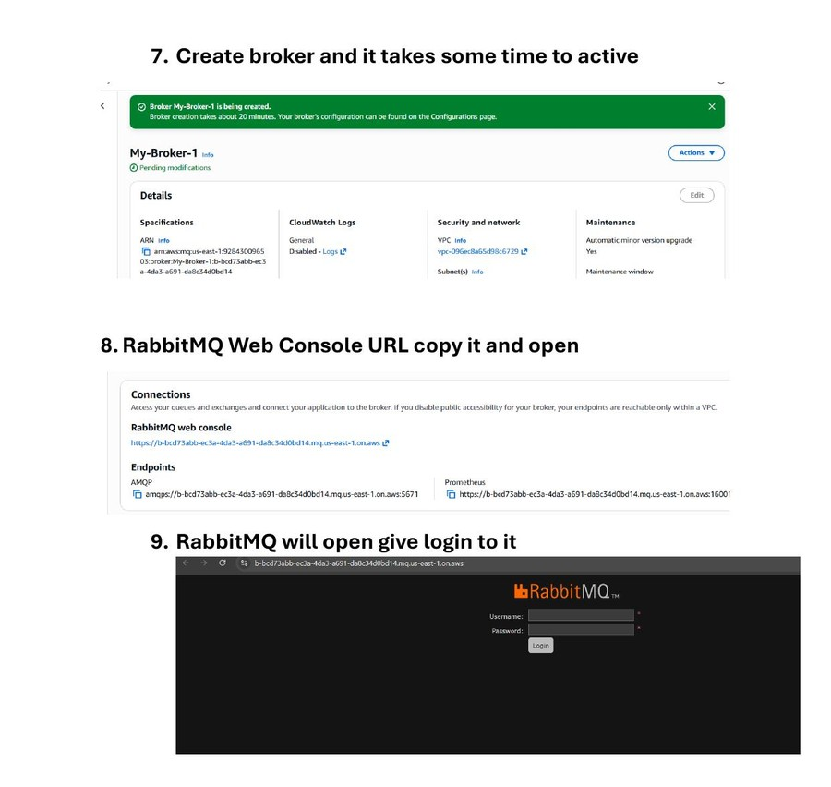
05
Amazon MQ
Managed Message Broker
Steps 8–9: Access Web Console
1
Wait for broker status to change to 'Running'
2
Navigate to Connections tab — copy RabbitMQ Web Console URL
3
Open URL in browser
4
Login with the admin username and password set earlier
5
RabbitMQ management dashboard opens
Broker Active & RabbitMQ Web Console Login
K. Arunsai | DevOps

Slide 6
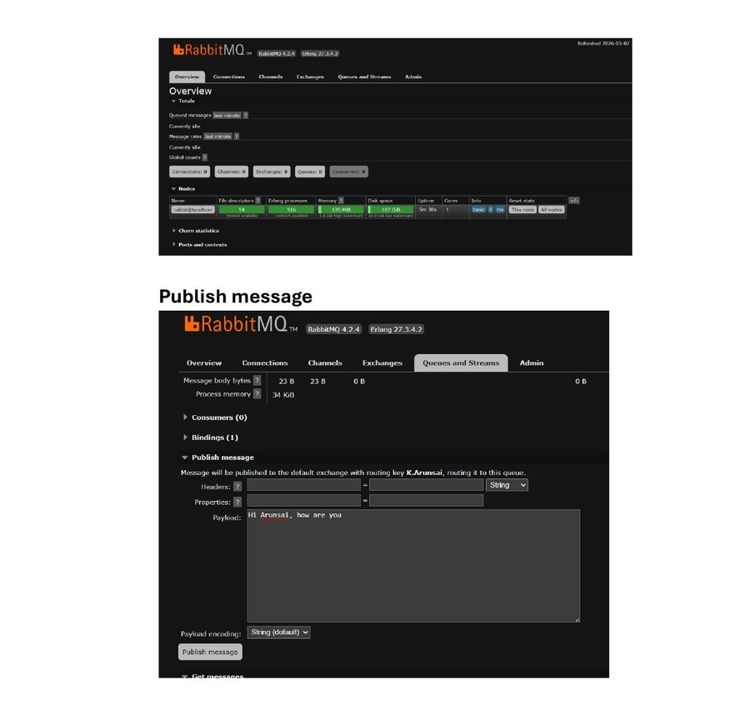
05
Amazon MQ
Managed Message Broker
Steps 10–11: Publish & Get Messages
1
In RabbitMQ console: go to Queues and Streams
2
Add a new queue (e.g. K.Arunsai)
3
Open the queue → Publish message section
4
Enter payload: 'Hi Arunsai, how are you' → Publish
5
Scroll to Get Messages → Click Get Message(s)
6
Verify payload is received correctly
Publishing & Retrieving Messages via RabbitMQ Console
K. Arunsai | DevOps

