Slide 1
AWS Secrets Manager
Secure Rotation & Retrieval of Credentials
Presented by:
K. Arunsai
DevOps | AWS Infrastructure

Slide 2
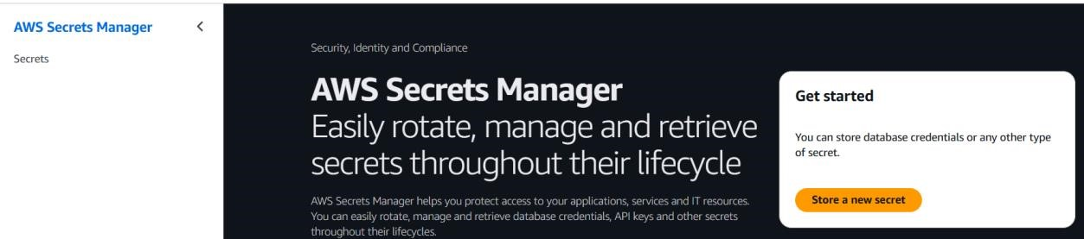
06
AWS Secrets Manager
Secrets Lifecycle Management
What is it?
AWS Console Preview
AWS Secrets Manager helps you protect access to applications, services, and IT resources without the upfront cost of managing HSMs. It enables you to rotate, manage, and retrieve database credentials, API keys, and other secrets throughout their lifecycle.
Key Highlights
Stores DB credentials, API keys, OAuth tokens
Automatic secret rotation (e.g. RDS passwords)
Encrypted at rest using AWS KMS
Fine-grained IAM access policies
Cross-region replication support
K. Arunsai | DevOps
Audit access via CloudTrail

Slide 3
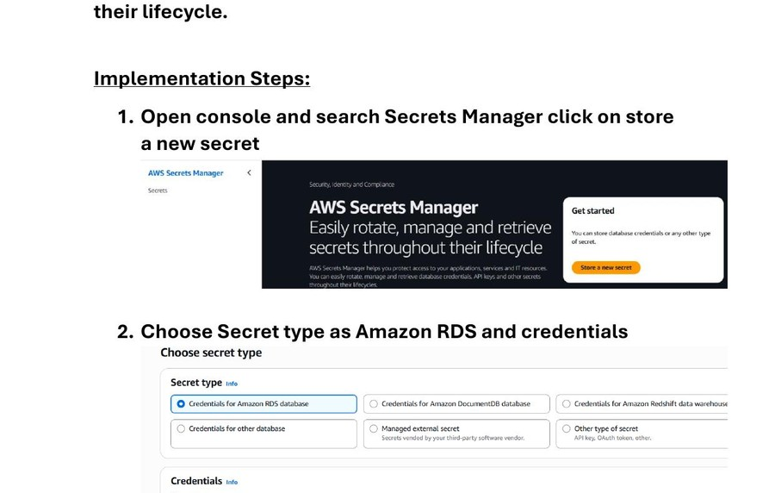
06
AWS Secrets Manager
Secrets Lifecycle Management
Steps 1–3: Store a New Secret
1
Open AWS Console → Search 'Secrets Manager'
2
Click 'Store a new secret'
3
Choose secret type: Credentials for Amazon RDS database
4
Enter username: admin
5
Enter password (will be encrypted)
6
Encryption key: keep default (aws/secretsmanager)
Secrets Manager — Secret Type & Credential Entry
K. Arunsai | DevOps

Slide 4
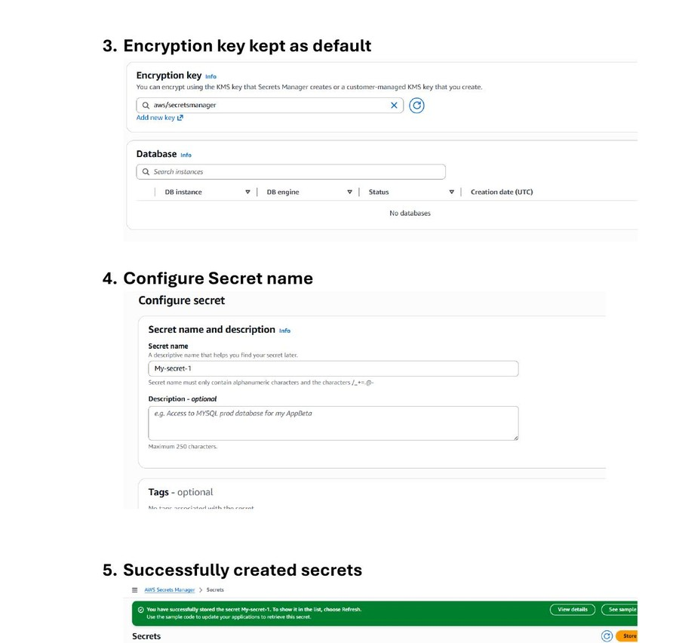
06
AWS Secrets Manager
Secrets Lifecycle Management
Steps 4–6: Name & Create Secret
1
Enter secret name: My-secret-1
2
Add optional description (e.g. 'Access to MySQL prod DB')
3
Add optional tags for cost allocation
4
Configure rotation (optional for now, keep disabled)
5
Review all settings and click 'Store'
6
Success message confirms secret is created
Secret Name Configuration & Successful Creation
K. Arunsai | DevOps

Slide 5
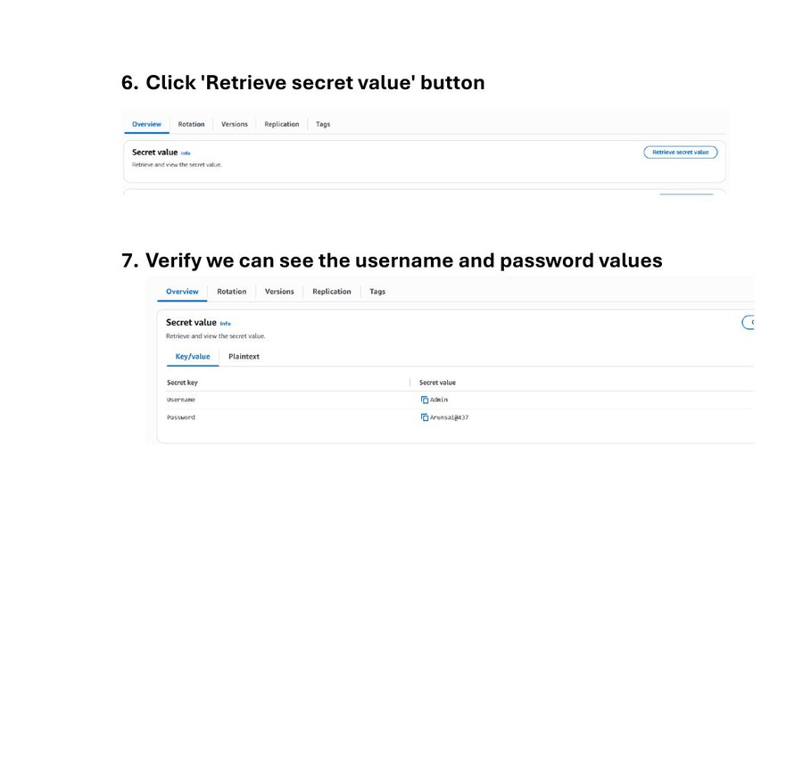
06
AWS Secrets Manager
Secrets Lifecycle Management
Steps 7–9: Retrieve & Verify Secret
1
Secret 'My-secret-1' appears in the Secrets list
2
Click on the secret name to open details
3
Scroll to 'Secret value' section
4
Click 'Retrieve secret value'
5
Key/Value view shows: Username = Admin, Password = ****
6
Plaintext tab shows the raw JSON secret
Secret Details — Retrieve & Verify Stored Values
K. Arunsai | DevOps

