Slide 1
AWS WAF
Web Application Firewall — Layer 7 Protection Against SQL Injection, XSS & DDoS
Presented by:
K. Arunsai
DevOps | AWS Infrastructure

Slide 2
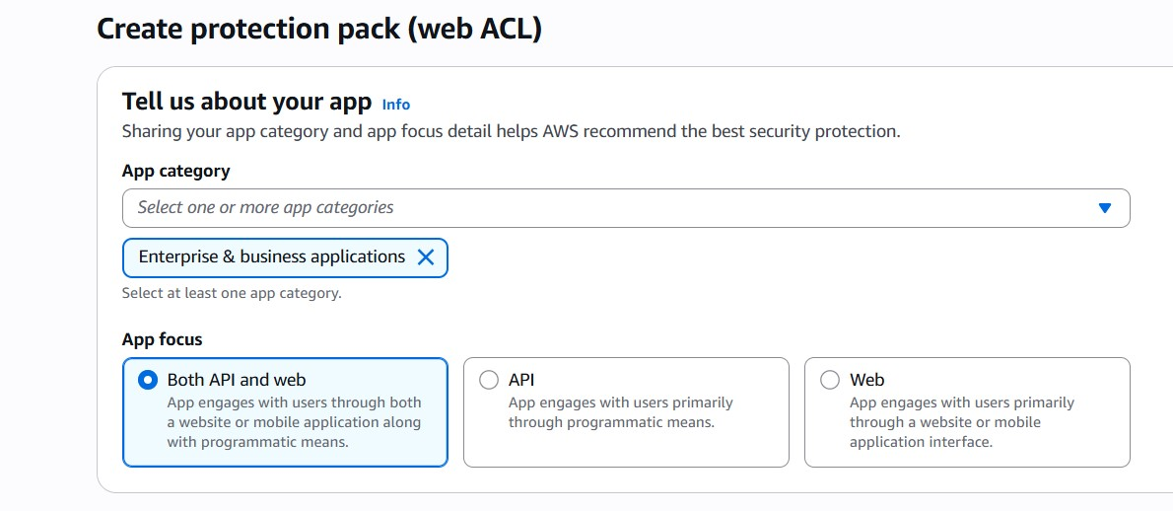
07
AWS WAF
Web Application Firewall
What is it?
AWS Console Preview
AWS WAF (Web Application Firewall) lets you monitor and control HTTP/HTTPS requests forwarded to your web applications. It protects against common web exploits like SQL injection, cross-site scripting (XSS), bot traffic, and DDoS attacks at Layer 7. Integrated with an Application Load Balancer to protect an EC2-hosted Apache application using AWS managed security rules and real-time traffic monitoring.
Key Highlights
Protects against SQLi, XSS, bot & DDoS at Layer 7
Integrates with ALB, CloudFront, API Gateway
AWS Managed Rules — zero config protection
IP allowlist / blocklist & geographic blocking
Real-time traffic dashboard & sampled requests
K. Arunsai | DevOps
Web ACL with up to 10,000 WCUs

Slide 3
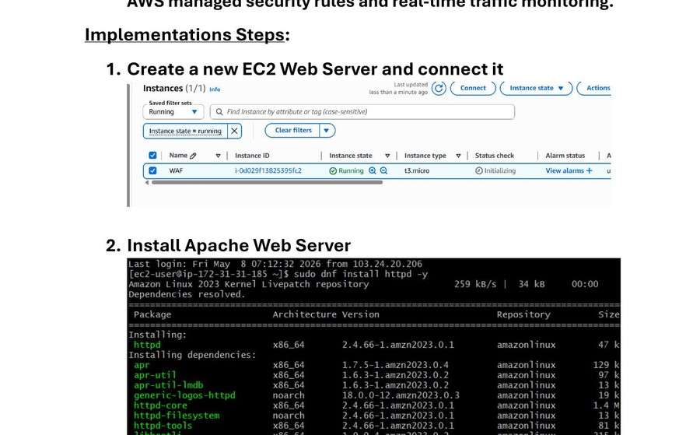
07
AWS WAF
Web Application Firewall
Steps 1–3: EC2 + Apache Web Server
1
Launch EC2 instance (t3.micro) — name it WAF
2
Connect to instance via EC2 Instance Connect
3
Install Apache: sudo dnf install httpd -y
4
Start & enable Apache: sudo systemctl start httpd
5
Create demo page: echo 'WAF Demo Application Running' | sudo tee /var/www/html/index.html
6
Verify in browser using EC2 public IP — page shows 'WAF Demo Application Running'
EC2 Instance Running & Apache Install Output
K. Arunsai | DevOps

Slide 4
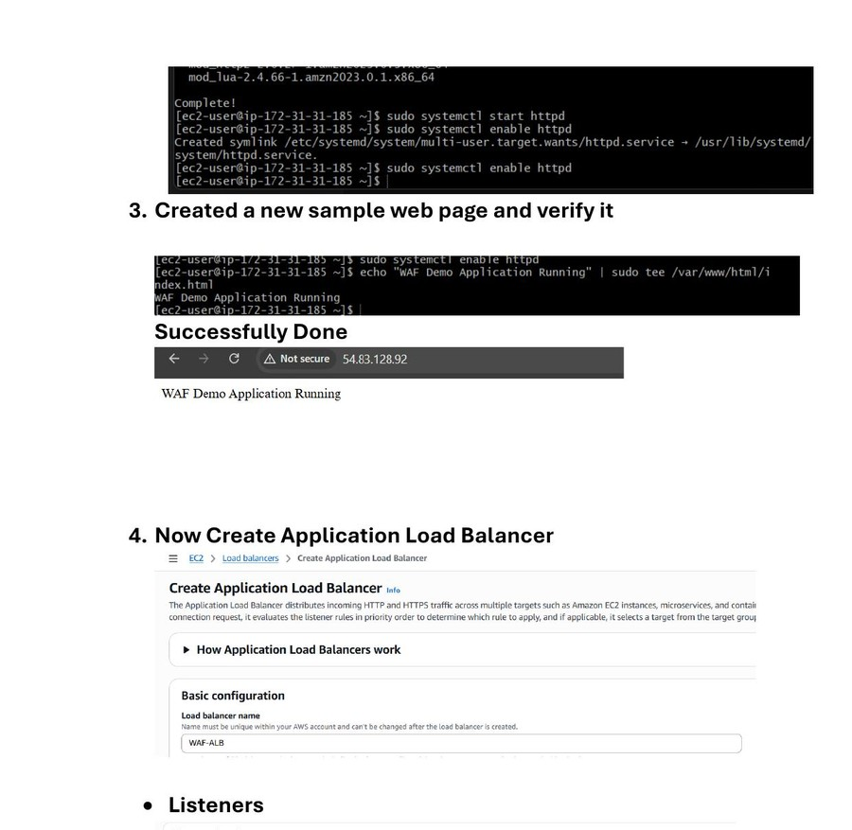
07
AWS WAF
Web Application Firewall
Steps 4–6: Create Application Load Balancer
1
Navigate to EC2 → Load Balancers → Create ALB
2
Name: WAF-ALB, Scheme: Internet-facing, IP type: IPv4
3
Configure Listener: HTTP on port 80
4
Set VPC and select both availability zone subnets
5
Attach default security group
6
Create Target Group: WAF-TG, type=Instance, protocol HTTP:80
ALB Creation — Basic Config, Listener & Security Group
K. Arunsai | DevOps

Slide 5
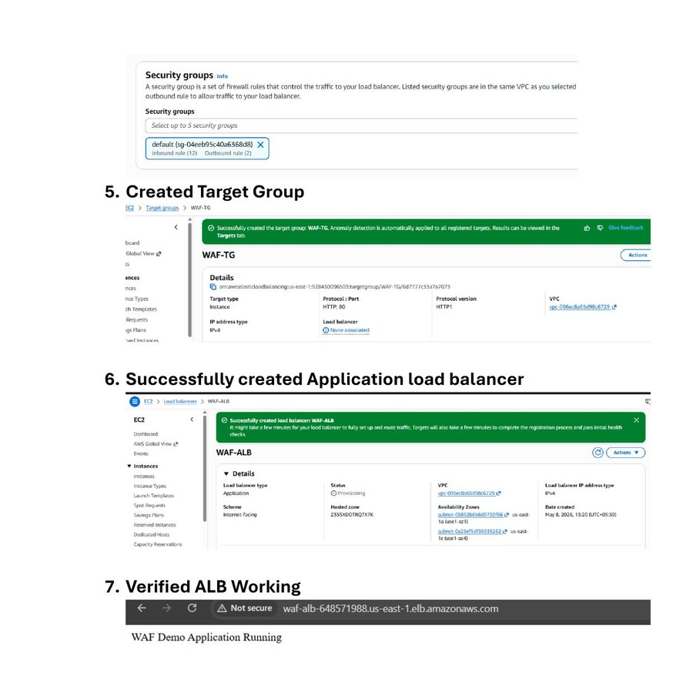
07
AWS WAF
Web Application Firewall
Steps 6–7: Finalize ALB & Verify
1
Register EC2 instance in target group WAF-TG
2
Complete ALB creation — status: Provisioning
3
Wait for ALB status to change to: Active
4
Copy ALB DNS name from details panel
5
Open ALB DNS in browser
6
Verify: 'WAF Demo Application Running' loads via ALB DNS
ALB Successfully Created & DNS Verified in Browser
K. Arunsai | DevOps

Slide 6
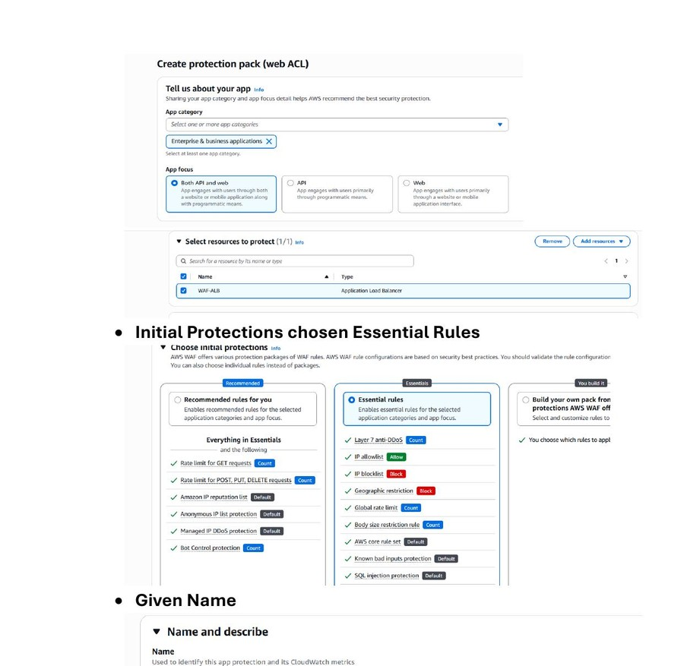
07
AWS WAF
Web Application Firewall
Steps 8–9: Create Web ACL (WAF Protection)
1
Navigate to WAF & Shield → Create protection pack (Web ACL)
2
App category: Enterprise & Business, Focus: Both API and web
3
Select resource to protect: WAF-ALB (Application Load Balancer)
4
Choose initial protections: Essential Rules
5
Essential rules include: SQLi, XSS, IP blocklist, Layer 7 anti-DDoS, Geographic block
6
Enter Web ACL name: WAF-ACL → Create
Web ACL — App Category, Resource Selection & Essential Rules
K. Arunsai | DevOps

Slide 7
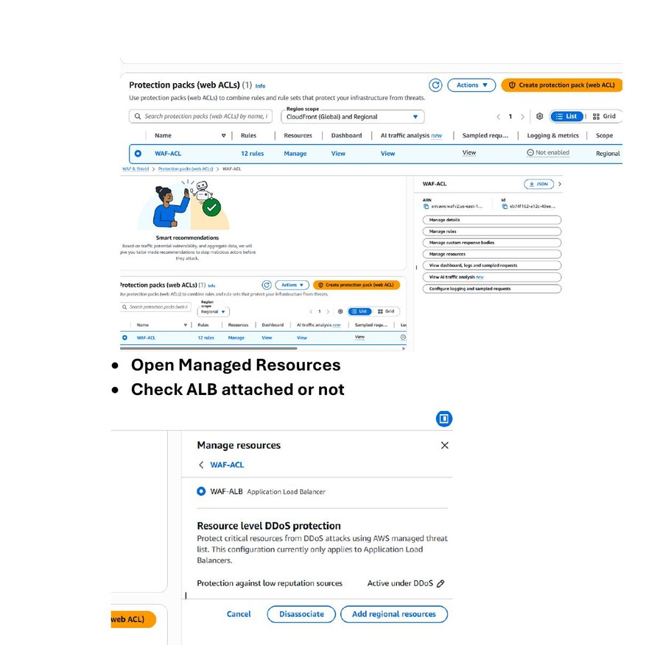
07
AWS WAF
Web Application Firewall
Steps 9–10: Verify ACL & ALB Attachment
1
WAF-ACL created with 12 rules — status shown in console
2
Click WAF-ACL → Manage resources
3
Confirm WAF-ALB (Application Load Balancer) is attached
4
Resource-level DDoS protection is active under DDoS
5
Navigate back to ALB DNS in browser
6
Verify ALB DNS still serves 'WAF Demo Application Running'
Web ACL Dashboard & ALB Resource Attachment Confirmation
K. Arunsai | DevOps

Slide 8
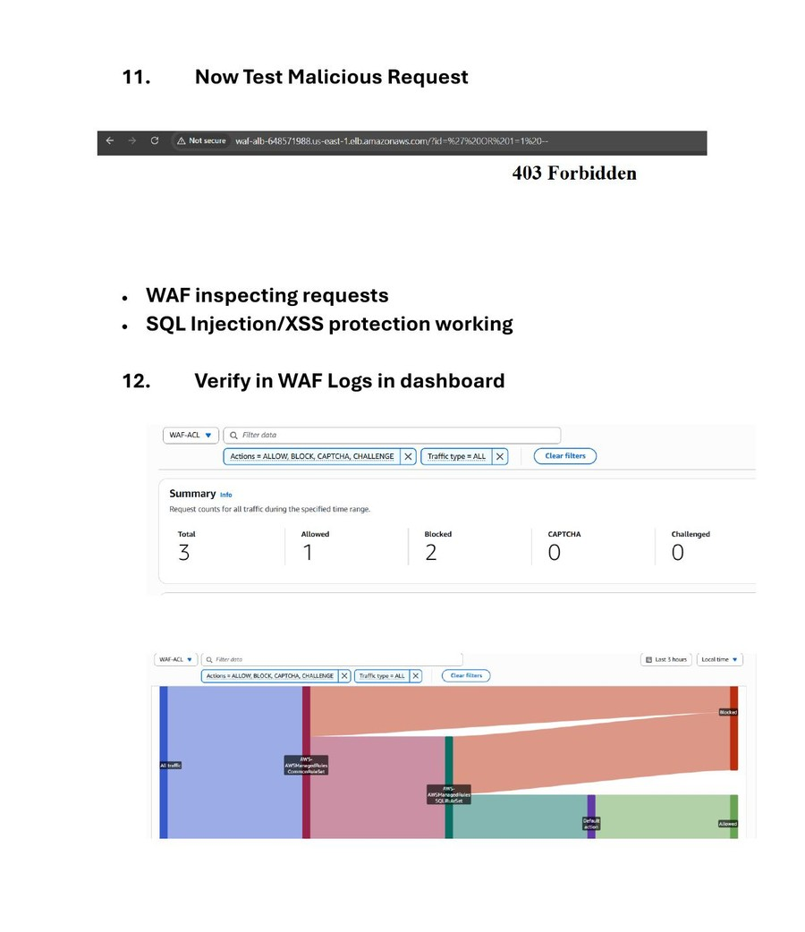
07
AWS WAF
Web Application Firewall
Steps 11–12: Test & Verify WAF Blocking
1
Send a malicious SQL injection request via ALB URL: ?id=%27%20OR%201=1%20--
2
WAF blocks the request → browser returns: 403 Forbidden
3
SQL Injection and XSS protection confirmed working
4
Open WAF-ACL Dashboard → Overview tab
5
View traffic summary: Total=3, Allowed=1, Blocked=2
6
Traffic flow chart shows AWSManagedRules blocking SQLi requests
403 Blocked Response & WAF Dashboard Traffic Summary
K. Arunsai | DevOps

