Slide 1
AWS Systems Manager Parameter Store
Secure Hierarchical Storage for Configuration Data & Secrets
Presented by:
K. Arunsai
DevOps | AWS Infrastructure

Slide 2
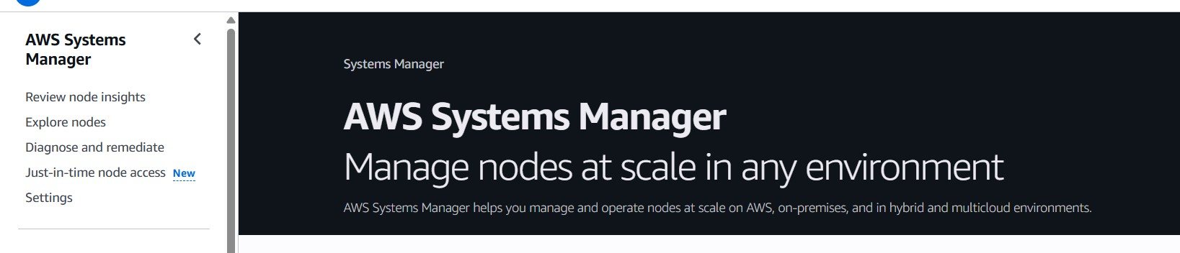
08
AWS Systems Manager — Parameter Store
Secure Configuration & Secrets Management
What is it?
AWS Console Preview
AWS Systems Manager Parameter Store provides secure, hierarchical storage for configuration data and secrets management. You can store database connection strings, application configuration values, license codes, and passwords as parameter values. Implemented with IAM Roles, allowing EC2 instances to retrieve encrypted configuration values dynamically without hardcoding credentials.
Key Highlights
Stores strings, StringLists, or SecureStrings (KMS-encrypted)
Hierarchical naming (e.g. /prod/db/password)
IAM policy-based fine-grained access control
No extra cost for Standard tier parameters
Integrated with EC2, Lambda, ECS & CodeBuild
K. Arunsai | DevOps
Full audit trail via CloudTrail

Slide 3
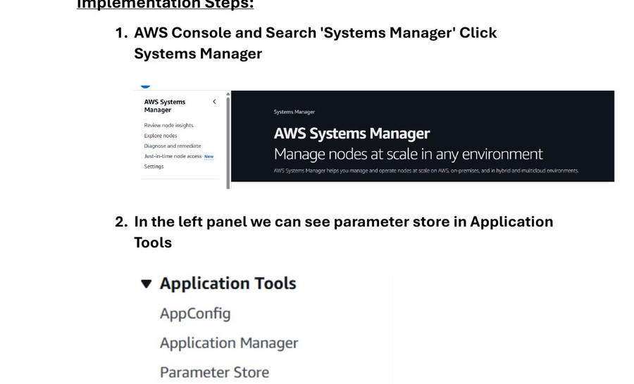
08
AWS Systems Manager — Parameter Store
Secure Configuration & Secrets Management
Steps 1–3: Navigate & Create Parameter
1
Open AWS Console → Search 'Systems Manager'
2
Click on AWS Systems Manager
3
In the left panel → Application Tools → Parameter Store
4
Click 'Create parameter'
5
Enter parameter name: /prod/db/password (hierarchical path)
6
Select type: SecureString (KMS-encrypted)
Systems Manager Console & Parameter Store Navigation
K. Arunsai | DevOps

Slide 4
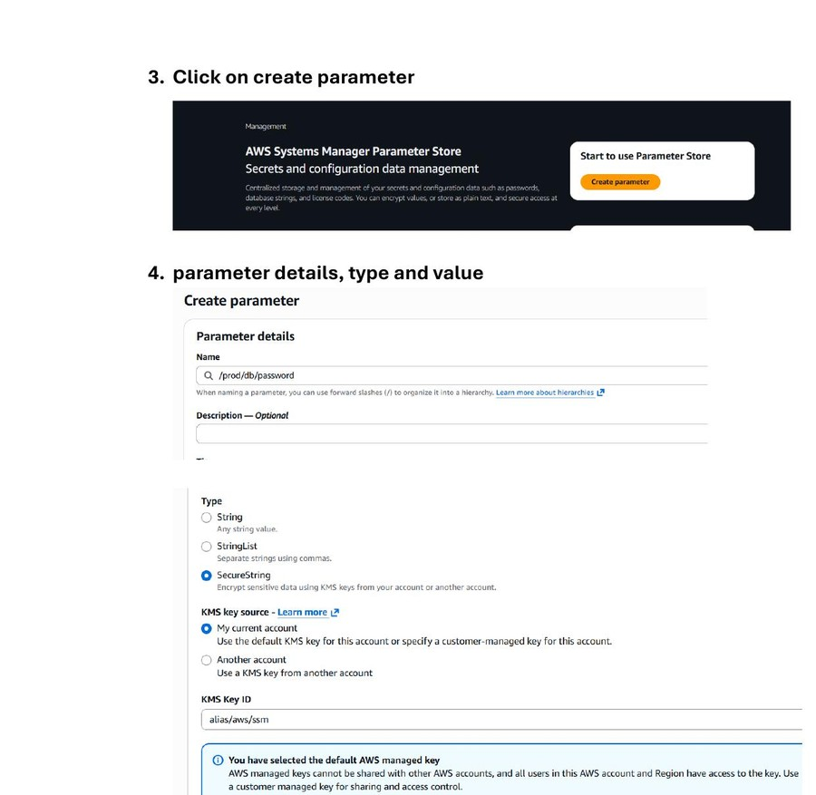
08
AWS Systems Manager — Parameter Store
Secure Configuration & Secrets Management
Steps 4–5: Configure & Save Parameter
1
KMS key source: My current account (alias/aws/ssm default)
2
Enter the secret value (e.g. MySecret123)
3
Click 'Create parameter'
4
Parameter /prod/db/password created — type: SecureString
5
Shown in My parameters list with Tier: Standard
6
Last modified: confirmed in console
Parameter Details — SecureString Type, KMS Key & Value Entry
K. Arunsai | DevOps

Slide 5
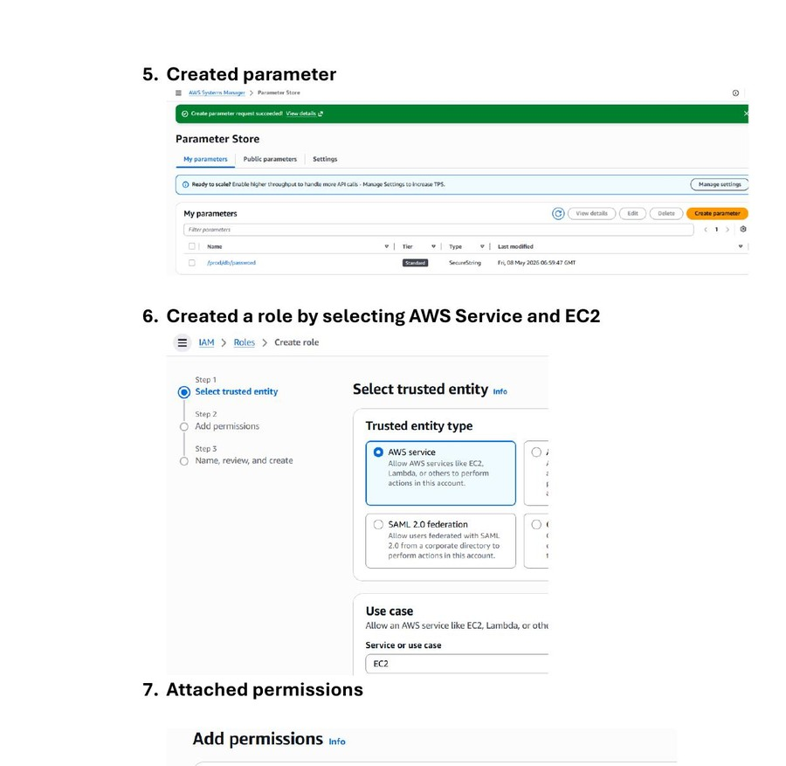
08
AWS Systems Manager — Parameter Store
Secure Configuration & Secrets Management
Steps 6–8: Create IAM Role for EC2
1
Navigate to IAM → Roles → Create role
2
Trusted entity type: AWS Service
3
Use case: EC2 (allows EC2 to call AWS services)
4
Search and attach policy: AmazonSSMReadOnlyAccess
5
Enter role name: EC2-SSM-Role
6
Description: Allows EC2 instances to call AWS SSM on your behalf
7
Click Create role — 'Role EC2-SSM-Role created' confirmation
IAM Role Creation — EC2 Trust Policy & SSM Read Permission
K. Arunsai | DevOps

Slide 6
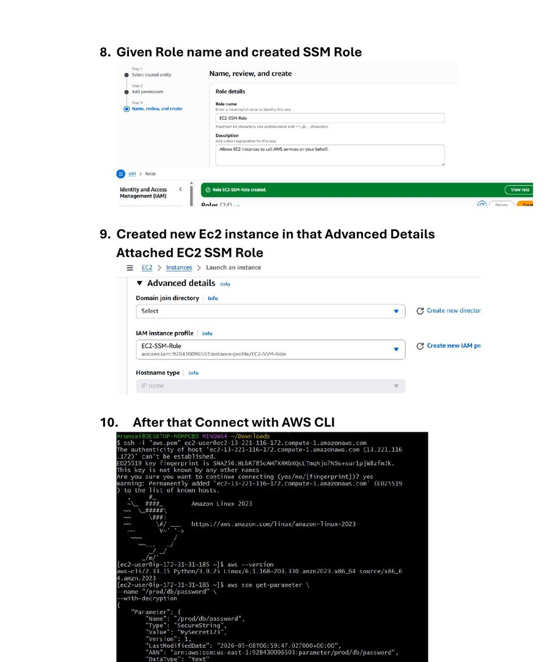
08
AWS Systems Manager — Parameter Store
Secure Configuration & Secrets Management
Steps 9–10: Attach Role to EC2 & Retrieve Secret
1
Launch new EC2 instance
2
In Advanced Details → IAM instance profile: EC2-SSM-Role
3
Connect to EC2 using SSH (AWS CLI / terminal)
4
Run: aws ssm get-parameter --name '/prod/db/password' --with-decryption
5
Response shows: Name, Type: SecureString, Value: MySecret123
6
Encrypted parameter retrieved securely — no hardcoded credentials!
EC2 IAM Profile Attachment & SSM CLI Secret Retrieval
K. Arunsai | DevOps

