Slide 1
IMAGE ANALYSIS FOR EARLY DETECTION OF DIABETIC RETINOPATHY
by,
Arunkumaar t s
Aswin s
Anitha Lakshmi s
Akshya a n
Jaswanth kumar n

Slide 2
CONTENTS
ABSTRACT
INTRODUCTION
LITERATURE REVIEW
EXISTING SYSTEM
PROPOSED SYSTEM
ARCHITECTURE DIAGRAM
MODULE DETAILS
UML DIAGRAM
RESULt
CONCLUSION

Slide 3
ABSTRACT
Diabetes is a serious condition that affects approximately 2.6 million Indians over 18 years of age in 2012 according to the National Diabetic Registry (NDR).
According to the project, the diagnosis of diabetes is made using the image of the fundus and the deep neural learning network..

Slide 4
Fundus image is a photo taken using a 3CCD color video camera on Topcon TRC NW6 non-mydriatic retinography with a 45-degree view field.
In short, fundus is the inner image of the human eye. Therefore, this project introduces a way to diagnose diabetes in a person using fundus images of their eyes
Accordingly, diabetes can have many effects on the eyes such as blurred vision, blurred vision and / or blurred vision, eye pain, cataracts, slow recovery after eye damage and blindness.

Slide 5
INTRODUCTION
DIABETIC RETINOPATHY IS A DIABETES COMPLICATION THAT AFFECTS EYES.
IT IS CAUSED BY DAMAGE TO THE BLOOD VESSELS OF THE LIGHT-SENSITIVE TISSUE AT THE BACK OF THE EYE (RETINA).
AT FIRST, DIABETIC RETINOPATHY MIGHT CAUSE NO SYMPTOMS OR ONLY MILD VISION PROBLEMS. BUT IT CAN LEAD TO BLINDNESS.

Slide 6
NINETY-THREE MILLION PEOPLE ARE GLOBALLY AFFECTED BY DIABETIC RETINOPATHY.
PREVALENCE OF DIABETIC RETINOPATHY IS 77.3% IN TYPE 1 DIABETES PATIENTS AND 25.1% IN TYPE 2 DIABETES PATIENTS, OUT OF WHICH APPROXIMATELY 25% TO 30% ARE EXPECTED TO DEVELOP VISION-THREATENING DIABETIC MACULAR EDEMA.

Slide 7
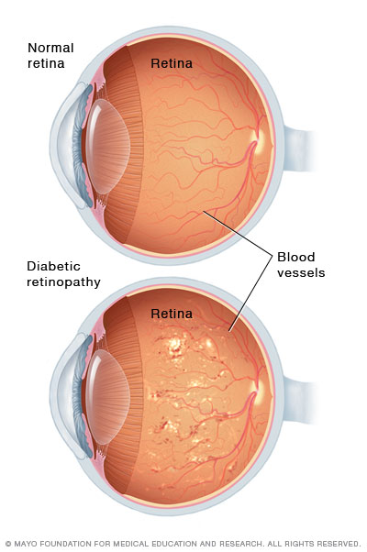
THE TWO TYPES OF DIABETIC RETINOPATHY ARE:
NONPROLIFERATIVE
PROLIFERATIVE.
NONPROLIFERATIVE REFERS TO EARLY STAGES OF THE DISEASE, WHILE PROLIFERATIVE IS AN ADVANCED FORM OF THE DISEASE.

Slide 8
AIM & OBJECTIVE
This project aims to discover the best model for detection of diabetic retinopathy, which can help doctors decide the nature of disease based on the symptoms using image analysis .
Our Primary OBJECTIVE IS TO DEVELOP A CLASSIFICATION METHOD USING IMAGE ANALYSIS WITH DEEP LEARNING Technology

Slide 9
DEFINITION OF DIABETIC RETINOPATHY
Diabetic retinopathy (also known as diabetic eye disease), is a medical condition in which damage occurs to the retina due to diabetes mellitus.
It is a leading cause of blindness in developed countries.
Diabetic retinopathy affects up to 80 percent of those who have had both type 1 and type 2 diabetes for 20 years or more

Slide 10
STAGES OF DIABETIC RETINOPATHY
We HAVE DIFFERENT STAGES OF DIABETIC RETINOPATHY:
Mild Nonproliferative Retinopathy
Moderate Nonproliferative Retinopathy.
Severe Nonproliferative Retinopathy
Proliferative Retinopathy

Slide 11
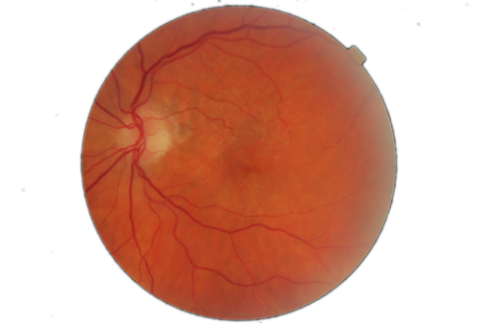
MILD NONPROLIFERATIVE RETINOPATHY
THIS IS THE INITIAL STAGE OF THE DISEASE, REPRESENTED BY MICROANEURYSMS, FORMATION OF SMALL BALLOON-LIKE SWELLINGS INSIDE THE RETINA’S TINY BLOOD VESSELS.

Slide 12
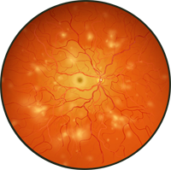
MODERATE NONPROLIFERATIVE RETINOPATHY
IN THIS STAGE, THE BLOOD VESSELS NOURISHING THE RETINA ARE BLOCKED DUE TO A SIGNIFICANT INCREASE IN NUMBER AND SIZE OF THOSE BALLOON-LIKE SWELLINGS OR MICROANEURYSMS

Slide 13
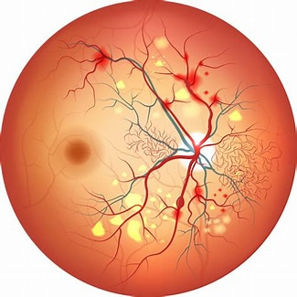
SEVERE NONPROLIFERATIVE RETINOPATHY
AT THIS STAGE, A CONSIDERABLE NUMBER OF BLOOD VESSELS ARE BLOCKED, WHICH LEADS TO DEPRIVATION OF BLOOD SUPPLY TO SEVERAL AREAS OF THE RETINA.

Slide 14
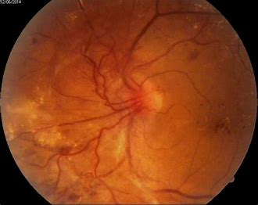
Proliferative DIABETIC Retinopathy
THIS IS THE MOST ADVANCED STAGE OF DR PROGRESS, WHEREBY A SIZEABLE GROWTH OF NEW BLOOD VESSELS OCCURS DUE TO THE RETINA’S SIGNAL TO THE BRAIN FOR COMPENSATION OF LOST NOURISHMENT

Slide 15
LITERATURE REVIEW
Survey 1 :
AUTHORS: Mohammad Z. Atwany , Abdulwahab H. Sahyoun , And Mohammad Yaqub (March 22).
METHODS: This paper reviews and analyzes state-of- theart deep learning methods in supervised, self-supervised, and Vision Transformer setups, proposing retinal fundus image classification and detection. For instance, referable, nonreferable, and proliferative classifications of Diabetic Retinopathy are reviewed and summarized. Moreover, the paper discusses the available retinal fundus datasets for Diabetic Retinopathy that are used for tasks such as detection, classification, and segmentation.

Slide 16

Survey 2:
AUTHOR: Recep Emre Hacisoftaoglu (Dec 2019).
METHODS: In this thesis, we first investigate the smartphone-based portable ophthalmoscope systems available on the market and compare their Field of View and image quality to determine if they are suitable for Diabetic Retinopathy detection during a general health screening.
they propose automatic Diabetic Retinopathy detection algorithms for smartphone-based retinal images using deep learning frameworks, Alex Net and Google Net.
To test our proposed methods, we generate smartphone-based synthetic retina images by simulating the different Field of View with masking the original image around the optic disk and cropping it.

Slide 17

EXISTING SYSTEM
A specific type of neural network optimized for image classification called a deep convolutional neural network(CNN) was trained using a retrospective development data set of 128 175 retinal images, which were graded 3 to 7 times for diabetic retinopathy, diabetic macular edema.
The existing system works with cnn produces lower accuracy.

Slide 18

PROPOSED SYSTEM
The goal is to identify diabetic retinopathy from the fundus image dataset as soon as possible, allowing individuals to proceed with the necessary treatments and avoid temporary or permanent vision loss
We will create a deep learning model with high accuracy to detect DR and protect people at risk of losing their vision because there is no complete cure for this form of disease

Slide 19
Xception is a deep convolutional neural network architecture that involves Depthwise Separable Convolutions.
The data first goes through the entry flow, then through the middle flow which is repeated eight times, and finally through the exit flow.
Depthwise Separable Convolutions are alternatives to classical convolutions that are supposed to be much more efficient in terms of computation time.
XCeption is an efficient architecture that relies on two main points :
DEPTHWISE SEPARABLE CONVOLUTION
SHORTCUTS BETWEEN CONVOLUTION BLOCKS AS IN RESNET

Slide 20
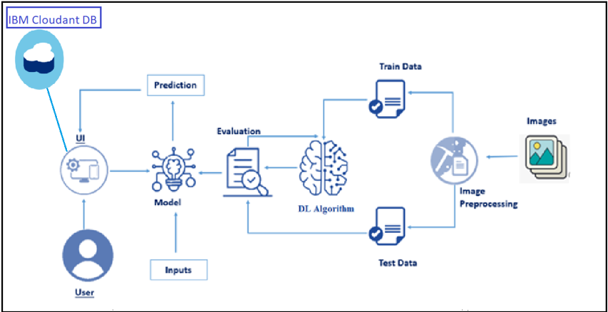

ARCHITECTURE DIAGRAM

Slide 21

MODULE DETAILS
DL Model
TRAINING & TEST DATA ANNOTATION
PREPROCESSING
DIABETIC RETINOPATHY DETECTION
FEATURE EXTRACTION
DIABETIC TYPE CLASSIFICATION
PREDICTION
Performance Analysis
FLASK APPLICATION BUILDING

Slide 22
UML DIAGRAMS
1.USE CASE DIAGRAM

Slide 23
CONCLUSION
DR is often asymptomatic in its early stages, making it difficult to detect. Deep learning (DL) is a type of artificial intelligence that can be used to automatically detect patterns in data.
DL has been shown to be effective for detecting DR in images of the retina.
In this study, a DL algorithm was used to automatically detect DR in fundus images. The algorithm was able to accurately detect DR in early stages, before it is symptomatic.
This could potentially lead to earlier diagnosis and treatment of DR, which could help to prevent vision loss

Slide 24
REFERENCES
Author: Marshall, S. M. & Flyvbjerg, A. Prevention and early detection of vascular complications of diabetes. BMJ. 333(7566), 475–480 (2006).
AUTHOR: Hutchinson, A. et al. Effectiveness of screening and monitoring tests for diabetic retinopathy–a systematic review. Diabet Med. 17(7), 495–506 (2000).
AUTHOR: Recep Emre Hacisoftaoglu (Dec 2019).

Slide 25
THANK YOU

