Slide 1
“GOAL SEEK” AND
TIME VALUE OF MONEY
ENGM 310
Online Learning Tools
#2

Slide 2

What are we going to learn using this tool?
This tool will present how the “Goal-Seek” function in Microsoft Excel can be used to solve some time value of money problems.
You can also refer to Example 3.27 in the textbook on
pages 123-124 for a textual explanation of this function.
[Based on Park, Zuo, Pelot (2012), Contemporary Engineering Economics, Pearson and Pelot (1998) course notes, Daltech]
[Clip arts from Microsoft Office (2014)]
Notes:
Sample problem: $500,000 machine with an actual expected life of 10 years. If you depreciate over five years:
Depreciation is $100,000 per year
Income is $50,000 per year understated in years one to five.
Income is $50,000 overstated in years six to ten.
Compared to depreciating over ten years.
Bob Pierce of Nova: to improve profitability, move depreciation from 12 to 20 years. Plant is now 20 years old, so in hindsight it was not in error.
General rule: be conservative but not ridiculous when picking depreciation.

Slide 3
ENGM 310: “Goal-Seek Function”
Interest Rate Question:
Find out the interest rate which makes one payment of $200,000 today equivalent to ten annual payments of $25,000. Note that payments occur at the end of each year.
Solution:
  We can use the “goal-seek” function in Microsoft Excel to solve this question.
  The following slides will provide a step-by-step procedure to solve for the interest rate.

Slide 4
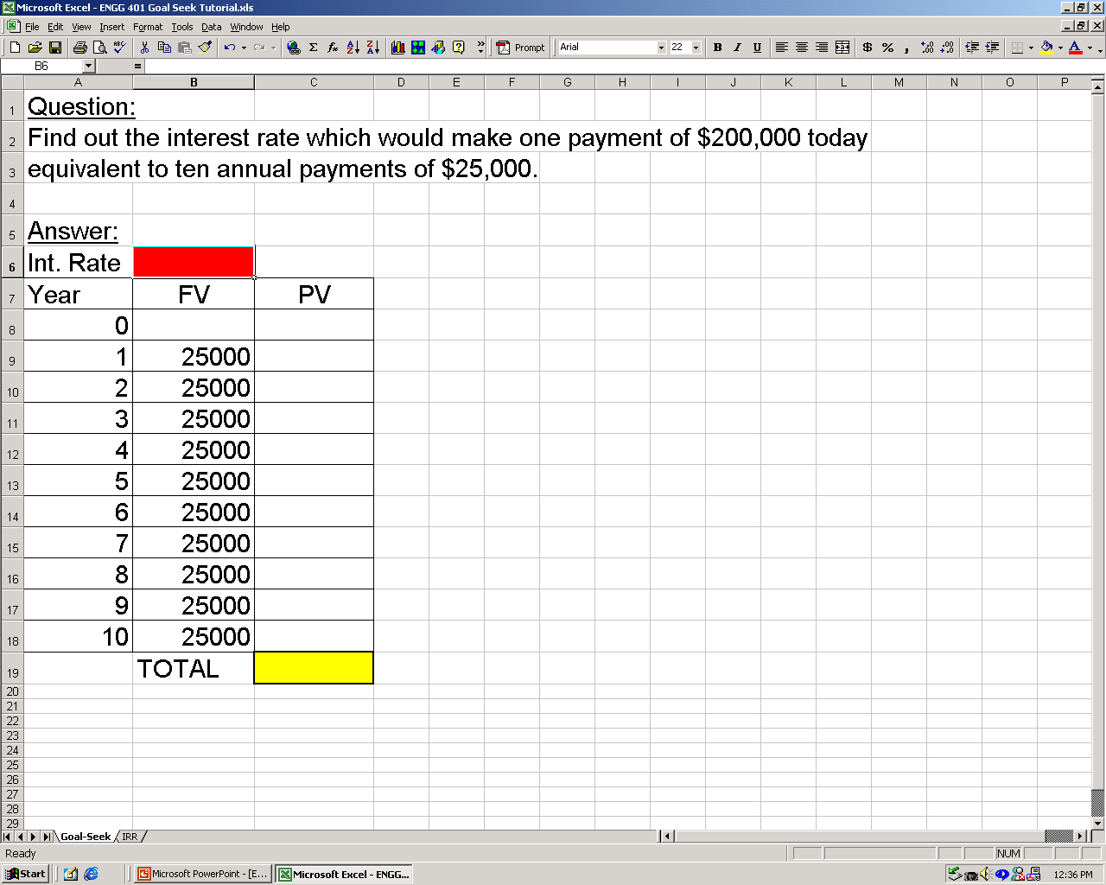
STEP 1: Set up a tabular cash flow diagram. Leave the “int. rate” cell empty.

Slide 5
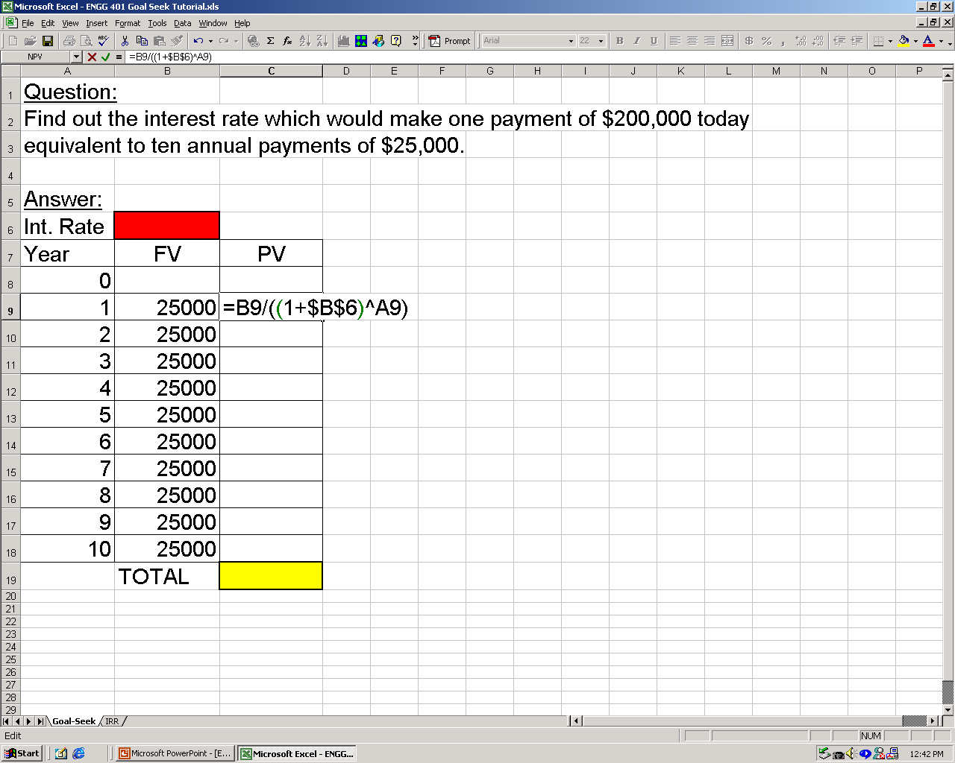
STEP 2: Calculate the present values of annual payments.

Slide 6
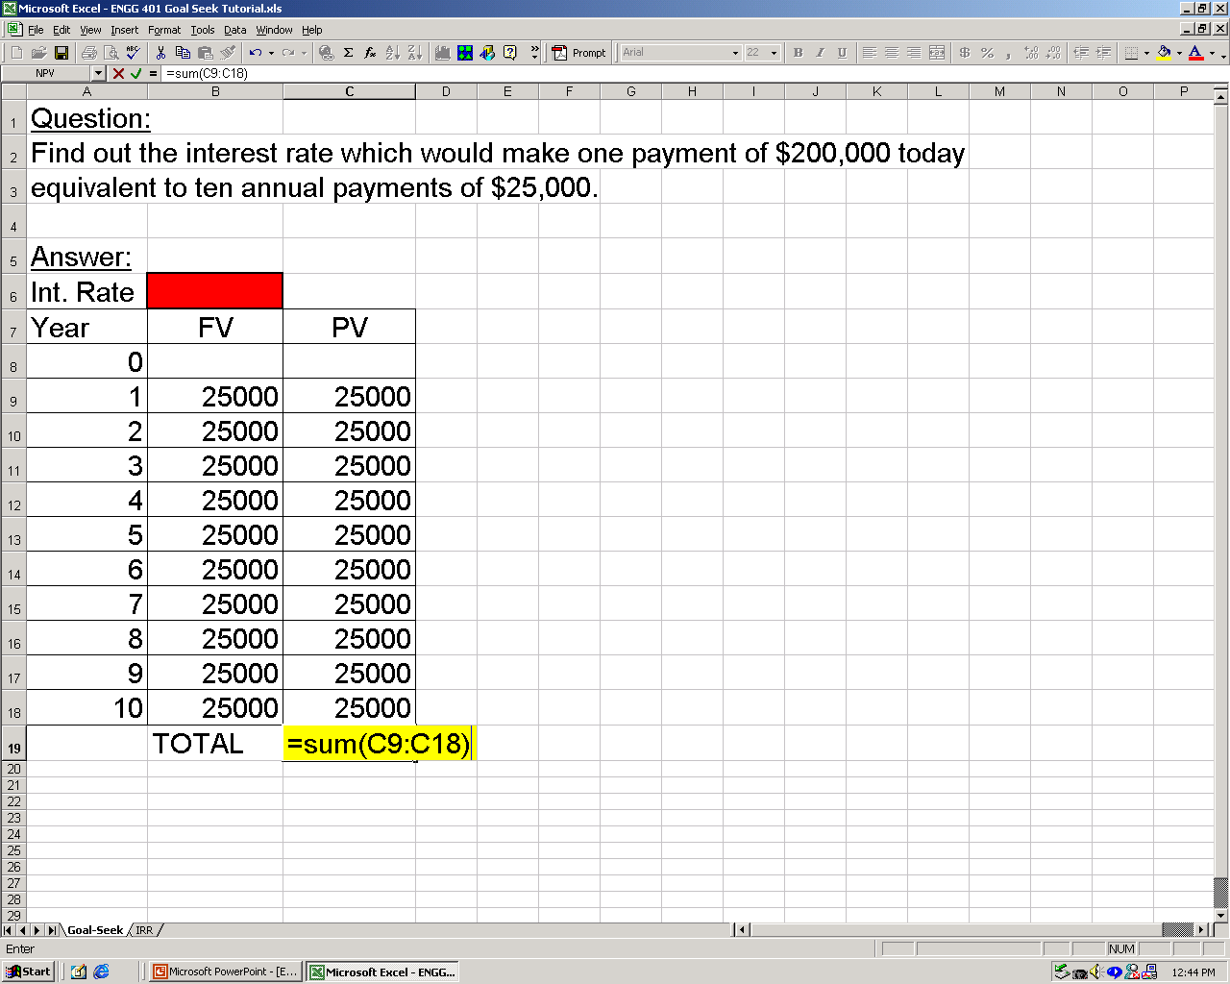
STEP 3: Calculate the equivalent present value of all payments.

Slide 7
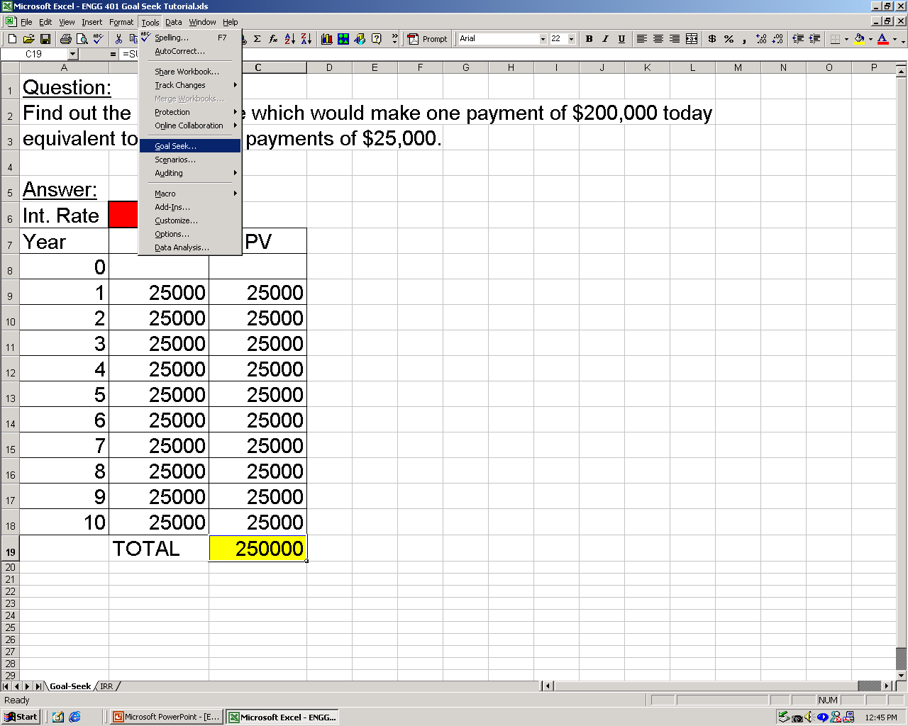
STEP 4 (A): Use “Goal-Seek” from the “Tools” menu.
The “Goal Seek” function can be found
in “Data” – “What If Analysis” menu in
Microsoft Excel 2007.

Slide 8
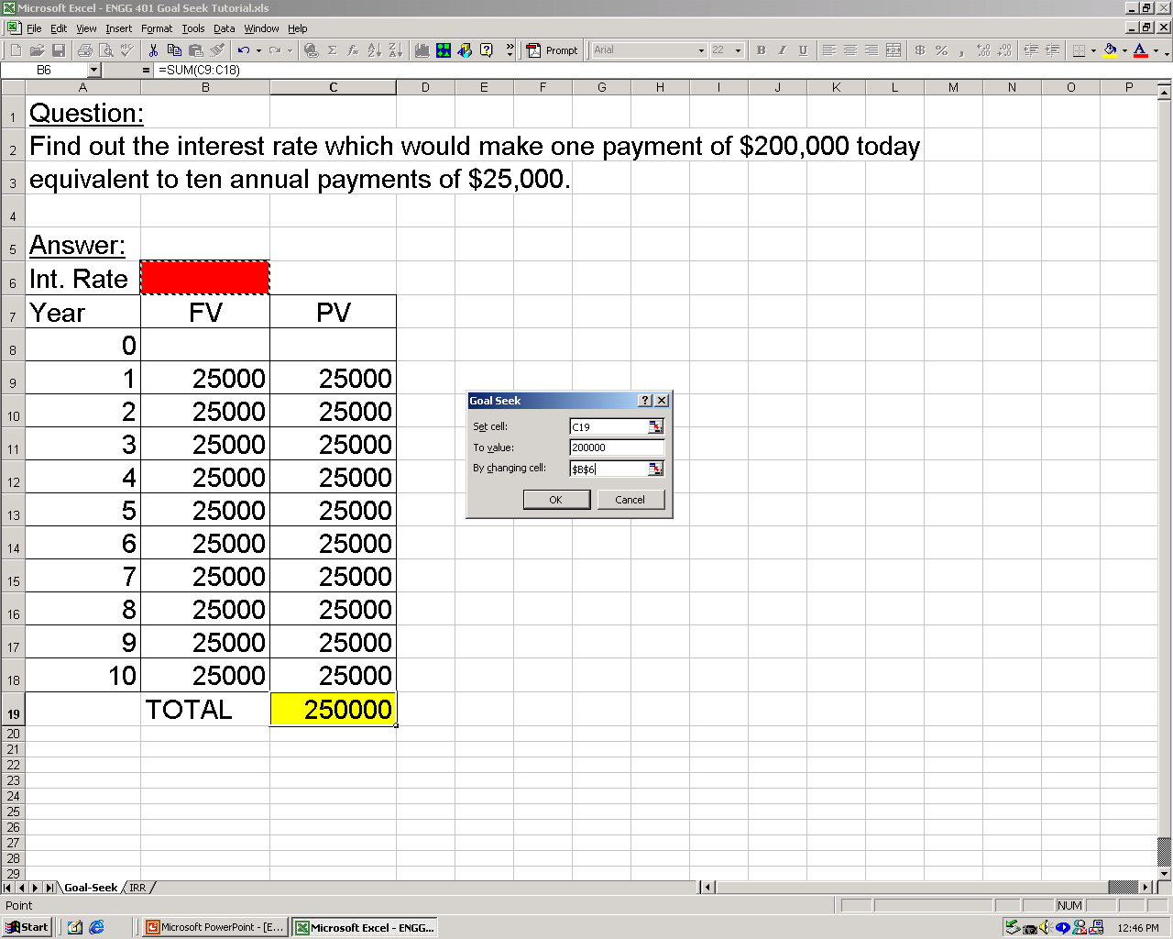
STEP 4 (B): Set the goal (PV=$200,000) and variable cell (int. rate).

Slide 9
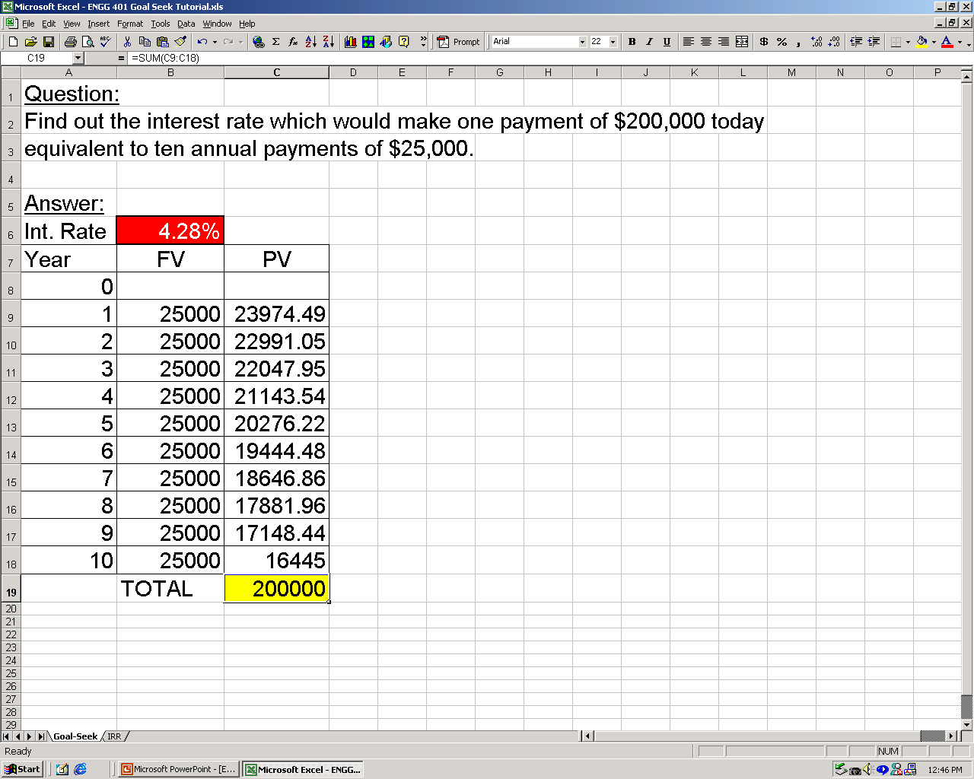
STEP 5: The solution is given in the “Int. Rate” cell.

Slide 10
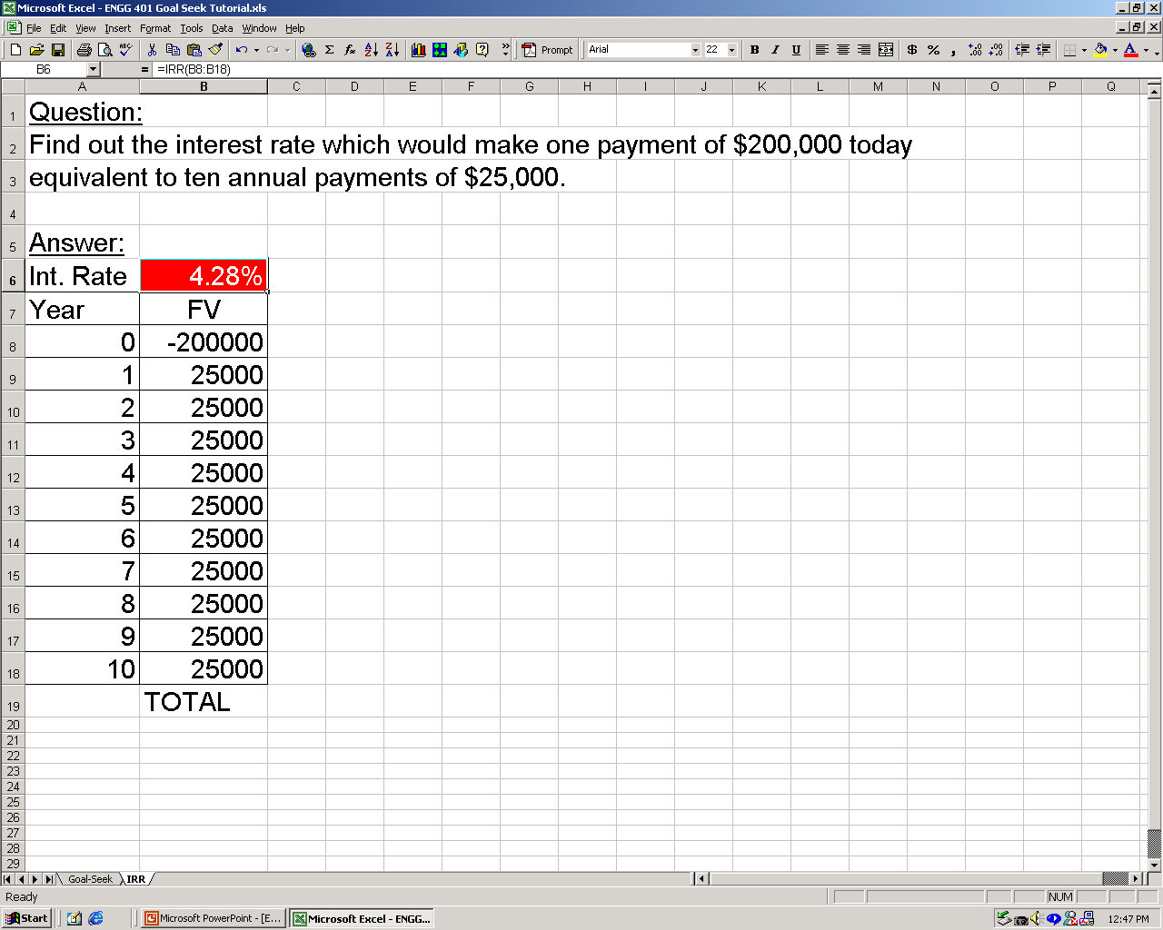
Note that you will get the same result with the IRR function.

Slide 11
ENGM 310: “Goal-Seek Function”
Annuity Question
(Example 3.17, page 98-99, textbook):
Find out the annuity on a six-year level-payment loan of $250K at 8% interest compounded annually.
Solution:
  Apart from the interest factor method and the built-in function method, which are both presented in the textbook, we can also use the “goal-seek” function in Microsoft Excel to solve for the annuity (please see the slides ahead).

Slide 12
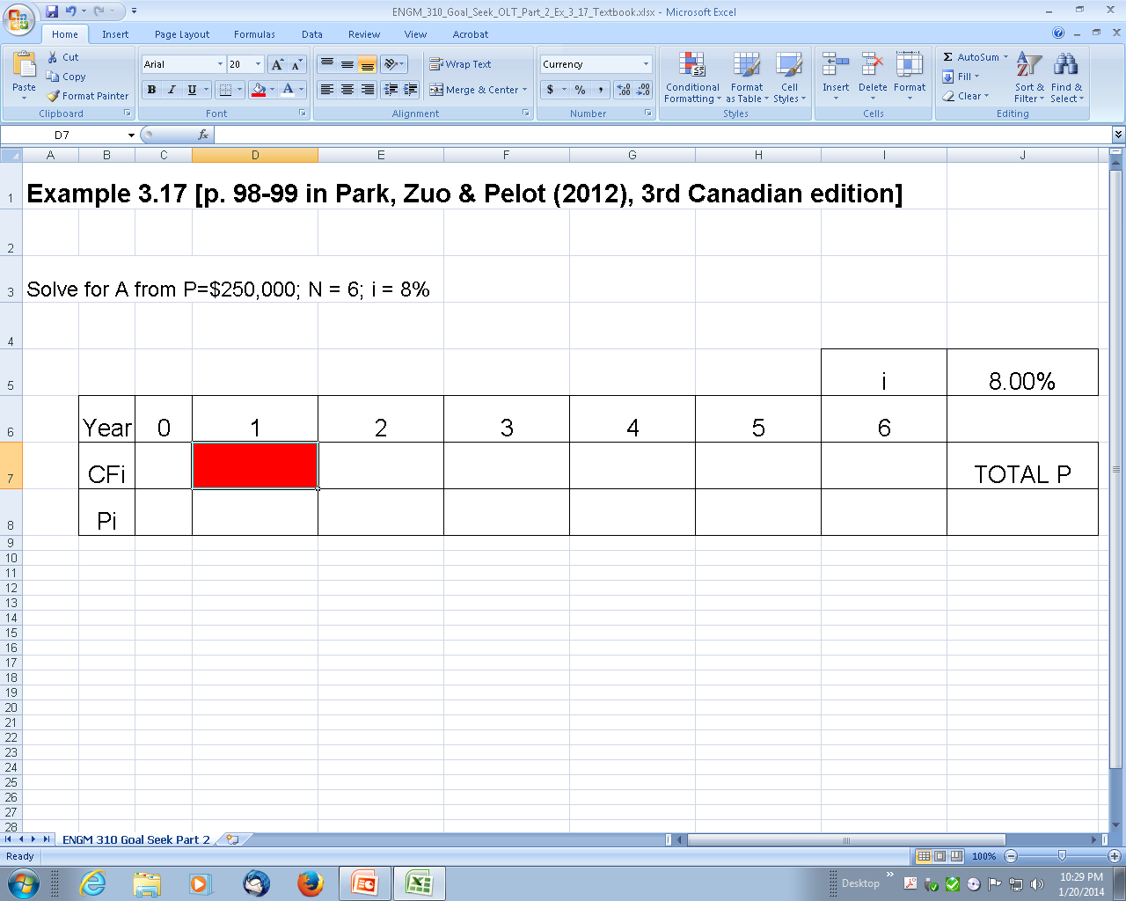
STEP 1a: Set up a tabular cash flow diagram. Leave the “A₁” cell empty.

Slide 13
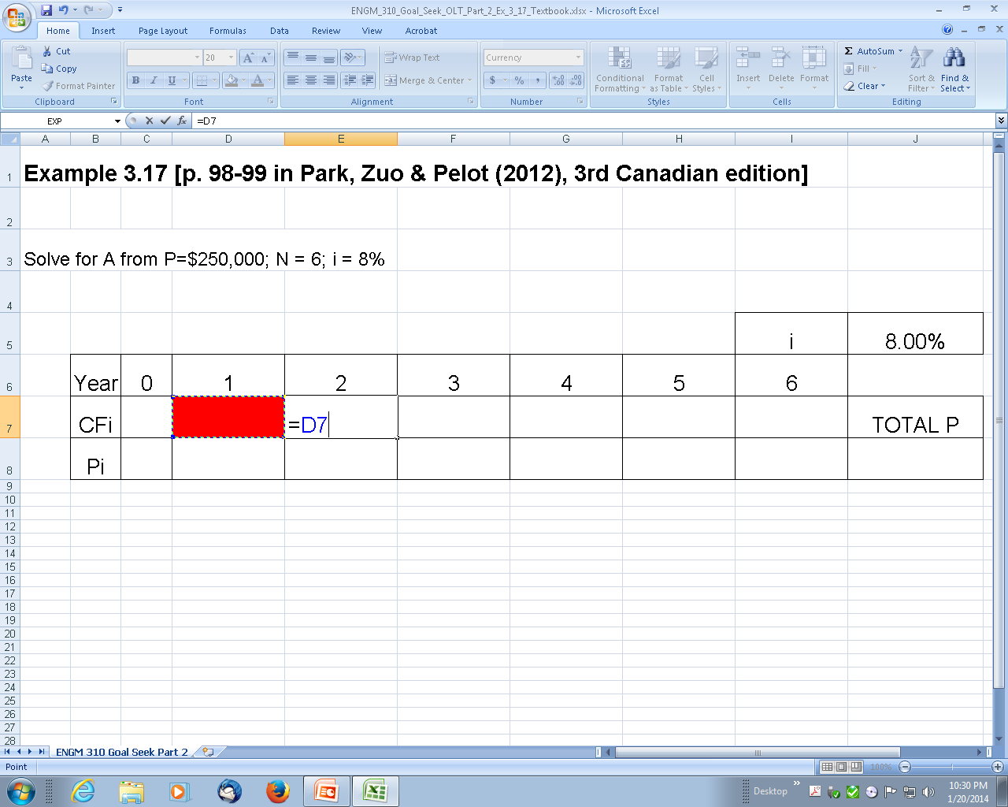
STEP 1b: Set the value of A₂ to be equal to the value of A₁.

Slide 14
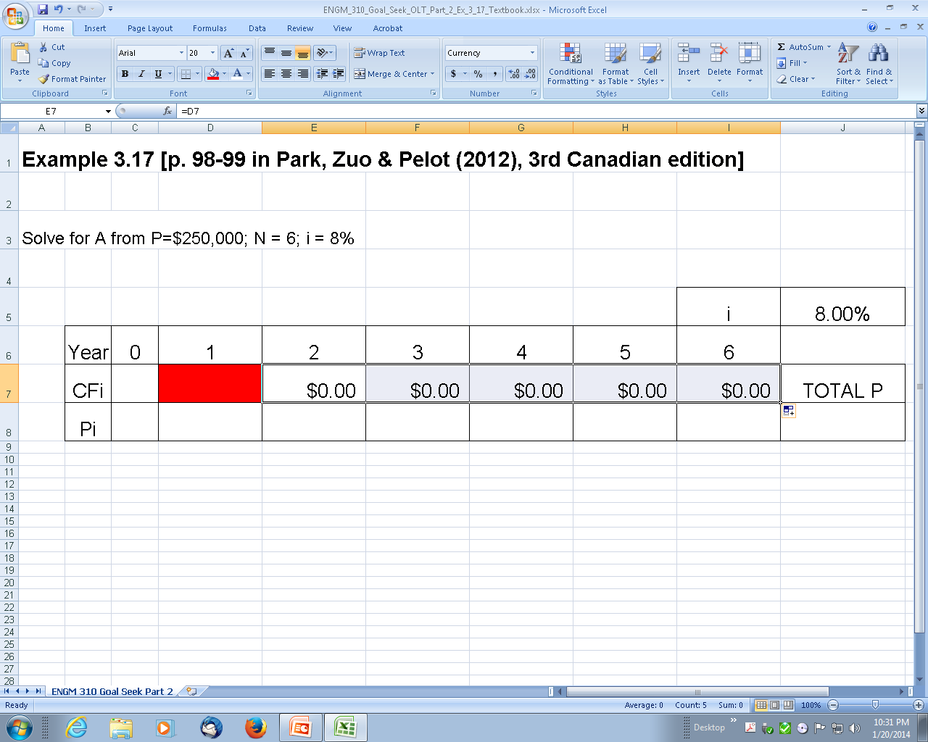
STEP 1c: Set all other values of A to be equal to the value of A₁.

Slide 15
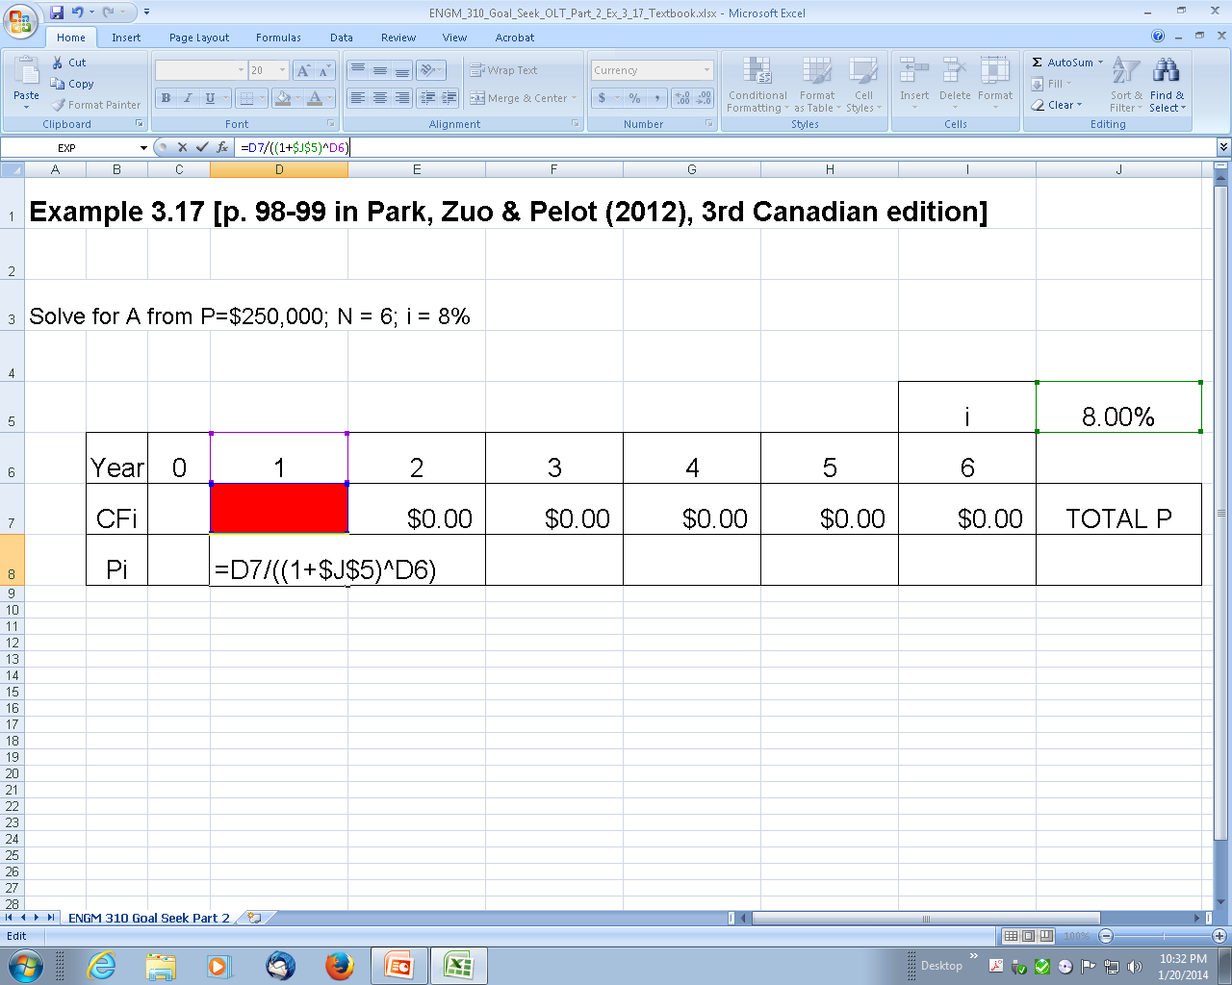
STEP 2: Calculate the equivalent present value of the annuities.

Slide 16
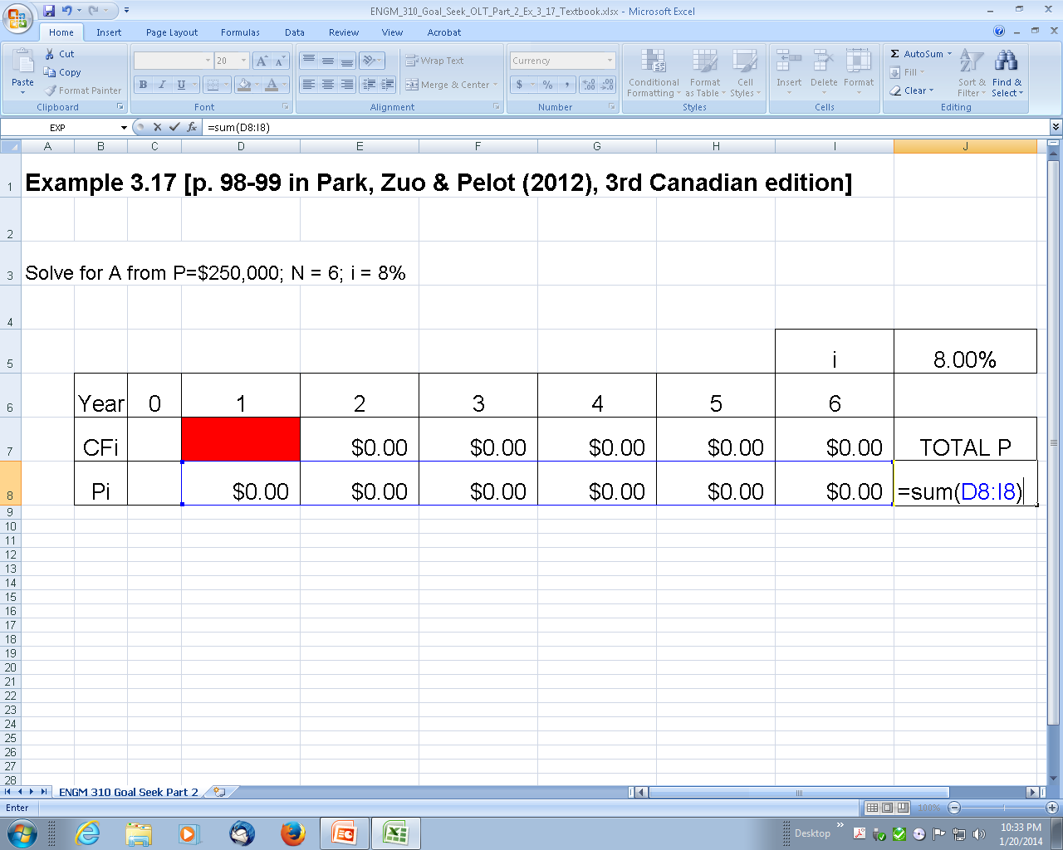
STEP 3: Calculate the equivalent present value of all annuities.

Slide 17
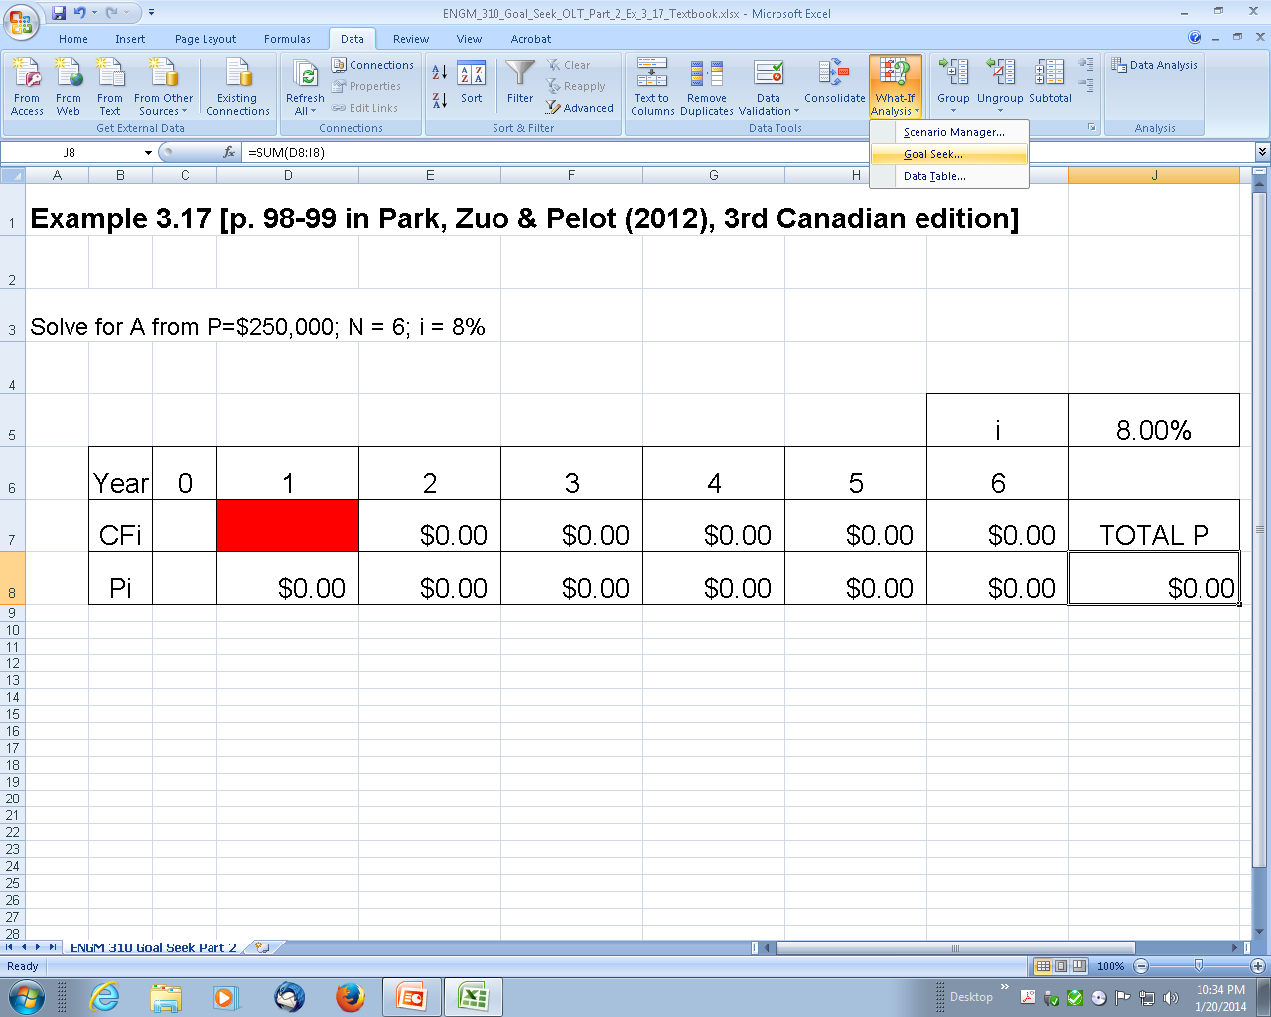
STEP 4a: Use “Goal-Seek” from the “Data” – “What-If Analysis” menu.

Slide 18
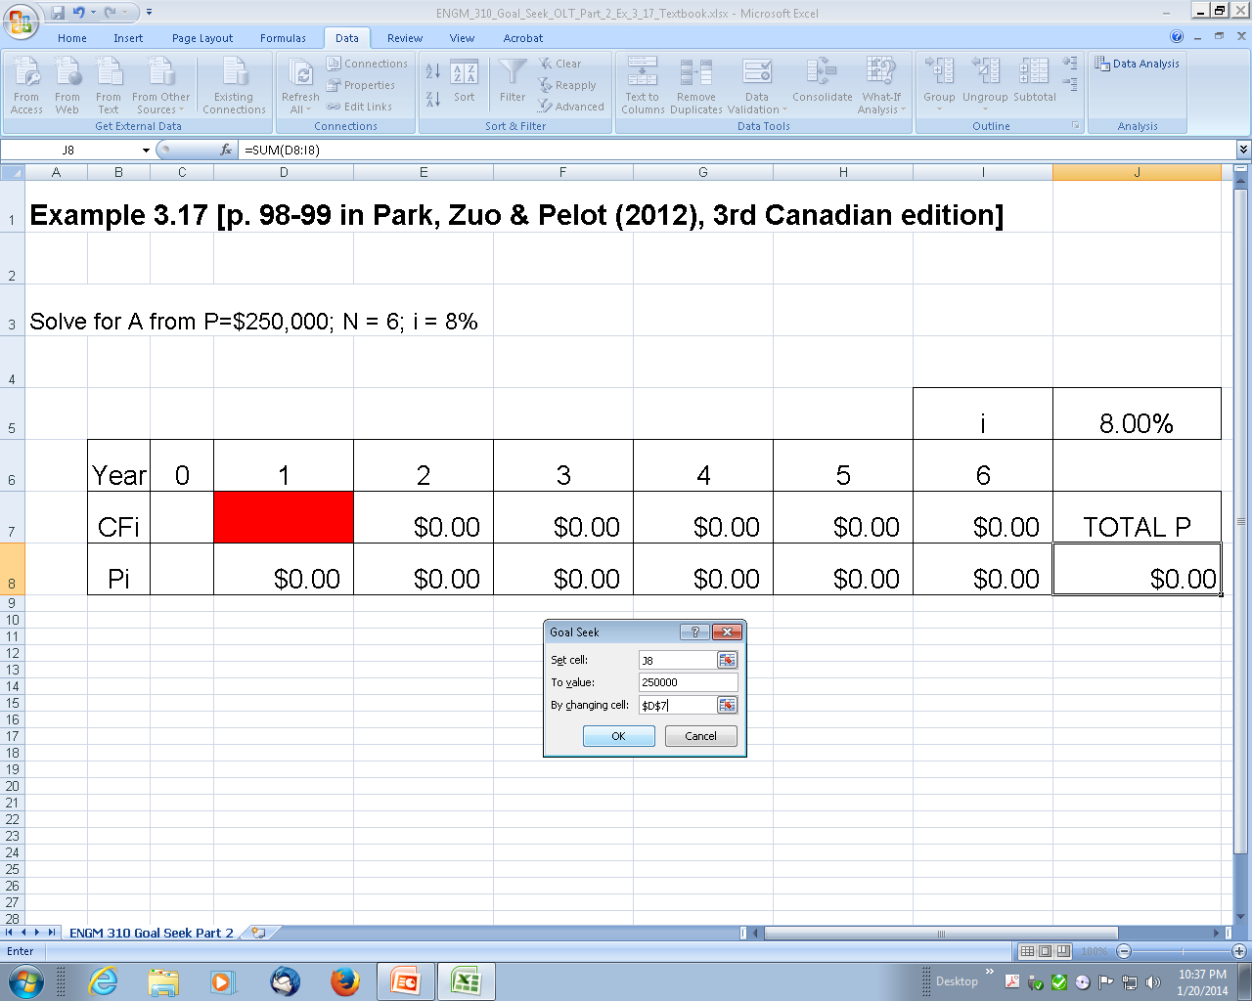
STEP 4b: Set the goal (P=$250,000) and variable cell (A₁).

Slide 19
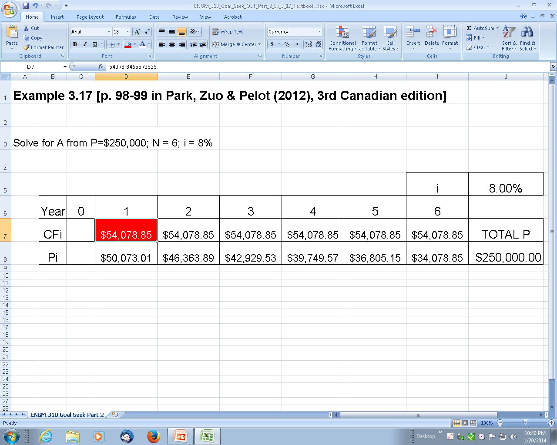
STEP 5: The solution is given in the cells corresponding to the annuities.

Slide 20
Congratulations and thank you for using the online learning tool on the “Goal Seek” function in the time value of money problems!
Please send any questions
or comments to the professor
Notes:
Sample problem: $500,000 machine with an actual expected life of 10 years. If you depreciate over five years:
Depreciation is $100,000 per year
Income is $50,000 per year understated in years one to five.
Income is $50,000 overstated in years six to ten.
Compared to depreciating over ten years.
Bob Pierce of Nova: to improve profitability, move depreciation from 12 to 20 years. Plant is now 20 years old, so in hindsight it was not in error.
General rule: be conservative but not ridiculous when picking depreciation.

