Slide 1
LOANS
ENGM 310
Online Learning Tools
#3

Slide 2
What are we going to learn using this tool?
We will look at the “tabular method” for the calculation of the amortized (or “level payment”) type of a loan*.
*Please note that other types of loans are addressed in the ENGM 310 textbook (Park, Zuo & Pelot, 2012, Contemporary Engineering Economics, 3rd Canadian Edition, Prentice Hall, p. 171-172), as well as in Flynn, 2009, Financial Management for Engineers, Castle Rock (Appendix 3.3), which is used in ENGM 401.
[Clip arts from Microsoft Office (2014)]
Notes:
Sample problem: $500,000 machine with an actual expected life of 10 years. If you depreciate over five years:
Depreciation is $100,000 per year
Income is $50,000 per year understated in years one to five.
Income is $50,000 overstated in years six to ten.
Compared to depreciating over ten years.
Bob Pierce of Nova: to improve profitability, move depreciation from 12 to 20 years. Plant is now 20 years old, so in hindsight it was not in error.
General rule: be conservative but not ridiculous when picking depreciation.

Slide 3
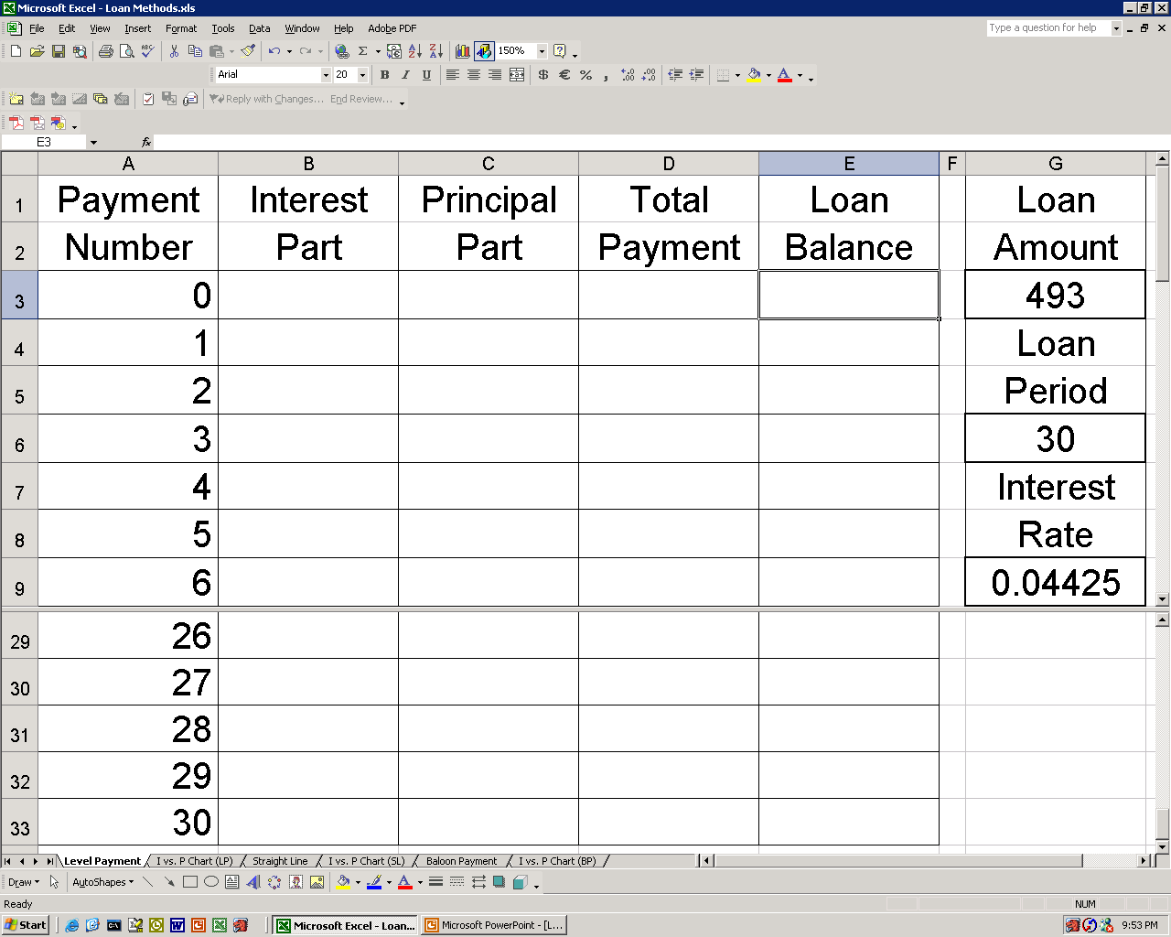
Amortized Loan (Example Setup):
Notes:
Sample problem: $500,000 machine with an actual expected life of 10 years. If you depreciate over five years:
Depreciation is $100,000 per year
Income is $50,000 per year understated in years one to five.
Income is $50,000 overstated in years six to ten.
Compared to depreciating over ten years.
Bob Pierce of Nova: to improve profitability, move depreciation from 12 to 20 years. Plant is now 20 years old, so in hindsight it was not in error.
General rule: be conservative but not ridiculous when picking depreciation.

Slide 4
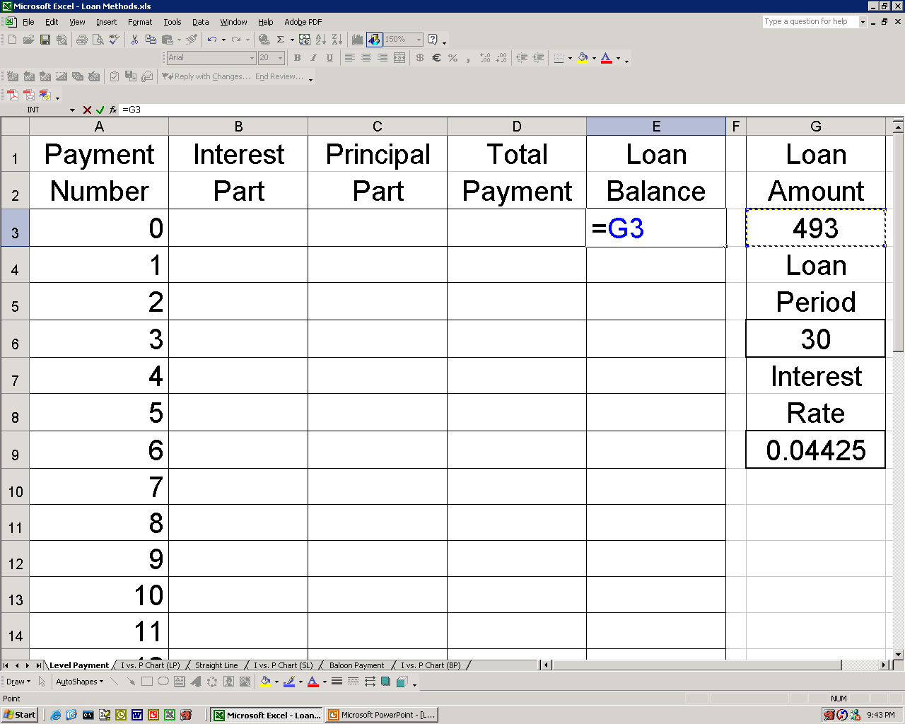
Amortized Loan Calculation (Start):
Notes:
Sample problem: $500,000 machine with an actual expected life of 10 years. If you depreciate over five years:
Depreciation is $100,000 per year
Income is $50,000 per year understated in years one to five.
Income is $50,000 overstated in years six to ten.
Compared to depreciating over ten years.
Bob Pierce of Nova: to improve profitability, move depreciation from 12 to 20 years. Plant is now 20 years old, so in hindsight it was not in error.
General rule: be conservative but not ridiculous when picking depreciation.

Slide 5
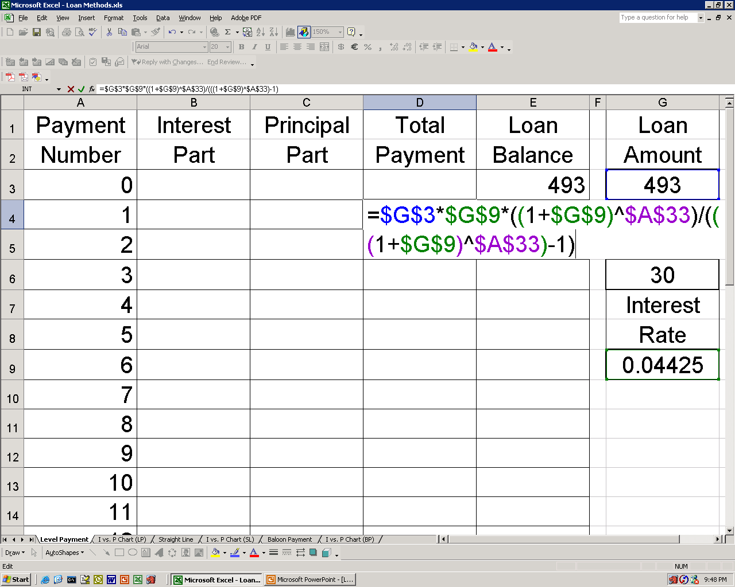
Amortized Loan Calculation (Payment):
Notes:
Sample problem: $500,000 machine with an actual expected life of 10 years. If you depreciate over five years:
Depreciation is $100,000 per year
Income is $50,000 per year understated in years one to five.
Income is $50,000 overstated in years six to ten.
Compared to depreciating over ten years.
Bob Pierce of Nova: to improve profitability, move depreciation from 12 to 20 years. Plant is now 20 years old, so in hindsight it was not in error.
General rule: be conservative but not ridiculous when picking depreciation.

Slide 6
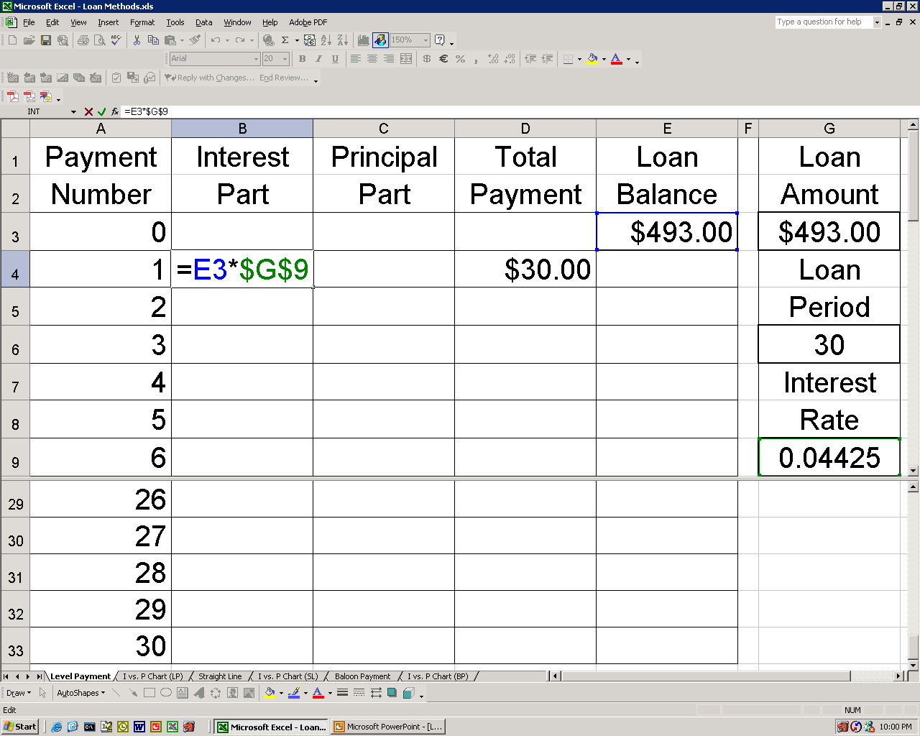
Amortized Loan Calculation (Interest):
Notes:
Sample problem: $500,000 machine with an actual expected life of 10 years. If you depreciate over five years:
Depreciation is $100,000 per year
Income is $50,000 per year understated in years one to five.
Income is $50,000 overstated in years six to ten.
Compared to depreciating over ten years.
Bob Pierce of Nova: to improve profitability, move depreciation from 12 to 20 years. Plant is now 20 years old, so in hindsight it was not in error.
General rule: be conservative but not ridiculous when picking depreciation.

Slide 7
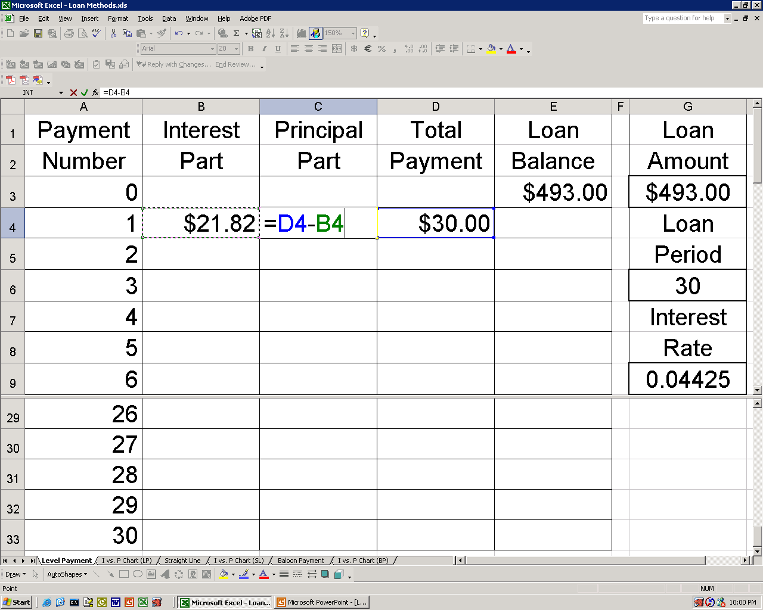
Amortized Loan Calculation (Principal):
Notes:
Sample problem: $500,000 machine with an actual expected life of 10 years. If you depreciate over five years:
Depreciation is $100,000 per year
Income is $50,000 per year understated in years one to five.
Income is $50,000 overstated in years six to ten.
Compared to depreciating over ten years.
Bob Pierce of Nova: to improve profitability, move depreciation from 12 to 20 years. Plant is now 20 years old, so in hindsight it was not in error.
General rule: be conservative but not ridiculous when picking depreciation.

Slide 8
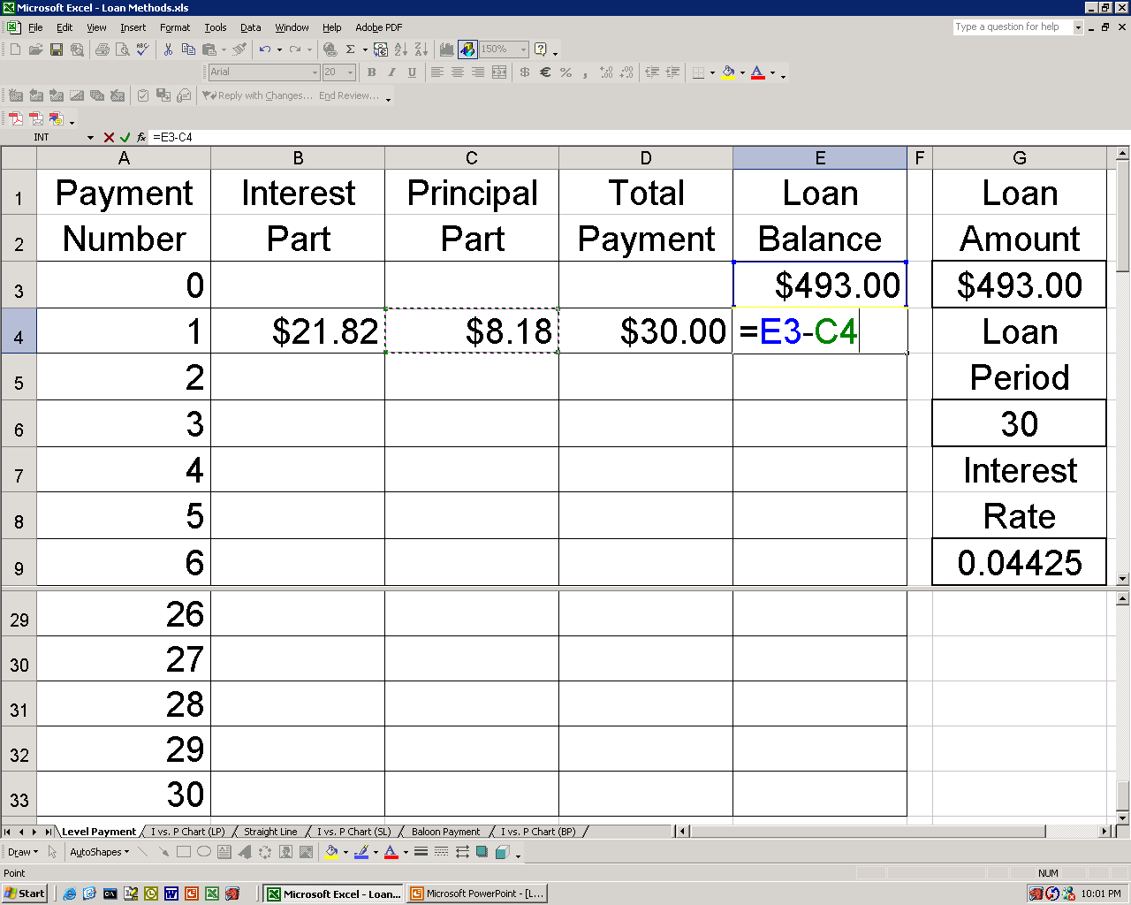
Amortized Loan Calculation (Balance):
Notes:
Sample problem: $500,000 machine with an actual expected life of 10 years. If you depreciate over five years:
Depreciation is $100,000 per year
Income is $50,000 per year understated in years one to five.
Income is $50,000 overstated in years six to ten.
Compared to depreciating over ten years.
Bob Pierce of Nova: to improve profitability, move depreciation from 12 to 20 years. Plant is now 20 years old, so in hindsight it was not in error.
General rule: be conservative but not ridiculous when picking depreciation.

Slide 9
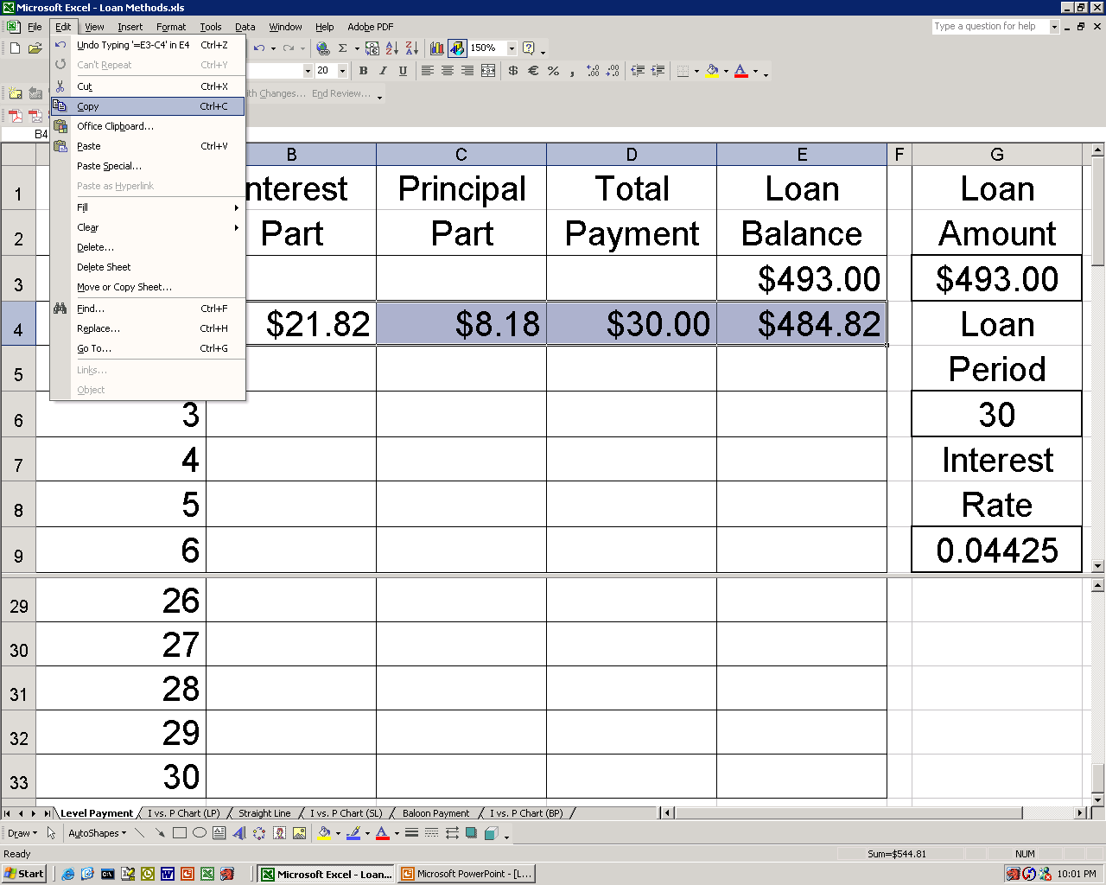
Amortized Loan Calculation (Year 1):
Notes:
Sample problem: $500,000 machine with an actual expected life of 10 years. If you depreciate over five years:
Depreciation is $100,000 per year
Income is $50,000 per year understated in years one to five.
Income is $50,000 overstated in years six to ten.
Compared to depreciating over ten years.
Bob Pierce of Nova: to improve profitability, move depreciation from 12 to 20 years. Plant is now 20 years old, so in hindsight it was not in error.
General rule: be conservative but not ridiculous when picking depreciation.

Slide 10
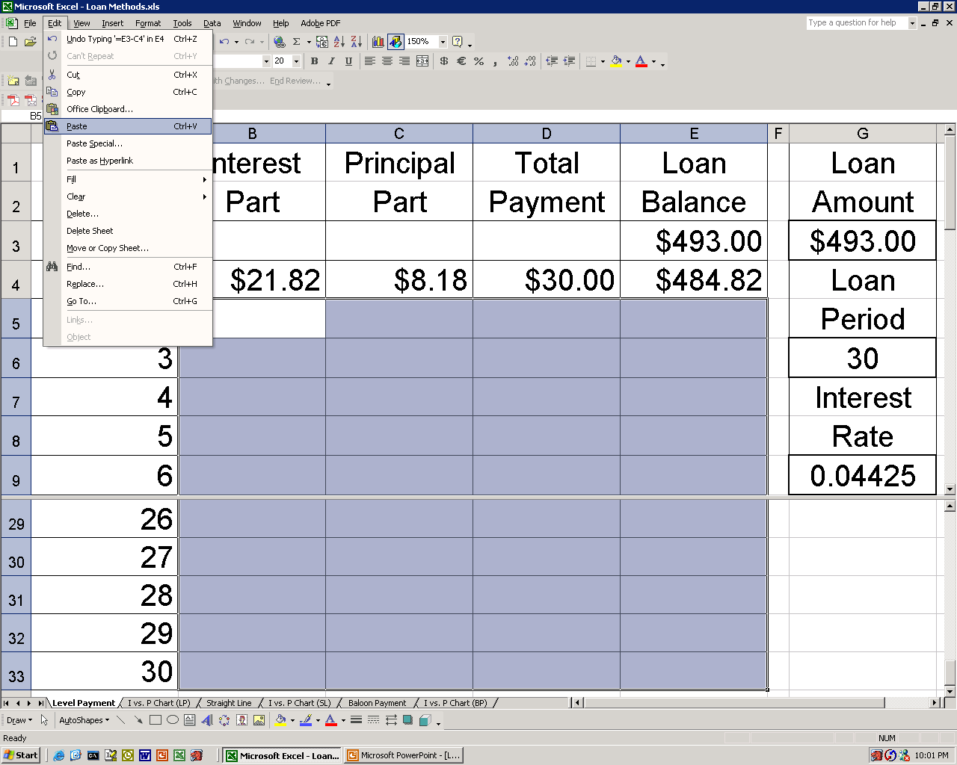
Amortized Loan Calculation (Year N):
Notes:
Sample problem: $500,000 machine with an actual expected life of 10 years. If you depreciate over five years:
Depreciation is $100,000 per year
Income is $50,000 per year understated in years one to five.
Income is $50,000 overstated in years six to ten.
Compared to depreciating over ten years.
Bob Pierce of Nova: to improve profitability, move depreciation from 12 to 20 years. Plant is now 20 years old, so in hindsight it was not in error.
General rule: be conservative but not ridiculous when picking depreciation.

Slide 11
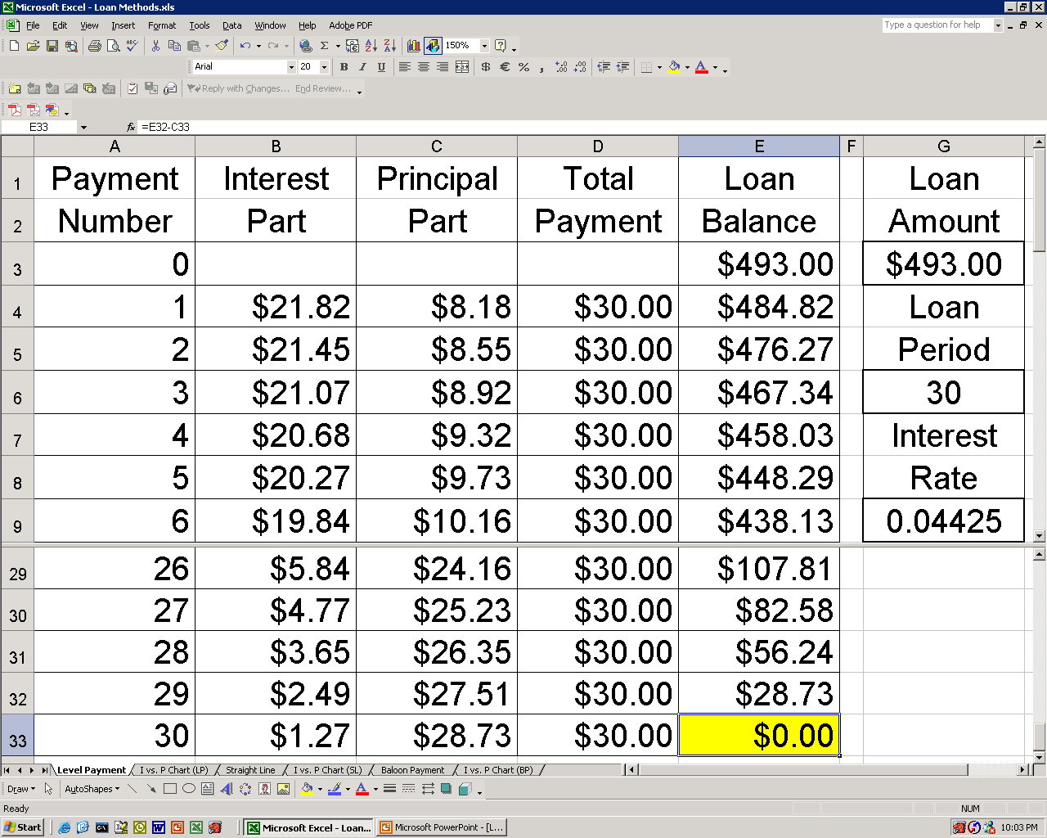
Amortized Loan Calculation (Check):
Notes:
Sample problem: $500,000 machine with an actual expected life of 10 years. If you depreciate over five years:
Depreciation is $100,000 per year
Income is $50,000 per year understated in years one to five.
Income is $50,000 overstated in years six to ten.
Compared to depreciating over ten years.
Bob Pierce of Nova: to improve profitability, move depreciation from 12 to 20 years. Plant is now 20 years old, so in hindsight it was not in error.
General rule: be conservative but not ridiculous when picking depreciation.

Slide 12
Notes:
Sample problem: $500,000 machine with an actual expected life of 10 years. If you depreciate over five years:
Depreciation is $100,000 per year
Income is $50,000 per year understated in years one to five.
Income is $50,000 overstated in years six to ten.
Compared to depreciating over ten years.
Bob Pierce of Nova: to improve profitability, move depreciation from 12 to 20 years. Plant is now 20 years old, so in hindsight it was not in error.
General rule: be conservative but not ridiculous when picking depreciation.

Slide 13
Congratulations and thank you for using the online learning tool on loans!
Please send any questions
or comments to the professor
Notes:
Sample problem: $500,000 machine with an actual expected life of 10 years. If you depreciate over five years:
Depreciation is $100,000 per year
Income is $50,000 per year understated in years one to five.
Income is $50,000 overstated in years six to ten.
Compared to depreciating over ten years.
Bob Pierce of Nova: to improve profitability, move depreciation from 12 to 20 years. Plant is now 20 years old, so in hindsight it was not in error.
General rule: be conservative but not ridiculous when picking depreciation.

