Slide 1
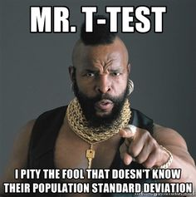
STAT 235 - Lab 4

Slide 2
Contact Info
Email: jmarley@ualberta.ca
Office: CCIS L1-195
Schedule: Tuesday 6pm, Wednesday 6pm and Friday 2pm
Available labs to you: CAB 331, 335, 341, 345

Slide 3
Things to Remember
All assignments are typed
Assignments must have a cover page WITHOUT your student ID (seriously, don’t put it on there)
Late assignments will not be accepted
Caption/header on every figure and table.
www.stat.ualberta.ca/statslabs for more info

Slide 4
Just a note...
I (Jessa) am very open to discussing your grades from your assignments. Please if you have any concerns or questions, come talk to me (not your profs!) since I was the one who marked them. Sometimes I make counting mistakes (it happens) and I’m MORE than happy to change a grade if warranted.

Slide 5
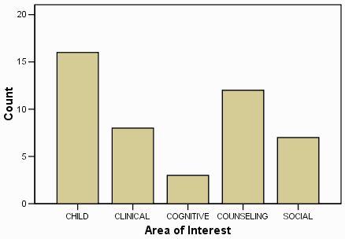
How to Caption/Header
Figure 1: Histogram of career interested for students in 2008

Slide 6
Lab 1 - Statistics
Histogram: Show the frequency (or count) for each bin.
Summary statistics: Mean (or average), standard deviation (σ) and variance (σ²).
Quartiles: First = middle of smallest and median, Second = median, third = middle of median and highest. Splits data into four groups.
Mean change: μ₂- μ₁ change in means
Scatter plots: Visualization of your data, compares the data under two conditions (x and y). Typically the response goes on the y-axis, i.e. how does x influence y?
Interquartile Range: Spread between third and first quartile. Q3-Q1

Slide 7
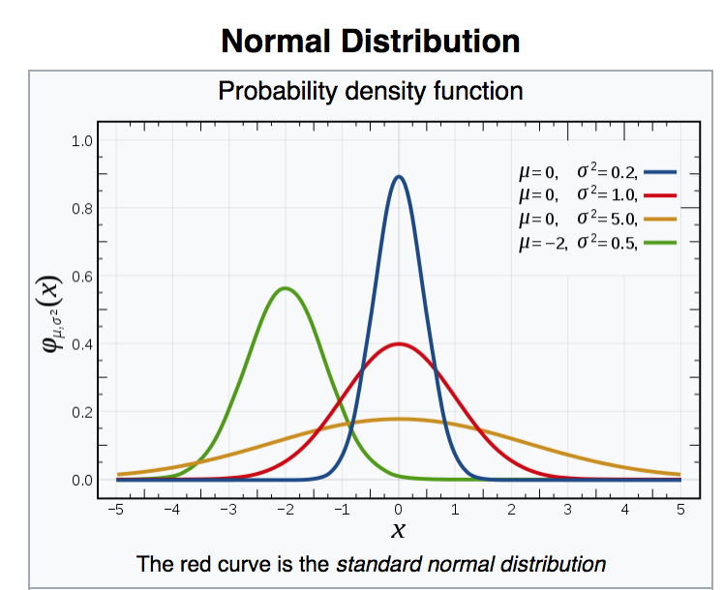
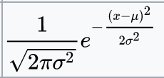
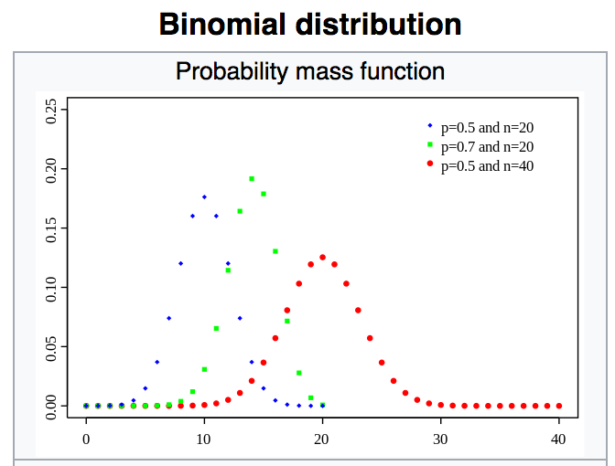

Lab 2 - Statistics
Normal Distribution: Bell shaped, continuous, positive and negative, it has two parameters (μ = mean, σ = standard deviation). Note that this distribution is symmetric.
Mean: For the normal distribution, the mean occurs at the maximum value.
Standard Deviation: For the normal distribution this describes the spread of the distribution.
Random Number Generation: Gives random numbers based on a desired distribution. Note that seeds results in the same random numbers. (Ask me about this if you’re curious)
Binomial distribution: DISCRETE, looks at number of successes

Slide 8
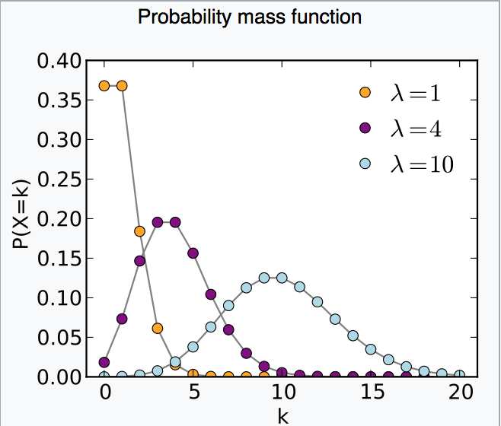
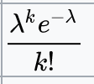
Lab 3 - Statistics
Poisson Distribution: Discrete, positive, one parameter (ƛ)
Lambda (ƛ): Expected number of occurrences.
Central limit theorem: If a random sample of size n is drawn from a population with mean μ and variance σ², the sample mean approximately follows a normal distribution with mean μ and variance σ²/n if the sample size is sufficiently large. Also averages of samples converge to normal distributions.

Slide 9
Lab 4 - Statistics
Confidence intervals: the range of which we are #% certain. Note that a wider range means more uncertainty.
Margin of error: provides information about the accuracy of the estimate of the population parameter.
Two sided (tailed) test: checks if alternate hypothesis is not equal
One sided (tailed) test: checks if alternate hypothesis is greater or lesser. Need to divide two-tailed p-values by 2.
T-test: Comparison of two means, requires normality.
P-value: the probability that your alternate hypothesis is wrong, typical use ⍺=0.05 or =0.01

Slide 10
Lab 1 - Excel
Histogram: Add ins (under Insert) -> Manage other Add-ins -> Go… -> Check “Analysis Toolpak” -> Data Analysis (under Data) -> Histogram -> Choose data and check “Chart Output”
Summary Statistics: (If “Analysis Tool Pack” is already added in) Data Analysis (under Data) -> Descriptive Statistics -> Choose data and check “Summary Statistics”
Quartiles: Insert Formula (under Formulas) -> formula is “QUARTILE.INC” -> Choose data and quartile number.
Mean Change: Can be found using a formula, one cell minus the one above. You won’t have a value for the first one.
Scatter Plot: Scatter (under Insert) -> Right click and “Select Data” to change the plotted data
Interquartile Range: IQR= Q3(third quartile)-Q1(First quartile)

Slide 11
Lab 2 - Excel
Normal Distribution: Formulas -> Insert Function -> there are several function for the normal dist. (NOT NECESSARY FOR THIS LAB)
Mean: Can be found using summary statistics.
Standard Deviation: Can be found using summary statistics.
Random Number Generation: Data -> Data Analysis -> Random Number Generation -> number of variables = #, Number of random variables = #, Distribution = “dist”, seed = #, mean = #, st. deviation = #
Binomial Distribution: Formulas -> Insert Function -> There are several functions available. (NOT NECESSARY FOR THIS LAB)

Slide 12
Lab 3 - Excel
Poisson Distribution: Don’t worry about it, it’s given to you.
Lambda (ƛ): This is just entered by you this time, not fitting a distribution.

Slide 13
Lab 4 - Excel
Confidence intervals: Insert function -> Confidence Norm -> alpha = #, standard deviation = #, size = #)
Margin of error: Given to you in lab, also in summary statistics.
T-test: Data Analysis -> t Test (three versions, depends on what you need)

Slide 14
Lab 4 - Data
The data for this lab was collected to determine which alloy would be best for improving strength of metal rods.
ALLOY 1: The strength of rods made of Alloy 1
ALLOY 2: THe strength of rods made with Alloy 2
ALLOY 2 + Treatment: The strength of ALLOY 2 rods subjected to high pressure and temperature.

Slide 15
Lab 4 - Guidelines
Q1. a.
Q1. b.
CONFIDENCE LEVEL | MARGIN OF ERROR
0.90
0.95
0.99
CONFIDENCE LEVEL | OBSERVED FRACTION OF INTERVALS OUTSIDE OF CONFIDENCE INTERVAL

Slide 16
Q2. a.
The theory is in reference to the level of significance, i.e. how does the fraction of data compare to the level of significance?
Q2. b. The wording on this question is a bit unclear, so this is how I want you to answer it. Write 3 null hypotheses (one for 90%, 95%, and 99% each) . Write your null hypotheses in terms of your confidence interval (that’s the only part that changes). Then, explain when you would reject your null hypothesis. Explain the relationship between the C.I. and alpha (⍺) as an equation.
LEVEL OF SIGNIFICANCE | NUMBER OF SAMPLES THAT LED TO THE REJECTION OF H_{O} | OBSERVED FRACTION OF SAMPLES
0.10
0.05
0.01

Slide 17
Q3. a. OUTPUT: Summary tables for Alloy 1 and Alloy 2 from Excel. Calculate the confidence intervals yourself using the margin of error (aka confidence level). Get the margin of error through either your summary table or the Confidence function
Q3. b. Can be summarized in a few sentences, keep it simple. Does it exceed the threshold value?
Q4. a. Show your work! This includes the math. Do NOT write it by hand, type it. You will be comparing the mean of Alloy 1 to 64 and the mean of Alloy 2 to 64
Q4. b. What assumptions must be true for a t-test? Is there a theorem we covered that related to normal distributions? Can use a visualization if you’d like.

Slide 18
Q5. a. OUTPUT: t-Test output from Excel. Which t-test should you use? Did you assume equal variances? For hypotheses, is this one-tailed or two-tailed? Choose the correct t-test.
Q5. b. What are the assumptions for the t-test?
Q6. a. OUTPUT: t-Test output form excel. Choose your t-test carefully.
Q6. b. OUTPUT: Summary statistics table from Excel.
Q6. c. What are the assumptions for a t-test? Is there a theorem we touched on earlier that relates to the normal dist?
Q6. d. OUTPUT: Change in strength vs. Scatter plot of Alloy 2 strength. Remember to put response on y-axis. All relationships have error, look at the middle of the data “cloud” to determine shape.

Slide 19
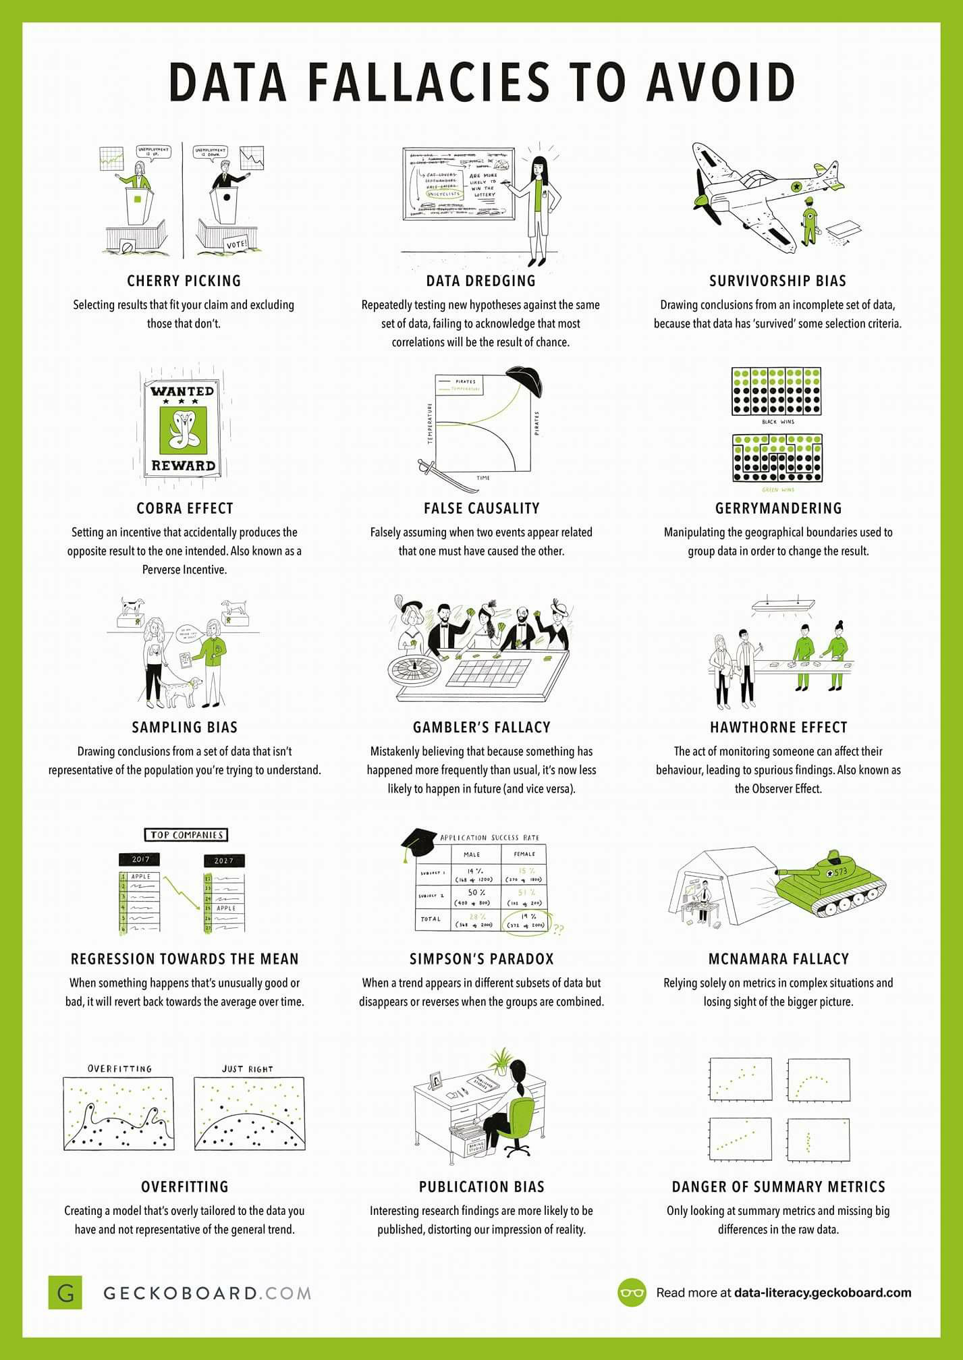
Data Fallacies to Avoid (aka how to be a bad statistician)

Slide 20
Data Fallacies to Avoid (aka how to be a bad statistician)

