Slide 1
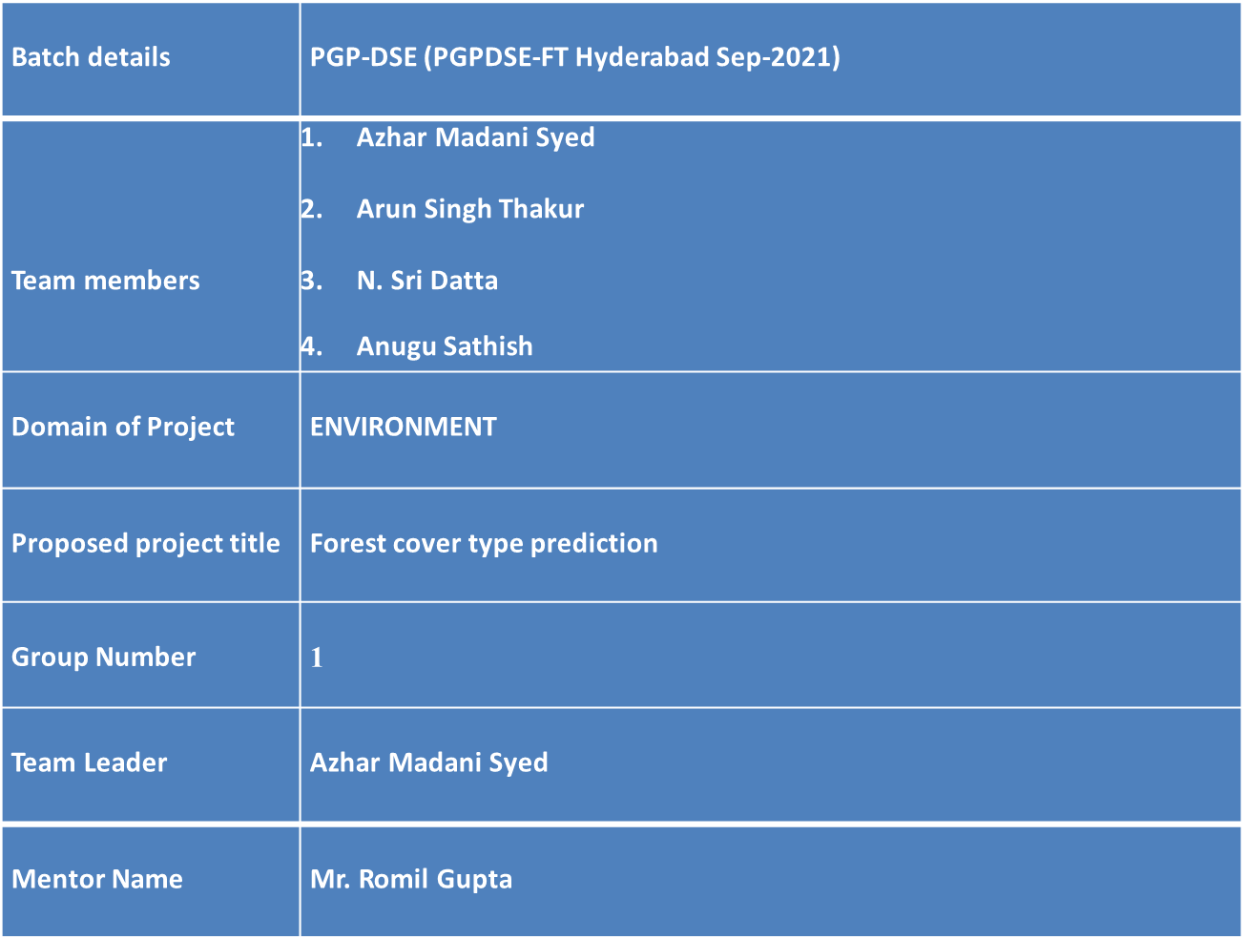
Project Summary
Batch details
PGP-DSE (PGPDSE-FT Hyderabad Sep-2021)
Team members
1. Azhar Madani Syed
2. Arun Singh Thakur
3. N. Sri Datta
4. Anugu Sathish
Domain of Project
ENVIRONMENT
Proposed project title
Forest cover type prediction
Group Number
1
Team Leader
Azhar Madani Syed
Mentor Name
Mr. Romil Gupta
Batch details
PGP-DSE (PGPDSE-FT Hyderabad Sep-2021)
Team members
1. Azhar Madani Syed
2. Arun Singh Thakur
3. N. Sri Datta
4. Anugu Sathish
Domain of Project
ENVIRONMENT
Proposed project title
Forest cover type prediction
Group Number
1
Team Leader
Azhar Madani Syed
Mentor Name
Mr. Romil Gupta

Slide 2
Data Description
Dataset name : covtype_data.csv
Problem Statement:
The problem is to “predict the forest cover type (the predominant kind of tree cover) from strictly cartographic variables (as opposed to remotely sensed data)”.
Variable information/Data description:
The data set consists of 5,81,012 observations and 55 features before the cleaning and contains variables like Elevation, Slope, Aspect, Hillshade_9am, Hillshade_3pm,Horizontal_Distance_To_Fire_Points, Horizontal_Distance_To_Roadways ,Wilderness Area(4), Soil types(40), cover type etc.,.

Slide 3
Business Problem:
Understanding forest composition is a valuable aspect of managing the health and vitality of our wilderness areas. Classifying cover type can help further research regarding forest fire susceptibility and de/reforestation concerns.
Forest cover type data is often collected by hand or computed using remote sensing techniques, e.g. satellite imagery. Such processes are both time and resource intensive. In this project, we aim to predict forest cover type using cartographic data and a variety of classification algorithms.

Slide 4
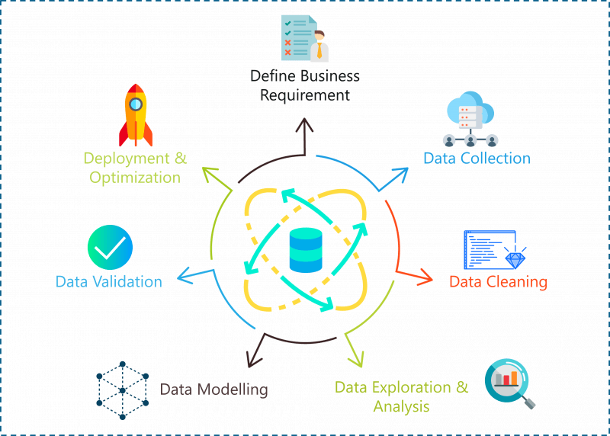
Methodology
Business Understanding
Data Understanding
Data Preprocessing
Exploratory Data Analysis
Feature Engineering
Feature Selection
Modelling
Model Evaluation

Slide 5
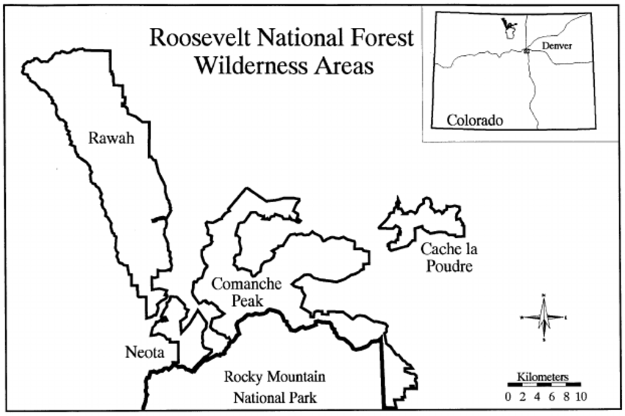
Data Understanding
There is a Roosevelt National Forest Wilderness area located in US Colorado and we are trying to predict the types of forest cover in that 813,799 acres area.

Slide 6
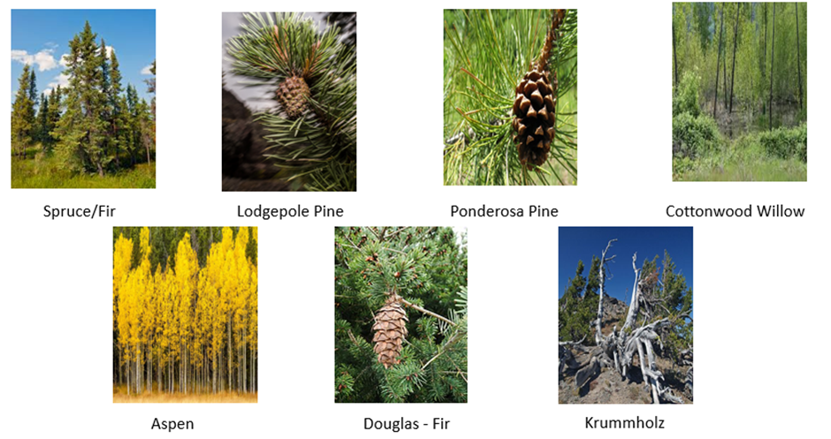
Forest Cover Types
1 | Spruce / Fir
2 | Lodgepole Pine
3 | Ponderosa Pine
4 | Cottonwood / Willow
5 | Aspen
6 | Douglas-fir
7 | Krummholz

Slide 7
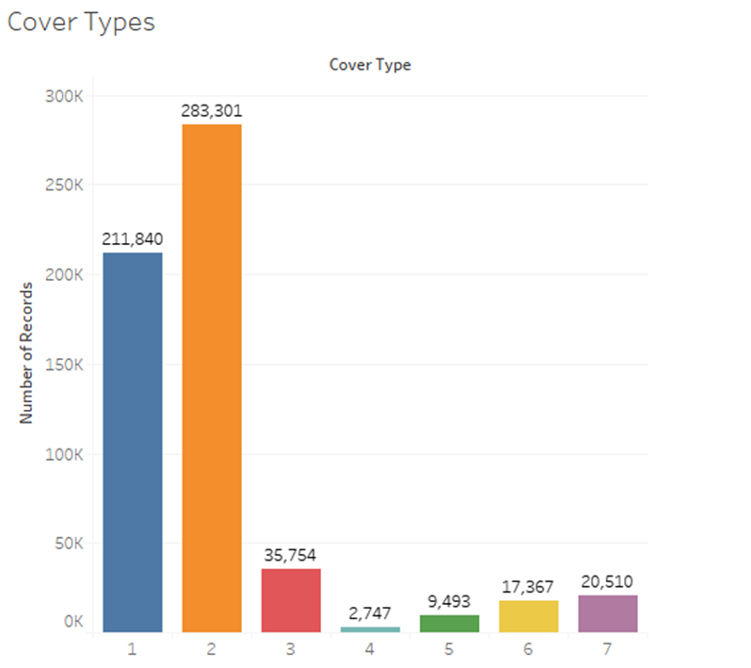
Distribution of Cover types
Highest Observations:- Lodgepole Pine
Lowest Observations:- Cottonwood / Willow

Slide 8
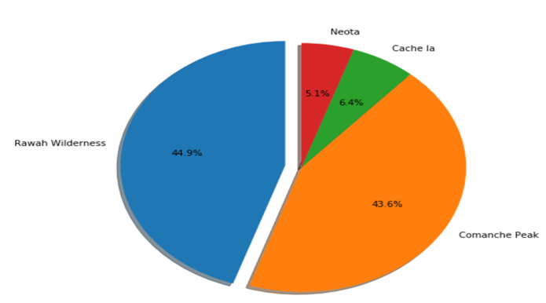
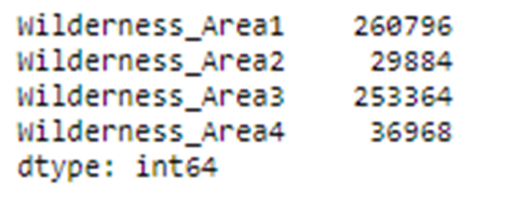
Distribution of Wilderness Area
A wilderness area is a region where the land is in a natural state; where impacts from human activities are minimal that is, a wilderness. It might also be called a wild or natural area

Slide 9
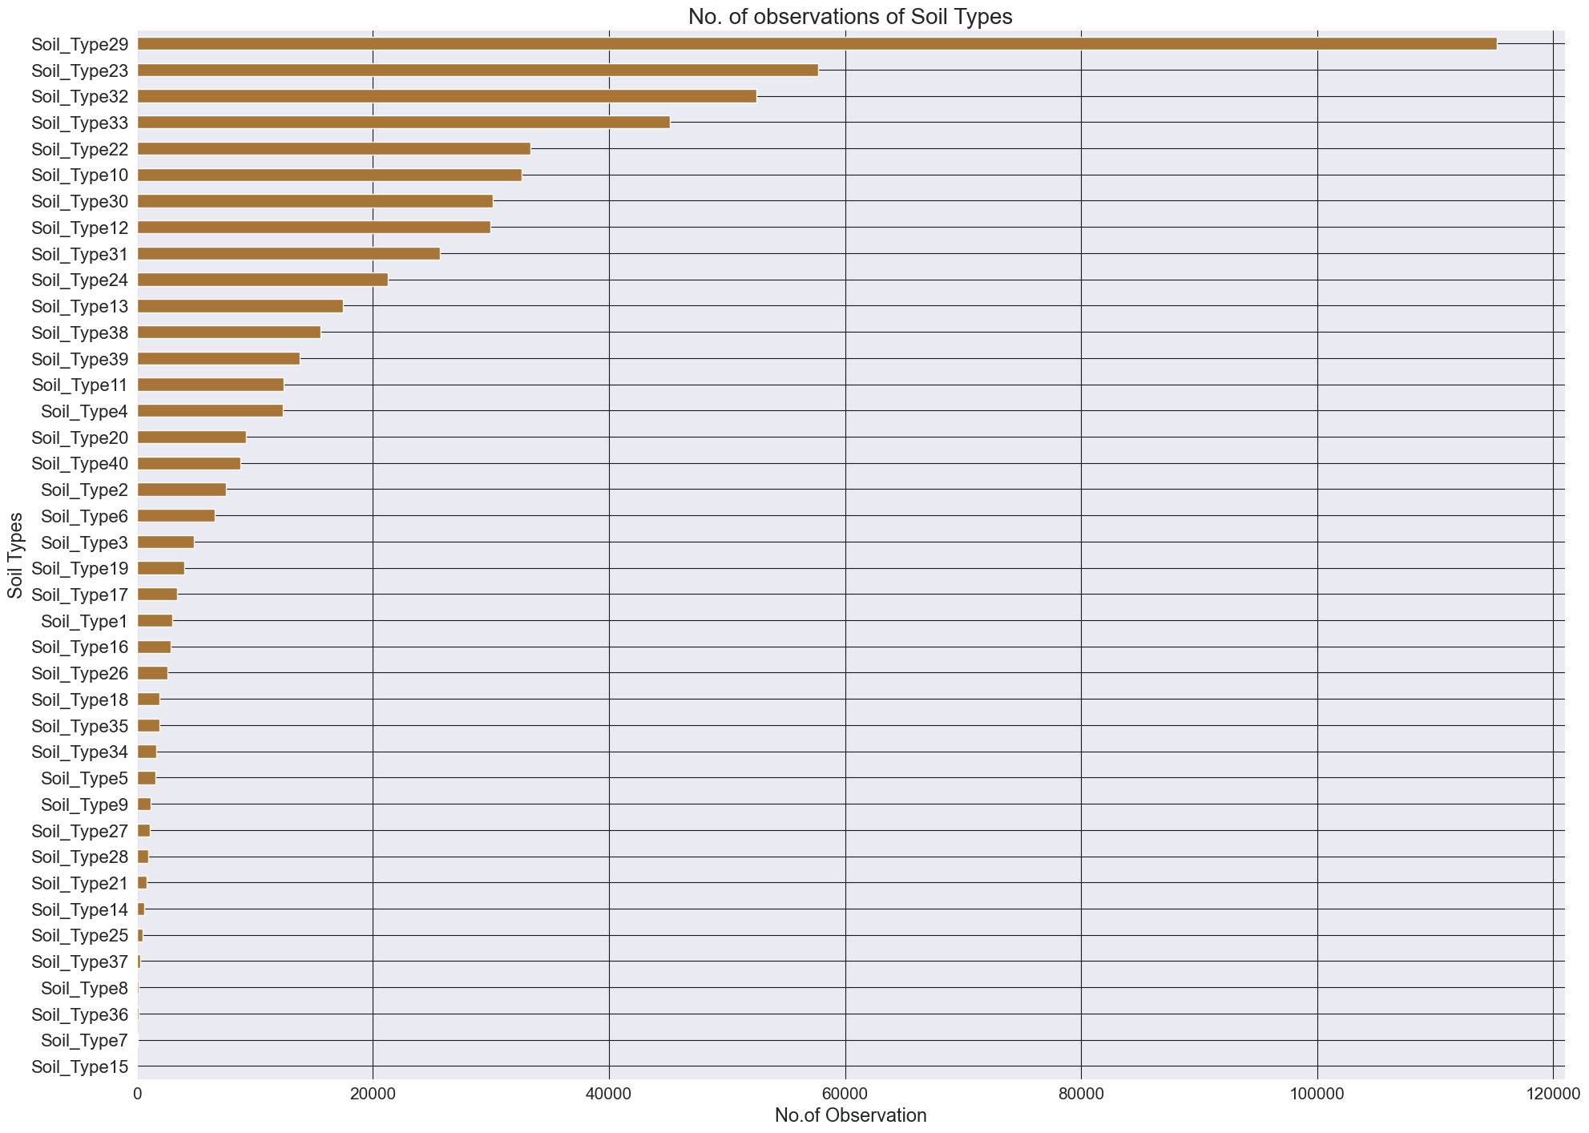
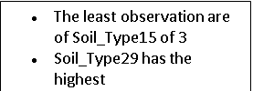
Soil type distribution

Slide 10
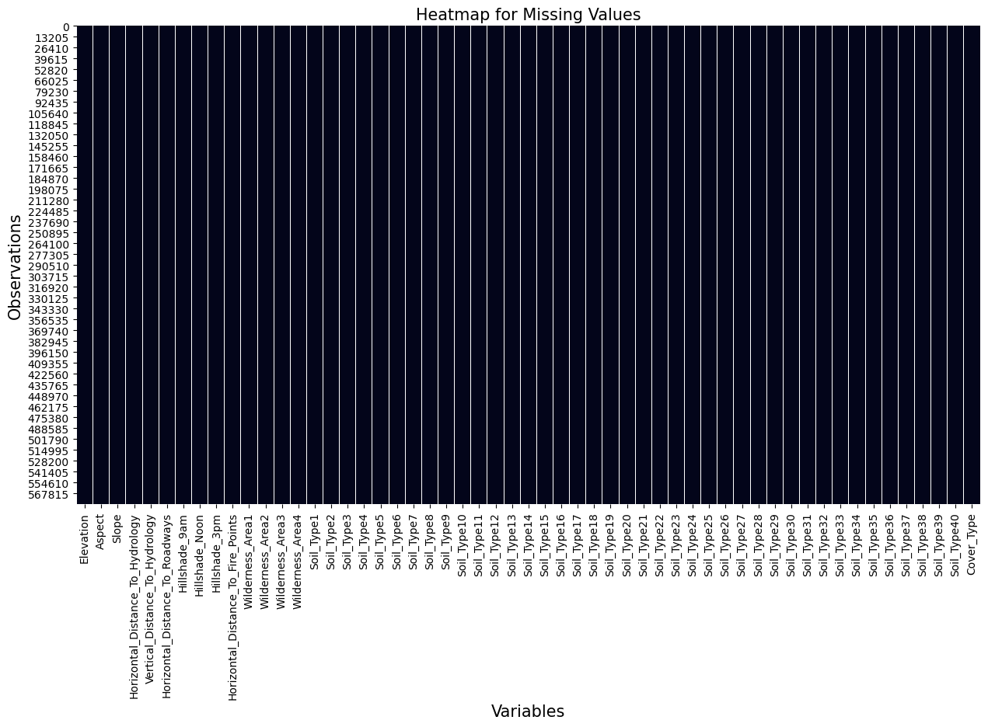
Missing values
No missing values in the dataset.

Slide 11
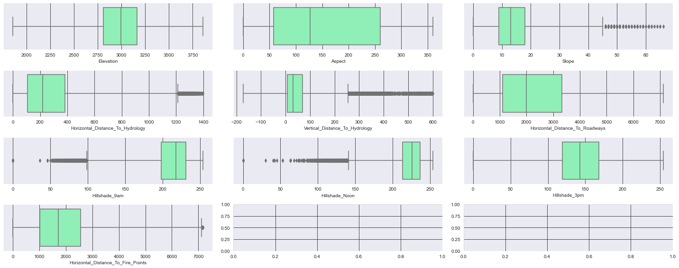
Outliers
Slope – 275 outliers
Horizontal distance to hydrology – 414 outliers
Vertical distance to hydrology – 5339 outliers.
Hill shade 9 am – 1029 outliers.
Hill shade noon - 1191 outliers.
Horizontal distance to fire points – 10 outliers.

Slide 12
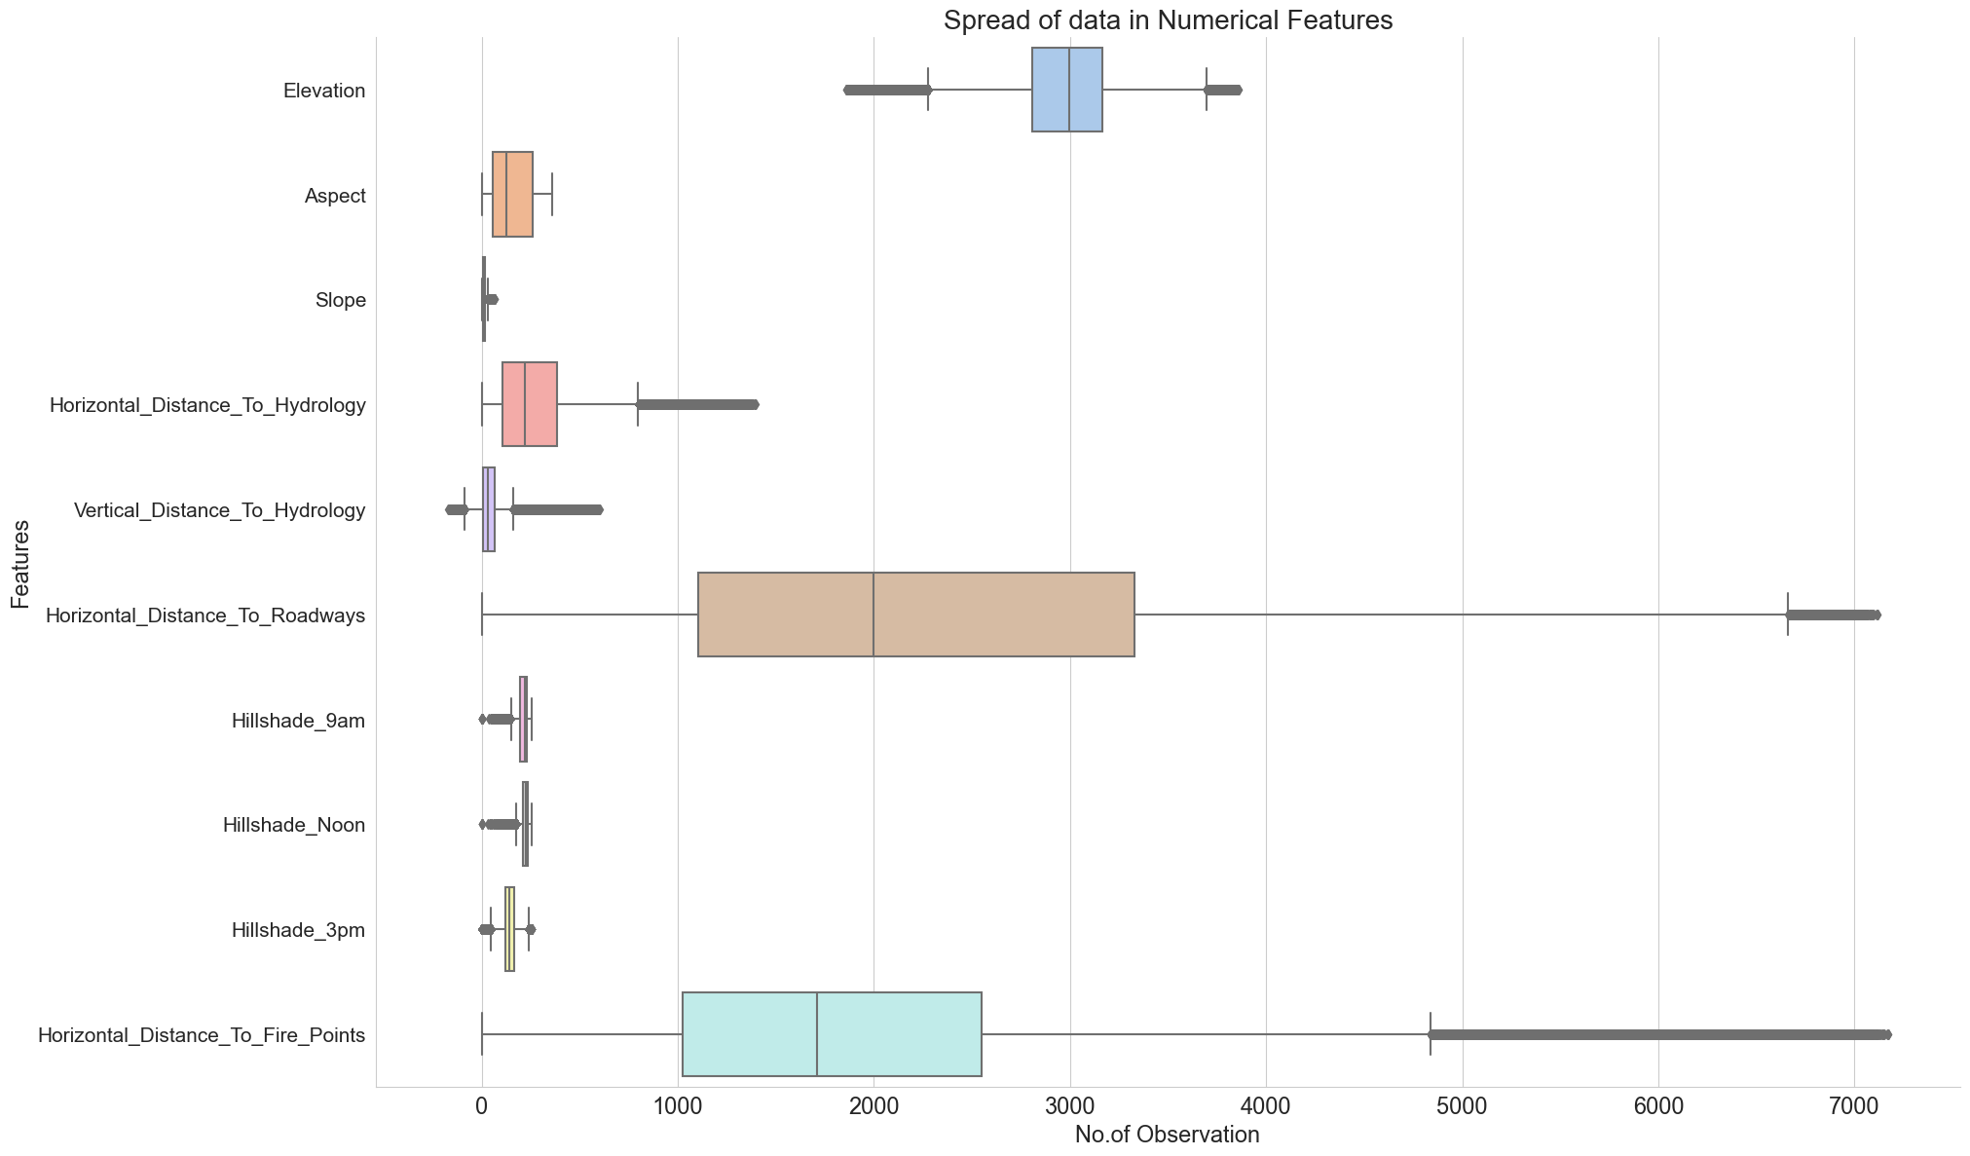
Spread of Data in Numerical features
Different numerical features have different types of spread which actually makes sense since the units are different for each feature for example aspect and slope are measured in degrees and hill shade has 0-255 index and all the other columns having units in meters which is actually the distance.

Slide 13
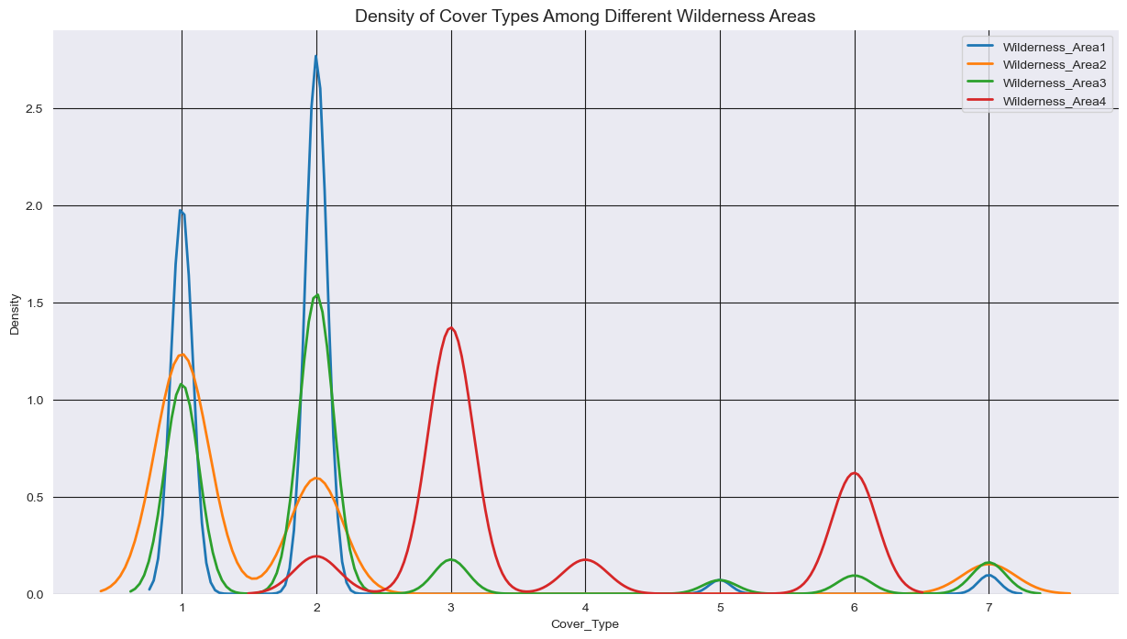
Cover Type distribution among different Wilderness Areas
This graph speaks about the type of forest cover which grows in wilderness area. For example, cover type 2(Lodgepole Pine) is majorly grown in wilderness area 1 whereas same for the remaining cover types.

Slide 14
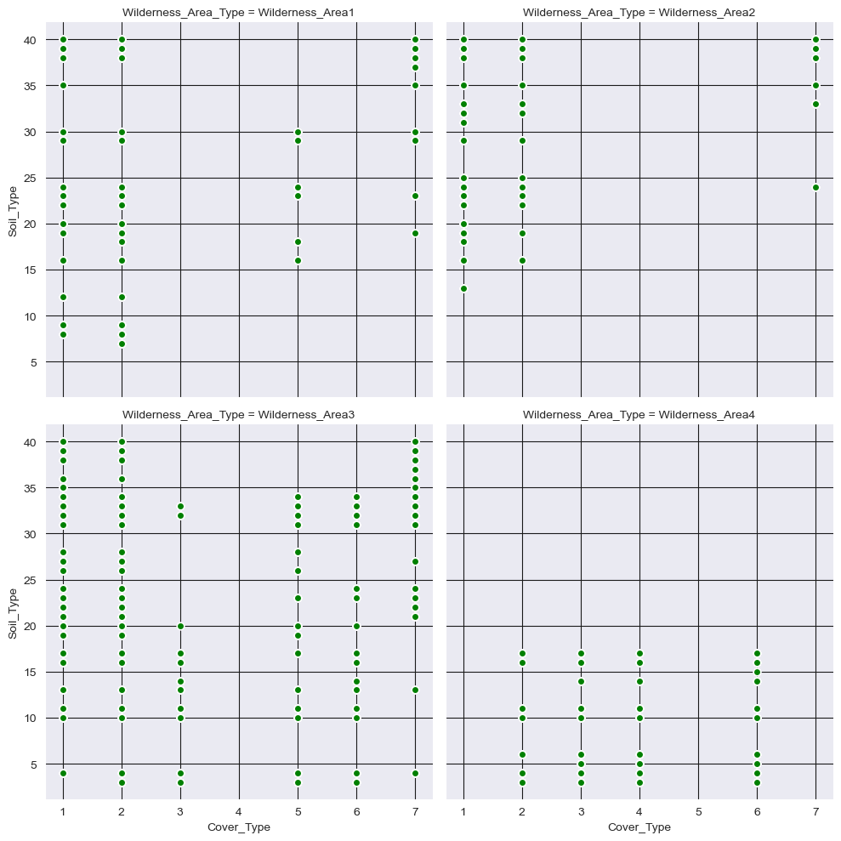
Soil Type and Cover Type relationship
This graph gives the relation between the soil type, cover type and wilderness area. We can observe that cover type-1(Spruce / Fir) is basically grown in almost all the soil types but is absent in wilderness area 4

Slide 15
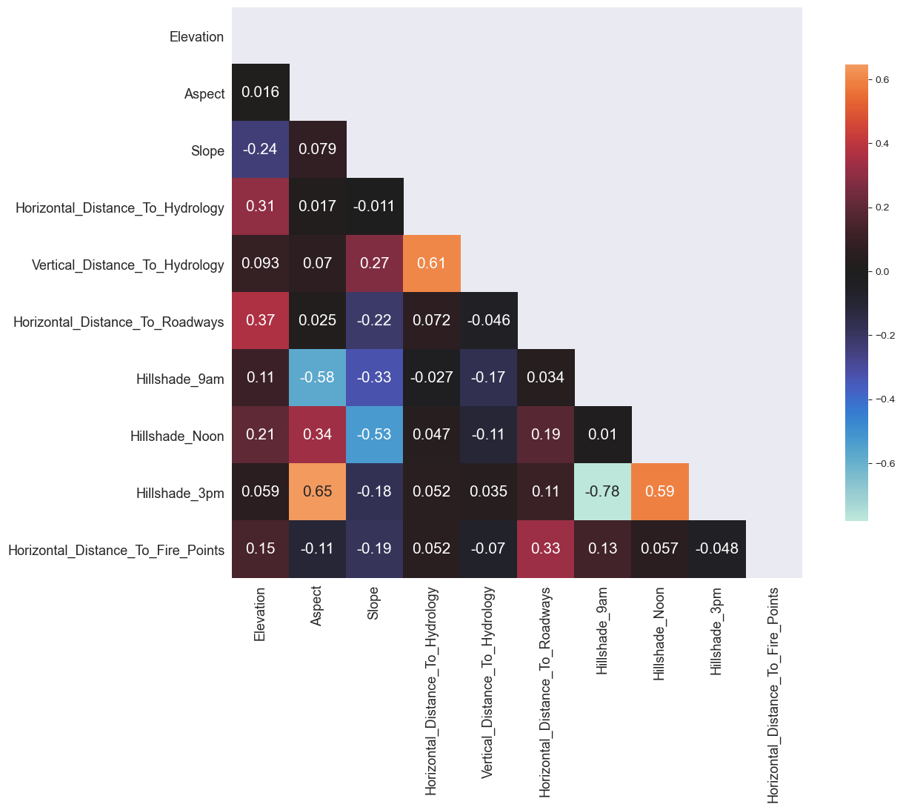
Feature Correlation
Only very few columns are correlated with each other.
Hill Shade 3 pm is the most correlated with Aspect while the most negatively correlated column is Hill shade 3 pm with Hill shade 9 am.

Slide 16
Statistical Tests
We have applied One way Anova test for all the numerical features.
Feature | P-value
Elevation | 0.0
Aspect | 0.0
Slope | 0.0
Horizontal_Distance_To_Hydrology | 0.0
Vertical_Distance_To_Hydrology | 0.0
Horizontal_Distance_To_Roadways | 0.0
Hillshade_9am | 0.0
Hillshade_Noon | 0.0
Hillshade_3pm | 0.0
Horizontal_Distance_To_Fire_Points | 0.0
Since Pvalue is less than alpha(0.05) for all continuous variables, all numerical features need to be considered.

Slide 17
Modelling
Since we already have lots of observation now to train the model, we also happen to have lots of features. This will make algorithm run very slowly, have difficulty in learning and also tend to overfit in training set and do worse in testing.
We have many options here to apply like PCA, RFE or by applying models like Random Forest, Gradient Boosting Classifiers and AdaBoost which have offer a special attribute like feature_importances_.
We thus can select important features from these models and apply these features to the final model(benchmark model).
PCA is really a good dimensionality reduction technique but the interpretation becomes difficult.
So, we have applied Random Forest and Extra trees classifier to select important features.

Slide 18
Feature Selection
We have selected the top 24 features from the models that we have built and selected the 20 common features from it and use it for the further model building, hyper tuning and fitting the final model.
As of now we will be showing the top 10 features from both the models.
ETC |  | RFC
Elevation | 0.081353 | Elevation | 0.119570
Wilderness_Area4 | 0.037032 | Wilderness_Area4 | 0.029803
Horizontal_Distance_To_Roadways | 0.019124 | Horizontal_Distance_To_Roadways | 0.021154
Horizontal_Distance_To_Fire_Points | 0.015150 | Horizontal_Distance_To_Fire_Points | 0.018126
Soil_Type22 | 0.015074 | Horizontal_Distance_To_Hydrology | 0.009345
Soil_Type4 | 0.011520 | Soil_Type4 | 0.009285
Soil_Type12 | 0.011158 | Soil_Type39 | 0.009167
Soil_Type38 | 0.010800 | Soil_Type10 | 0.008397
Soil_Type10 | 0.010212 | Vertical_Distance_To_Hydrology | 0.007866

Slide 19
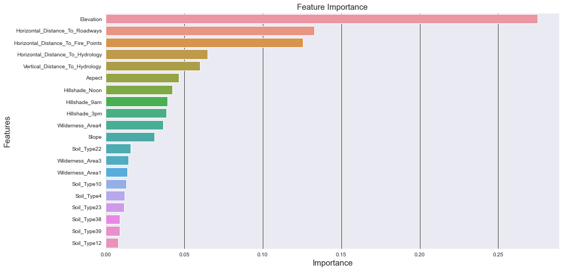
Important Features

Slide 20
Base Model
Logistic Regression Model
Accuracy Score: 71.11 %
F1 Score : 70.03 %
Time taken to train: 0.741 minutes
Random Forest Model
Accuracy Score: 95.53 %
F1 Score : 95.33 %
Time taken to train: 2.175 minutes

Slide 21
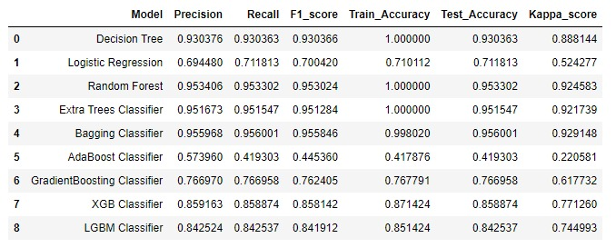
Scorecard for all the models
Bagging Classifier gets the highest accuracy score of 95.6%. There is no much difference in Bagging and Random Forest(95.3%). Here we can clearly see that boosting models have underperformed for this data. All time perfect models like XGB, LGBM were also unable to beat the scores of Random Forest.

Slide 22
Model Evaluation
Logistic Regression: Bias error: 0.302615 Variance error: (0.001191)
Decision Tree: Bias error: 0.086397 Variance error: (0.000339)
Random Forest: Bias error: 0.057938 Variance error: (0.000570)
Extra Trees Classifier: Bias error: 0.059552 Variance error: (0.000521)
Bagging Classifier: Bias error: 0.055538 Variance error: (0.000610)
AdaBoost Classifier: Bias error: 0.509208 Variance error: (0.097116)
Gradient Boosting Classifier: Bias error: 0.239631 Variance error: (0.000272)
XGB Classifier: Bias error: 0.141273 Variance error: (0.001736)
LGBM Classifier: Bias error: 0.160006 Variance error: (0.002158)

Slide 23
Model Evaluation
These were the scores of the models before tuning.
Logistic Regression has highest bias error when compared to all the other models with a bias error of 0.302.
Even in terms of bias and variance error we are having the best scores for Random forest only with the scores as bias: 0.057 and variance: 0.0005.
Bagging Classifier as well working the same way as Random Forest having the least bias and variance errors.
We can even try the GridSearchCV to reduce the bias and variance error. We can also observe that boosting models have failed enormously to work well on this dataset.

Slide 24
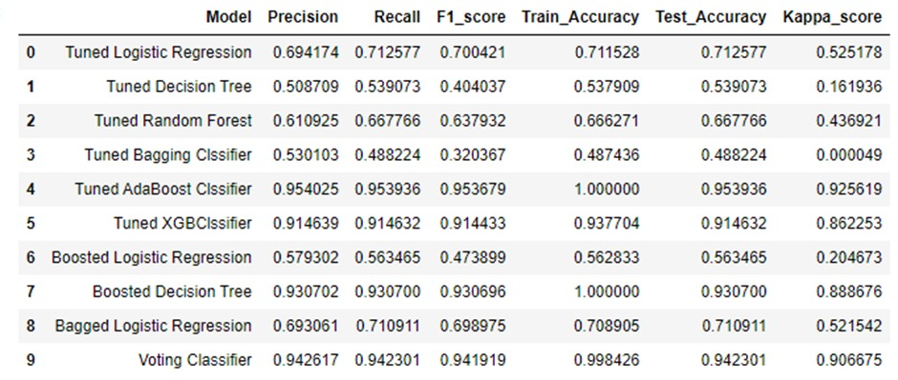
Scorecard for tuned models
Tuned XGB Classifier has performed well in terms of both train and test data. We can see that tuned Adaboost(Boosted random Forest) has good accuracy but it’s a kind of overfitting. So we can choose XGBClassifier as the benchmark model.

Slide 25
Model Evaluation
Tuned Logistic Regression: Bias error: (0.301092) Variance error: (0.000579)
Tuned Decision Tree: Bias error: (0.597329) Variance error: (0.001018)
Tuned Random Forest: Bias error: (0.364767) Variance error: (0.000240)
Tuned Bagging Classifier: Bias error: (0.672976) Variance error: (0.013632)
Tuned Adaboost Classifier: Bias error: (0.057788) Variance error: (0.000983)
Tuned XGBClassifier: Bias error: (0.092892) Variance error: (0.000103)
Boosted Logistic Regression: Bias error: (0.526824) Variance error: (0.003304)
Boosted Decision Tree: Bias error: (0.086657) Variance error: (0.000310)
Bagged Logistic Regression: Bias error: (0.303396) Variance error: (0.000535)
Voting Classifier: Bias error: (0.069323) Variance error: (0.000303)

Slide 26
Model Evaluation
These are the scores obtained after performing hyper parameter tuning using GridSearchCV.
We are having less Variance and bias errors for three models - Tuned AdaBoost Classifier, Tuned XGB Classifier and Voting Classifier.
Tuned Adaboost which is nothing but boosted Random forest having the least bias error and tuned XGB Classifier is having least variance error.
Fundamentally, the question of the best model is about finding a sweet spot in the trade-off between bias and variance.
Now to select the best model we have to compromise on either the bias or variance error. There is always this bias-variance trade off.
Here, we are selecting Tuned XGB Classifier as the best model over the Random Forest because overfitting can generate more false positives which is not appreciable.

Slide 27
Conclusion
Coming back from where we have started, can we predict which Forest Cover Type it is, given elevation, hydrologic, sunlight and wilderness area data? **Yes we can!
Tree models are your best friends in predicting forest cover types.
Various feature engineering techniques performed on the datasets to improve over the primary data-set.
Tuned XGB Classifier performed so well giving a training accuracy of 93% and testing accuracy of 91%.
Benchmark model:- Tuned XGB Classifier.

Slide 28
References
Machine learning Workflow
Blackard, Jock A. and Denis J. Dean. 2000. "Comparative Accuracies of Artificial Neural Networks and Discriminant Analysis in Predicting Forest Cover Types from Cartographic Variables." Computers and Electronics in Agriculture
Forest Cover Type Prediction | Kaggle
Text books referred
Python Data Science Handbook: Essential Tools for Working with Data - Book by Jake VanderPlas

Slide 29


