Slide 1
Airport data analysis

Slide 2
Table of contents :
Project Area
Literature Survey
Problem Statement
Github Repositories
Conclusion

Slide 3
Project Area :
This project is based on Data analytics (DA) i.e, The analysis is for different airports from which the airlines depart and arrive. when is the best time to book a flight

Slide 4
Literature Survey :
S. No | Authors | Publishing | Techniques | Title | Cons&pro
1 | Ankita Rane, Anand Kumar | IEEE | Decision Tree classifier , Random Forest Classifier | Sentiment Classification System of Twitter Data for US Airline Service Analysis | Accuracy of 85% Only twitter Based Model, can become more stronger.
2 | Haiman Tian , Maria Presa-Reyes , Yudong Tao , Tianyi Wang , Samira Pouyanfar , Alonso Miguel , Steven Luis | ACM COMPUTING SURVEY | Semantic Network Analysis , Linear Regression Analysis | Data Analytics for Air Travel Data: A Survey and New Perspectives | Enhances the customers satisfaction using CONCOR analysis
3 | Eunil Parka,∗ , Yeonju Janga , Jina Kima , Nam Jeong Jeonga , Kunwoo Baea , Angel P. del Pobil. | Journal of Retailing and Consumer Services, Volume 51 | SEM method is employed using data | Determinants of customer satisfaction with airline services: An analysis of customer feedback big data | socio-demographic factors are not taken into consideration

Slide 5
Problem statement :
Analyze the flight status (on time, delayed, cancelled) month wise and airline wise. Also have a look at average delay time for that duration.
Air traffic analysis is to be performed which gives insights as when is the best time to book a flight and what is the peak hour when the maximum, flights are available.

Slide 6
Github repositories
https://github.com/Aruntejreddy/POWERBI

Slide 7
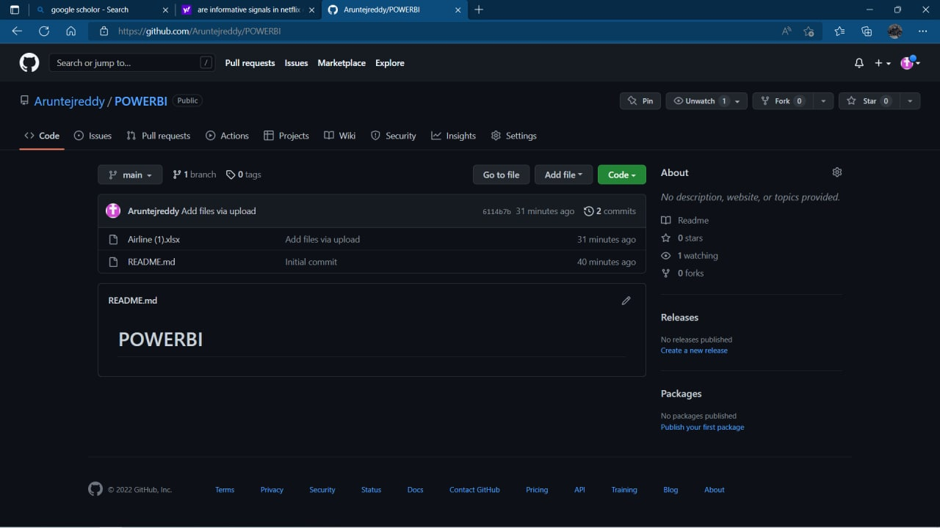
Github repositories

Slide 8
Conclusion :
We hope that the model will provide a reference for people, when is the best time to book a flight what is the peak hour when the maximum, flights are available . this help customer to when to buy flights tickets very less price

Slide 9
THANKS!

