Slide 1

SMART INDUSTRIAL SAFETY MONITORING SYSTEM
Embedded C & Microcontroller Programming Hackathon – 2026
Presented by:
Team Calm Ninjas
Government College of Engineering, Erode

Slide 2

Introduction
Industrial environments contain many risks such as gas leakage, overheating machines, and abnormal vibrations.
Traditional monitoring systems require manual checking and cannot provide real-time alerts.
To improve industrial safety and prevent accidents, an automated smart monitoring system is required.
Our project uses ESP32 and IoT technology to continuously monitor important industrial parameters.

Slide 3

Problem Statement
Industries face several safety challenges:
• Gas leakage may cause explosions or health hazards
• High temperature can damage machines
• Excess vibration may indicate machine failure
Traditional monitoring systems:
Do not provide real-time alerts
Lack remote monitoring
Cannot predict equipment failure
Therefore, a smart embedded system is needed for industrial safety monitoring.

Slide 4

Objective
The main objective of our project is:
To design a Smart Industrial Safety Monitoring System using ESP32 programmed in Embedded C.
The system aims to:
• Monitor temperature, gas leakage, and vibration levels
• Generate alerts during unsafe conditions
• Provide real-time cloud monitoring
• Improve industrial safety and reliability

Slide 5

Proposed System
Our system uses an ESP32 microcontroller to collect data from sensors.
The ESP32 processes sensor data and checks whether the values exceed safety limits.
If any abnormal condition occurs:
LEDs turn ON
Buzzer gives alert
Data is sent to a cloud dashboard for monitoring.
This allows industries to monitor machines remotely in real time.

Slide 6

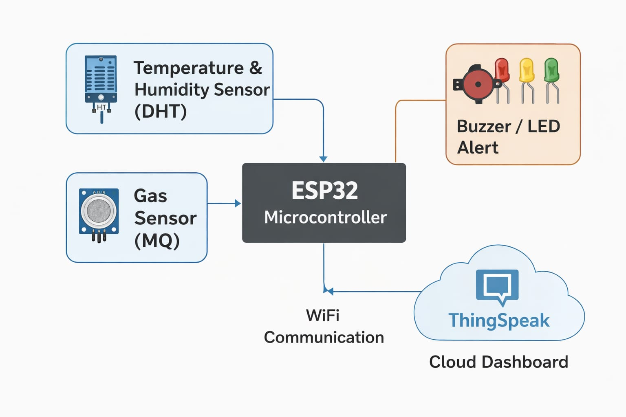
System Architecture
System Flow:
Sensors → ESP32 Controller → Alert System → Cloud Dashboard
Components involved:
• Gas Sensor
• Temperature Sensor
• Vibration Sensor
• ESP32 Microcontroller
• LEDs and Buzzer
• Wi-Fi Cloud Dashboard

Slide 7

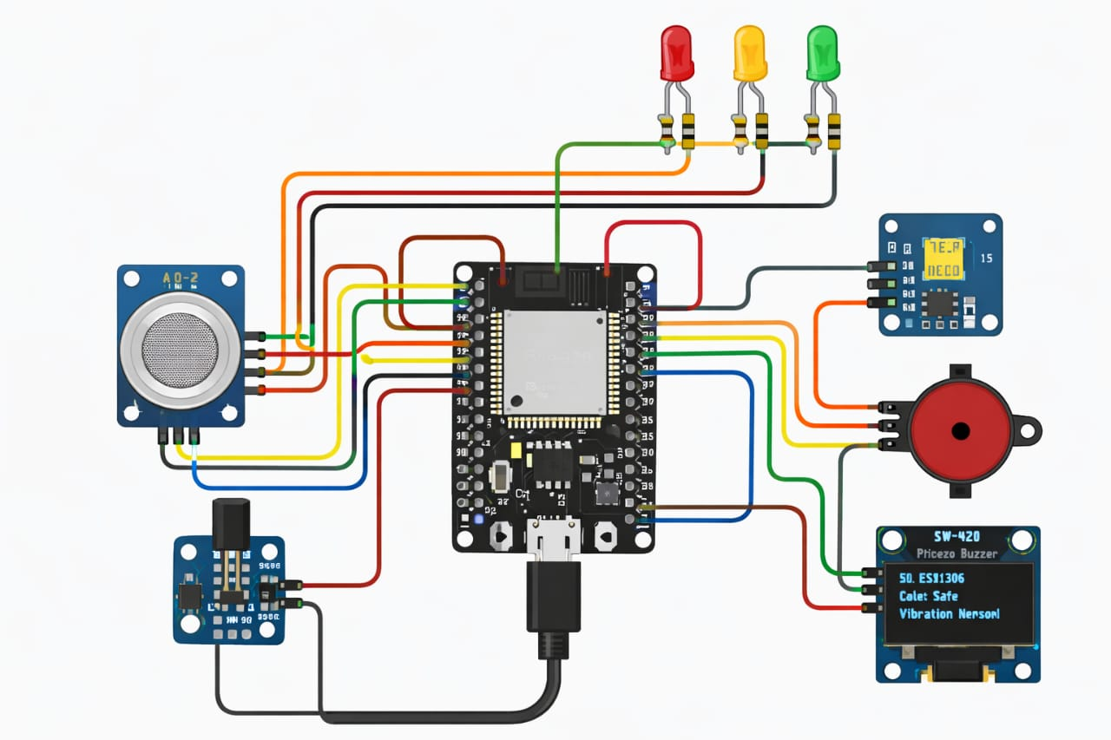
Hardware Components
The main hardware components used in our project are:
• ESP32 Development Board
• Gas Sensor
• Temperature Sensor
• Vibration Sensor
• LED indicators
• Buzzer for alert
• LCD Display
• Power Supply
• Connecting wires

Slide 8

Software Tools
Software used in our project:
• Arduino IDE – for programming ESP32
• Embedded C language
• Serial Monitor – for debugging
• IoT Dashboard / Blynk – for cloud monitoring
These tools help us develop and monitor the system easily.

Slide 9

Working Principle
Sensors collect environmental data from the industrial environment.
ESP32 reads sensor values using ADC and GPIO pins.
The system continuously checks whether values exceed predefined limits.
If danger is detected:
Buzzer produces alert sound
LEDs indicate warning
Data is sent to the cloud dashboard
Users can monitor the system remotely through the IoT dashboard.

Slide 10

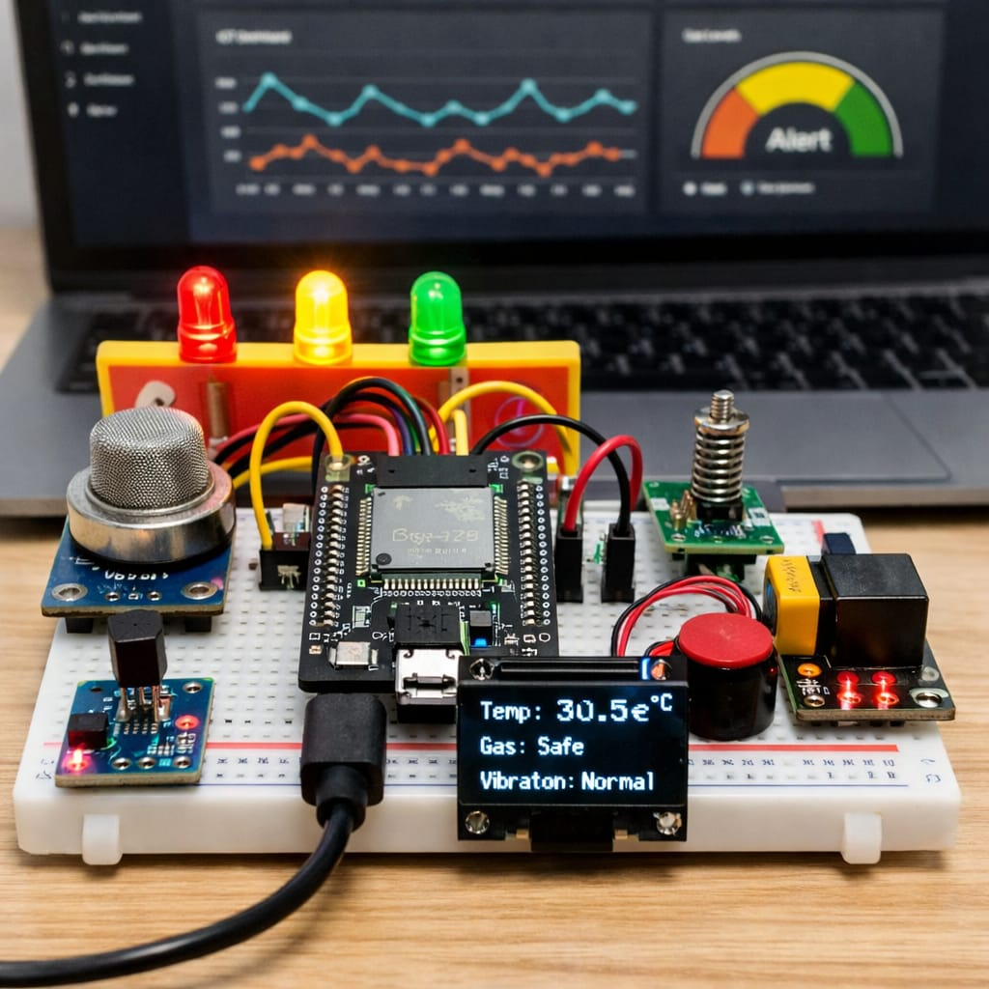
Expected Outcomes
The expected results of this project are:
• A functional smart industrial monitoring system
• Real-time safety alerts
• Remote monitoring through IoT dashboard
• Improved safety and accident prevention
• Modular Embedded C firmware design

Slide 11

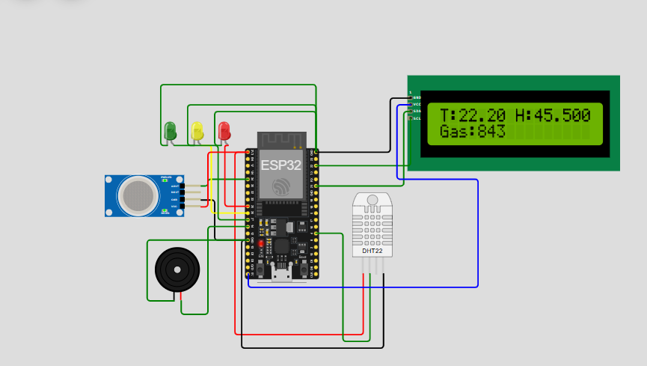
OUTPUT

Slide 12
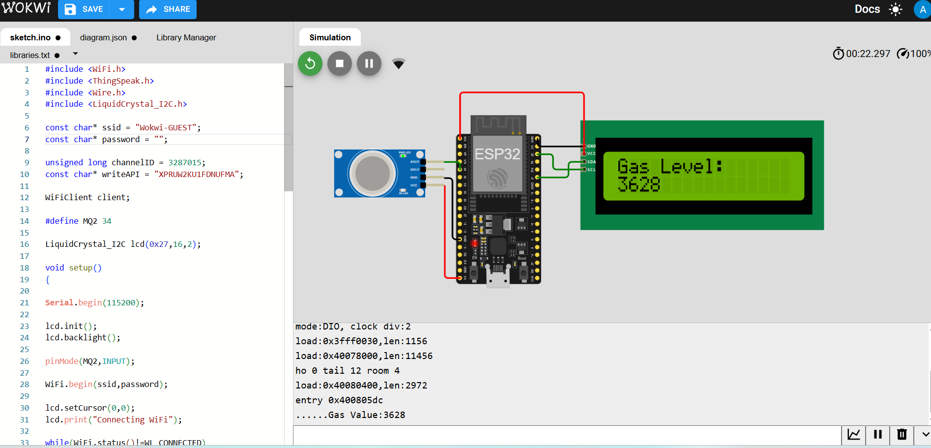

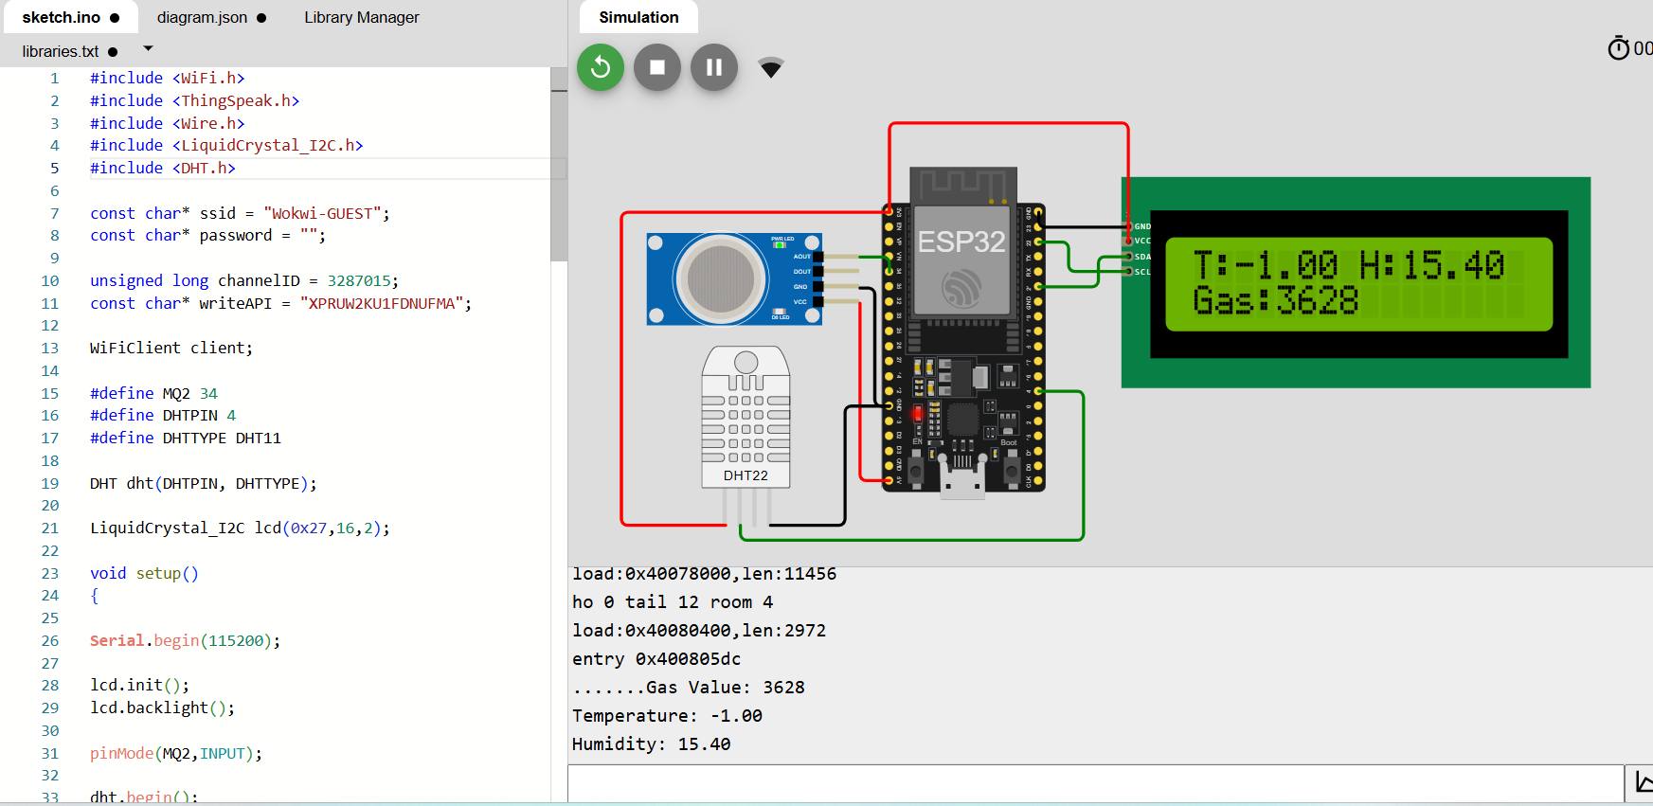
GAS LEVEL
T
TEMPERATURE AND HUMIDITY LEVEL

Slide 13
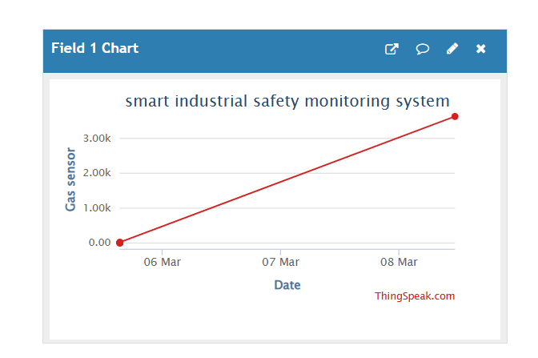

Slide 14
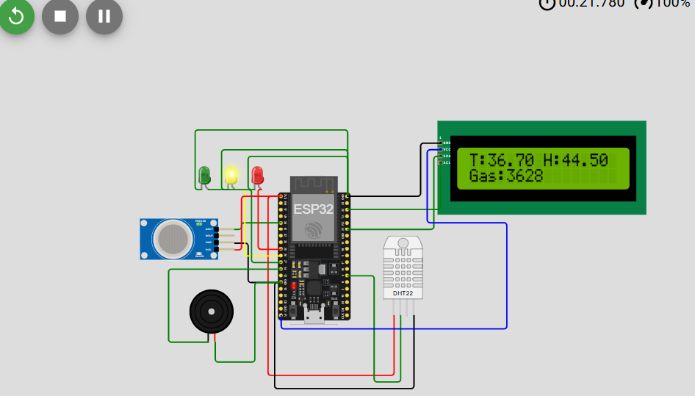
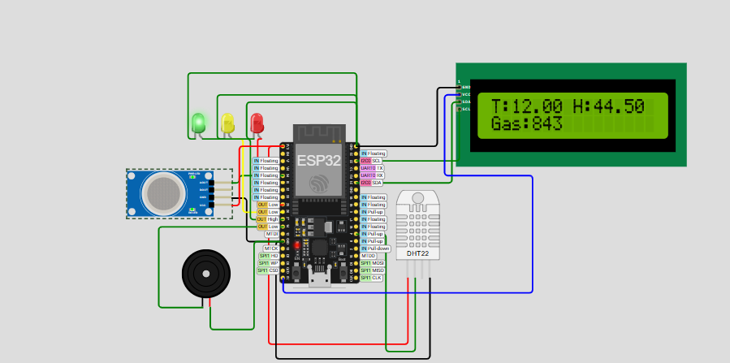

Slide 15
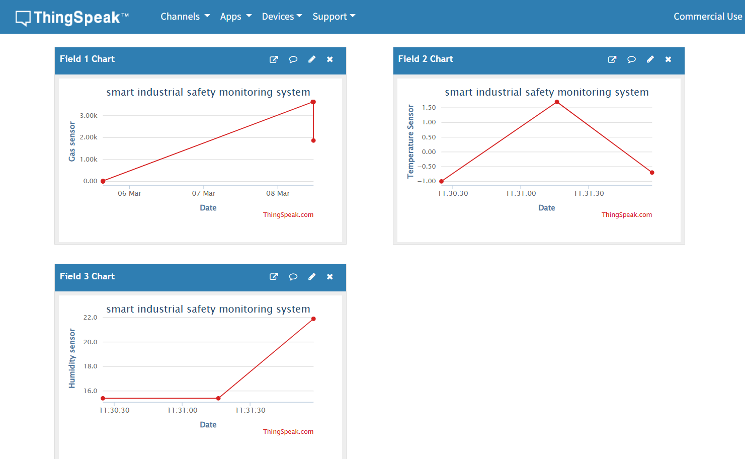

Slide 16
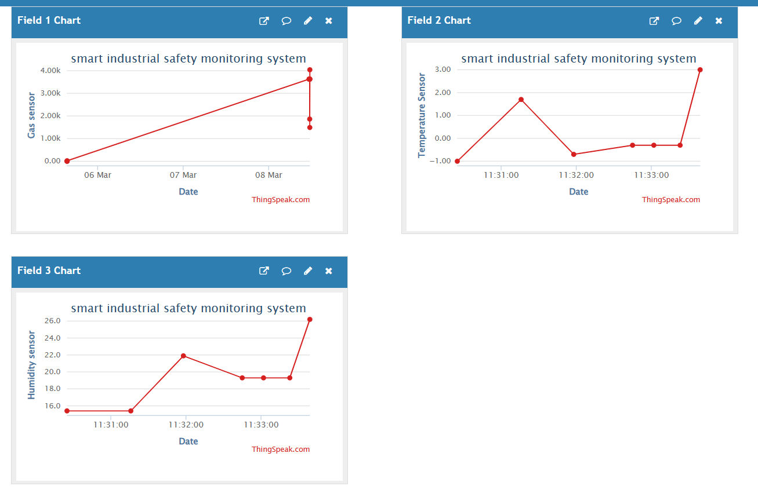

Slide 17
Conclusion
Our Smart Industrial Safety Monitoring System helps industries monitor safety parameters efficiently.
The system provides real-time alerts and remote monitoring, which helps prevent accidents and equipment failure.
This solution improves industrial safety, reliability, and operational efficiency.

Slide 18

THANK YOU
BY PROJECT DEVELOPMENT TEAM
Thirisha K
Kayalvizhi M
Arunthathi M

