Slide 1

MyParker : A complete Parking Solution

Slide 2
Development Team
Sreejith Thrivikraman (C0726943)
Lakshmi Priya (C0732069)
Arun Thekkoot Sasi (C0729525)

Slide 3
MyParker : An Overview
MyParker is a Car parking android application designed to deliver an easier and fastest vehicle parking experience for the end user .
With MyParker, the end-user don’t have to follow the traditional way of driving around the parking lot to find the free parking space as this application does the same for you in seconds.
This application saves the user’s time by locating his parked car so as making the user to easily locate his/her vehicle.
Forget about the confusing payment kiosks and annoying tickets

Slide 4
MyParker : Vision and Purpose
To deliver a fastest and easiest vehicle parking experience to the user in a busy and dynamic urban environment.
A solution that is at the reach of every common individual, irrespective of age and financial situation

Slide 5
Sprint Planning
Sprint 1
4 – 7 Apr
Sprint 2
8 -12 Apr
Sprint 3
13 – 16 Apr
Sprint 4
17 – 19 Apr
Research for available services
Login Screen Design
Registration Screen Design
Home Screen Design
Login Screen Coding and validation
Unit Testing and review for Login screen
Parking Location screen design and coding
Parking Report Screen design and coding
Parking Payment Receipt screen design and coding
Unit testing and review for parking Location.
Registration Screen coding and validation
Home Screen coding and validation
Parking Manual
User Profile screen design and coding
Unit Testing
Support Contact- Screen Design, coding and validation
Logout functionality
Final Testing
Project completion

Slide 6
Minimum System Requirements
Android powered hand held device
Android Version : Ice Cream Sandwich 4.0.1 (API level 14 )
GPS access
Internet access.

Slide 7
MyParker :
Major Requirements at focus
To design and develop a parking solution app that :
Uses a map functionality to locate the geo-location of the user.
Functionality to record the time, date and parking lot at the locked location
Billing based on the time elapsed at the parking lot.
Functionality to implement the record keeping of previous parking history.
Functionality to keep track of the user profile.
Functionality to provide a easy-to-use user guide for the app
Functionality for live support for the end-user.

Slide 8



MyParker :
Scope in open market and business scenario
Individual and organizational participation
Bringing individuals, organizations and neighborhood onboard to contribute adding more parking area which keeps on expanding the parking map across the region.

Slide 9



MyParker :
Scope in open market and business scenario
Monetizing free space and time in a more reliable manner
Individual’s space and time could be invested for parking through MyParker and they will receive a share of the profit.

Slide 10





MyParker :
Scope in open market and business scenario
Location and time based pricing of lots:
More pricing for urban parking lots, lesser for the suburbs.
Increased pricing at peak times.
Hourly promotions and offers during peak time.
Reduces the traffic congestion in downtowns and major metropolises.

Slide 11
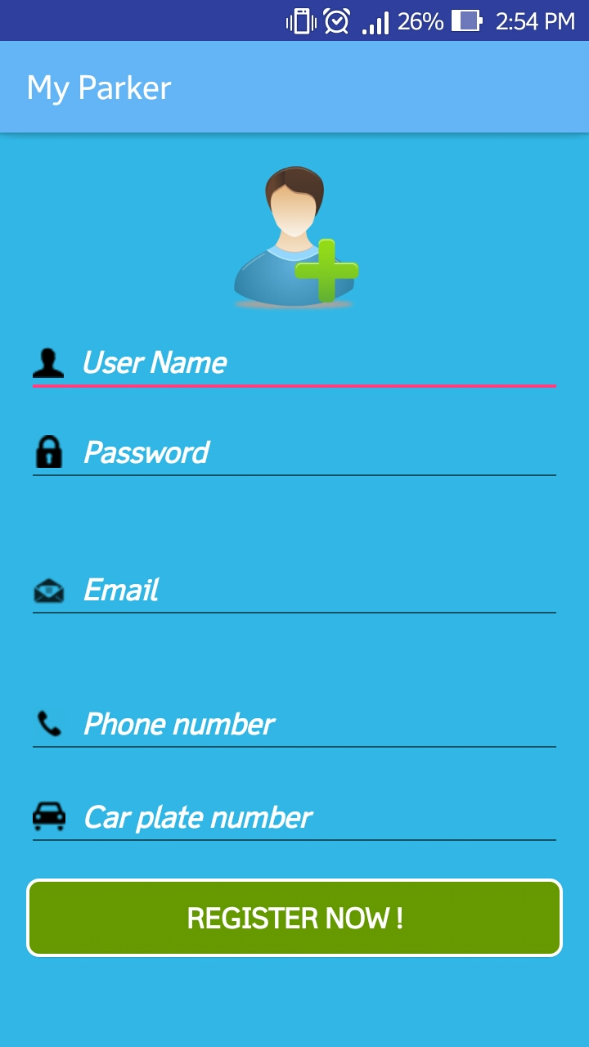
REGISTRATION
To GET REGISTERED
Enter
Username
Password
Email ID
Phone Number
Car Plate Number
Then click on REGISTER NOW !

Slide 12
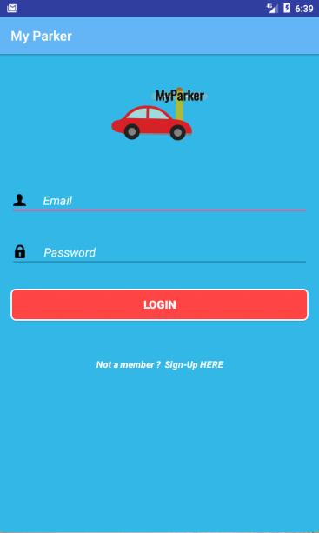
LOGIN SCREEN
GETTING STARTED
Login to the app using your registered
Email ID and Password.

Slide 13
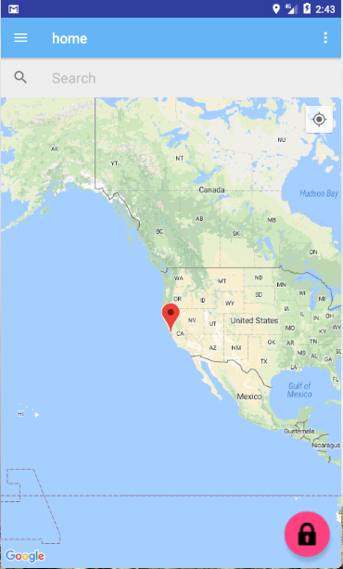
HOME SCREEN
After Login the Home page is
displayed with a Map.

Slide 14
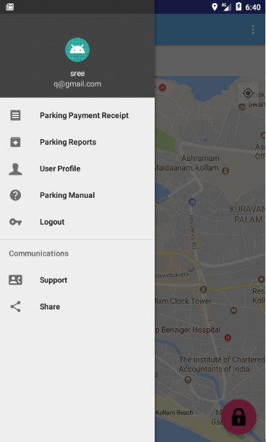
HOME SCREEN
The Navigation Panel is shown with the following options:
Parking Reports
User Profile
Parking Manual
Logout
Support
Share

Slide 15
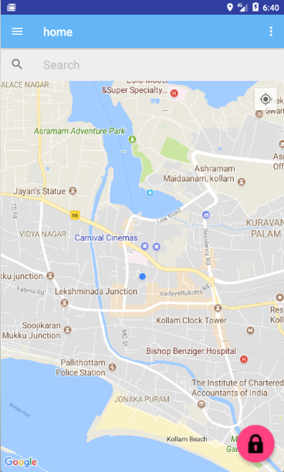
Locking a parking spot
The app will directly locate our current location in the home screen.
To lock the parking spot, tap on the lock button ( FAB ).

Slide 16
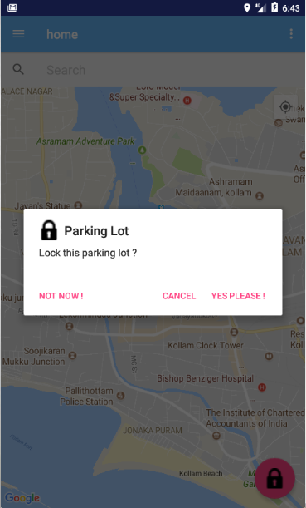
Once the lock button is tapped, confirmation dialog box will be popped up to confirm locking.

Slide 17
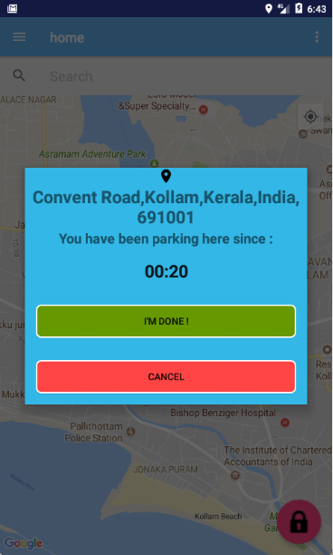
Once the parking lot is confirmed, the parking session will be initiated with the timer.
The parking session will display the time elapsed and the parked location.
To finish the parking session, tap the green button.

Slide 18
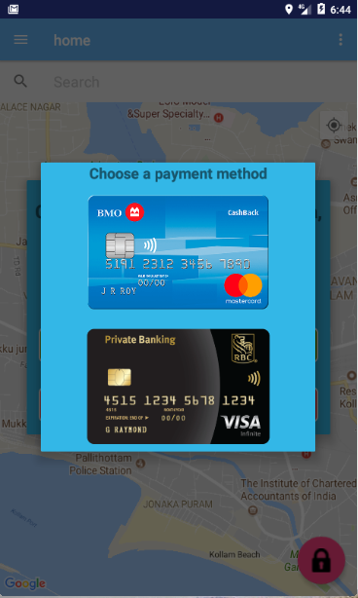
Once the parking session is completed, the user will be directed to the payment portal dialog box.
Choose the mode of payment either using credit or debit card.

Slide 19
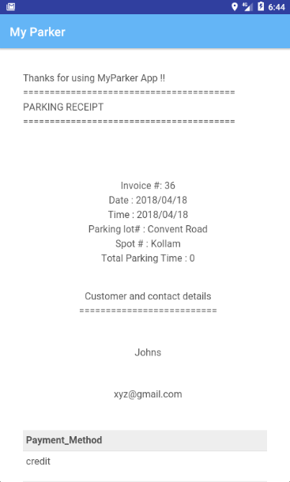
Once the payment is done ,the parking receipt will be printed.

Slide 20
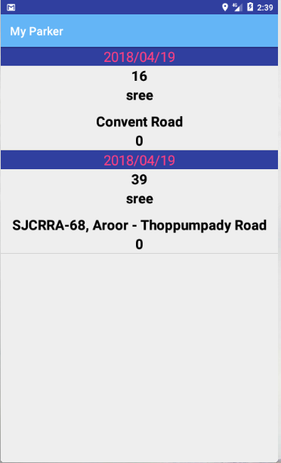
PARKING REPORT
This generates the parking reports of all the parking done so far.
This makes it convenient for the user to identify all the parking the user had done.

Slide 21
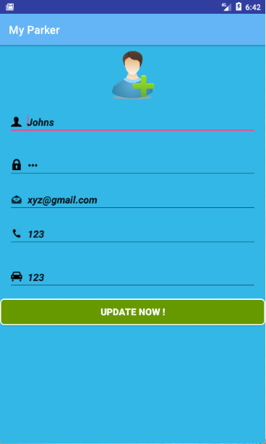
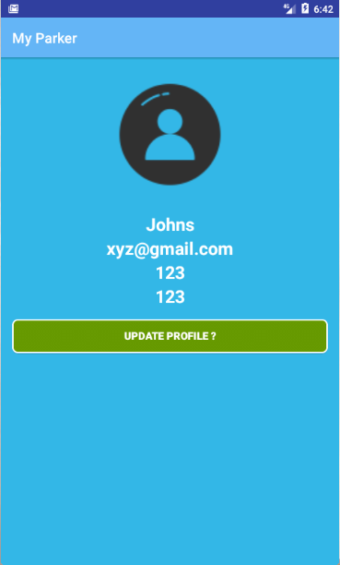
USER PROFILE
Home Screen > Navigation Bar > User Profile
You can edit your personal details ie;
User Name,
Email ID, update.png
Phone Number,
Password
Car Plate Number
in the user profile screen.

Slide 22
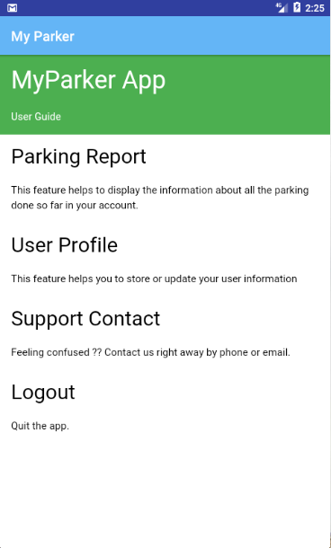
PARKING MANUAL
Instructions for using the application can be found on the parking manual.
Get more info on parking zones, parking fee, payment modes and parking penalties

Slide 23
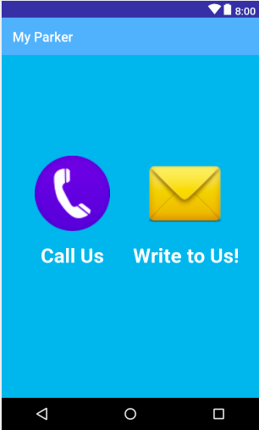
SUPPORT CONTACT
For any help the user can contact our customer care service via Phone or Email.

Slide 24
LOGOUT
By clicking the LOGOUT, we can EXIT the application.

Slide 25
MyParker :
Best Practices and Industry Standards Followed
Following steps has been followed to keep in track with the industry
standards and quality:
Simple UI design for each activity.
Testing for all possible scenarios.
Documentations
Testing documents :
→ Test Plan document.
→ Test Result document
Development and Design Documents :
→ Technical design document

Slide 26
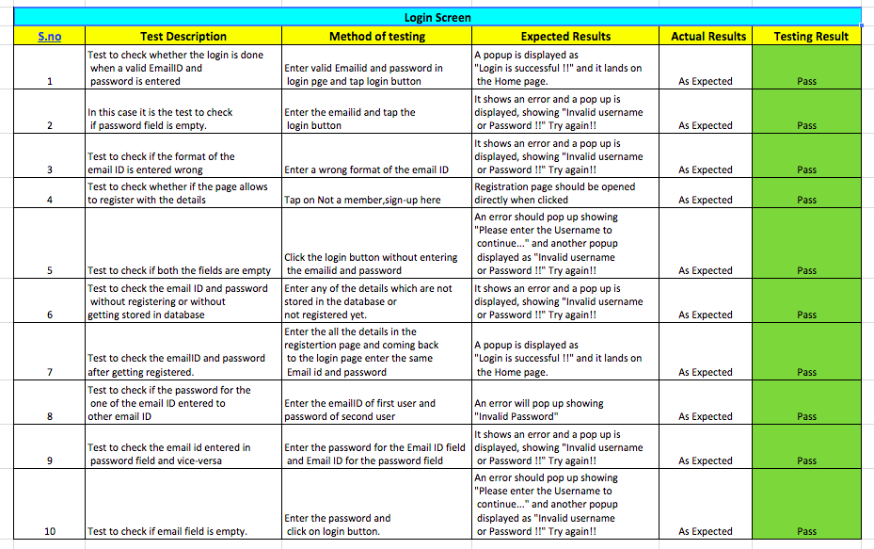
Test Result Document : Sample

Slide 27
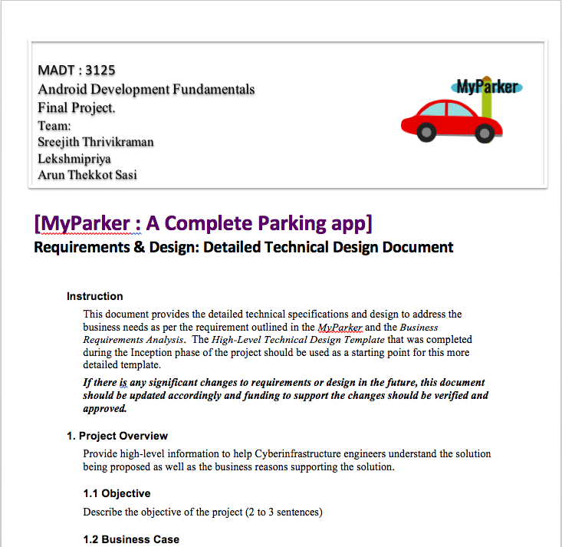
Technical Design Document : Sample

Slide 28

MyParker :
Competitor's Products
Following is one of the top rated parking app in Google Play
BestParking (ParkWhiz Inc)
Available in 105 cities and 115 airports throughout North America,
It will find you the best spot, no matter where you are.
It sorts spots by price, so visualisation of most affordable lots
are projected to the user.

Slide 29
MyParker :
Legal Requirements
Following are the legal dependencies for the MyParker App
Data security for the personal ,renting lot information.
Encryption of payment options for banking information and transactions
Legal verification of new users registering into the product by means of phone or Photo IDs.

Slide 30
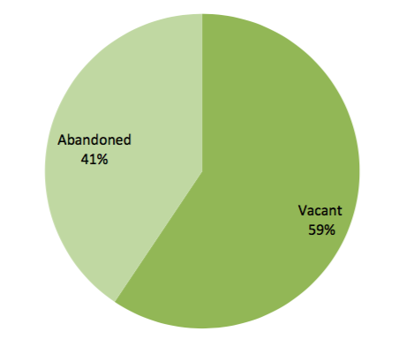
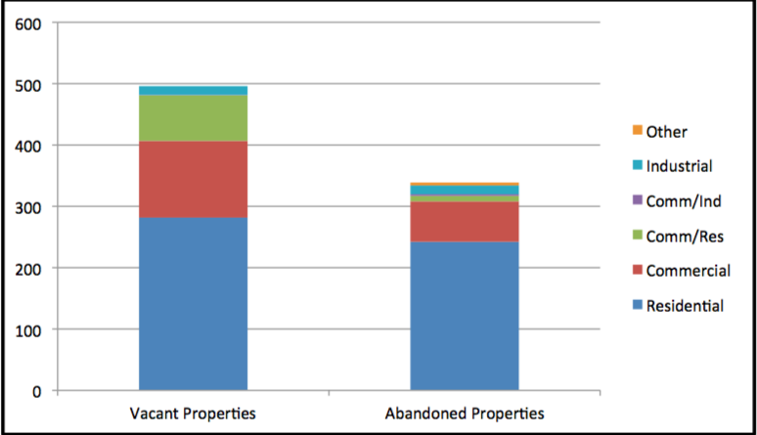
MyParker :
Projected adoption rate
As per the 2014 analysis report* of vacant and abandoned properties in Toronto, by Vanessa Fletcher
Of vacant properties, 57% were residential, 40% commercial and 3% industrial.
Most notably, of abandoned properties, 71% were residential.
This means that in Toronto, vacancy and abandonment is most often found in the residential housing stock.”
Notes:
*(ANALYSIS OF VACANT AND ABANDONED PROPERTIES IN THE CITY OF TORONTO” by
Vanessa Fletcher –
http://digital.library.ryerson.ca/islandora/object/RULA%3A3329/datastream/OBJ/download/
Analysis_of_vacant_and_abandoned_properties_in_the_City_of_Toronto_.pdf )

Slide 31
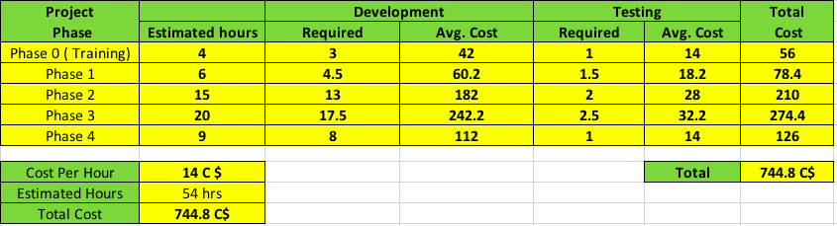
MyParker :
Project estimation
Resources
Total Resources : 3
Development resource : 2
Testing resource : 1

Slide 32
DIFFICULTIES FACED
Database connection issues
HTML Parsing for web view
Embedding Map functionality into the application
Conversion of latitude and longitude into street address
Challenge in accessing the files in “assets” folder.

Slide 33



TECHNOLOGIES
Android - Target Operating System
HTML & CSS - For rendering the format of parking receipt
JAVA - Primary programming language
SQLite - DBMS used for database operations

Slide 34





TOOLS
Android Studio - Development IDE
DB Browser for SQLite - Application to view SQLite files
Google Drive - File sharing
Google Docs & MS Office - Documentation

Slide 35
Final Sprint
Sprint 1
4 – 7 Apr
Sprint 2
8 -12 Apr
Sprint 3
13 – 16 Apr
Sprint 4
17 – 19 Apr
Research for available services
Login Screen Design
Registration Screen Design
Home Screen Design
Login Screen Coding and validation
Unit Testing and review for Login screen
Parking Location screen design and coding
Parking Report Screen design and coding
Parking Payment Receipt screen design and coding
Unit testing and review for parking Location,
Registration Screen coding and validation
Home Screen coding and validation
Parking Manual
User Profile screen design and coding
Unit Testing
Support Contact- Screen Design, coding and validation
Logout functionality
Final Testing
Project completion

Slide 36
Future Enhancements
To Introduce new commenting and rating feature for each parking slots.
Parking lot rate comparison feature and automatic slot suggestion to user as per stored user preferences.

Slide 37


