Slide 1

PROBABILITY & STATISTICS · REVIEW 1
VARSA
Variability, Anomalies and Regional
Statistics of Indian Rainfall
STATISTICAL ANALYSIS OF INDIAN MONSOON RAINFALL
Seasonality · variability · distributions · trends | 1901–2015
COURSE
TEAM
Probability and Statistics (BAMAT207)
Pratik
25BCE0337
FACULTY GUIDE
Adarsh
25BCE0401
Dr. Juhi Baroi
Arunya
25BCE0344
October 2026
Notes:
VARSA stands for Variability, Anomalies and Regional Statistics of Indian Rainfall; the name also echoes varṣā, the Sanskrit and Hindi word for rain. VARSA studies how rainfall varies across India’s meteorological subdivisions and over time. We use statistical methods to describe these patterns, quantify uncertainty, and check which apparent trends are statistically supported.

Slide 2
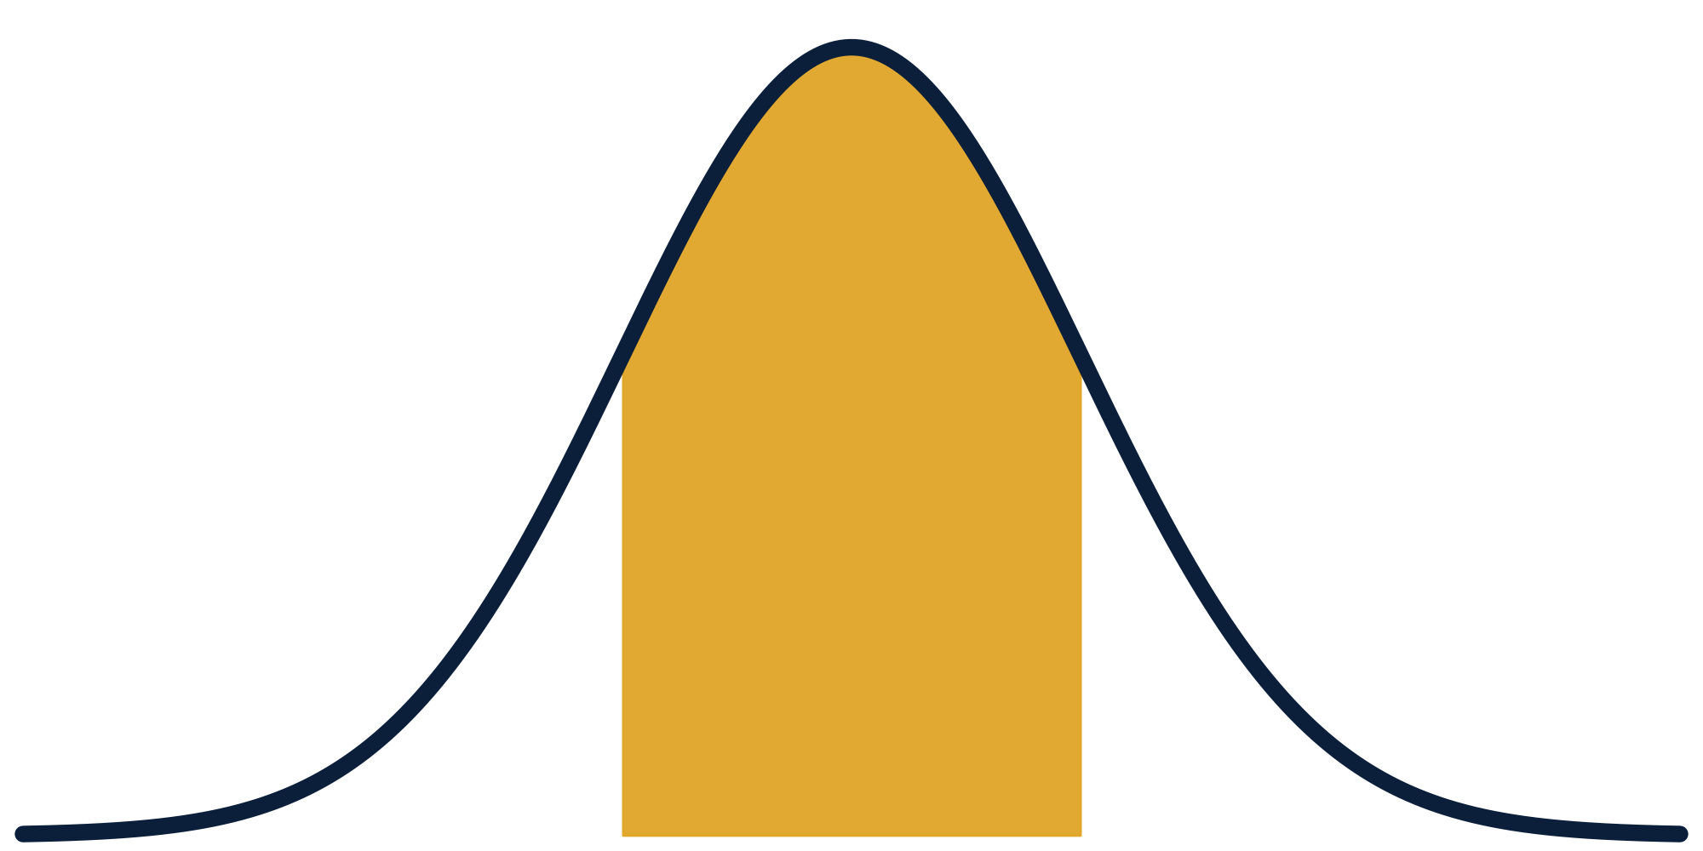
THE NAME
What VARSA stands for
V
A
R
S
A
Variability
Anomalies
Regional
Statistics
Analysis
How much annual rainfall swings: CV runs from 12% to 41% across regions
Unusually dry years: 23 of 115 fell below 90% of normal; driest was 1972
Differences across 36 subdivisions: region explains 87% of monsoon variance
Distributions, Welch ANOVA, confidence intervals and trend tests
Reproducible and assumption-checked, with correction for 36 tests
Variability, Anomalies and Regional Statistics of Indian Rainfall
VARSA · Probability & Statistics · BAMAT207
2
Notes:
Each letter of VARSA maps to a part of the project and to a result we already have: variability (CV 12% to 41%), anomalies (23 of 115 years below 90% of the all-India normal), regional differences (η² = 0.87), statistics (distribution fits, Welch ANOVA, trend tests) and analysis (reproducible, with multiple-testing correction). The name also echoes varṣā, the Sanskrit and Hindi word for rain.

Slide 3
OVERVIEW
Where this review takes you
Motivation and aim
Data
1
2
Why rainfall variability matters and what we ask of the data
The 1901–2015 IMD dataset: coverage, gaps and quality
Method
Preliminary results
3
4
Which test answers which question, and why
Seasonality, regions, distributions, trends and drought risk
Statistical care
Deliverables and next steps
5
6
Unequal variances, many tests and correlated regions
Workflow, limits and what remains to be done
VARSA · Probability & Statistics · BAMAT207
3
Notes:
A quick map of the review: why the question matters, what data we use, how we test, what the preliminary results show, how we guard against misleading statistics, and what remains.

Slide 4
01 · MOTIVATION
Rainfall is seasonal, uneven and easy to misread
India’s rainfall arrives in a few intense months, and a single national average hides how reliable it is in each region. Dry years are part of the record, but how often they occur, and where, matters for farming and water planning. This project asks what the historical record can and cannot tell us, using statistics that quantify uncertainty.
75.2%
36
of annual rain falls in June–September
meteorological subdivisions
Relevant to agricultural planning and water-resource management
Regional analysis reveals patterns that national averages hide
A significant-looking result is not automatically strong evidence
Probability models let us state how confident each claim is
115
23 of 115
years of monthly records (1901–2015)
years below 90% of the all-India normal
VARSA · Probability & Statistics · BAMAT207
4
Notes:
We are not trying to replace the IMD or predict the weather. The aim is to make historical rainfall data easier to understand and evaluate rainfall patterns with statistical evidence.

Slide 5
02 · AIM
Aim, objectives and research questions
To statistically analyse historical rainfall across India’s subdivisions: seasonality, regional variability, rainfall distributions and long-term trends.
RQ1
RQ2
How concentrated is rainfall in the June–September monsoon?
How much does annual variability differ between subdivisions?
RQ3
RQ4
Which probability distributions describe rainfall totals well?
Which subdivisions show a long-term trend after multiple-testing correction?
VARSA · Probability & Statistics · BAMAT207
5
Notes:
These questions connect directly to the syllabus: descriptive statistics, distributions, confidence intervals, hypothesis testing, ANOVA, correlation, regression and diagnostics.

Slide 6
02 · OBJECTIVES
What the analysis will deliver
1
Describe
2
Compare
3
Model
Monthly and seasonal rainfall patterns across subdivisions
Average rainfall and relative variability (CV) by region
Candidate distributions for rainfall totals, judged on fit
4
Test
5
Trend
6
Communicate
Whether rainfall differs by region and between two periods
Long-term trends, with correction for multiple testing
Clear plots, tables, and a dashboard prototype if time allows
VARSA · Probability & Statistics · BAMAT207
6
Notes:
Six objectives map directly to the syllabus: descriptive statistics, distributions, confidence intervals, hypothesis testing, ANOVA, regression and diagnostics. The dashboard is optional; the analysis is the core deliverable.

Slide 7
03 · DATA
Dataset and data quality
4,116 × 19
Coverage and quality
Source: India Meteorological Department (IMD) rainfall, published through India’s Open Government Data platform
26 rows lack annual totals; some monthly columns have gaps
Coverage is uneven: Arunachal Pradesh starts in 1916; some island series are shorter
Aggregated data: daily extremes cannot be analysed
Each row is one subdivision-year, with 12 monthly, 4 seasonal and 1 annual column
rows × columns, CSV (about 428 KB)
36 × 115
subdivisions × years, monthly / seasonal / annual
Analysed copy: a verified mirror of the OGD file (Kaggle, CC BY-SA 4.0). Official page: data.gov.in, “Area-weighted monthly, seasonal and annual rainfall, 36 subdivisions, 1901–2015”.
VARSA · Probability & Statistics · BAMAT207
7
Notes:
We chose this dataset because it is public, manageable in size, spans more than a century and supports several methods in the syllabus. We checked missing values and uneven historical coverage rather than assuming the data is perfect.

Slide 8
04 · METHOD
Each test is chosen for its question and assumptions
Research task | Statistical method | Purpose
Describe patterns | Mean, median, SD, coefficient of variation | Level and relative variability
Examine seasonality | Monthly summaries; one-way ANOVA with checks | Compare months
Compare subdivisions | Welch ANOVA and Games–Howell post-hoc | Groups with unequal variances
Model totals | Normal, Gamma, Weibull, Lognormal fits | Distributional fit
Compare periods | Confidence intervals and two-sample test | Period differences
Examine trends | Linear regression; Mann–Kendall and Sen slope | Direction and size of trend
Many tests | Benjamini–Hochberg false-discovery-rate control | Fewer false positives
Validate | Residual diagnostics, sensitivity checks | Trustworthy conclusions
Association is not causation: these methods describe patterns, not drivers.
VARSA · Probability & Statistics · BAMAT207
8
Notes:
We will choose each test based on the question and its assumptions, rather than applying every formula mechanically.

Slide 9
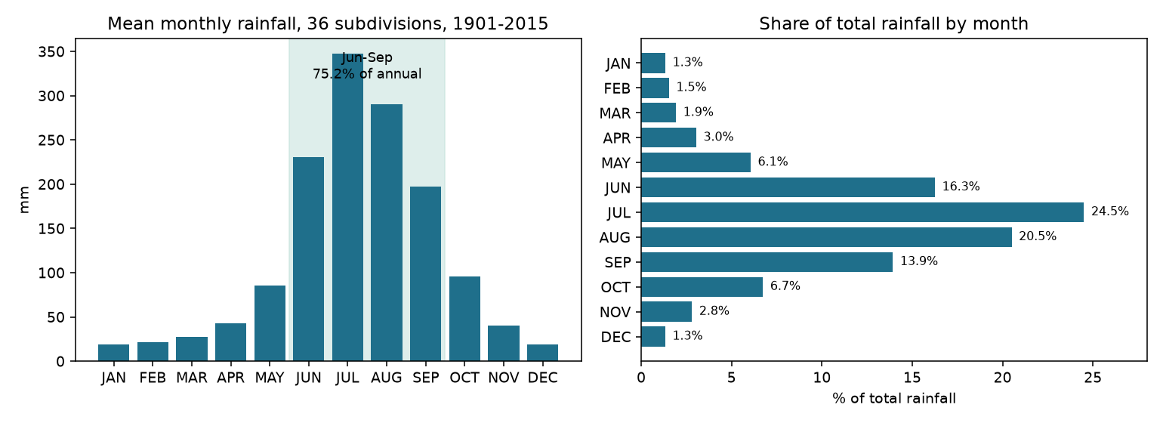
05 · PRELIMINARY RESULTS
The monsoon dominates the rainfall year
75.2%
of annual rain falls June–September
19 → 347 mm
average monthly rain, January to July
η² = 0.41
variance in rainfall explained by month
VARSA · Probability & Statistics · BAMAT207
9
Notes:
These are descriptive results, not causal conclusions. About three quarters of the year’s rain falls in June–September. Monthly means rise from about 19 mm in January to 347 mm in July. The one-way ANOVA by month gives F = 3,052 and η² = 0.41. These patterns are what the formal tests then investigate.

Slide 10
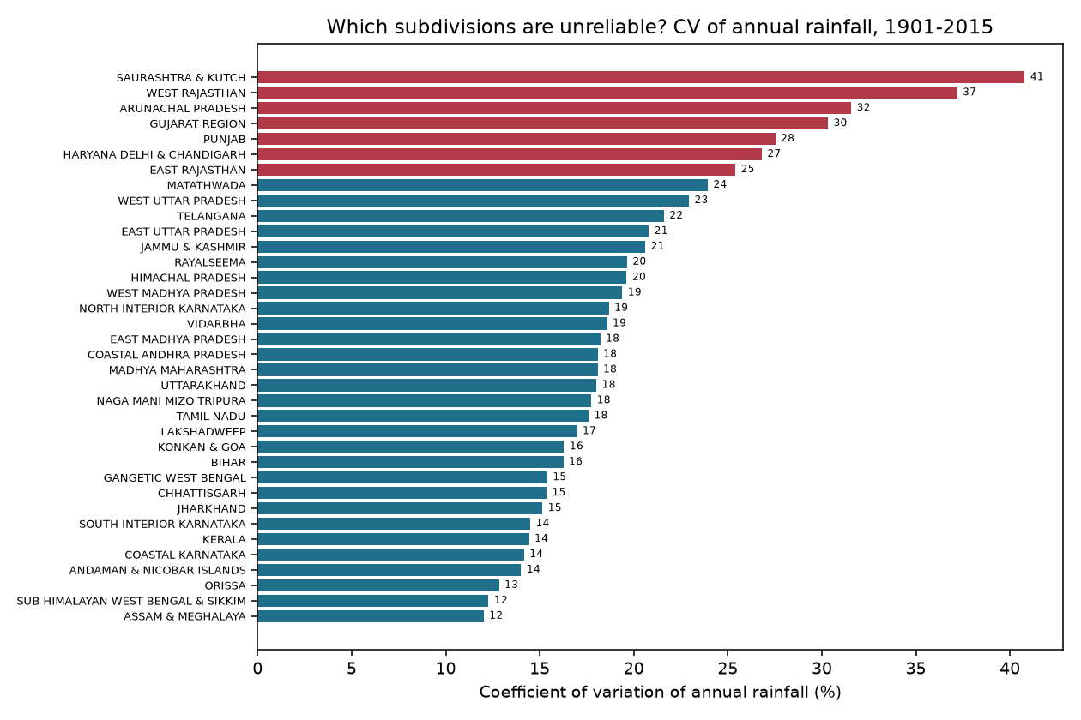
05 · PRELIMINARY RESULTS
Regions differ strongly, in size and in reliability
η² = 0.87
F = 811.5
variance explained by region
ANOVA, Jun–Sep by division
Why Welch, not ordinary, ANOVA
Levene test: W = 53.4, p ≈ 0, so variances differ
Welch ANOVA with Games–Howell post-hoc is the right test
CV: Assam & Meghalaya 12.0% (steadiest) to Saurashtra & Kutch 40.8% (least reliable)
Also high: West Rajasthan 37.2% and Arunachal Pradesh 31.6%
VARSA · Probability & Statistics · BAMAT207
10
Notes:
Large differences in June–September rainfall between subdivisions are clear, but the equal-variance assumption for ordinary one-way ANOVA fails (Levene p ≈ 0). That is why we report Welch ANOVA. CV compares standard deviation with the mean, so relative variability is comparable across regions.

Slide 11
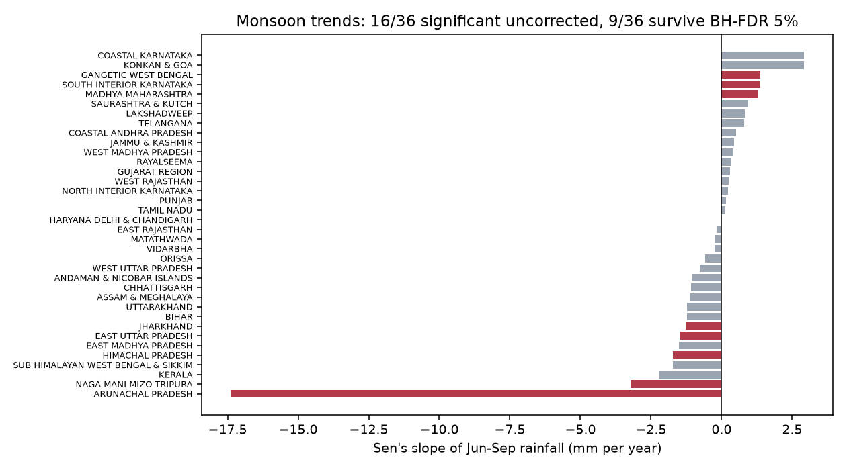
05 · PRELIMINARY RESULTS
Trend claims shrink after multiplicity correction
16 of 36
trends with p < 0.05, before correction
9 of 36
still significant after BH at 5% FDR
36 of 36
OLS and Mann–Kendall agree on trend sign
Example: Kerala p = 0.044 becomes q = 0.10, so it is no longer significant after correction.
VARSA · Probability & Statistics · BAMAT207
11
Notes:
One of the key lessons so far: statistical significance depends on the analysis procedure. Correcting for multiple testing changes the conclusion, which is exactly why the correction is important. Do not treat 36 uncorrected p-values as 36 confirmed discoveries.

Slide 12
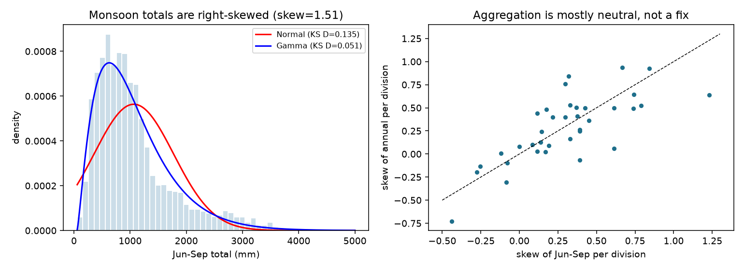
05 · PRELIMINARY RESULTS
Monsoon totals are skewed, so the Normal model fails
0.135
KS distance, Normal fit (poor)
0.051
KS distance, Gamma fit (much better)
Pooled Jun–Sep totals have skew 1.51, so Normal is the wrong default
Lognormal fits best still (KS D ≈ 0.026, from the project notes)
Best model differs by region; check per division
Pooled monsoon totals, 36 divisions
VARSA · Probability & Statistics · BAMAT207
12
Notes:
Distribution fitting is part of the syllabus and works here: the Normal distribution is clearly wrong for monsoon totals. The right model depends on the region, so the report will compare candidates per division.

Slide 13
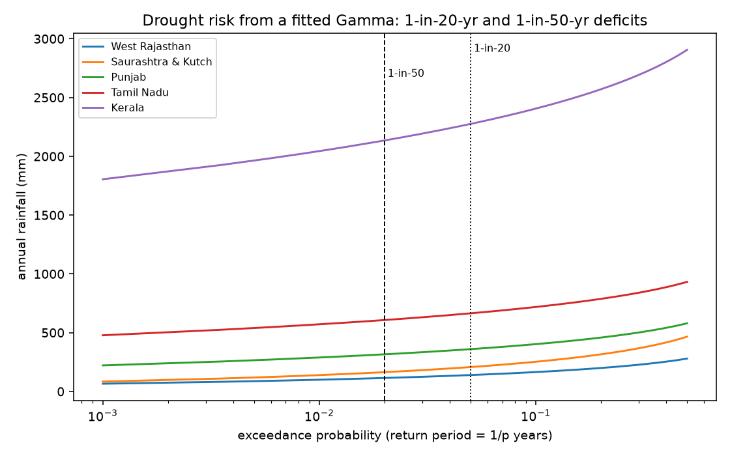
05 · PRELIMINARY RESULTS
Drought risk is regional, not national
47.6%
1-in-20-year deficit, West Rajasthan (of normal)
77.8%
1-in-20-year deficit, Kerala (of normal)
No year falls below 75% of normal nationally
Severe deficits appear in specific divisions, so risk is mapped per division
Return periods are statistical summaries of the record, not forecasts
VARSA · Probability & Statistics · BAMAT207
13
Notes:
Return periods come from a Gamma fit to annual totals in each division. A 1-in-20-year drought is a year whose rainfall falls below the 5th-percentile value. This is a statistical return period, not a forecast.

Slide 14
06 · STATISTICAL CARE
Three checks shape how we analyse the data
1
Unequal variances
2
Many tests
3
Shared weather
Variances differ across subdivisions, so ordinary equal-variance ANOVA is not used. Use Welch ANOVA with Games–Howell, and report both versions to show how sensitive the conclusion is.
36 trend p-values are not 36 discoveries. Benjamini–Hochberg controls the false-discovery rate. A region at p = 0.044 can fail once all 36 tests are considered together.
Divisions are not independent. Most pairs move together, so pooled inference needs care. Correlated divisions carry overlapping information, so 36 results are not 36 independent samples.
Levene p ≈ 0
16 → 9 after BH
78.6% of pairs correlate
We choose each test by its question and assumptions, not by applying every formula mechanically.
VARSA · Probability & Statistics · BAMAT207
14
Notes:
Each check changes a real conclusion in this dataset. Unequal variances change the test. Multiplicity changes the number of trends. Dependence between divisions limits how much independent evidence pooling can claim.

Slide 15
07 · DELIVERABLES
From raw CSV to a reproducible analysis
1
2
3
4
5
Load and validate the CSV
Clean and document gaps
Run reproducible analyses
Export tables and figures
Report and dashboard
Proposed dashboard views
Tools
Overview of seasonality
Regional mean rainfall and CV
Observed vs candidate distributions
Trend estimates with adjusted significance
R / RStudio or Python for analysis and plots
CSV for data and results
GitHub for code and version history
VARSA · Probability & Statistics · BAMAT207
15
Notes:
The dashboard is a presentation layer for the statistics. The central deliverable is the analysis and its interpretation, not the website.

Slide 16
SUMMARY
Five things the data already tells us
1
Rain is concentrated
75.2% falls in June–September; month alone explains 41% of the variance.
2
Regions differ sharply
Region explains 87% of monsoon variance; annual CV runs from 12% to 41%.
3
Normal is the wrong model
Monsoon totals are right-skewed; Gamma and Lognormal fit far better.
4
Trends need caution
16 of 36 trends look significant, but only 9 survive correction.
5
Drought risk is local
A 1-in-20-year deficit is 47.6% of normal in West Rajasthan, 77.8% in Kerala.
VARSA · Probability & Statistics · BAMAT207
16
Notes:
If the panel remembers five things: the monsoon dominates, regions differ a lot, the Normal model fails, trend claims shrink after correction, and drought risk is regional. All are preliminary and will be reproduced and validated for the final report.

Slide 17
08 · STATUS
Limits and next steps
Limitations
Next steps
Data ends in 2015 and is historical, not real-time
Resolution is 36 subdivisions, not districts
Monthly and annual aggregates cannot show daily extremes
Trend results depend on the 1901–2015 window and on linear models
Preliminary results still need full reproduction
1
Reproduce preliminary results from the raw CSV
2
Finalise cleaning and document missingness
3
Complete distribution fits, intervals and tests
4
Run trend analysis with diagnostics and correction
5
Build the dashboard prototype and final report
VARSA · Probability & Statistics · BAMAT207
17
Notes:
Preliminary findings need to be reproduced, checked and interpreted alongside their assumptions and uncertainty.

Slide 18
BACKUP
Likely questions from the panel
Why this dataset?
Why not ordinary ANOVA?
Public, manageable, 115 years, 36 subdivisions, and it supports several syllabus methods.
Variances differ across subdivisions (Levene p ≈ 0), so Welch ANOVA is the appropriate test.
What is a p-value?
Does this prove climate change caused trends?
The probability of a result at least this extreme if the null and the test assumptions hold. It is not P(null is true).
No. It is observational. Trends describe the data and do not attribute causes.
Why correct for multiple testing?
What if trends are not significant?
Testing 36 divisions separately inflates false positives. BH controls the expected false-discovery rate.
That is still a valid result. We report what the data supports, including uncertainty.
VARSA · Probability & Statistics · BAMAT207
18

Slide 19
VARSA turns historical rainfall records into statistically defensible findings.
Questions welcome
Pratik (25BCE0337) · Adarsh (25BCE0401) · Arunya (25BCE0344)
Dr. Juhi Baroi · Probability and Statistics (BAMAT207)
Method: reproducible R / Python workflow on public IMD rainfall data, 1901–2015
Notes:
Close on the aim: turn historical rainfall records into a statistically defensible understanding of seasonal patterns, regional variability and long-term trends.

