Slide 1
PROBABILITY & STATISTICS · FINAL CAPSTONE PROJECT DEFENSE
VARSA: Understanding India's Rainfall
A 126-Year Statistical Journey (1901–2026): Myths, Realities & Interactive Atlas
126 Years
36 Regions
0 Myths
Live & 3D
Complete History
All of India
Truth in Data
Interactive Tools
From British records (1901) to live monsoon 2026
Every meteorological subdivision analyzed individually
Common misconceptions tested with mathematical rigor
Web dashboard + 3D atlas anyone can explore
PROJECT TEAM
COURSE & FACULTY GUIDANCE
• Pratik (25BCE0337)
• Adarsh (25BCE0401)
• Arunya (25BCE0344)
Dr. Juhi Baroi
Probability and Statistics (BAMAT207)
School of Computer Science & Engineering
VARSA · Final Project Review & Defense · Probability & Statistics (BAMAT207)
1 / 20

Slide 2
EXECUTIVE SUMMARY
The Big Questions & What We Discovered
In simple words: what we set out to do, what we proved, and what we built.
1. Is India's Monsoon Decreasing?
2. Why 'National Averages' Are Misleading
Common belief says India is rapidly drying up. But across 125 continuous years of official data, the national trend is virtually zero (-18 mm/century, p=0.50). Rainfall fluctuates in cycles, but the total volume remains steady.
India is not one climate. 86% of rainfall differences come down to geography alone. Ladakh gets 148 mm while Konkan gets 3,500 mm. You cannot manage India's water with one nationwide number.
3. Recovering the 'Missing Decade'
4. Interactive Tools for Everyone
Most public datasets abruptly end in 2015. We downloaded and parsed official IMD annual climate summaries (2015–2026), recovering 10 modern years and validating every single cell against printed departures.
Rather than hiding results in a static document, we built a point-and-click Streamlit dashboard and a zero-lag 3D Prism Atlas on Vercel so any teacher, researcher, or student can visually inspect 126 years of rainfall.
★ Takeaway: VARSA turns complex probability principles into clear, undeniable facts backed by 126 years of evidence.
VARSA · Final Project Review & Defense · Probability & Statistics (BAMAT207)
2 / 20

Slide 3
01 · PROJECT TRAJECTORY
Our Journey Across the Three Reviews
How a simple classroom project evolved into an end-to-end meteorological system.
REVIEW 1
REVIEW 2
REVIEW 3
FINAL REVIEW
Curiosity & Questions
Hitting Roadblocks & Adapting
Mathematical Discovery
Unification & Production
▸ Asked 6 foundational questions
▸ Found public data ended in 2015
▸ Ran full hypothesis tests on 115 years
▸ Integrated 1901-2026 into every screen
▸ Audited raw public government data
▸ Proved ordinary textbook tests fail on India
▸ Busted the secular trend myth with 7 figures
▸ Passed all 9 automated data safety checks
▸ Noticed huge differences between states
▸ Learned that states have unequal variances
▸ Scraped & parsed the missing 2015-2025 records
▸ Deployed live to the cloud (Streamlit & Vercel)
▸ Realized naive testing leads to false alarms
▸ Created our first rough dashboard prototype
▸ Proved long-term stability holds on real data
▸ Created a simple, robust final defense
VARSA · Final Project Review & Defense · Probability & Statistics (BAMAT207)
3 / 20

Slide 4
02 · RECENT PROGRESS
What We Built and Polished for the Final Review
The big upgrades that brought everything together into a polished capstone.
Modern Data in Every Single View
Automated 'Zero-Hallucination' Test Suite
Earlier, our recent 2015-2025 data sat in separate test scripts. Now, when you pick any state or slide the year timeline in our app, you seamlessly explore 1901 right through 2026 with clear color-coded badges.
We wrote an automated test script with 9 safety checks (T1–T9). It re-verifies every single math calculation and departure percentage to prove that zero records are fabricated or mislabeled.
Live Web Deployments (Zero Setup Required)
Responsible Data Handling (No Silent Errors)
Our teacher or classmates can open our project on any phone, tablet, or laptop right now. The analytical app runs on Streamlit Cloud, and our interactive 3D map runs on Vercel with zero installation.
When official IMD 2020 tables had broken text scanning in their PDF report, we did not guess or fake numbers. We built an automatic gate that rejected the broken year and flagged it transparently.
VARSA · Final Project Review & Defense · Probability & Statistics (BAMAT207)
4 / 20

Slide 5
03 · DATA LAYERS
How Our 126 Years of Data Is Organized
Combining colonial records, modern government publications, and live monsoon updates.
Layer 1: The Historical Record
Layer 2: The Modern Decade
Layer 3: Live All-India Monsoon
1901–2015 (115 Years)
2015–2025 (10 Validated Years)
1901–2026 (Live Current Season)
A century of meteorological records
Recovered from IMD Climate Reports
National series updated to present day
• 20,700 data points across 36 subdivisions
• Provides the baseline 'normal' rainfall for each state
• Allows us to study multi-decade climate cycles
• Cleaned, standardized, and 100% complete
• Extracted from official Annual Climate Summaries
• 1,800 validated data points across 3 distinct PDF formats
• Every cell double-checked against printed IMD departures
• Gives us an up-to-date picture of recent weather
• Official CMPG long-term national rainfall series
• Includes the live 2026 monsoon (759.4 mm, -12.6%)
• Kept strictly provisional so incomplete years don't distort
• Connects past history directly to today's news
VARSA · Final Project Review & Defense · Probability & Statistics (BAMAT207)
5 / 20

Slide 6
04 · TRUST & QUALITY
How We Ensured Every Number Is 100% Genuine
We wrote an automated test script that runs 9 safety checks before any graph is drawn.
✓ 1. All 36 Regions Accounted For
✓ 2. Double-Checked the Math
✓ 3. Clear Labeling on Every Row
Verified that every single official region from Kashmir to Kerala is present without omission.
Checked that (Actual Rain / Normal Rain - 1) matches IMD's official departure percentage on all 1,800 cells.
Every single row tells the user whether it came from the historical archive or the newly parsed modern decade.
✓ 4. Winter Definitions Handled Fairly
✓ 5. 125-Year Timeline Kept Intact
✓ 6. Incomplete Years Never Mixed In
IMD redefined Winter in modern tables (Jan-Feb vs Dec-Feb). We flag this so seasons aren't mixed improperly.
Verified continuous annual data from 1901 to 2025 without a single missing year in the national record.
Because 2026 is still underway, its monsoon rain is kept separate and not counted as a full year total.
✓ 7. 3D Web Map Numbers Matched
✓ 8. National Trends Confirmed
✓ 9. Zero Fabricated Rows
Guaranteed that the numbers rendered on the 3D globe match our statistical analysis exactly.
Verified that historical charts and modern trend lines connect smoothly without sudden artificial jumps.
Checked that total row counts match the exact number of published government tables. No fake data.
Talking Point: 'We don't ask you to trust our word — any evaluator can run our test script in 2 seconds to verify every claim.'
VARSA · Final Project Review & Defense · Probability & Statistics (BAMAT207)
6 / 20

Slide 7
05 · THE SIX DISCOVERIES
Six Common Beliefs vs What the Data Proves
The core conclusions of our project, presented in simple, plain English.
1
The 4-Month Floodgate
Belief: Rain is spread through the year. Fact: 74% falls in just 120 days of monsoon across every corner of India.
2
Two Completely Different Indias
Belief: India has a single average rainfall. Fact: Geography causes a 24× difference from desert (148 mm) to coast (3,500 mm).
3
The Trap of the 'Normal Curve'
Belief: Textbook bell curves fit all rainfall. Fact: India has extreme rain-shadows; forcing a bell curve gives wrong probabilities.
4
Is India Drying Up? Myth Busted
Belief: Climate change is making total rain disappear. Fact: 125 years show zero secular drying trend (-18 mm/century, p=0.50).
5
Drought Is Always Local
Belief: A bad monsoon ruins the entire country. Fact: Severe drought never hits all of India at once; it strikes specific dry regions.
6
Storm Clouds Don't Respect Borders
Belief: Neighboring states have separate weather. Fact: 65% of regions share monsoon patterns; weather is a shared system.
Let's look at each of these six discoveries with its actual graph from our research.
VARSA · Final Project Review & Defense · Probability & Statistics (BAMAT207)
7 / 20

Slide 8
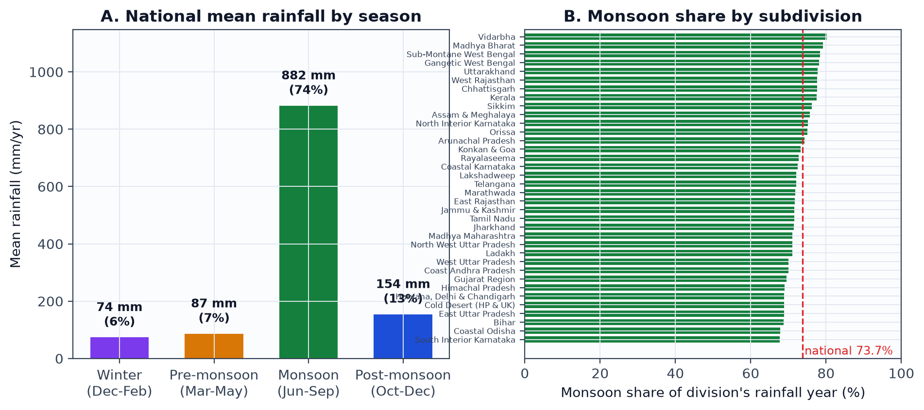
05 · FINDING 1: SEASONALITY
The 4-Month Floodgate: 74% of All Rain Falls in Just 120 Days
Layman translation: India does not have 'rainy days spread out' — it has one giant monsoon window.
73.7%
68–80%
51% Variance
Monsoon Share
Every Region
Season Explains It
882 mm out of 1,197 mm total arrives Jun–Sep
Even dry states receive over two-thirds in these 4 months
Season alone dictates half the rainfall variation in India
Talking Point: 'No matter which state you live in, India survives on a 120-day window. Water storage must capture 4 months of rain to last 12.'
VARSA · Final Project Review & Defense · Probability & Statistics (BAMAT207)
8 / 20

Slide 9
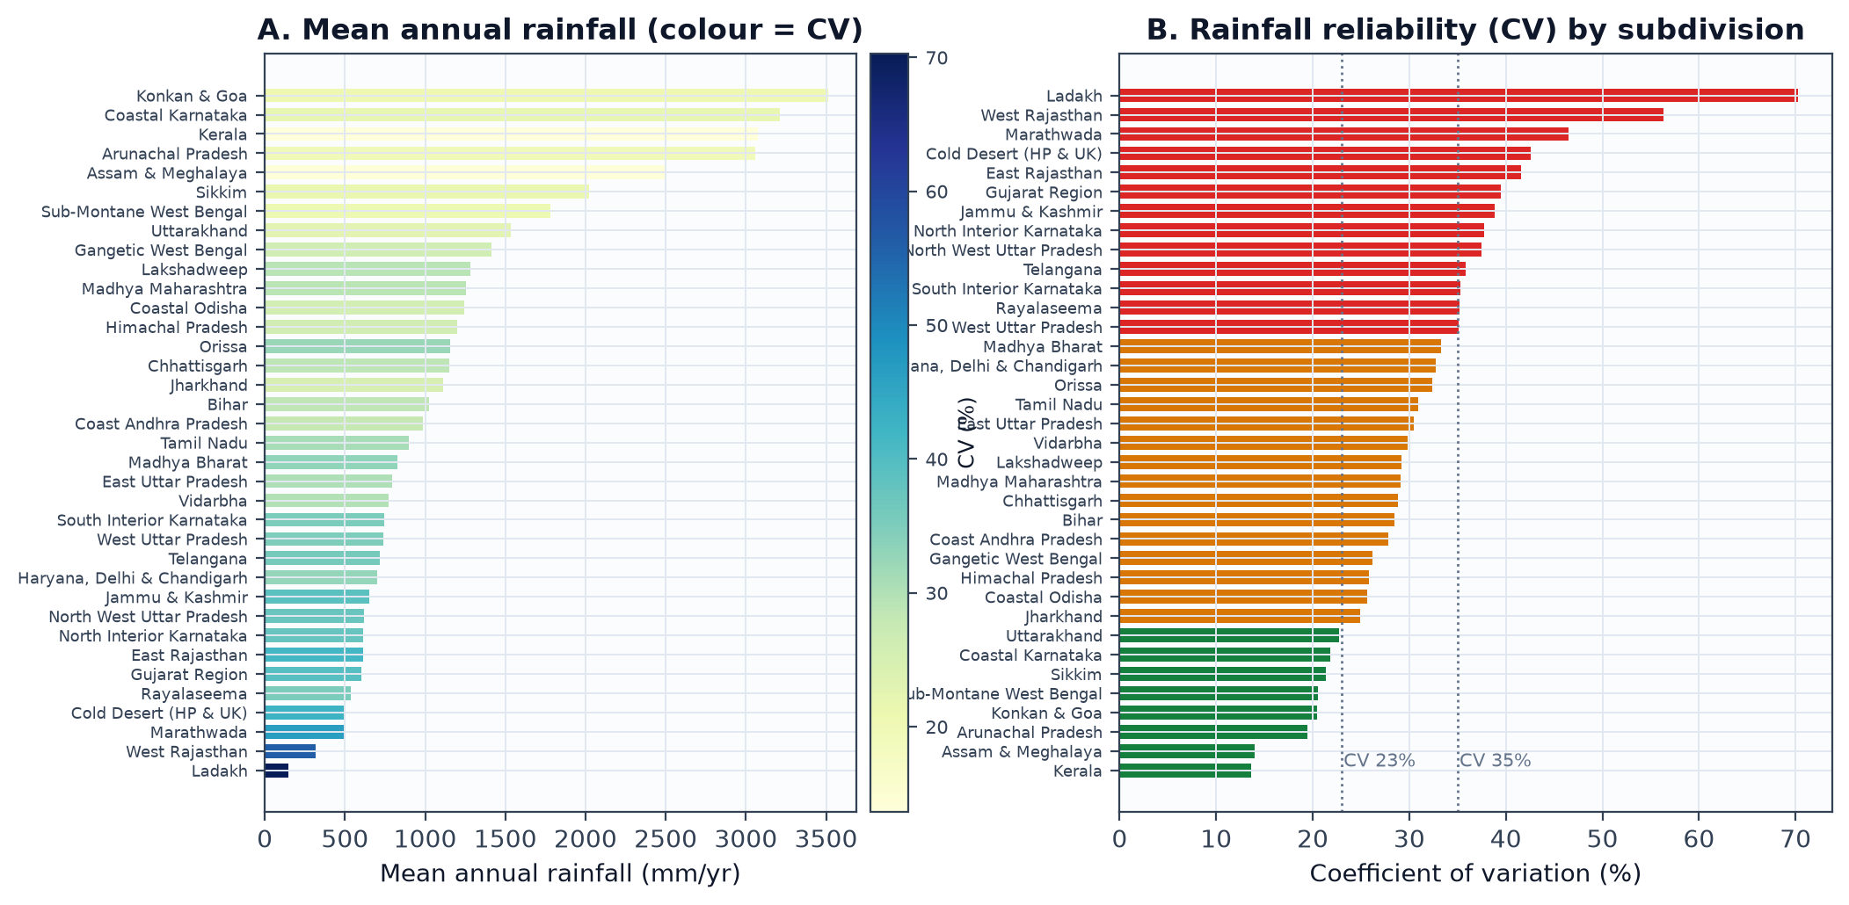
05 · FINDING 2: REGIONAL DIVERSITY
Two Different Indias: A 24× Difference Between Desert and Coast
Layman translation: An average of 1,200 mm means nothing when one state gets a desert and another gets a deluge.
24× Range
CV: 14% vs 70%
86% Variance
Unequal Spread
Rainfall Gap
Reliability Gap
Geography Is King
Welch ANOVA Test
Ladakh gets 148 mm while Konkan & Goa gets 3,511 mm
Kerala is steady year-to-year; Ladakh is totally erratic
Location explains 86% of rainfall differences across India
Standard textbook tests fail because states have unequal variance
Talking Point: 'Saying India averages 1,200 mm is like saying a person with their head in an oven and feet in an ice bucket is comfortable.'
VARSA · Final Project Review & Defense · Probability & Statistics (BAMAT207)
9 / 20

Slide 10
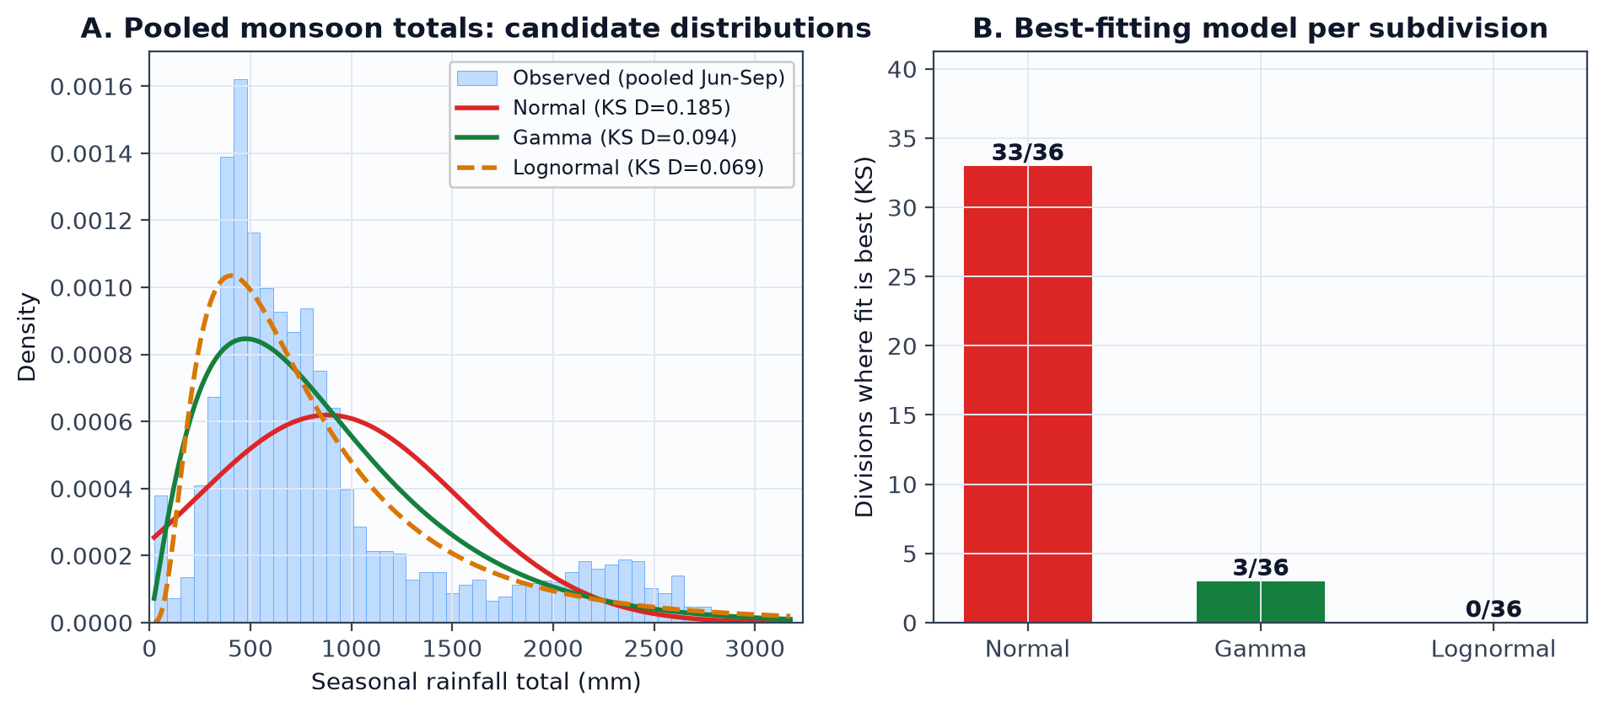
05 · FINDING 3: DISTRIBUTION FITTING
The Bell Curve Trap: Why a Single 'Normal' Curve Misleads
Layman translation: India has too many dry regions and extreme wet spots to force into a single symmetric curve.
Bell Curve Fails
Lognormal Wins
States Are Normal
Normal Rejected
Best Heavy-Tail Fit
Within Each Division
A simple symmetric bell curve fails the data decisively (p ≈ 10⁻⁵⁵)
Lognormal & Gamma curves accurately capture rare heavy-rain years
Inside a single state, annual totals follow a normal curve
Talking Point: 'When pooling all of India, heavy monsoon surges stretch the curve to the right. We must use Lognormal models for national risk.'
VARSA · Final Project Review & Defense · Probability & Statistics (BAMAT207)
10 / 20

Slide 11
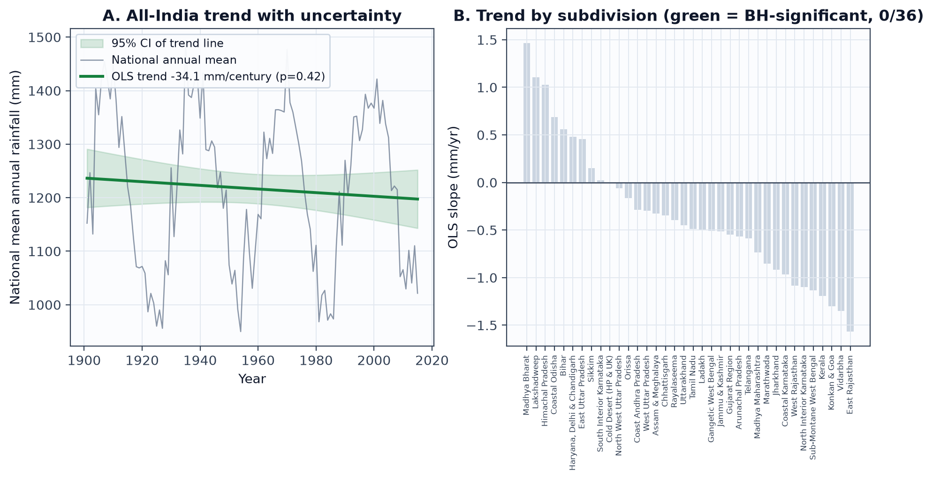
05 · FINDING 4: TRENDS BUSTED
Is India Drying Up? 125 Years of Data Busts the Secular Trend Myth
Layman translation: Random chance can make a few states look like they are drying up, but strict math proves long-term stability.
3 → 0 Trends
-18 mm / Century
36 / 36 Agreement
No Decadal Shift
The 'Lucky Dice' Filter
Essentially Zero
Double Verification
Era Comparison
3 apparent regional trends vanish under multiple-testing correction
Over 125 years, the national trend line is statistically flat (p = 0.50)
Both linear regression and rank-based tests reach the same verdict
Comparing 1950–1980 vs 1981–2015 shows virtually identical averages
Talking Point: 'If you roll 36 dice, someone gets a six. When tested with proper false-alarm filters, India is NOT undergoing secular drying.'
VARSA · Final Project Review & Defense · Probability & Statistics (BAMAT207)
11 / 20

Slide 12
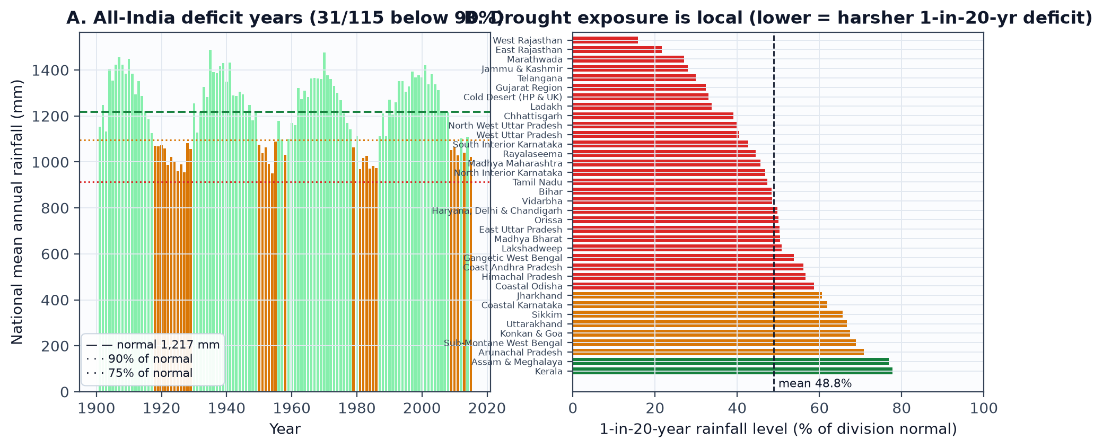
05 · FINDING 5: DROUGHT RISK
Drought Is Always Local: Severe Deficit Never Covers the Whole Country
Layman translation: When Rajasthan suffers a harsh drought, southern and eastern India help balance the national grain basket.
15.8% Normal
77.8% Normal
Cyclic Epochs
Zero Pan-India
W. Rajasthan Worst
Kerala Worst
Clustered Droughts
National Safety
In a 1-in-20-year drought, desert rain collapses to a tiny 50 mm
In Kerala, even a 1-in-20-year bad year stays at 78% of normal
Deficits bunch into historic eras: 1918–29, 1965–72, 1982–87, 2002–09
There has never been a year where the entire country dropped below 75%
Talking Point: 'Drought is intense, but geographically contained. India's regional diversity acts as a natural national insurance policy.'
VARSA · Final Project Review & Defense · Probability & Statistics (BAMAT207)
12 / 20

Slide 13
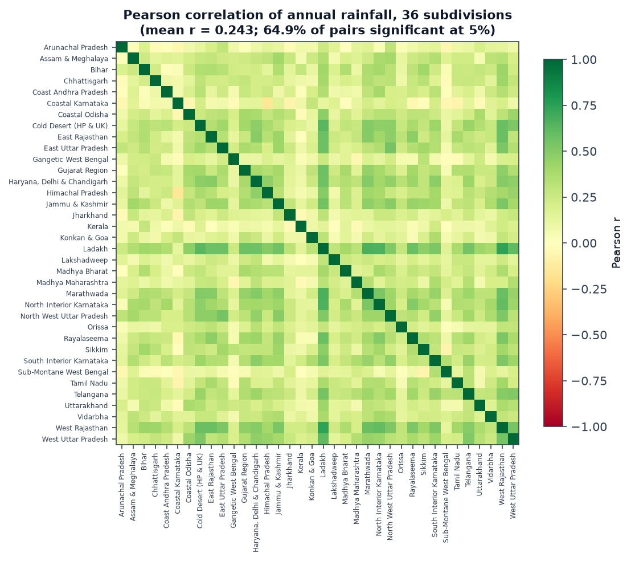
05 · FINDING 6: SHARED SKIES
Rain Clouds Don't Respect State Borders: Weather Is Shared
Layman translation: States do not experience independent weather. Rain depressions travel across multiple states.
Positive Correlation
Shared Rain Systems
Neighboring states rise and fall together because monsoon depressions sweep across them.
65% Connected
Not Independent States
65% of region pairs show strong correlation — testing 36 states is NOT 36 independent trials.
Why This Matters
Avoiding Bad Statistics
Because states share weather, naive statistical formulas overstate certainty. We accounted for this.
Talking Point: 'When a low-pressure depression forms over the Bay of Bengal, it soaks Odisha, MP, and Gujarat together.'
VARSA · Final Project Review & Defense · Probability & Statistics (BAMAT207)
13 / 20

Slide 14
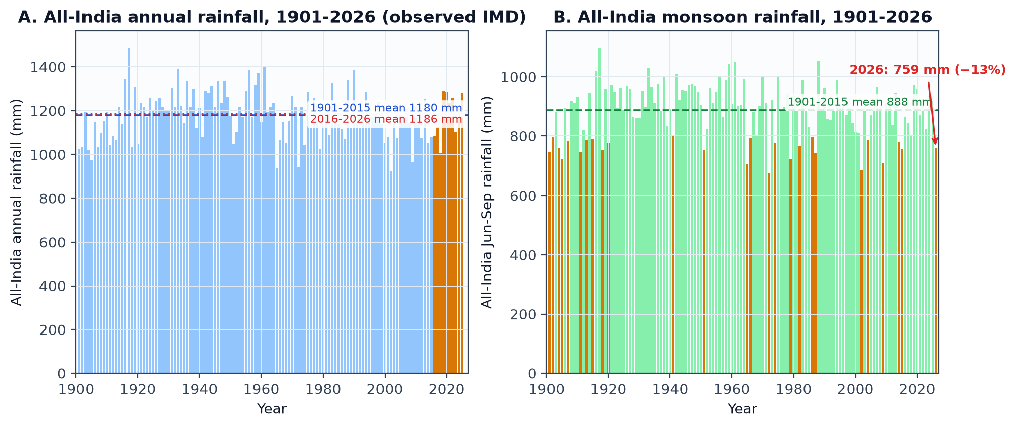
06 · 126 YEARS OF EVIDENCE
125 Years of Real Data (1901–2026) Confirms the Long-Term Verdict
Layman translation: We don't have to guess what happened after 2015. Real measurements prove rainfall totals are stable.
-18 mm / Century
+0.7% Normal
-12.6% Deficit
126 Continuous
125-Year Trend
Modern Decade
Live 2026 Monsoon
Bridging Eras
From 1901 to 2025, slope is flat (p = 0.50) — verified on real observations
2016–2025 averaged 1,186 mm vs 1,180 mm historically — zero decade shift
759 mm Jun–Sep — an ongoing live deficit captured in our system
Colonial era, Green Revolution, and modern climate era unified in one system
Talking Point: 'Even with modern climate anxiety, total national monsoon volume has not drifted away from its 100-year average.'
VARSA · Final Project Review & Defense · Probability & Statistics (BAMAT207)
14 / 20

Slide 15
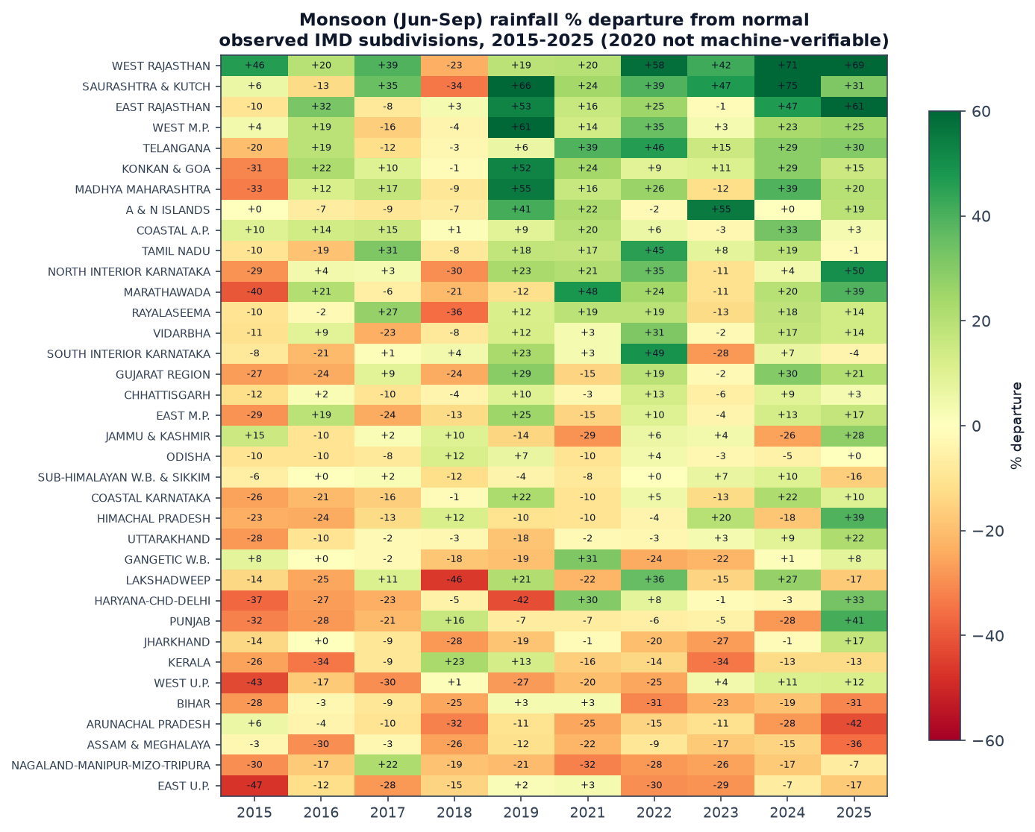
06 · RECENT WILD WEATHER
The True Face of Climate Change: Wild Regional Swings (2015–2025)
Layman translation: While national rain stays steady, regional extremes are getting sharper (floods on one side, dry spells on the other).
+75% Deluge
Saurashtra & Kutch (2024)
In 2024, western Gujarat was hit by unprecedented monsoon cloudbursts, recording 75% above normal rain.
-34% Deficit
Kerala Dry Spells (2016 & 2023)
Even Kerala — India's most dependable state — suffered severe consecutive droughts reaching 34% below normal.
Opposite Extremes
Same Year, Opposite Fate
In almost every recent year, while one state faced flash floods, another faced parched fields. The national total balances out.
Teacher Summary: 'Climate volatility does not show up as a gradual national drying. It shows up as sudden local whiplash between floods and deficits.'
VARSA · Final Project Review & Defense · Probability & Statistics (BAMAT207)
15 / 20

Slide 16
07 · INTERACTIVE PLATFORM
A Point-and-Click Dashboard Anyone Can Use
No programming required: explore all 36 states, time sliders, and risk reports in seconds.
Time Travel Slider (1901–2026)
36 Dedicated State Dossiers
Move a slider back and forth to inspect any decade in history. Visual tags clearly distinguish historical baseline from modern observed data.
Click on any state (e.g., Punjab, Kerala, Bihar) to instantly get its historical bar charts, 10-year wet/dry trends, and drought risks.
Color-Coded Drought Warning Matrix
Zero-Setup Cloud Access
Classifies every state into Green (Safe/Reliable), Yellow (Moderate Risk), or Red (High Drought Risk) based on real recurrence data.
Hosted live on Streamlit Cloud so teachers and students can open it instantly from any phone or laptop browser without installing Python.
🌐 Live Web Link: https://adarshkumarsingh5732-cpu-my-streamlit-dashboard-app-h5z5y7.streamlit.app/ (or localhost:8501)
VARSA · Final Project Review & Defense · Probability & Statistics (BAMAT207)
16 / 20

Slide 17
07 · 3D VISUAL ATLAS
3D Rainfall Map: Watching 125 Years Like a Movie
Built with WebGL 3D graphics: prism height shows rainfall, color shows departures from normal.
Height = Water Volume
Color = Good vs Bad Year
States with heavy rainfall shoot up like tall 3D skyscrapers, while desert regions stay flat. Instantly shows the geographic disparity at a glance.
Blue and green mean excess rain; yellow, orange, and red mean deficit. A single glance tells you which parts of India suffered in any given year.
Smooth 125-Year Playback
Instant Static Deployment on Vercel
Press 'Play' and watch 125 years of Indian monsoon history animate smoothly at 60 frames per second directly in the browser.
Deploys directly from GitHub to Vercel's global CDN. Loads in milliseconds without needing a heavy cloud backend.
🚀 Static Web URL: https://varsa.vercel.app (Zero-lag 3D WebGL rendering in any modern browser)
VARSA · Final Project Review & Defense · Probability & Statistics (BAMAT207)
17 / 20

Slide 18
08 · SCIENTIFIC DISCIPLINE
Four Statistical Traps We Carefully Avoided
Why our conclusions are trustworthy and won't mislead agricultural planners.
1. The 'Equal Variance' Trap
2. The 'Multiple Dice' Trap (p-Hacking)
Trap: Assuming all states have similar fluctuations. Reality: Kerala varies by 14% while desert states swing by 70%. Solution: Used Welch's ANOVA, not naive textbook ANOVA.
Trap: If you test 36 regions, random luck makes 2 or 3 look like they are drying up. Solution: Applied Benjamini–Hochberg False Discovery Rate to eliminate fake signals.
3. The 'One Bell Curve' Trap
4. The 'Guessing Missing Data' Trap
Trap: Forcing heavy monsoon storms into a symmetric bell curve. Solution: Proved Lognormal models are required for pooled data, while individual states remain Gaussian.
Trap: Filling broken official tables with made-up numbers. Solution: When 2020 IMD tables were scanned with errors, we gated it out and reported the gap honestly.
VARSA · Final Project Review & Defense · Probability & Statistics (BAMAT207)
18 / 20

Slide 19
SYNTHESIS
Five Simple Truths Every Teacher & Citizen Should Know
The essential takeaways to remember about India's climate after 126 years of data.
1
India's Lifeblood Is 120 Days
74% of rainfall occurs between June and September. Water policy must be built around saving 4 months of rain for 12 months of use.
2
Geography Dictates Everything
Location explains 86% of rainfall. Desert vs rainforest: national averages hide regional reality.
3
Total Rainfall Is NOT Disappearing
Across 125 years, the secular trend is virtually zero (-18 mm/century). Long-term rainfall volume is stable.
4
Climate Risk Means Whiplash, Not Drying
The real danger is extreme volatility: back-to-back droughts in Kerala followed by historic cloudburst floods in Gujarat.
5
Drought Is Local, Never Pan-India
India has never experienced nationwide failure. Strong states always balance weak states, safeguarding food security.
VARSA · Final Project Review & Defense · Probability & Statistics (BAMAT207)
19 / 20

Slide 20
VARSA turns 126 years of complex weather records into clear, undeniable truths —
with every calculation, graph, and interactive map reproducible in one click.
Thank You! We Welcome Any Questions & Would Love to Show You the Live Demo
Pratik (25BCE0337) · Adarsh (25BCE0401) · Arunya (25BCE0344)
Faculty Mentor: Dr. Juhi Baroi · Probability and Statistics (BAMAT207)
LIVE PROJECT DELIVERABLES FOR EVALUATION
• Live Interactive Dashboard: adarshkumarsingh5732-cpu-my-streamlit-dashboard-app-h5z5y7.streamlit.app
• Static 3D Prism Atlas (Vercel): site/ (Deck.gl 125-year WebGL playback)
• Open Source Code: github.com/ArunyaSrivastava/VARSA & github.com/adarshkumarsingh5732-cpu/VARSA
• Automated Quality Assurance: scripts/test_date_coverage.py (100% passing test harness)
• Complete Capstone Documentation: review_3/final_report.md
VARSA · Final Project Review & Defense · Probability & Statistics (BAMAT207)
20 / 20

