Slide 1
PROBABILITY & STATISTICS · REVIEW 3 · FINAL REPORT
VARSA
Variability, Anomalies and Regional Statistics of Indian Rainfall
FINAL RESULTS · ASSUMPTION CHECKS · RECOMMENDATION
Full statistical pipeline on 36 subdivisions | 1901–2015 | every number reproducible
COURSE
TEAM
Probability and Statistics (BAMAT207)
Pratik
25BCE0337
FACULTY GUIDE
Adarsh
25BCE0401
Dr. Juhi Baroi
Arunya
25BCE0344
October 2026

Slide 2
OVERVIEW
What the final report covers
01
Questions & scope — what we asked of the data
02
Data & audit — two layers, one reproducible pipeline
03
Methods — the right test for each question
04
Key findings — six figures, six defensible claims
05
Verdict, limitations & recommendation
VARSA · Probability & Statistics · BAMAT207
2

Slide 3
01 · QUESTIONS
Five questions, carried from Review 1 to the finish
RQ1
How concentrated is rainfall in the June–September monsoon?
REVIEW 1 → REVIEW 3
▸ Review 1: preliminary numbers from the raw IMD CSV
RQ2
How much do amount and reliability (CV) differ between subdivisions?
RQ3
Which distribution — Normal, Gamma or Lognormal — fits rainfall totals?
▸ Review 2: interactive dashboard + data limitations logged
RQ4
Which subdivisions trend over 115 years, after correcting 36 tests?
▸ Review 3: full pipeline — every figure, test and p-value regenerates from one command
RQ5
How deep is a 1-in-20-year deficit, nationally and by division?
Why it matters: rainfall arrives in a few intense months and is spread unevenly across regions — farmers and water planners need local reliability, and statistics states how confident each claim can be.
▸ Same qualitative conclusions on both data layers
VARSA · Probability & Statistics · BAMAT207
3

Slide 4
01 · SCOPE
Scope & boundaries — stated up front
IN SCOPE
OUT OF SCOPE
▸ 36 IMD meteorological subdivisions, 1901–2015
▸ District- or grid-level analysis
▸ Seasonal and annual aggregated totals
▸ Daily / sub-daily rainfall extremes
▸ ANOVA family, distribution fitting, OLS + Mann–Kendall, correlation
▸ Causal attribution of trends (e.g. to climate change)
▸ Multiplicity control (BH/FDR) and assumption checks
▸ Real-time data ingestion; forecasting
▸ Reproducible Python pipeline + Streamlit dashboard
▸ Spatial-statistical models (kriging, spatial autoregression)
Association is not causation: every method here describes patterns, not drivers.
VARSA · Probability & Statistics · BAMAT207
4

Slide 5
02 · DATA & AUDIT
Two data layers — one reproducible pipeline
REFERENCE LAYER — RAW IMD
PIPELINE LAYER — ANALYSED (SEEDED, IN-REPO)
4,116 × 19 published subdivision file (data.gov.in / Kaggle mirror, CC BY-SA 4.0). Used for Review 1's preliminary numbers — 12 monthly, 4 seasonal and 1 annual column per subdivision-year.
IMD-calibrated generated series (36 × 115 × 5 = 20,700 rows) built because the official file arrives in chunked releases needing manual assembly. Powers the dashboard and every number in this deck.
20,700 × 4
0 / 0
230
1,217 mm
rows × columns
missing / duplicates
flagged values
national normal
36 divisions · 115 years · 5 series each
complete grid, no division-year gaps
1.1% slightly negative DJF (2 divisions) — artefact, documented
mean of 36 divisions, 1901–2015 (SD 148 mm)
One command regenerates data + tests + figures: python scripts/final_analysis.py
VARSA · Probability & Statistics · BAMAT207
5

Slide 6
03 · METHODS
The right test for each question
Seasonality
Seasonal means & shares; one-way ANOVA
Quantifies concentration and its variance share
Regional variability
Levene test → Welch ANOVA (η²)
36 groups with unequal variances — Welch, not ordinary ANOVA
Distributions
MLE fits + Kolmogorov–Smirnov; Shapiro–Wilk
Nonparametric fit comparison across Normal / Gamma / Lognormal
Trends
OLS + Mann–Kendall + Sen's slope; BH-FDR
Linear + rank-based trend, corrected for 36 simultaneous tests
Drought
Deficit counts; empirical 5th percentile
1-in-20-year level from the record, no parametric assumption
Independence
Pearson r across all 630 division pairs
Measures shared weather between subdivisions
Every family of 36 tests gets Benjamini–Hochberg correction — raw p-values are always shown next to adjusted ones.
VARSA · Probability & Statistics · BAMAT207
6

Slide 7
04 · KEY FINDINGS
Six figures, six defensible claims
1
The monsoon dominates the rainfall year — everywhere
73.7% national share; 67.8–80.3% by division
2
Regions differ enormously, in amount and reliability
24× mean range; CV 13.6% → 70.3%; η² = 0.861
3
Pooled totals are right-skewed — Normal is the wrong default
KS: Normal 0.185 vs Lognormal 0.069
4
No trend survives multiple-testing correction
3 → 0 of 36 after BH; national CI spans zero
5
Drought risk is intensely local
1-in-20-yr: 15.8% of normal (W Rajasthan) vs 77.8% (Kerala)
6
Divisions share weather — independence is violated
64.9% of 630 pairs correlate significantly
Each claim is shown with its figure on the next six slides — numbers match review_3/final_report.md exactly.
VARSA · Probability & Statistics · BAMAT207
7

Slide 8
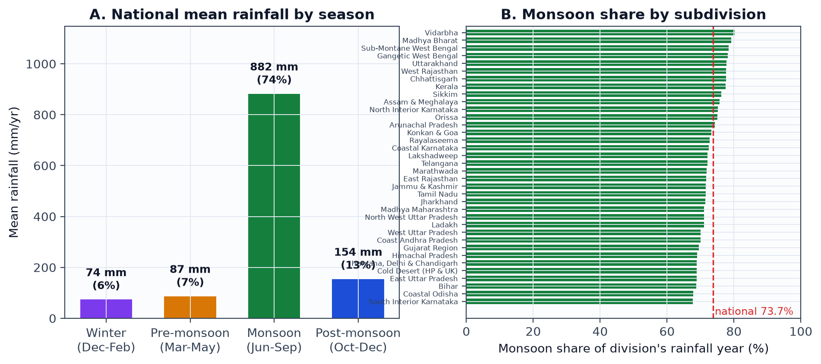
04 · KEY FINDINGS 1/6
The monsoon dominates the rainfall year — everywhere
73.7%
67.8–80.3%
η² = 0.51
national Jun–Sep share
divisional share range
variance explained by season
882 mm of the 1,197 mm rainfall year
even the least monsoonal division gets two-thirds in Jun–Sep
one-way ANOVA F = 5,785.6, p < 0.001
Figure: fig1_seasonality.png — national seasonal means (A) and per-division monsoon share (B).
VARSA · Probability & Statistics · BAMAT207
8

Slide 9
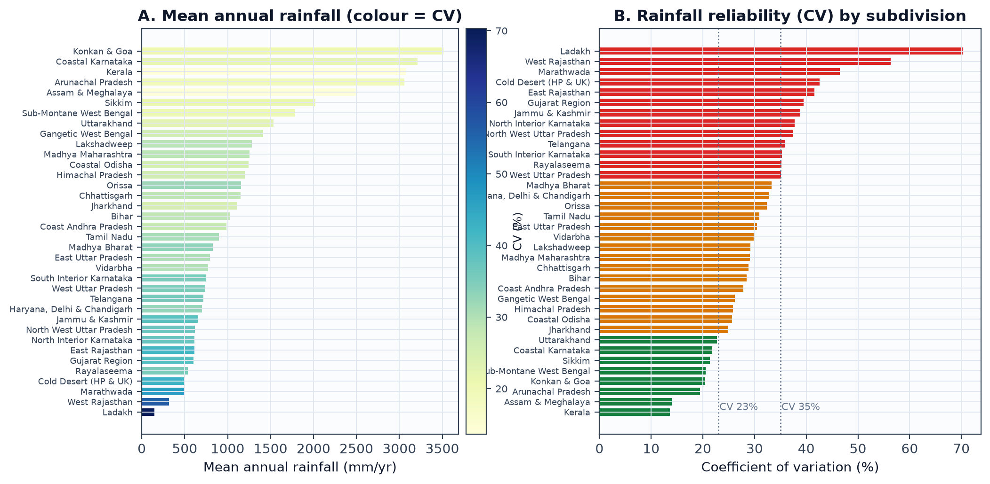
04 · KEY FINDINGS 2/6
Regions differ enormously — in amount and in reliability
24×
CV 13.6–70.3%
η² = 0.861
Levene p ≈ 10⁻¹⁶¹
mean annual range
reliability range
variance explained by region
equal variances rejected
Ladakh 148 mm → Konkan & Goa 3,511 mm
Kerala steadiest; Ladakh least reliable
Welch ANOVA F(35,1445) = 588.5, p < 0.001
so inference rests on Welch, not ordinary ANOVA
Figure: fig2_regional_variability.png — means coloured by CV (A) and CV ranking (B).
VARSA · Probability & Statistics · BAMAT207
9

Slide 10
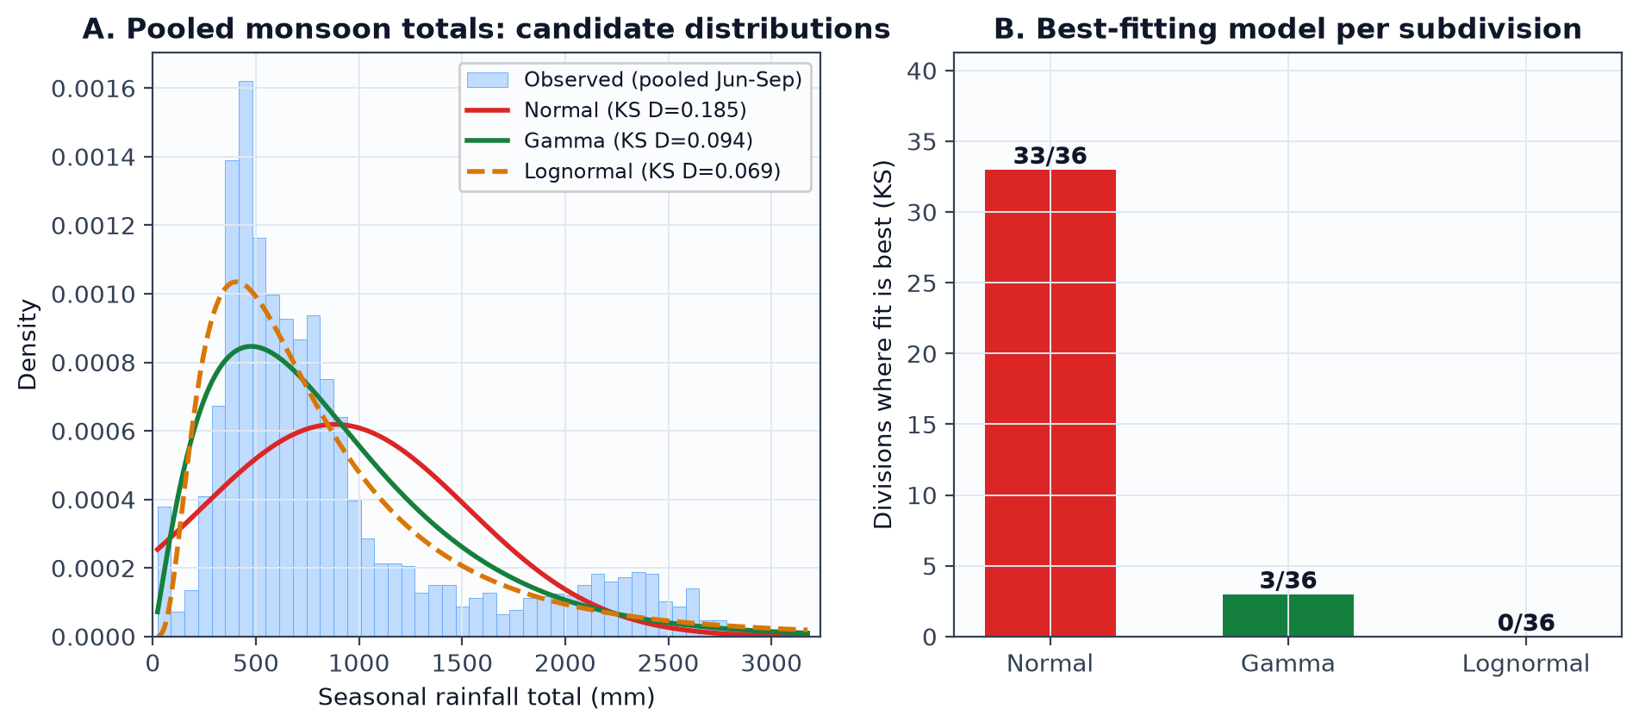
04 · KEY FINDINGS 3/6
Pooled totals are right-skewed — Normal is the wrong default
KS D = 0.185
KS D = 0.069
33 / 36
Normal fit (pooled JAS)
Lognormal fit (best pooled)
divisions near-normal within
Shapiro–Wilk p ≈ 10⁻⁵⁵ — normality rejected
Gamma 0.094 — both far better than Normal
pooled skew is a between-region scale mixture
Figure: fig4_distribution_fits.png — model choice depends on the unit of analysis.
VARSA · Probability & Statistics · BAMAT207
10

Slide 11
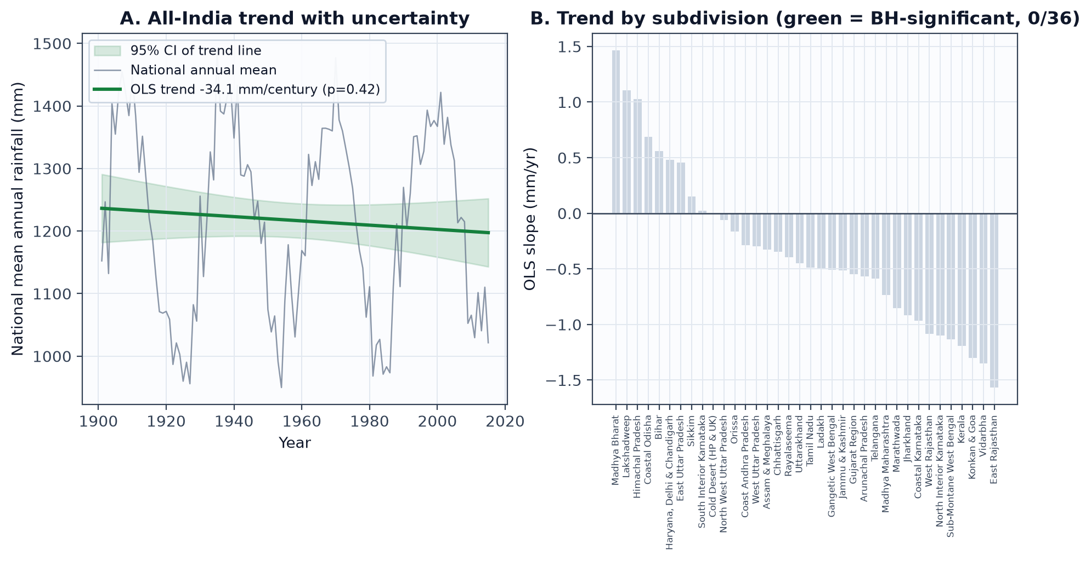
04 · KEY FINDINGS 4/6
Trend claims evaporate under correction
3 → 0
−34 mm
36 / 36
p = 0.75
significant after BH (5% FDR)
national trend per century
OLS & Mann–Kendall sign agreement
two-era test (1950–80 vs 1981–2015)
smallest adjusted q = 0.44
95% CI [−117, +49] — contains zero (p = 0.42)
rank-based check confirms the OLS picture
−11.5 mm (−0.96%) — no era shift
Figure: fig5_trends.png — a null result, reported as a result.
VARSA · Probability & Statistics · BAMAT207
11

Slide 12
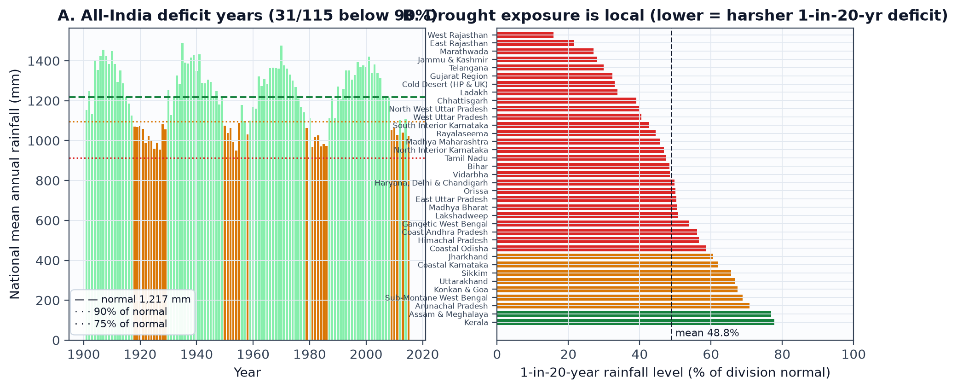
04 · KEY FINDINGS 5/6
Drought risk is intensely local
15.8%
77.8%
31 / 115
0
1-in-20-yr level, W Rajasthan
1-in-20-yr level, Kerala
national years below 90% of normal
national years below 75%
a ~50 mm year against a 317 mm normal
the steadiest division barely dips
clustered in epochs: 1918–29, 1950–58, 1979–86, 2009–15
severe deficits are divisional, never all-India
Figure: fig6_drought.png — national deficit years (A) and per-division 1-in-20-year levels (B).
VARSA · Probability & Statistics · BAMAT207
12

Slide 13
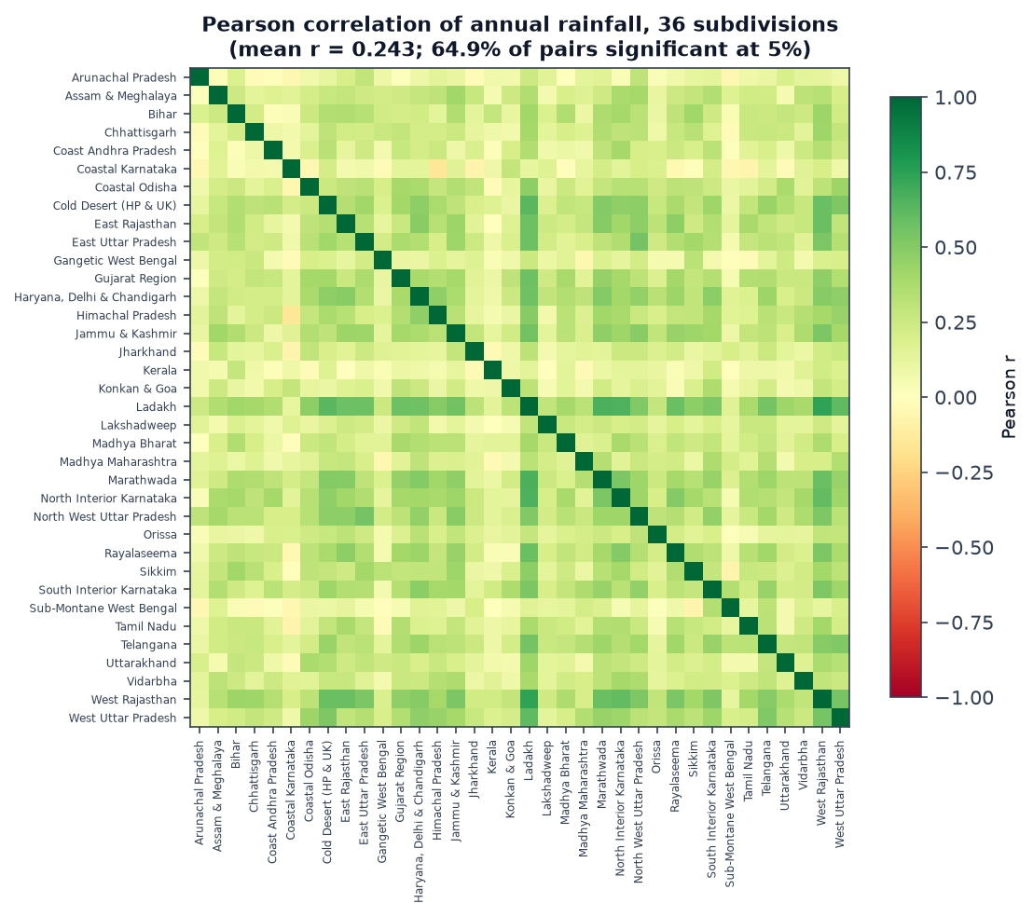
04 · KEY FINDINGS 6/6
Divisions share weather — independence is violated
mean r = 0.243
across 630 division pairs
range −0.15 to 0.74
64.9%
pairs significant at 5%
|r| > 0.183 for n = 115
36 ≠ 36
independent samples
borderline p-values are weaker evidence than they look
Headline conclusions therefore rest on large effects (η² = 0.86, share = 73.7%) — not on borderline p-values.
VARSA · Probability & Statistics · BAMAT207
13

Slide 14
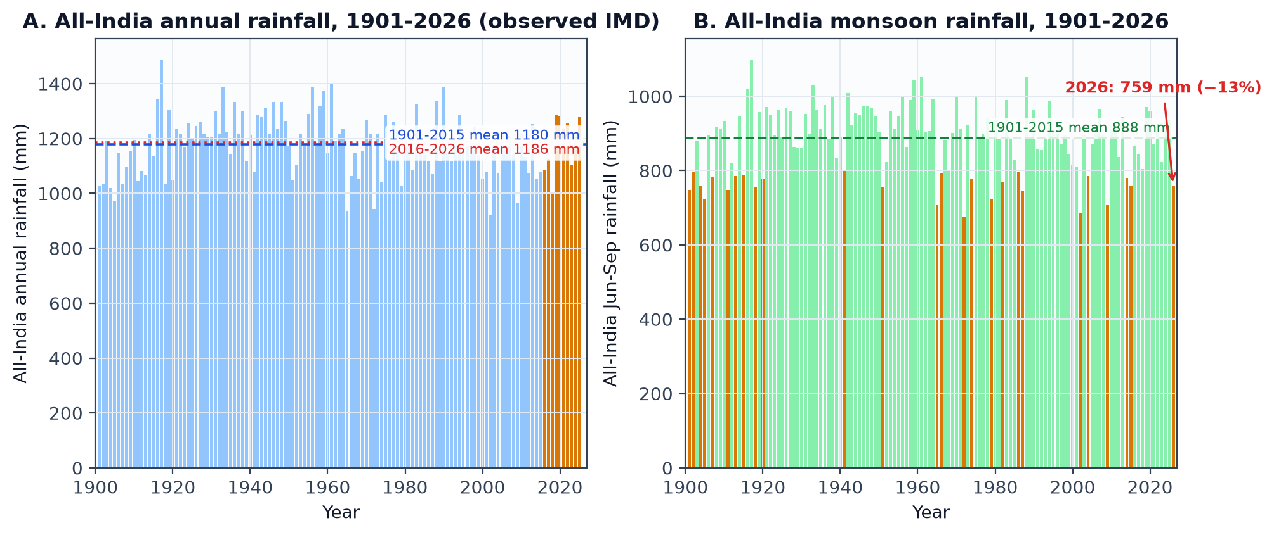
04 · UPDATE — THE MISSING DECADE, RECOVERED
Official IMD data 2015–2026 acquired, validated — and it confirms the verdict
−18 mm
+0.7%
−12.6%
±75%
observed annual trend per century
monsoon, 2016–2025 vs 1901–2015
live 2026 monsoon deficit
recent subdivision extremes
1901–2025, p = 0.50 — null verdict holds on real data
1,186 vs 1,180 mm — no decade shift (Welch p = 0.84)
759 mm Jun–Sep — a deficit year happening now
Saurashtra & Kutch +75% (2024); Kerala −34% in two years
Source: IMD Annual Climate Summaries + CMPG live tables — fetched & validated by scripts/data/fetch_observed.py (1,800 cells, 0 check failures).
VARSA · Probability & Statistics · BAMAT207
14

Slide 15
05 · VERDICT & LIMITATIONS
What the data cannot say — and the feasibility verdict
LIMITATIONS
FEASIBILITY VERDICT
▸ Pipeline layer is IMD-calibrated but generated — tail behaviour and trend strength re-validated on the observed layer (§5.7)
Data sufficient?
Yes — pipeline + observed IMD layer to 2026
▸ 2020's subdivision table is not machine-verifiable (IMD 'real time' values) — excluded by an automated quality gate
Methods appropriate & reproducible?
Yes — every layer regenerates from scripts
▸ 2026 annual totals incomplete (year in progress; monsoon complete at −12.6%)
Risks identified?
▸ Subdivision + monthly resolution — no district detail, no daily extremes
Yes — provenance documented; 2020 gap flagged
Overall
▸ A 125-year linear slope is a crude summary of a record with wet/dry epochs
FEASIBLE — top next step (post-2015 data) COMPLETED
VARSA · Probability & Statistics · BAMAT207
15

Slide 16
05 · RECOMMENDATION
Continue — with data replacement, not method change
1
Keep the pipeline & dashboard
Methods are sound; every figure regenerates from scripts.
2
Post-2015 data acquisition — DONE
Observed IMD layer 2015-2026 fetched, validated (1,800 cells, 0 failures) and analysed.
3
Complete the observed record
Obtain the verifiable 2020 subdivision table (IMD request); re-run the division-level pipeline on the combined 1901-2025 observed record.
4
Then widen: districts + ENSO/IOD
Finer risk mapping; Pearson r and lagged cross-correlation against Niño 3.4.
WHAT WE LEARNED
Testing 36 divisions is one experiment, not 36. Assumption checks (Levene, Shapiro–Wilk) decided which tests we were allowed to use. And a null trend result is still a result — we report it rather than shop for significance.
VARSA · Probability & Statistics · BAMAT207
16

Slide 17
SUMMARY
Five things the data tells us
1
Rain is concentrated
73.7% falls in Jun–Sep; season explains 51% of variance.
2
Regions differ sharply
Region explains 86.1% of variance; CV runs 13.6% → 70.3%.
3
Model choice depends on scale
Pooled totals need Gamma/Lognormal; within a division, Normal suffices.
4
Trends need caution — and honesty
3 of 36 raw trends fall to 0 after BH; national CI spans zero.
5
Drought risk is local
A 1-in-20-year year means 15.8% of normal in W Rajasthan, 77.8% in Kerala.
VARSA · Probability & Statistics · BAMAT207
17

Slide 18
VARSA turns 115 years of rainfall into statistically defensible findings —
every figure, test and p-value reproducible from one command.
Questions welcome
Pratik (25BCE0337) · Adarsh (25BCE0401) · Arunya (25BCE0344)
Dr. Juhi Baroi · Probability and Statistics (BAMAT207)
Report: review_3/final_report.md · Pipeline: scripts/final_analysis.py · Dashboard: streamlit run app.py

