Slide 1
JDBC (Java Database Connectivity)
Lecture on Advanced Java
Prepared for CSE Students

Slide 2
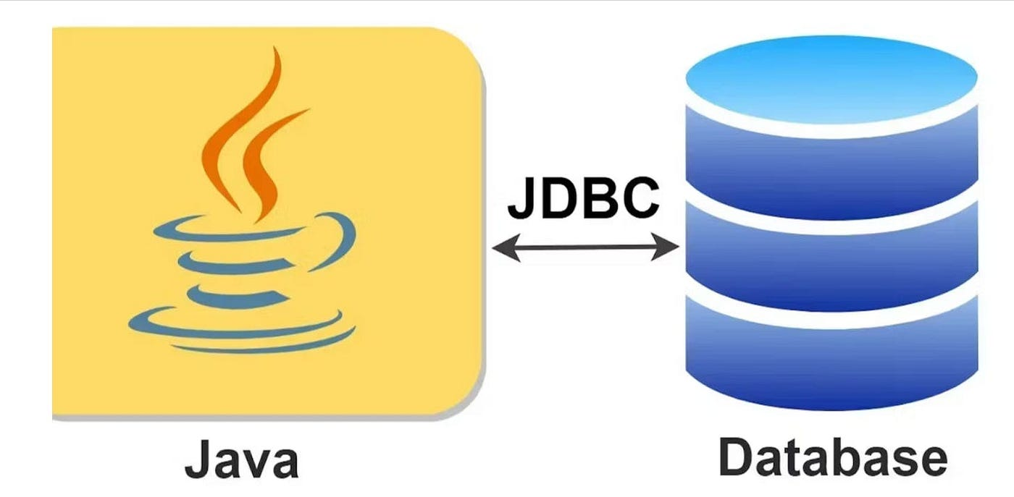
JDBC (Java Database Connectivity) is a standard Java API (Application Programming Interface) that allows Java applications to interact with Various relational databases. In simple words: JDBC is a bridge between Java applications and databases.
JDBC is a specification defined by Java developers (Oracle/Sun). Database vendors provide the implementation of this specification in the form of JDBC driver software. JDBC Specification → JDBC Driver → Database

Slide 3
What JDBC Do-
Establish connections with databases
Execute SQL queries
Retrieve and manipulate data
holds results of sql queries ()
Jdbc is the part of java standard edition.
We don’t need to download jdbc it come with jdk.

Slide 4
Why JDBC need?
First Observe the Scenario: Attendance Tracking System class Student { private int roll; private String name; Student(int roll, String name) { this.roll = roll; this.name = name; } public static boolean attendance(int roll, String name) { // Simple roll call check (for demo, always true) return true; } public int getRoll() { return roll; } public String getName() { return name; } public static void main(String[] args) { // Suppose we want to take attendance for N students Student s1 = new Student(1, "Amit"); Student s2 = new Student(2, "Riya"); ………………………………………………………. Student sN = new Student(N, "Rahul"); int totalAttendance = 0; // Simulating roll call if (attendance(s1.getRoll(), s1.getName())) { totalAttendance++; System.out.println("Present: Roll " + s1.getRoll() + ", Name " + s1.getName()); } …………………………………UPTO N number…………………………………………. System.out.println("Total Attendance in Math class today: " + totalAttendance); }}

Slide 5
Limitation of This Code (Without JDBC)
Volatile Data*
The attendance exists only in RAM while the program is running.
Once you stop the program, all records are gone.
Repetition of Effort*
Every day, every class, and every subject → we must re-enter all student objects again.
No Central Storage*
If you want to know yesterday’s attendance or generate reports, it’s impossible because no data is stored permanently.
Not Scalable*
For N students × multiple subjects × multiple classes, managing objects in code is impractical.
Reduced Code Repetition

Slide 6
Why JDBC is Needed?
JDBC allows us to store student data in a database (MySQL, Oracle, PostgreSQL, etc.).
Attendance records can be inserted into tables and retrieved later whenever required.
This ensures persistence – data remains even after the program ends.
With JDBC:
Store Student Major data (roll, name) in student table.
Store Attendance data (date, roll, subject, status) in attendance table.
Tomorrow, you can query yesterday’s attendance without re-creating objects.
Real-World Mapping
Without JDBC → Attendance register is a whiteboard → erased after every lecture.
With JDBC → Attendance register is a notebook/database → permanent, reusable anytime.

Slide 7
Importance of JDBC
JDBC is crucial for enterprise and real-time applications because:
Database Connectivity*
Almost every software application needs to store, retrieve, and manipulate data.
JDBC enables seamless communication between Java applications and databases like Oracle, MySQL, PostgreSQL, SQL Server, etc.
Platform Independence*
Java is platform-independent, but databases differ in vendors and implementations.
JDBC standardizes access, so Java code works with different databases without major changes.
Vendor Neutrality*
JDBC provides a uniform API. JDBC provides standard Guidelines for db vendors (like Mysql, Mongodb, Oracle )
Underlying vendors supply drivers for their databases, but the developer always uses the same JDBC API.

Slide 8
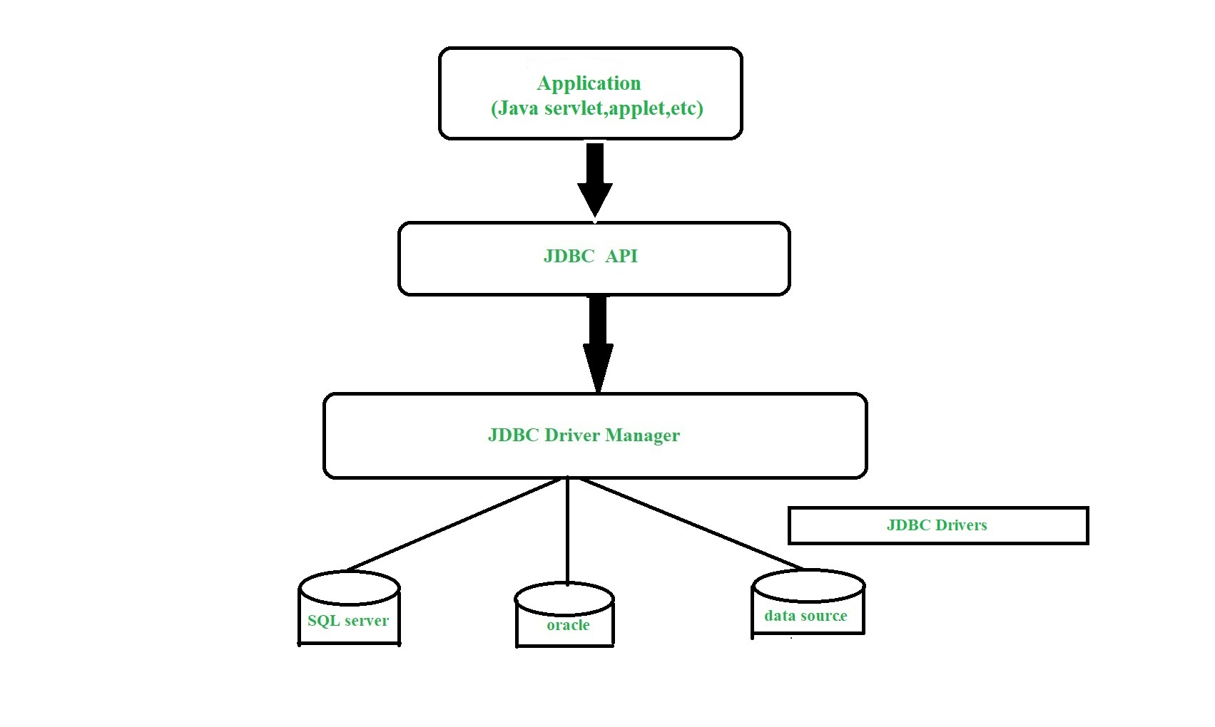
JDBC Architecture
Application → JDBC API → Driver → Database

Slide 9
Components: 1)Driver: It translate Java codes for data specific calls to database, and database specific calls into java code. 2)connection- it helps java application to communicate with database.
3) Statement – It sends sql query from java application to databases, 4) resultset = holds result of sql query.

Slide 10
Session 3 – Steps to Build JDBC Application
1) Load and Register Driver
2) Establish Connection
3) Create Statement
4) Execute SQL Query
5) Process ResultSet
6) Close Connection
Code Example: JdbcDemo.java

Slide 11
import java.sql.*;// we need to import prebuild sql classes cls jdbcdemo throws exception{//to avoid exceptions psvm(str[] args){ Class.forname(“mysql.jdbc.driver”)//check in google for this to according to your db name and version connection con = Drivermanagergetconnection(url,user,pwd);//we need to provide this Statement st = con.createstatment(); ResultSet rs = st.executeQuery()//assume get data from student table while(rs.next()){ int id = rs.getInt("id");
String name = rs.getString("name");
System.out.println("Roll: " + id + ", Name: " + name); } con.close()}}

Slide 12
Workflow of JDBC Calls
1. Load and Register Driver
The JDBC driver is a software component that implements the JDBC API for a specific database (e.g., MySQL, Oracle).
Example:
Class.forName("com.mysql.cj.jdbc.Driver");
2. Establish Connection
The application establishes a connection to the database using `DriverManager`.
Example:
Connection con = DriverManager.getConnection(
"jdbc:mysql://localhost:3306/school", "root", "password");

Slide 13
3. Create Statement Object
A `Statement`, `PreparedStatement`, or `CallableStatement` object is created to send SQL queries.
Example:
Statement stmt = con.createStatement();
4. Execute SQL Query
The SQL command is sent to the database.
Example:
ResultSet rs = stmt.executeQuery("SELECT * FROM student");
5. Process Results
The database returns results, which are stored in a `ResultSet`.
while(rs.next()) {
System.out.println("Roll: " + rs.getInt("id") +
", Name: " + rs.getString("name"));
}
6. Close Connection**
Always close database resources (`ResultSet`, `Statement`, `Connection`) to avoid memory leaks.
rs.close();
stmt.close();
con.close();

Slide 14
Base sql query: create database db1; show databases; use db1; CREATE TABLE student (id INT PRIMARY KEY AUTO_INCREMENT, name VARCHAR(100) NOT NULL ); show tables; desc student; INSERT INTO student (id, name) VALUES (10, 'Amit’); SELECT * FROM student;

Slide 15
public class MySQLJDBCExample {
public static void main(String[] args) throws Exception {
String url = "jdbc:mysql://localhost:3306/db1"; //**check port of your device and search in google url demo according to your db
String user = "root"; //not same as your device
String password = "root"; //not same as your device
Class.forName("com.mysql.cj.jdbc.Driver");//**check this in google for driver class name according to driver name and version
Connection con = DriverManager.getConnection(url, user, password);
System.out.println("✅ Connected to MySQL database!");
Statement stmt = con.createStatement();
ResultSet rs = stmt.executeQuery("SELECT id, name FROM student");
while (rs.next()) {
int id = rs.getInt("id");
String name = rs.getString("name");
System.out.println("Roll: " + id + ", Name: " + name);
}
con.close();
}
}

Slide 16
JDBC Features
Database Independent – works with Oracle, MySQL, PostgreSQL etc. Once you have write a code for database x, with small minor changes and some specific details change like url, password you can easily switch to database y. No needed to change entire code or rewrite new code.
Platform Independent-
Supports CRUD operations
Transactions & Batch Processing
Huge Driver Support

Slide 17
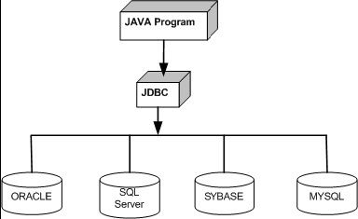
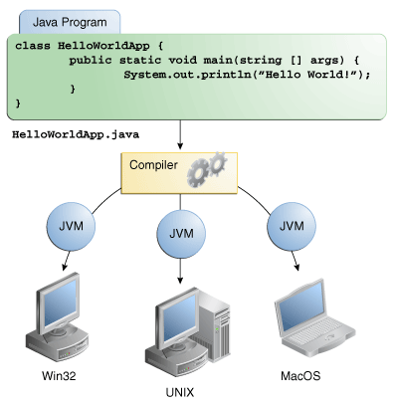
How java db independent?
How java platform
independent?
Diff. btw. JDK, JRE, JVM? Diff. btw compiler, interpreter? Nature of java
MySQL
Drivers oracle

Slide 18
JDBC API
The JDBC API is a collection of classes and interfaces that enable Java applications to connect to databases, send SQL queries, and process results.
It is mainly available in two packages:
java.sql and javax.sql(*)
Contains the core JDBC classes and interfaces.
Used for basic database operations such as connections, statements, and result sets.
Example For Interfaces: Driver, Connection, Statement, PreparedStatement, CallableStatement, ResultSet

Slide 19
JDBC API
Class.forname(“Oracle.driver”)
Driver Class.forname(“Oracle.driver”)JDBC API guideline Implementation
Java Application
JDBC API Guideline what type of classes and interfaces needed that declaration
Db oracle; dbmysql …
Class.forname(mysql.driver)

Slide 20
For Classes: DriverManager,Date,Time,Timestamp,Types javax.sql package
Provides advanced JDBC features, mainly for enterprise-level applications.
Supports connection pooling, distributed transactions, and advanced row set features.
Examples:
For Interfaces: DataSource,RowSet,RowSetListener,ConnectionEventListener
For Classes:RowSetEvent, ConnectionEvent

Slide 21
Summary:
Use java.sql for basic database operations (CRUD, queries).
Use javax.sql for advanced features (connection pooling, row sets, events).

Slide 22
What is a JDBC Driver?
Software component that translates Java JDBC calls → DB-specific protocol.
Without a driver, Java cannot talk to DB.
Provided by DB vendors (Oracle, MySQL, PostgreSQL, etc.).

Slide 23
JDBC Drivers (Types 1–4)
Based on Functionality and Architecture JDBC Drivers divided into 4 types:
Type 1: Bridge Driver
Type 2: Native Driver
Type 3: Network Driver
Type 4: Thin Driver

Slide 24
ODBC
ODBC (Open Database Connectivity) is a standard API developed by Microsoft in 1992.
It allows applications (written in C, C++, VB, etc.) to connect to different relational databases (Oracle, MySQL, SQL Server, DB2, etc.) in a uniform way.
It is part of Microsoft’s Data Access strategy.
In simple words: ODBC is a universal translator that allows different programming languages to talk to different databases.

Slide 25
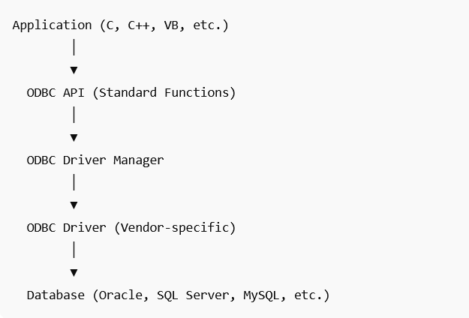
Application: written in C/C++
ODBC API: Standard set of function calls like (SQLConnect, SQLExecDirect, etc.)
Driver Manager: Loads the right driver based on DSN (Data Source Name).
ODBC Driver: Database-specific driver that translates ODBC calls into database-specific commands.
Database: Like Oracle, MySQL, etc.
Architecture of ODBC

Slide 26
Difference Between ODBC and JDBC
Feature* | ODBC (Open Database Connectivity) | JDBC (Java Database Connectivity)
Developer* | Microsoft | Sun Microsystems (Oracle)
Language Support* | Any language (mainly C, C++) | Java only
Platform* | Originally Windows-only | anywhere
Driver Type* | Uses ODBC Drivers | Uses JDBC Drivers
API Style | Procedural (C style functions) | Object-oriented (Java classes & interfaces)
Ease of Use | More complex, requires DSN | Easier, pure Java code
Performance | Slower (extra translation) | Faster (Type 4 drivers are pure Java)
Current Relevance | Legacy systems, Windows apps | Modern Java applications

Slide 27
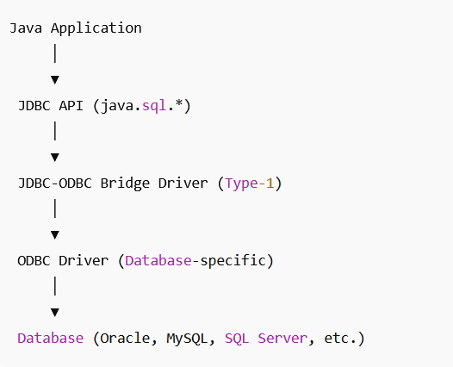
Type 1: Bridge Driver or JDBC-ODBC Bridge Driver It converts JDBC calls → ODBC calls → Database-specific calls. It acts as a bridge between JDBC and ODBC. Driver Class Name = Class.forName("sun.jdbc.odbc.JdbcOdbcDriver");
The JDBC call is translated into an ODBC function call.
Then, the ODBC driver translates it into database-specific calls.

Slide 28
Advantages
No need to install separately, comes with JDK.
Easy to use for beginners.
Can connect to any database according to odbc dvr.
Useful for small projects. Limitations
Slowest driver due to Two layers of translation (JDBC → ODBC → DB).
Platform dependent – Requires ODBC driver, Windows-only.
Not portable – Won’t work on systems without ODBC setup.
Deprecated – Removed from JDK 8.
Not suitable for web-based applications.

Slide 29
import java.sql.*; public class Type1Example { public static void main(String[] args) { try { // Load Type-1 JDBC-ODBC Bridge Driver Class.forName("sun.jdbc.odbc.JdbcOdbcDriver");
// Connect using DSN (Data Source Name) configured in ODBC Connection con = DriverManager.getConnection("jdbc:odbc:studentDSN", "user", "password");
Statement stmt = con.createStatement();
ResultSet rs = stmt.executeQuery("SELECT * FROM students");
while (rs.next()) {
System.out.println("ID: " + rs.getInt(1) + ", Name: " + rs.getString(2)); }
con.close(); } catch (Exception e) { e.printStackTrace(); } } }

Slide 30
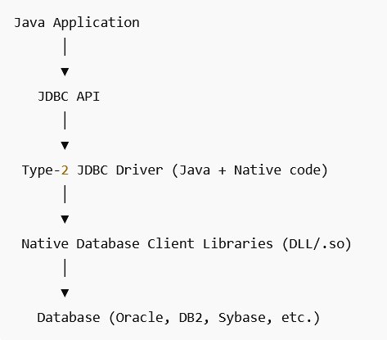
Type-2: Native Driver or Native-API Driver or partly Java Driver It converts JDBC calls → Native Library calls This library calls are understandable by DBs. Driver class name = Class.forName("oracle.jdbc.driver.OracleDriver");

Slide 31
Advantages
Faster than Type-1 . No needed ODBC driver.
Portability is more then Type-1 we can switch windows to mac.
Directly uses the database’s native client API, so it supports all DB features.
Limitations
Requires database client software to be installed on each client machine.
Partly portable – since it depends on native libraries .
Rarely available the native libraries.

Slide 32
import java.sql.*;
public class Type2Example {
public static void main(String[] args) {
try {
// Load Oracle Type-2 Native Driver
Class.forName("oracle.jdbc.driver.OracleDriver");
// Connect using Oracle client libraries
Connection con = DriverManager.getConnection(
"jdbc:oracle:oci:@localhost:1521:xe", "system", "password");
Statement stmt = con.createStatement();
ResultSet rs = stmt.executeQuery("SELECT * FROM students");
while (rs.next()) {
System.out.println("ID: " + rs.getInt(1) +", Name: " + rs.getString(2));
}
con.close();
} catch (Exception e) {
e.printStackTrace();
}
}
}

Slide 33
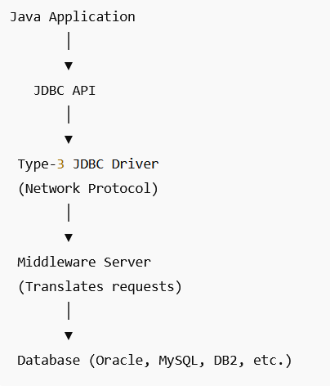
Type-3 driver Network Protocol Driver or Middleware Driver IT do : JDBC API calls → Net protocol → middleware server → database-specific driver. does not talk directly to the database. Instead, it communicates with a middleware server (application server). Two layers of translation Java program sends JDBC requests to net. Protocol API, then it sends/delivers to middle server, and that server translates requests to the database .

Slide 34
Advantages
Database independent – does not need database-specific drivers, only the middleware knows about the DB.
No native library required – Unlike Type-2, no DLL/.so installation needed.
Cross-platform – Works anywhere because the client driver is pure Java.
Limitations
Middleware required – You must install and configure a middleware server.
Extra network needed – Requests go via middleware → slightly slower than Type-2/4.
Complex deployment – Needs additional infrastructure (middleware).
Rare today – Replaced by Type-4 drivers and application servers with built-in pooling.

Slide 35
import java.sql.*;
public class Type3Example {
public static void main(String[] args) {
try {
// Load Type-3 Network Protocol Driver
Class.forName("ids.sql.IDSDriver");
// Connect to middleware server (not directly to DB)
Connection con = DriverManager.getConnection(
"jdbc:ids://localhost:5000/studDB", "user", "password");
Statement stmt = con.createStatement();
ResultSet rs = stmt.executeQuery("SELECT * FROM students");
while (rs.next()) {
System.out.println("ID: " + rs.getInt(1) +", Name: " + rs.getString(2));}
con.close();
} catch (Exception e) {
e.printStackTrace();
}
}}

Slide 36
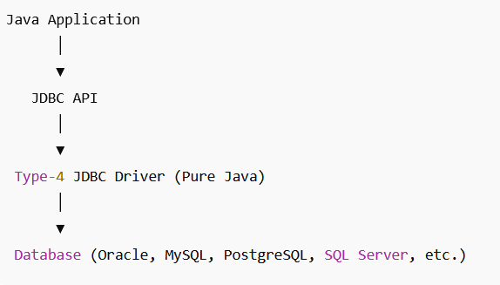
Type-4 driver or Thin Driver or Pure Java Driver.
It converts JDBC calls directly into the database’s native protocol.
It is written entirely in Java → no native libraries, no ODBC, no middleware.
This is the most widely used JDBC driver in real-world Java applications. JDBC calls → Database protocol → Database (direct connection)
Class.forName("com.mysql.cj.jdbc.Driver");

Slide 37
Advantages
Pure Java – portable, platform independent.
Fastest driver – communicates directly with DB protocol (no extra layers).
No client software needed – unlike Type-2, no Oracle Client or DB2 Client required.
Easy deployment – just add the driver JAR to classpath.
Supports all advanced DB features (transactions, batch processing, stored procedures).
Widely supported – every major DB vendor provides a Type-4 driver. Limitations
Vendor specific – each DB has its own driver JAR (Oracle, MySQL, PostgreSQL).
If you switch DB, you must change the driver JAR + connection URL.
Requires internet/intranet connectivity to the database server.
Some advanced features may vary slightly across vendors (not 100% uniform)

Slide 38
import java.sql.*;
public class OracleDriverDemo {
public static void main(String[] args) {
try {
// Load Oracle Thin Driver (optional in JDBC 4+)
Class.forName("oracle.jdbc.driver.OracleDriver");
// Establish connection
Connection con = DriverManager.getConnection(
"jdbc:oracle:thin:@localhost:1521:xe", "system", "password);
if (con != null) {
System.out.println("Oracle Thin Driver connected successfully!");
}
con.close();
} catch (ClassNotFoundException e) {
System.out.println("Driver not found! " + e);
} catch (SQLException e) {
System.out.println("Database connection error! " + e);
}
}
}

Slide 39
Comparison of JDBC Driver Types
Feature | Type 1 | Type 2 | Type 3 | Type 4
Implementation | Java+ODBC | Java+Native | Java+Middleware | Pure Java
Performance | Poor | Avg | Good | Best
Portability | Low | Low | High | High
Setup | Needs ODBC | Needs native libs | Needs middleware | Only JAR
Status | Removed jdk-8 | Legacy | Rare | Standard

Slide 40
Statement It is an interface form java.sql package IT is like a messenger that carries SQL commands from Java to the database. used to execute static SQL queries such as CREATE, INSERT, UPDATE, DELETE, and SELECT. Important Methods
1) executeQuery(String sql)
Used for SELECT queries and Returns a ResultSet ResultSet rs = stmt.executeQuery("SELECT * FROM students");
2) executeUpdate(String sql)
Used for INSERT, UPDATE, DELETE, CREATE, DROP. st.executeUpdate("INSERT INTO student5 (roll, name) VALUES (100, 'aad')");
System.out.println("data added in the table"); 3) execute(String sql)
Can be used for any SQL statement
st.execute("CREATE TABLE student5 (roll INT PRIMARY KEY, name VARCHAR(255) )");
System.out.println("Table is created");

Slide 41
PreparedStatement It is a sub-interface of Statement. It also an interface from java.sql package. It is like a template query that you can fill with values at runtime. used to execute precompiled SQL queries with dynamic parameters. Here SQL is written as a single string with placeholders (?) for values. Example: Connection con = DriverManager.getConnection(
"jdbc:mysql://localhost:3306/school", "root", "password");
PreparedStatement pstmt = con.prepareStatement(
"INSERT INTO students (id, name, age) VALUES (?, ?, ?)"); Important Methods of PreparedStatement
setXXX(int parameterIndex, value)
Used to set values for placeholders (?) in SQL queries.
parameterIndex starts from 1 (not 0).
pstmt.setInt(1, 101); pstmt.setString(2, "Riya");

Slide 42
executeUpdate()
Executes INSERT, UPDATE, DELETE, CREATE TABLE queries.
PreparedStatement pstmt = con.prepareStatement(
"INSERT INTO students (id, name, age) VALUES (?, ?, ?)");
pstmt.setInt(1, 1);
pstmt.setString(2, "Amit");
pstmt.setInt(3, 20);
int rows = pstmt.executeUpdate();
System.out.println(rows + " row(s) inserted.");

Slide 43
executeQuery()
Executes SELECT queries.
Returns a ResultSet object
PreparedStatement pstmt = con.prepareStatement(
"SELECT * FROM students WHERE age > ?");
pstmt.setInt(1, 18);
ResultSet rs = pstmt.executeQuery();
while (rs.next()) {
System.out.println("ID: " + rs.getInt("id") +
", Name: " + rs.getString("name") +
", Age: " + rs.getInt("age"));
}

Slide 44
execute()
Executes any SQL statement (INSERT/UPDATE/DELETE/SELECT)
PreparedStatement pstmt = con.prepareStatement("DELETE FROM students WHERE id = ?");
pstmt.setInt(1, 3);
boolean result = pstmt.execute();
System.out.println("ResultSet returned? " + result);

Slide 45
CallableStatement It is a sub-interface of preparedStatement from java.sql package. used to call stored procedures and stored functions in a database.
Stored procedures are precompiled SQL programs stored in the database itself. CallableStatement cstmt = con.prepareCall("{call procedure_name(?, ?, ?)}"); {call …} syntax is used.
? represents input/output parameters Statement → runs SQL directly.
PreparedStatement → runs parameterized SQL.
CallableStatement → calls stored procedures in DB. Interface Hierarchy:
java.sql.Statement
- java.sql.PreparedStatement
- java.sql.CallableStatement

Slide 46
Method | Purpose | Example
setXXX(int, value) | Sets IN parameter | cstmt.setInt(1, 101);
registerOutParameter(int, sqlType) | Registers OUT parameter with SQL type | cstmt.registerOutParameter(2, Types.VARCHAR);
getXXX(int) | Retrieves OUT parameter value | String name = cstmt.getString(2);
execute() | Executes the stored procedure | cstmt.execute();
executeUpdate() | Executes an update procedure (e.g., INSERT/UPDATE inside procedure) | cstmt.executeUpdate();
executeQuery() | Executes a SELECT-type procedure (returns ResultSet) | ResultSet rs = cstmt.executeQuery();

Slide 47
ResultSetMetaData is an interface in JDBC (java.sql.ResultSetMetaData).
It provides metadata (data about data) of a ResultSet object.
In other words → it tells you column information (name, type, count, precision, etc.) for the query result.
ResultSet = actual query results
ResultSetMetaData = description of those results
ResultSet rs = stmt.executeQuery("SELECT * FROM students");
ResultSetMetaData rsmd = rs.getMetaData();
Use Cases
To build generic database tools (e.g., SQL browsers, ORMs).
When you don’t know the query structure at compile time.
To dynamically display table columns in a UI.

Slide 48
Method | Description | Example
getColumnCount() | Returns number of columns in the result set | rsmd.getColumnCount()
getColumnName(int column) | Returns the column name | rsmd.getColumnName(1)
getColumnTypeName(int column) | Returns DB-specific column type (e.g., VARCHAR, INT) | rsmd.getColumnTypeName(2)
getColumnDisplaySize(int column) | Returns max width of the column | rsmd.getColumnDisplaySize(2)
isNullable(int column) | Checks if column allows NULL values | rsmd.isNullable(3)
isAutoIncrement(int column) | Checks if column is auto-increment | rsmd.isAutoIncrement(1)
getTableName(int column) | Returns the table name of the column | rsmd.getTableName(1)

Slide 49
import java.sql.*;
public class ResultSetMetaDataExample {
public static void main(String[] args) throws Exception{
Class.forName("com.mysql.cj.jdbc.Driver");
Connection con = DriverManager.getConnection(
"jdbc:mysql://localhost:3306/school", "root", "password");
Statement stmt = con.createStatement();
ResultSet rs = stmt.executeQuery("SELECT * FROM students");
// Get metadata
ResultSetMetaData rsmd = rs.getMetaData();
int columnCount = rsmd.getColumnCount();
System.out.println("Total Columns: " + columnCount);
for (int i = 1; i <= columnCount; i++) {
System.out.println("Column " + i + ": " +rsmd.getColumnName(i) + " (" + rsmd.getColumnTypeName(i) + ")");
con.close();
}}

