Slide 1
Introduction to Servlets
Lecture on Advanced Java
Prepared for CSE Students

Slide 3
Basics & History of Web Technologies
The World Wide Web (WWW) was invented in 1991 by Tim Berners-Lee at CERN.
It started as a system to share documents using:
HTML (HyperText Markup Language) → for content and structure.
HTTP (HyperText Transfer Protocol) → for communication.
Web browsers → to display web pages.
The first websites were just collections of static HTML documents displayed by browsers like Mosaic and Netscape.
These sites were mostly informational (text + links + some images).
Main Challenge: Web was read-only and couldn’t handle dynamic content (like forms, user data, shopping carts, etc.).

Slide 4
Evolution of Web Technologies
Static Web – Static HTML pages.
CGI Era– Need for dynamic content → technologies like CGI and Applets introduced.
Late Java Servlets emerged to solve CGI’s performance and scalability issues
Dynamic Web – JavaScript, Servlets, JSP, PHP, ASP.NET enabled dynamic, interactive applications.
Modern Web – Rich Internet Applications, frameworks (React, Angular, Spring Boot), APIs, and microservices.
So the journey is: Static HTML → CGI → Applets → Servlets → JSP → Frameworks → Modern Web Apps (React, Angular, Spring Boot, etc.)

Slide 5
Static Pages (HTML)
HTML (HyperText Markup Language): The backbone of early web pages.
Pages were static, meaning the same content was delivered to every user.
Example:
<html><head><title>My First Page</title></head>
<body> <h1>Welcome to My Website</h1>
<p>This is a static page.</p> </body></html>

Slide 6
Advantages:
Simple and fast.
Good for small websites.
Limitations:
No personalization (same page for everyone).
No interaction with databases or business logic.
Example: A company’s “About Us” page written only in HTML.

Slide 7
Dynamic Pages with CGI (Common Gateway Interface)
CGI allows web servers to execute external programs (usually in C, C++, Perl, or Python) to generate dynamic content. Work-Flow: A user sends a request throughout Browser→ server receive the request and runs a CGI program according request → CGI program can interact with DB or logic to generate HTML response → Server sends generated HTML back to browser.
Advantage: First solution to make websites interactive (log-in, search engines, forms).
Disadvantages:
Performance issue: Each request creates a new process (slow, heavy).
Hard to maintain (code scattered across multiple scripts).
Not portable across platforms easily.

Slide 8
Applets
IT’s a small Java programs embedded inside HTML pages and run on the client-side browser using Java Plugin/JVM. Example: A Java Applet could display animations, calculators, or small games inside the web page.
Advantages:
Platform-independent (Java’s “Write Once, Run Anywhere”).
Could create rich, interactive UIs not possible with HTML alone.
Disadvantages:
Required Java plugin (browser compatibility issues).
Security restrictions (sandbox model).
Slow loading (download + JVM start-up).
Not SEO friendly.
Result: Lost popularity with rise of JavaScript and Servlets.

Slide 9
Introduction of Java Servlets
Java Servlets were introduced by Sun Microsystems as part of Java EE. Servlet is a Java class running on a server, responding to client requests.
It handles HTTP requests and generates responses (usually HTML, JSON, XML).
Servlet Container (like Tomcat, Jetty, JBoss) manages lifecycle: loading, initialization, request handling, destruction.
Architecture:
Browser → HTTP Request → Web Server (with Servlet Container) → Servlet → Response → Browser.
Key Features:
Runs inside JVM (no OS process overhead like CGI).
Multithreaded (one instance can serve multiple requests).
Platform-independent (Java-based).
Can easily connect to databases, APIs, etc

Slide 10
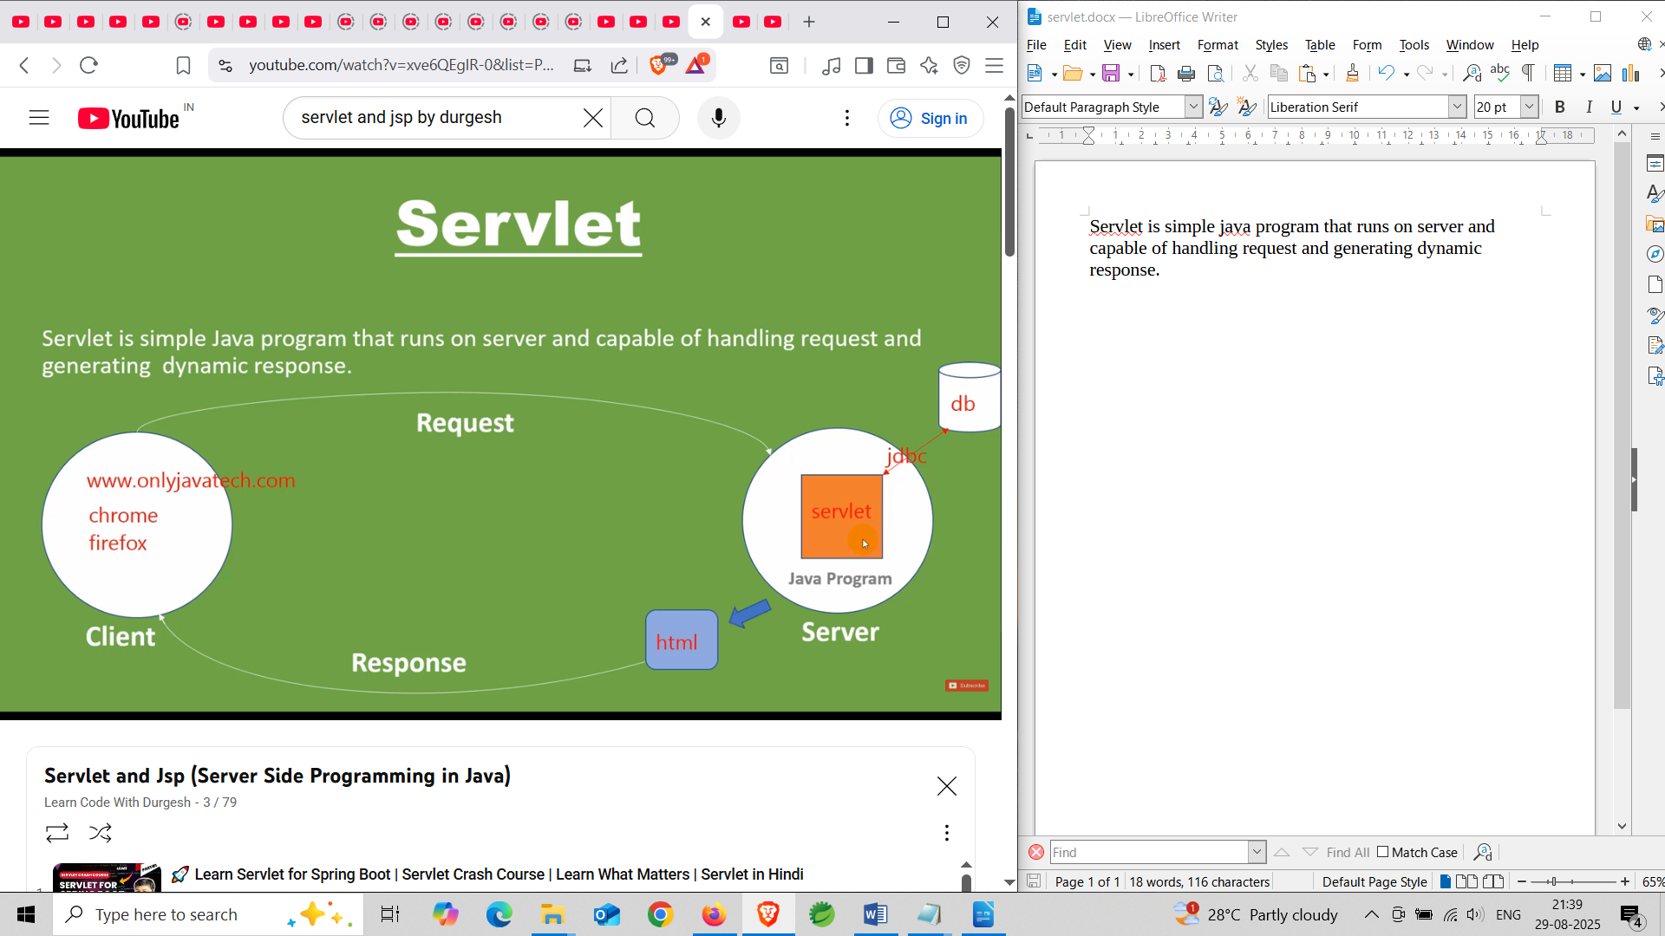

Slide 11
Why Servlets Replaced CGI and Applets
Compared to CGI:
CGI: One process per request → very slow and resource-heavy.
Servlet: Single JVM process with multiple threads → fast and scalable.
Servlets use multithreading instead of spawning new processes → that's why it much faster and more scalable.
Easier to maintain (Java OOP, modular, reusable) and It Can handle complex applications like e-commerce, banking. Compared to Applets:
Applets: Ran on client → browser dependency, security restrictions, plugin issues.
Servlets: Run on server → browser-independent, secure, reliable.
Works seamlessly with HTML, JavaScript, JSP.
Conclusion:
Static Pages → CGI → Applets → Servlets is the natural evolution.
Servlets became the foundation of Java web development.

Slide 12
Strengths of Servlets It uses multi-threading This reduces memory usage and improves performance Efficiency & scalability. Deployment is easy on any web server that supports a Servlet Container. Servlets use Java’s exception handling, memory management (garbage collection), and security features. Due to Java OOP principles easier to build modular, reusable components. Java provides sandboxing, classloaders, and security managers.

Slide 13
Servlet Lifecycle
Loading and Instantiation
The container loads the servlet class into memory.
Creates one instance of the servlet.
This happens only once per servlet.
it like: object creation in Java but managed by the container.
Initialization (init())
After instantiation, the container calls init(ServletConfig config) method.
Purpose: Perform one-time initialization tasks (e.g., open DB connection, read config).
Called only once, just like a constructor in Java.
code: public void init(ServletConfig config) throws ServletException

Slide 14
Request Handling (service(), doGet(), doPost())
For each client request, the container creates request and response objects.
Calls the service(HttpServletRequest req, HttpServletResponse res) method.
Based on request type:
GET request → doGet()
POST request → doPost()
This phase happens many times (once for each request).
Code: public void service(HttpServletRequest req, HttpServletResponse res)
throws ServletException, IOException
Destruction (destroy())
When the server shuts down or servlet is unloaded, the container calls destroy().
Used to release resources (close DB connections, files, etc.).
Called only once in the servlet’s life.
Code:
public void destroy()

Slide 15
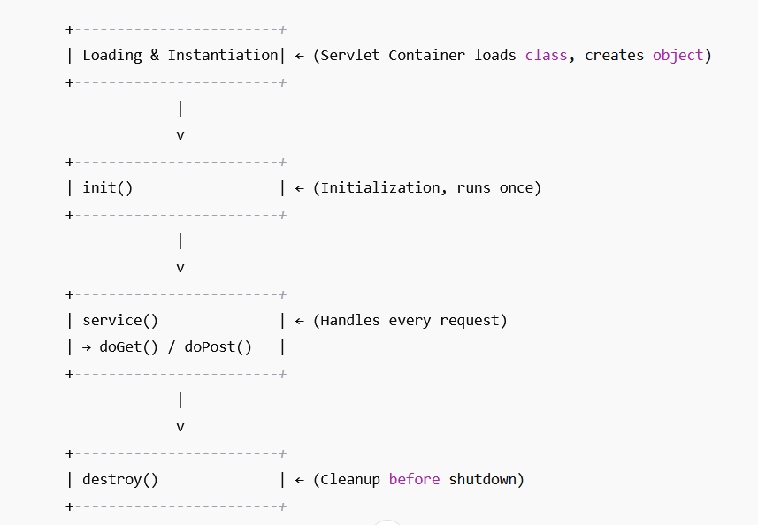
Servlet Lifecycle Flow:

Slide 16
PrintWriter is a Java class from the package java.io.
It provides methods to send text data (like HTML, plain text, numbers, etc.) to the output stream.
In a servlet, the HttpServletResponse (res) object represents the response going back to the client (browser).
res.getWriter() gives a PrintWriter object, which is connected to that response.
So, whatever write with out.println(...) will be sent back to the browser’s page. Code: PrintWriter out = res.getWriter();
out.println("<h1>Hello from Servlet!</h1>");
Methods: print(String s),println(String s), write(String s), flush(), close()
//task: check the methods o/p

Slide 17
Web Server is a technology that: Accepts HTTP requests from client side, Processes those requests, Sends back an HTTP response (usually HTML, CSS, JS, or other resources).
Examples of Web Servers: Apache HTTP Server, Nginx, Microsoft IIS, Jetty, Tomcat (acts as both web server + servlet container) Container is a part of the web server that manages the execution of dynamic web components like Servlets and JSPs.
Types of Containers
Web Container (Servlet Container): Provides the environment for Running lifecycle of Servlets & JSPs or helping request/response handling.
Example: Apache Tomcat (most popular).
EJB Container (Enterprise Java Beans): Runs EJB components in full-fledged enterprise applications.
Example: JBoss/WildFly, GlassFish.

Slide 18
Role of servlet in Web application development:
Servlet Lifecycle Management: Load servlet class; Instantiate it; Call init(), service(), and destroy() appropriately.
Request Handling: Receive client’s request; Create HttpServletRequest and HttpServletResponse objects; Call the servlet’s service() method to process.
Security Management: Handle authentication (login, roles, SSL); Provide access restrictions.
Multithreading Support: Create/manage a thread for each incoming request.
Communication Support: Supports HTTP and sometimes other protocols (HTTPS, WebSocket).
Session Management: Maintain user session using cookies, URL rewriting, or HttpSession.
Middleware Role :Acts as middleware between Frontend (HTML/JSP/JS) and Backend (DB, APIs).

Slide 19
The Servlet API is the foundation of Java web development. It defines:
How a servlet is created, initialized, and destroyed.
How requests and responses are handled.
How sessions, cookies, and configuration are managed.
Def: Servlet API is a set of interfaces, classes, and exceptions that interacts with Web server (like Tomcat) Client (Browser)
Another way: Servlet API is the contract (rules + methods) between java classes and the web container.
Without Servlet API, a servlet is just a plain Java class—it becomes a web component and not able to handle HTTP requests/responses.
Packages in Servlet API: two 1)Jakarta.servlet 2)Jakarta.servlet.http (earlier javax)

Slide 20
Example: protected void doGet(HttpServletRequest request, HttpServletResponse response)
throws ServletException, IOException {
// Step 1: Extract data from request
String name = request.getParameter("name");
// Step 2: Set response type
response.setContentType("text/html");
// Step 3: Send response back
PrintWriter out = response.getWriter();
out.println("<h1>Welcome, " + name + "!</h1>");
}

Slide 21
HTTP (HyperText Transfer Protocol) is the communication protocol used by web browsers (clients) and web servers.
It is a request-response protocol:
Client (browser) sends a request (e.g., clicking a link, submitting a form).
Server (Tomcat/Jetty etc.) processes the request and sends back a response (HTML, JSON, image, etc.).
Methods:
GET → Data sent in URL query string.
POST → Data sent in body of request.
PUT, DELETE, etc. → Used in REST APIs.

Slide 22
Communication Flow Inside HTTP protocol :
HTML → Servlet
User interacts with HTML page (form, button, link).
Browser sends HTTP request (GET or POST) to the server.
Servlet container receives request, finds the correct Servlet mapping.
Servlet executes and processes input.
Servlet sends HTTP response (HTML, JSON, etc.) back to the browser.

Slide 23
Example Code – Communication Between HTML & Servlet: HTML Form (index.html): <!DOCTYPE html>
<html>
<head>
<title>Sum Calculator</title>
</head>
<body>
<h2>Enter Two Numbers</h2>
<!-- Form will send data to the servlet -->
<form action="SumServlet" method="post">
Number 1: <input type="text" name="num1"><br><br>
Number 2: <input type="text" name="num2"><br><br>
<input type="submit" value="Calculate Sum">
</form>
</body>
</html>
Here:
action="SumServlet" → URL pattern defined in Servlet (@WebServlet("/SumServlet")).
method="post" → Data will be sent via HTTP POST request.

Slide 24
Servlet Code (SumServlet.java)
protected void doPost(HttpServletRequest req, HttpServletResponse res) throws ServletException, IOException {
// Get input from HTML form
String n1 = req.getParameter("num1");
String n2 = req.getParameter("num2");
int sum = Integer.parseInt(n1) + Integer.parseInt(n2);
// Send response back to browser
res.setContentType("text/html");
PrintWriter out = res.getWriter();
out.println("<h2>Sum of " + n1 + " and " + n2 + " is: " + sum + "</h2>");
}

Slide 25
Web Flow Explanation
1.User opens index.html → enters numbers → clicks submit.
2.Browser sends POST request:
POST /SumServlet HTTP/1.1
Host: localhost:8080
Content-Type: application/x-www-form-urlencoded
Body: num1=10&num2=20
3.Servlet reads request parameters:
String n1 = req.getParameter("num1");
String n2 = req.getParameter("num2");
4.Servlet processes → sends response:
HTTP/1.1 200 OK
Content-Type: text/html
<h2>Sum of 10 and 20 is: 30</h2>
5.Browser displays result on the page.

Slide 26
Difference Between GET and POST
Using GET (data in URL)
<form action="SumServlet" method="get">
...
</form>
Request looks like: GET /SumServlet?num1=10&num2=20
Using POST (data in body, safer for sensitive info)
<form action="SumServlet" method="post">
...
</form>
Request body contains:num1=10&num2=20

Slide 27
Summary:
HTTP is request-response protocol.
Servlets act as request handlers that process client input and return responses.
HTML forms + Servlet demonstrate communication flow.
Use GET for small data (search, navigation) and POST for sensitive/large data (login, registration, calculations).

Slide 28
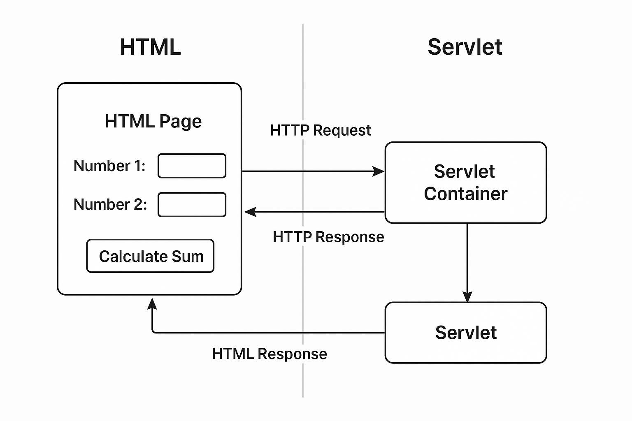

Slide 29
3 Types of Servlet: Servlet Interface, Generic-Servlet Class and HttpServlet Class
Servlet Interface (Low-level type)
The base interface (jakarta.servlet.Servlet) that every servlet must implement.
Methods to implement:
init(ServletConfig config) ,service(ServletRequest req, ServletResponse res), destroy(), getServletConfig(), getServletInfo()
Key Features:
Lowest-level API (not commonly implemented directly).
Usually extended through GenericServlet or HttpServlet.

Slide 30
import java.io.*;
import jakarta.servlet.*;
public class MyServlet implements Servlet {
@Override
public void init(ServletConfig config) { }
@Override
public void service(ServletRequest req, ServletResponse res) throws IOException {
res.setContentType("text/html");
PrintWriter out = res.getWriter();
out.println("<h2>Hello from Servlet Interface</h2>");
}
@Override
public void destroy() { }
@Override
public ServletConfig getServletConfig() { return null; }
@Override
public String getServletInfo() { return "Basic Servlet"; }
}

Slide 31
GenericServlet is an abstract class provided in the jakarta.servlet package. It implements the Servlet interface and provides implementations for all methods except service().
Designed to handle any protocol, not just HTTP.
Key Features:
Protocol independent (not tied to HTTP).
Developer must override the service() method.
Rarely used in practice for web apps (since most are HTTP-based).

Slide 32
import java.io.*;
import jakarta.servlet.*;
public class MyGenericServlet extends GenericServlet {
@Override
public void service(ServletRequest req, ServletResponse res) throws IOException, ServletException {
res.setContentType("text/html");
PrintWriter out = res.getWriter();
out.println("<h2>Hello from GenericServlet</h2>");
}
}

Slide 33
HttpServlet is a subclass of GenericServlet designed specifically for HTTP protocol.
It provides specialized methods like:
doGet(), doPost(), doPut(), doDelete(), doHead(), etc.
Key Features:
Most commonly used servlet in web applications.
Saves effort: instead of overriding service(), we just override methods like doGet() or doPost().

Slide 34
import java.io.*;
import jakarta.servlet.*;
import jakarta.servlet.http.*;
public class MyHttpServlet extends HttpServlet {
@Override
protected void doGet(HttpServletRequest req, HttpServletResponse res) throws IOException {
res.setContentType("text/html");
PrintWriter out = res.getWriter();
out.println("<h2>Hello from HttpServlet (GET request)</h2>");
}
@Override
protected void doPost(HttpServletRequest req, HttpServletResponse res) throws IOException {
res.setContentType("text/html");
PrintWriter out = res.getWriter();
out.println("<h2>Hello from HttpServlet (POST request)</h2>");
}
}

Slide 35
Servlet Hierarchy: Servlet (interface)
↑
GenericServlet (abstract class, protocol independent)
↑
HttpServlet (abstract class, HTTP specific)
Type | Inheritance | Protocol Support | When to Use
Servlet (Interface) | Interface | Any protocol | Rarely, for full control
GenericServlet | Abstract class (implements Servlet) | Any protocol | If not limited to HTTP
HttpServlet | Extends GenericServlet | HTTP only | Almost always (web apps)

Slide 36
Life cycle of Servlets and different life cycle methods: A Servlet Life Cycle is the process through which a servlet goes during its execution in a web container (like Tomcat).
There are 3 main stages:
1.Loading and Initialization:
When the web application is started, or when the servlet is first requested, the Servlet container loads the servlet class.
Then it calls the init() method once in the whole lifecycle.
This is used to initialize resources like DB connections, files, etc.
Code: public void init(ServletConfig config) throws ServletException

Slide 37
2.Request Handling:
For each client request, the servlet container calls the service() method.
The service() method:
Checks the type of request (GET, POST, PUT, DELETE, etc.).
Dispatches the request to appropriate methods:
doGet(), doPost(), doPut(), doDelete(),etc.
codes:
public void service(ServletRequest req, ServletResponse res)
throws ServletException, IOException
In HttpServlet, you usually override doGet() or doPost() instead of service().

Slide 38
3.Destruction:
When the servlet is removed from service (e.g., server shutdown, app reload, or container decides to unload it), the destroy() method is called once.
Used to release resources like DB connections, files, threads etc.
code: public void destroy()
Servlet Life Cycle Flow(already discussed check sld no: 12-14 )
Load Class → Servlet class is loaded by container.
Create Instance → A single object of servlet is created.
Call init() → Initialize servlet resources.
Call service() → For each request (dispatches to doGet(), doPost()).
Call destroy() → When servlet is terminated.

Slide 39
import java.io.*;
import jakarta.servlet.*;
import jakarta.servlet.http.*;
public class LifeCycleDemo extends HttpServlet {
@Override
public void init() throws ServletException {
System.out.println("Servlet initialized!");
}
@Override
protected void doGet(HttpServletRequest req, HttpServletResponse res) throws IOException {
PrintWriter out = res.getWriter();
out.println("<h2>Hello! This is a GET request.</h2>");
}
@Override
public void destroy() {
System.out.println("Servlet destroyed!");
}
}

Slide 40
Important Life Cycle Methods:
Method | When Called | Purpose
init() | Once, at servlet initialization | Initialize resources (DB connections, config, etc.)
service() | For each client request | Handles requests, delegates to doGet(), doPost(), etc.
destroy() | Once, when servlet is removed | Clean up resources (close DB, files, etc.)
doGet() | When HTTP GET request is sent | Handle GET (read/display data)
doPost() | When HTTP POST request is sent | Handle POST (submit form data)

Slide 41
doGet(): Use GET when you want to fetch something.
Sends data as query string in the URL.
Data is visible in the browser (less secure).
Has a size limit (usually ~2KB).
Request can be bookmarked, cached, stored in history.
Generally used for retrieving or fetching data (search, filters, navigation).
Idempotent → calling it multiple times does not change data. Html Get method: <form action="HomePage" method=“get"> Username: <input type="text" name="username" /> Password: <input type="password" name="password" /> <input type="submit" value="Login" /></form>

Slide 42
Java class/ servlet code for Get: @WebServlet("/HomePage")
public class HomePage extends HttpServlet {
@Override
protected void doGet(HttpServletRequest req, HttpServletResponse res) throws IOException {
String name = req.getParameter("name");
String age = req.getParameter("age");
PrintWriter out = res.getWriter();
out.println("GET Request: Hello " + name + ", your age is " + age);
}
}

Slide 43
doPost(): Use POST when you want to send/submit something.
Sends data inside the request body.
Data is hidden from the URL (more secure).
Can send large amounts of data (no fixed size limit).
Request is not cached or bookmarked by default.
Generally used for submitting data (login, signup, payments, CRUD).
Not idempotent → multiple calls may create/update/delete data.
Html code for post method:
<form action="HomePage" method="post">
Username: <input type="text" name="username" />
Password: <input type="password" name="password" />
<input type="submit" value="Login" />
</form>

Slide 44
Servlet for post method: @WebServlet("/HomePage")
public class HomePage extends HttpServlet {
@Override
protected void doPost(HttpServletRequest req, HttpServletResponse res) throws IOException {
String username = req.getParameter("username");
String password = req.getParameter("password");
PrintWriter out = res.getWriter();
out.println("POST Request: Username = " + username + ", Password = " + password);
}
}

Slide 45
Difference between doGet() and doPost():
Feature | doGet() | doPost()
Purpose | Used to retrieve information from the server (safe, idempotent operations). | Used to send data to the server (form submission, data update).
Request Type | HTTP GET | HTTP POST
Data in URL | Data is sent appended to the URL as query string (e.g., /HomePage?name=&age=). | Data is sent inside the request body (hidden from URL).
Visibility | Parameters are visible in URL (less secure). | Parameters are hidden in body (more secure).
Data Limit | Limited to around 2048 characters (depends on browser/server). | Practically unlimited (depends on server memory).
Caching | GET requests are often cached by browser and stored in history. | POST requests are not cached by default.
Idempotency | GET is idempotent → multiple GETs give same result. | POST is not idempotent → multiple POSTs may change data.
Use Case | Searching, fetching data, navigation. | Submitting forms (login, signup, payments).

Slide 46
<!DOCTYPE html>
<html>
<head>
<title>Servlet Generating HTML</title>
</head>
<body>
<h2>Enter Your Details</h2>
<form action="HtmlServlet" method="get">
Name: <input type="text" name="username" /><br><br>
Age: <input type="number" name="age" /><br><br>
<input type="submit" value="Submit" />
</form>
</body>
</html>

Slide 47
@WebServlet("/HtmlServlet")
public class HtmlServlet extends HttpServlet {
@Override
protected void doGet(HttpServletRequest req, HttpServletResponse res)
throws ServletException, IOException {
// Set response type as HTML
res.setContentType("text/html");
PrintWriter out = res.getWriter();
// Get data from user
String name = req.getParameter("username");
String age = req.getParameter("age");

Slide 48
// Generate dynamic HTML output
out.println("<html>");
out.println("<head><title>Response Page</title></head>");
out.println("<body style='font-family:Arial; background-color:#f2f2f2;'>");
out.println("<h2 style='color:blue;'>Servlet Generated HTML</h2>");
out.println("<p><b>Hello, " + name + "!</b></p>");
out.println("<p>Your age is: " + age + "</p>");
// Example of HTML table
out.println("<h3>Your Details in Table</h3>");
out.println("<table border='1' cellpadding='10'>");
out.println("<tr><th>Name</th><th>Age</th></tr>");
out.println("<tr><td>" + name + "</td><td>" + age + "</td></tr>");
out.println("</table>");
out.println("</body>");
out.println("</html>");
}
}

Slide 49
Workflow
User opens index.html, enters name and age, clicks submit.
Request goes to HtmlServlet.
Servlet:
Reads request parameters (username, age).
Generates dynamic HTML using out.println().
Browser displays the generated HTML page.

Slide 50
Task: Collecting Client submitted data in a Servlet. Show html code tell to make servlet <!DOCTYPE html>
<html>
<head>
<title>Client Data Form</title>
</head>
<body>
<h2>Enter Your Details</h2>
<form action="DataServlet" method="post">
Name: <input type="text" name="username"><br><br>
Email: <input type="email" name="email"><br><br>
Age: <input type="number" name="age"><br><br>
<input type="submit" value="Submit">
</form>
</body>
</html>

Slide 51
@WebServlet("/DataServlet")
public class DataServlet extends HttpServlet {
@Override
protected void doPost(HttpServletRequest req, HttpServletResponse res)
throws ServletException, IOException {
res.setContentType("text/html");
PrintWriter out = res.getWriter();
// Collect client data
String name = req.getParameter("username");
String email = req.getParameter("email");
String age = req.getParameter("age");
// Display output
out.println("<html><body>");
out.println("<h2>Client Submitted Data</h2>");
out.println("<p><b>Name:</b> " + name + "</p>");
out.println("<p><b>Email:</b> " + email + "</p>");
out.println("<p><b>Age:</b> " + age + "</p>");
out.println("</body></html>");
}}

Slide 52
Connection pooling is a technique used in web applications where a pool (collection) of database connections is created and maintained.
Instead of opening a new connection every time a client (Servlet, JSP, etc.) needs the database, the servlet borrows a connection from the pool, uses it, and then returns it for reuse.
This makes database communication much faster, efficient, and scalable.
Why Do We Need Connection Pooling?
Opening and closing DB connections is expensive (network round-trip, authentication, resource allocation).
In a busy web app with 1000 users, if each request creates a new connection → the DB server crashes.
Pooling solves this by reusing a fixed number of connections.

Slide 53
How It Works (Step by Step)
At Startup , A pool manager creates, say, 10 DB connections and stores them in a pool.
When Client Request come, Servlet asks the pool for a connection. Then Pool gives one already-open connection.
Servlet runs SQL using that connection.
After completing the query servlet does not go for closing the connection → it returns it to the pool.
Connection is now free for another request.
If all 10 are busy and an 11th request comes → it waits, or pool temporarily creates more connections (up to a max limit).

Slide 54
How it works:
pom.xml → adds MySQL + Servlet API.
web.xml → declares resource reference jdbc/mydb.
context.xml → configures pool (max 20 connections).
Servlet → gets DataSource via JNDI lookup → borrows a connection → inserts + queries DB.
Connection is returned to pool after request.

Slide 55
Tomcat’s config (conf/context.xml) or META-INF/context.xml <Context>
<Resource name="jdbc/mydb"
auth="Container"
type="javax.sql.DataSource"
maxTotal="20"
maxIdle="5"
maxWaitMillis="10000"
username="root"
password="root"
driverClassName="com.mysql.cj.jdbc.Driver"
url="jdbc:mysql://localhost:3306/db1"/>
</Context>

Slide 56
Pom.xml <project ..............................................>
<modelVersion>4.0.0</modelVersion>
<groupId>com.example</groupId>
<artifactId>ServletDBDemo</artifactId>
<version>1.0-SNAPSHOT</version>
<packaging>war</packaging>
<dependencies>
<!-- Servlet API (provided by Tomcat) -->
<dependency>
<groupId>jakarta.servlet</groupId>
<artifactId>jakarta.servlet-api</artifactId>
<version>6.0.0</version>
<scope>provided</scope>
</dependency>
<!-- MySQL JDBC driver -->
<dependency>
<groupId>mysql</groupId>
<artifactId>mysql-connector-j</artifactId>
<version>8.0.33</version>
</dependency>
</dependencies>
</project>

Slide 57
Inside WEB-INF/web.xml: <?xml version="1.0" encoding="UTF-8"?>
<web-app xmlns=“……………………………….">
<display-name>ServletDBDemo</display-name>
<!-- Resource Reference -->
<resource-ref>
<description>DB Connection Pool</description>
<res-ref-name>jdbc/mydb</res-ref-name>
<res-type>javax.sql.DataSource</res-type>
<res-auth>Container</res-auth>
</resource-ref>
<welcome-file-list>
<welcome-file>index.html</welcome-file>
</welcome-file-list>
</web-app>

Slide 58
Insert Servlet public class InsertUserServlet extends HttpServlet {
private DataSource dataSource;
@Override
public void init() throws ServletException {
try {
Context initContext = new InitialContext();
Context envContext = (Context) initContext.lookup("java:comp/env");
dataSource = (DataSource) envContext.lookup("jdbc/mydb");
} catch (Exception e) {
throw new ServletException("DB Pool Init Failed", e);
}
}
@Override
protected void doPost(HttpServletRequest request, HttpServletResponse response)
throws ServletException, IOException {
response.setContentType("text/html");
PrintWriter out = response.getWriter();
String name = request.getParameter("name");
String email = request.getParameter("email");

Slide 59
try (Connection con = dataSource.getConnection()) {
String insertSQL = "INSERT INTO users (name, email) VALUES (?, ?)";
PreparedStatement ps = con.prepareStatement(insertSQL);
ps.setString(1, name);
ps.setString(2, email);
ps.executeUpdate();
out.println("<h3>User inserted successfully!</h3>");
ResultSet rs = con.createStatement().executeQuery("SELECT * FROM users");
while (rs.next()) {
out.println("<p>" + rs.getInt("sl") + " - " +
rs.getString("name") + " - " +
rs.getString("email") + "</p>");
}
} catch (Exception e) {
e.printStackTrace(out);
}
}
}

Slide 60
Index.html <!DOCTYPE html>
<html>
<head>
<title>User Form</title>
</head>
<body>
<h2>Insert User</h2>
<form action="InsertUser" method="post">
Name: <input type="text" name="name" /><br/>
Email: <input type="email" name="email" /><br/>
<input type="submit" value="Submit" />
</form>
</body>
</html>

Slide 61
public class UserServlet extends HttpServlet {
// Inject DataSource from Tomcat Pool
@Resource(name = "jdbc/mydb")
private DataSource dataSource;
@Override
protected void doGet(HttpServletRequest req, HttpServletResponse resp)
throws ServletException, IOException {
resp.setContentType("text/html");
PrintWriter out = resp.getWriter();
try (Connection con = dataSource.getConnection()) {
// Query
PreparedStatement ps = con.prepareStatement("SELECT * FROM users");
ResultSet rs = ps.executeQuery();
out.println("<h2>Users from DB</h2>");
while (rs.next()) {
out.println("<p>" + rs.getInt("sl") + " - " +
rs.getString("name") + " - " +
rs.getString("email") + "</p>");
}
} catch (Exception e) {
e.printStackTrace(out);
}
}
}

Slide 62
View.html <!DOCTYPE html>
<html>
<head>
<title>Connection Pool Demo</title>
</head>
<body>
<h1>Test Connection Pool</h1>
<form action="UserServlet" method="get">
<input type="submit" value="Show Users" />
</form>
</body>
</html>

Slide 63
<servlet>
<servlet-name>HelloServlet</servlet-name>
<servlet-class>com.example.HelloServlet</servlet-class>
</servlet>
<servlet-mapping>
<servlet-name>HelloServlet</servlet-name>
<url-pattern>/hello</url-pattern>
</servlet-mapping>

Slide 64
Servlet chaining means one servlet passes the request to another servlet (sometimes multiple) for further processing.
RequestDispatcher.forward()
Forwarding is server-side.
The first servlet (or JSP) forwards the same request and response objects to another resource (servlet/JSP/HTML).
The client/browser is not aware of the forward; the URL in the browser remains unchanged.
Faster (no extra network round trip).
Can only forward inside the same web application. RequestDispatcher rd = request.getRequestDispatcher("WelcomeServlet");
rd.forward(request, response);

Slide 65
sendRedirect()
Redirection is client-side.
The server sends an HTTP 302 response with the new URL.
The browser makes a new request to the redirected resource.
URL in browser changes to the new target URL.
Slower (extra request/response cycle).
Can redirect to resources inside or outside the application (even another domain).
response.sendRedirect("https://www.google.com");
Use forward() when you want to keep request data and navigate inside the app.
Use sendRedirect() when you want to change the URL, go outside the app, or avoid form resubmission.

Slide 66
Example showing both:
if ("admin".equals(username)) {
// forward internally
RequestDispatcher rd = request.getRequestDispatcher("WelcomeServlet");
rd.forward(request, response);
} else {
// redirect externally
response.sendRedirect("error.html");
}

Slide 67
Differences:
Feature | forward() (RequestDispatcher) | sendRedirect()
Type | Server-side | Client-side
Request/Response | Same objects are shared | New request is created
Browser URL | Does NOT change | Changes to the new target
Performance | Faster (one request) | Slower (two requests)
Scope | Same application only | Can redirect to any domain/application
Use case | Internal navigation (e.g., servlet → JSP) | Redirect after form submit, or to another app/site

Slide 68
ServletConfig is an object created by the servlet container (like Tomcat).
It is used to pass configuration information (initialization parameters) to a servlet during deployment.
It is unique per servlet (every servlet has its own ServletConfig object).
Uses:
Sometimes a servlet needs custom data like database connection info, file paths, or admin email.
Instead of hardcoding these values in code, we declare them in web.xml (deployment descriptor).
ServletConfig helps the servlet read those values at runtime.

Slide 69
Methods of ServletConfig
String getInitParameter(String name)
→ Returns the value of a given initialization parameter.
Enumeration<String> getInitParameterNames()
→ Returns all initialization parameter names.
ServletContext getServletContext()
→ Returns the ServletContext object (application-wide scope).
String getServletName()
→ Returns the name of the servlet. Workflow:
You define init-params in web.xml.
Servlet container creates a ServletConfig object for the servlet.
Servlet can call getInitParameter() to read them

Slide 70
<servlet>
<servlet-name>MyServlet</servlet-name>
<servlet-class>servletdemo.MyServlet</servlet-class>
<init-param>
<param-name>dbUser</param-name>
<param-value>root</param-value>
</init-param>
<init-param>
<param-name>dbPassword</param-name>
<param-value>root123</param-value>
</init-param>
</servlet>
<servlet-mapping>
<servlet-name>MyServlet</servlet-name>
<url-pattern>/MyServlet</url-pattern>
</servlet-mapping>

Slide 71
private String dbUser;
private String dbPassword;
@Override
public void init(ServletConfig config) throws ServletException {
super.init(config);
dbUser = config.getInitParameter("dbUser");
dbPassword = config.getInitParameter("dbPassword");
}
@Override
protected void doGet(HttpServletRequest request, HttpServletResponse response)
throws ServletException, IOException {
response.setContentType("text/html");
PrintWriter out = response.getWriter();
out.println("<h2>ServletConfig Example</h2>");
out.println("<p>DB User: " + dbUser + "</p>");
out.println("<p>DB Password: " + dbPassword + "</p>");

Slide 72
A Servlet Filter is an object that performs filtering tasks on requests to a resource (servlet, JSP, static file) and on responses from that resource.
Think of it as a middleware: it sits between the client and the servlet. Common Uses of Filters:
Authentication & Authorization → Checking login before allowing access.
Logging & Auditing → Recording request/response info.
Compression → Compressing response data.
Cross-Cutting Concerns → Security, performance monitoring.

Slide 73
Wrappers are decorator classes provided by Servlet API:
HttpServletRequestWrapper, HttpServletResponseWrapper
They let you wrap (decorate) the request or response object to modify behavior without changing original classes.
Common Uses:
Modify request parameters (e.g., trim whitespace, sanitize input).
Change response headers or add custom content.
Encrypt/decrypt data.
Implement caching. Filter → A middleware component that can preprocess & postprocess requests/responses.
Wrapper → A decorator for HttpServletRequest or HttpServletResponse that modifies their behavior.

Slide 74
A Servlet Listener is a special class in the Servlet API that monitors events in a web application.
These events may be related to:
Application lifecycle (start/stop), Session lifecycle (create/destroy), Request lifecycle (start/finish)
Attribute changes in application/session/request scopes
Listeners as observers that listen to events and execute code automatically when those events happen.

Slide 75
Types of Listener(6)
Listener | Monitors Events
ServletContextListener | Application start/stop
ServletContextAttributeListener | Attributes in application scope
HttpSessionListener | Session create/destroy
HttpSessionAttributeListener | Session attribute changes
ServletRequestListener | Request create/destroy
ServletRequestAttributeListener | Request attribute changes

Slide 76
Session Tracking is the technique used to maintain state (data) across multiple requests from the same user (client). A cookie is a small piece of information stored on the client’s browser by the server. HttpSession is a server-side session tracking mechanism provided by the Servlet API.
It stores user-specific data on the server, and a unique session ID is maintained for each client.

Slide 77
A hidden field in HTML is an <input> element with type="hidden".
It is not visible to the user on the webpage.
It is mainly used to store and send data from client to server without displaying it in the form. URL Rewriting is a technique of session tracking in which data (usually a session ID or extra parameters) is appended to the URL itself.
The server can then recognize the client using that information.

Slide 78
Annotation-based Servlets?
Traditionally, we needed to configure servlets inside web.xml using <servlet> and <servlet-mapping> tags.
But since Servlet 3.0 (Java EE 6 / Jakarta EE), we can use annotations (Java metadata) to declare servlet configuration inside the servlet class itself, without web.xml.

