Slide 1

Transforming Retailer-Customer Experience Using BlockChain Approach
Akashnidhi B Prasad(1SI15CS007)
Arup Das(1SI15CS015)
Ashmani Kumar(1SI15CS017)
Harsh Raj(1SI15CS042)

Slide 2




AGENDA

Slide 3



WHAT IS BLOCKCHAIN?
The Blockchain is an interminable extending enumeration of records, described as blocks that are associated and protected through some cryptographic techniques.
Developed in October 2008
Satoshi Nakamoto

Slide 4


PROBLEM DESCRIPTION
Present Supermarket Scenario
Transactional marketing strategy is used to entice customers.
More than nine lakh Americans are casual labourers in such outlets.
Customers unable to use discount coupons of one branch of the outlet in another.

Slide 5
PROPOSED SOLUTION
Objective
Maintain a Blockchain of Customers.
Reward customers using Value-Coins.
Maintain immutable list of transaction record.

Slide 6
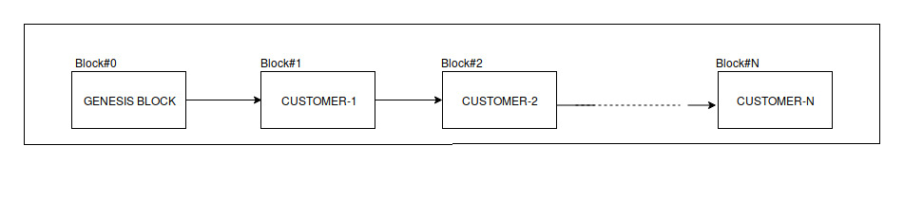

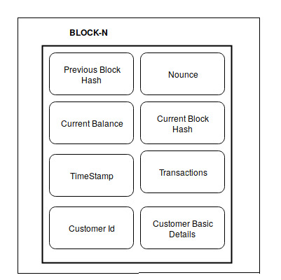
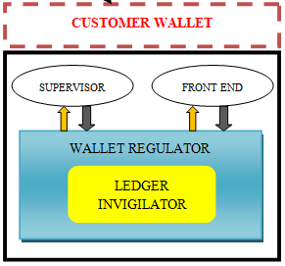

APPROACH
System Architecture

Slide 8
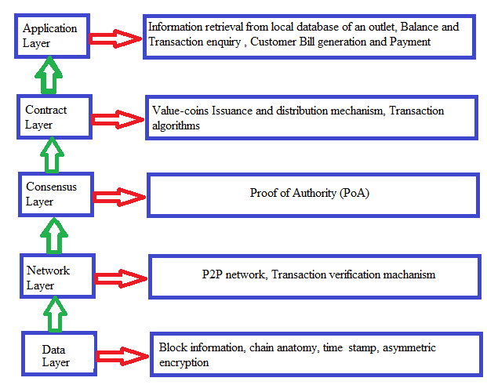
LAYER PATTERN ARCHITECTURE
Blockchain Technology Architecture

Slide 9
Algorithms Used
Block Creation
Construction of E-Wallet
UTXO
ECDSA algorithm
SHA-256
Attribute Based Encryption
POA
i. AuRa
ii. Clique

Slide 10
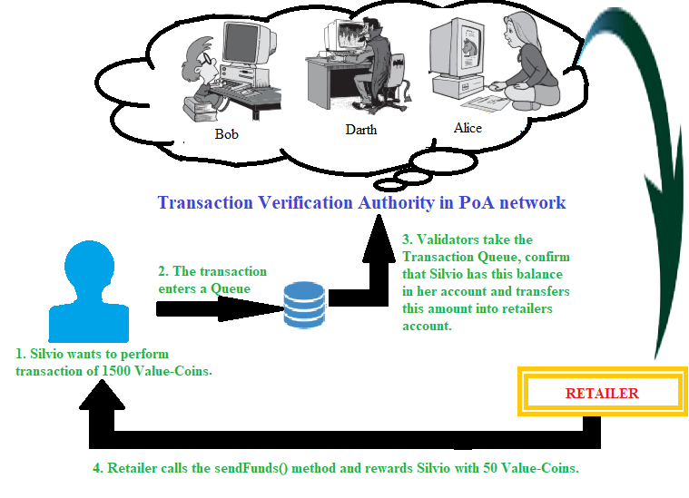
HOW THE ALGORITHMS WORK TOGETHER?

Slide 11




FUTURE ENHANCEMENTS

Slide 12

Any Questions?

