Slide 1
Welcome to Our Project

Slide 2
PROJECT NAME: ONLINE SHOP

Slide 3
Our Group Member’s
MD Habibul Basar Faruq (18701006)
Arup Dutta Bappy (18701010)
Saiful Islam Tarek (18701022)
Nishan Barua (17701033)

Slide 4
Role of Project Members:
MD Habibul Basar Faruq (Project Manager)
Arup Dutta Bappy (Project Analyst)
Saiful Islam Tarek (Designer & Coder)
Nishan Barua (Tester)

Slide 5

Introduction:
Online shopping is a process whereby consumers directly buy products or services over internet.

Slide 6
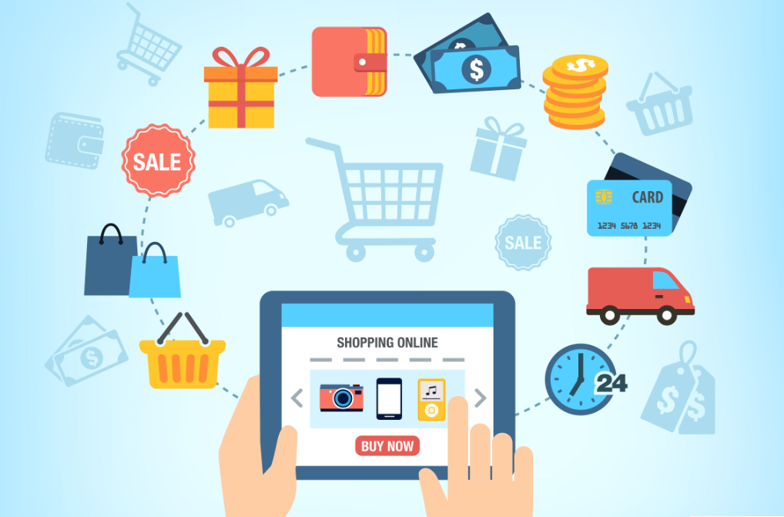
Why Online Shopping ?
There are many advantages of online shopping; this is the reason why online stores are a booming business today. Online shopping includes buying clothes, gadgets, shoes, appliances, or even daily groceries. Listed below are several online shopping advantages and these are the following.
Advantage of Online shopping:
Easy to find products.
It saves time and energy.
Comparison of Prices.
Buyer protection.
Easier to find rare products.
24/7 availability.

Slide 7
Tools Required :
Web Browser (Chrome)
IDE (Atom)
Programming Languages (Bootstrap, JavaScript, PHP)

Slide 8
Conclusion:
Online shopping is continuously becoming more popular and improving every single day. As the world responds to the coronavirus (COVID-19) pandemic, we’re seeing a dramatic shift from in-person to online shopping. Consumers are relying on the digital world more than ever and businesses are forced to adapt their strategies and shift toward digital transformation with much more urgency than before.

Slide 9
Thank You Q/A

