Slide 1
SDN Assisted Routing in IoT
By:-
Arup Kar (CSB17031)
Rishabh Trivedi (CSB17063)
Masood Rehman (CSB17070)

Slide 2
INTROODUCTION
The Internet of Things (IoT) is a system of interrelated computing devices, mechanical and digital machines, objects, animals or people that are provided with unique identifiers and the ability to transfer data over a network without requiring human-to-human or human-to-computer interaction. Some characteristics of IOT involve:-
Efficient, scalable architecture
Unambiguous naming and addressing system
Abundance of sleeping nodes and mobiles
Intermittent connectivity
SDN is an approach to networking that enables network nodes to be managed through programming, rather than traditional system administration methods.

Slide 3

RYU CONTROLLER
Ryu Controller is an open, software-defined networking (SDN) Controller designed to increase the agility of the network by making it easy to manage and adapt how traffic is handled. In general, the SDN Controller is the brain of the SDN environment, communicating information down to the switches and routers with southbound APIs, and up to the applications and business logic with northbound APIs.

Slide 4
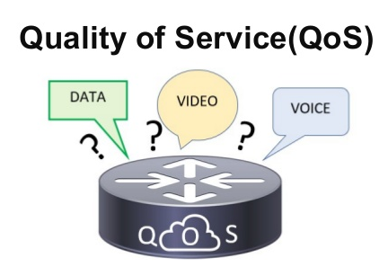
QUALITY OF SERVICE
Quality-of-Service (QoS) refers to traffic control mechanisms that seek to either differentiate performance based on application or network-operator requirements or provide predictable or guaranteed performance to applications, sessions or traffic aggregates. Basic phenomenon for QoS means in terms of packet delay and losses of various kinds.

Slide 5
QUALITY OF SERVICE Contd.
There are three default QoS Classes:
High Priority: It is assigned the highest possible priority value of 1
Normal Priority: It is assigned a priority value of 8
Low Priority: It is assigned the lowest possible priority value of 16
These are used in the default QoS Policy, Prioritize.

Slide 6
FLOW
A network flow is a series of communications between two endpoints that are bounded by the opening and closing of the session. It is simply a sequence of packets from a source to a destination .
It has some characteristics. They are:-
Reliability
Delay
Jitter
Bandwidth

Slide 7
QoS TECHNIQUES
Scheduling
First in First Out (FIFO) Queuing
Priority Queuing
Weighted Fare Queuing
Traffic Shaping
Leaky Bucket
Token Bucket
Resource Reservation
Admission Control

Slide 8
QoS CRITERIA FOR IOT
Explicit support for Quality of Service (QoS)
No transmission failures or exceeding required delay bounds
QoS support at the network level
Support at the application level
Resiliency
Reliability
Latency

Slide 9
QoS METHODS IN OPENFLOW
OpenFlow provides us with two methods to assign priority to flows:-
Queue: An OpenFlow switch provides limited Quality-of-Service support (QoS) through a simple queuing mechanism. One (or more) queues can attach to a port and be used to map flow entries on it. Flow entries mapped to a specific queue will be treated according to that queue’s configuration.
Meters: A switch element that can measure and control the rate of packets.

Slide 10
METER VS. QUEUE
QUEUE | METER
Guarantee minimum and maximum bandwidth for egress traffic | Guarantee only maximum bandwidth for ingress traffic
Applied per port | Applied per flow
Are not managed by OpenFlow | Are completely managed by OpenFlow
OpenFlow is only able to query queue statistics from the switch | Ensures minimum traffic between pair of hosts (even when lot of noise is present)

Slide 11
OPENFLOW METERS
OpenFlow 1.3 introduces meters to the OpenFlow protocol.
A meter table consists of meter entries, defining per-flow meters.
Meters are attached directly to flow entries. Each meter can have one or more meter bands.
Packets are processed by a single meter band based on the current measured meter rate. The meter applies the meter band with the highest configured rate that is lower than the current measured rate. If the current rate is lower than any specified meter band rate, no meter band is applied.
Meter Identifier | Meter Bands | Counter
Fig: Meter Table Entry
Band Type | Rate | Counter | Type Specific Arguments
Fig: Meter Band

Slide 12
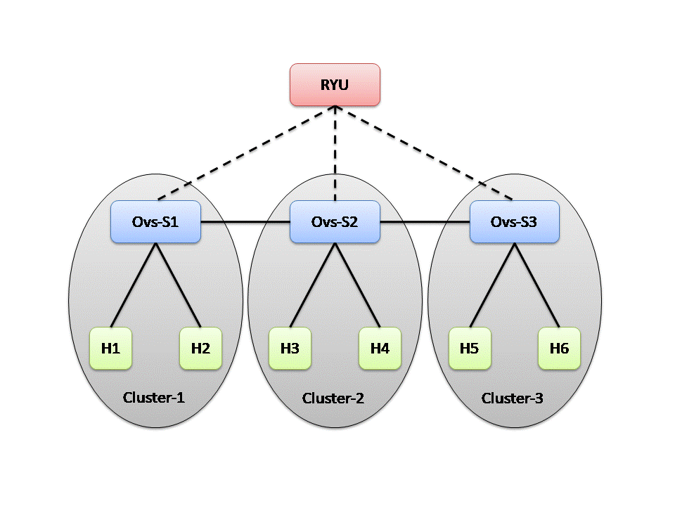
TOPOLOGY

Slide 13
METHODOLOGY
Create topology in mininet
Run Ryu Controller the application
Add the meter table
Add flow entries
Check flow table
Check meter table
Start UDP server in H1 and H3
Perform 100Mbps UDP traffic test for H1 and H3
Perform 50Mbps UDP traffic test for H3 and H1
Check meter table
Check flows of all the switchs
H1 ping H3

Slide 14
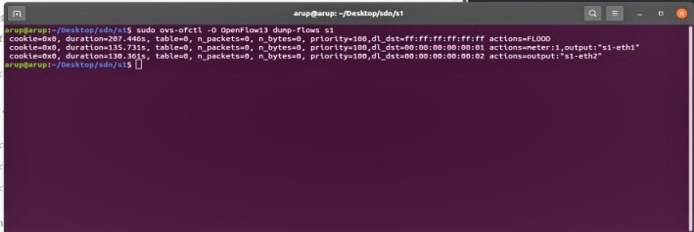
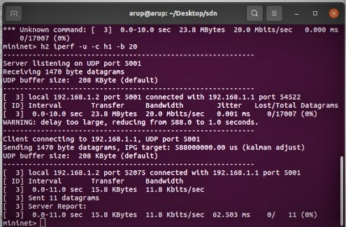
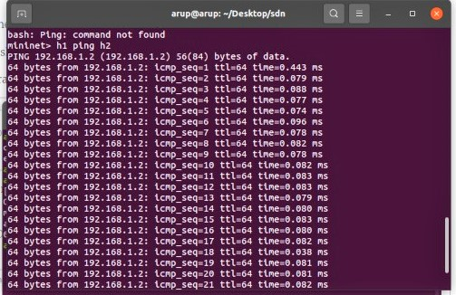
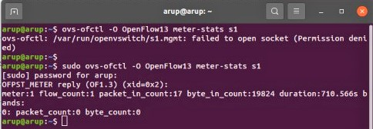
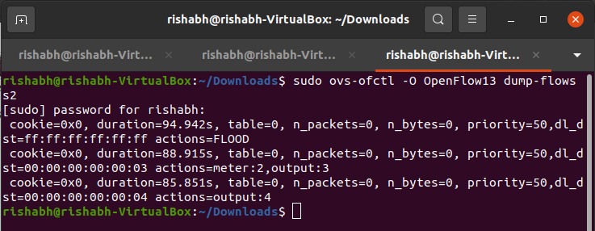
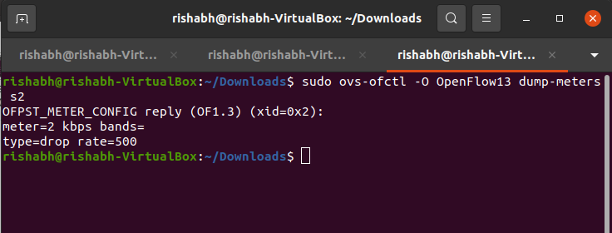
IMPLEMENTATION

Slide 15
WHAT WE LEARNED?
We learned about the working of mininet
We have learned what quality of service
We learned about Ryu controller and its working
How to handle flow table
How to handle Open vSwitch
Setting the priority and bandwidth using meters

Slide 16
SCOPE OF FUTURE WORK
Through this project we have gained a lot of insight in the workings of SDN and how it can be used to improve routing and quality of service for networks. As we had limited time to complete this project, we were not able to add all the functionalities we had in mind for it. So, these functionalities have been shown as a scope of future work.
Implementing our project for IoT networks
Controller Implementation
Smart traffic control
Application awareness
Heterogeneity awareness

Slide 17
THANK YOU

