Slide 1
VIT
BCSE313L · Fundamentals of Fog and Edge Computing
PROJECT REVIEW
ResQFog
Edge–Fog–Cloud Condition Monitoring for Water-Supply Pumping Stations
Presented by
Course faculty
Date
ARUSH MISHRA 23BCT0199
ABUZAR SIDDIQI 23BCT0186
Prof. Kauser Ahmed P
October 2026
Notes:
We are presenting ResQFog, our project for Fundamentals of Fog and Edge Computing under Prof. Kauser Ahmed P. In the last review we were asked to focus the system on one industry. We chose water-supply pumping stations, and in this version we added pump identification with GPS, automatic motor protection, two-way control from the fog server and offline buffering at the edge. At the end we show our plan for replacing the fixed thresholds with a machine learning model.

Slide 2
Outline
1
Target industry and problem
7
Detection and motor protection
2
Existing systems and their gaps
8
Machine identification with GPS
3
Objectives
9
Dashboard and fault recording
4
Novelty and contributions
10
Testing and results
5
System architecture
11
Hardware extensions
6
Hardware and software
12
Phase 2: AI model integration
Notes:
This is the flow of the presentation. We start with the industry we chose and the problem there, compare existing solutions, then go through our objectives, what is new, the architecture, hardware and software. After that we cover detection and motor protection, how each pump is identified with GPS, the dashboard and test results, possible hardware extensions, and finally Phase 2.

Slide 3
Target Industry: Water-Supply Pumping Stations
We applied ResQFog to the electric pumps that supply drinking water to towns and villages: borewell pumps, sump and booster pumps, and the pumps that fill overhead tanks.
What a pumping station needs, and how ResQFog provides it
Need at the site | ResQFog feature
Nobody on site | SMS to the maintenance engineer
Many scattered pumps | Pump ID and GPS location on a map and in the SMS
Unreliable network | Alarm and motor trip decided on the ESP32; readings buffered offline
Costly motor burn-outs | Automatic trip after sustained critical vibration
Planning repairs | Fault recording: 50 readings before and 50 after each fault
Why this industry
Pumps are rotating machines, and their common faults (bearing wear, impeller imbalance, misalignment, cavitation) all change vibration
Stations are spread over several kilometres and are usually unmanned
A failed pump is often noticed only when the taps run dry, by which time the motor may be burnt
Mobile coverage at remote sites is patchy
Rural schemes such as Jal Jeevan Mission keep adding pump-based supply schemes, and each one needs maintenance
The node itself works on any rotating machine (fans, compressors, conveyors). Pumping stations are where all of its features are needed together.
Notes:
In the last review we were asked to pick one industry. We chose water-supply pumping stations. These are the borewell pumps, sump pumps and booster pumps that supply drinking water. They are a good fit for three reasons. First, they are rotating machines, and the common pump faults all show up as a change in vibration. Second, the stations are spread out and usually unmanned, so a fault is often discovered only when people stop getting water. Third, the network at these sites is unreliable. The table shows how each need at a pumping station maps to a feature of ResQFog. The same hardware still works on other machines, but this is where all the features matter at once.

Slide 4
Problem Statement
A water-supply pump usually fails gradually. Bearings wear, the impeller goes out of balance or the shaft becomes misaligned, and the first visible sign is a rise in vibration. At an unmanned pumping station nobody is there to notice it, so the fault grows until the motor stops or burns out.
Effects of late detection
Water supply cut for the whole area served by the pump
Motor rewinding or replacement instead of a bearing change
Technician time wasted finding which pump has failed
Safety risk to anyone near a seizing pump
No record of the conditions that led to the failure
PROBLEM ADDRESSED
How can a low-cost node on each pump detect abnormal vibration, protect the motor on its own, tell the maintenance team exactly which pump has failed and where it is, and keep the data needed to analyse the fault, even when the network is unreliable?
Notes:
Pumps rarely fail suddenly. Wear, imbalance and misalignment build up over time, and the first sign is higher vibration. At an unmanned station nobody notices this, so the pump keeps running until it stops or the motor burns out. The result is a water cut for the whole area, a much bigger repair bill, and time lost finding which pump failed. So our problem statement is: how can a cheap node on each pump detect abnormal vibration, protect the motor locally, tell the team exactly which pump failed and where, and keep the data for analysis, even with a poor network.

Slide 5
Existing Systems and Their Gaps
Approach | Continuous | Works without internet | Locates faulty pump | Protects motor | Fault data kept | Cost
Operator visits and manual checks | No | Not applicable | No | No | No | Low
SCADA at large treatment plants | Yes | Yes | Yes | Yes | Yes | High
Starter with overload / dry-run relay | Yes | Yes | No | Electrical faults only | No | Low
GSM pump controllers, cloud IoT apps | Yes | No | Partly | On/off only | Raw stream | Low to medium
ResQFog (this work) | Yes | Yes, edge alarm and trip | Yes, ID and GPS | Yes, vibration trip | 50 before + 50 after | Low, about ₹1,400 per pump
Large treatment plants already use SCADA, but it is too expensive for a single borewell or tank-filling pump. Starter relays react to electrical faults such as overload, not the mechanical faults that show up first as vibration. Most low-cost IoT products depend on the internet for every decision. ResQFog sits in the gap between them.
Notes:
This compares what is used today. Operator visits are cheap but not continuous. SCADA does everything but is meant for large plants and is far too expensive for a single pump. A motor starter with an overload or dry-run relay protects against electrical problems but does not see mechanical wear developing. GSM pump controllers and cloud apps are continuous but depend on the network and usually just switch the pump on and off. ResQFog is low cost like the last two, but it raises the alarm and trips the motor at the edge, identifies the pump with its location, and keeps a recording of every fault.

Slide 6
Objectives
1
Monitor pump vibration continuously with a low-cost ESP32 and MPU6050 accelerometer.
2
Classify the condition on the ESP32 itself, so the alarm and motor trip work without a network.
3
Identify every pump by an ID and its location, using GPS where a fix is available.
4
Show all pumps on a live fog dashboard with a map, readings, events and statistics.
5
Send an SMS to the maintenance engineer with the pump ID, reading and a map link.
6
Lose no data during outages, and record 50 readings before and after every fault.
7
Keep the design ready for a machine learning model to replace the fixed thresholds in Phase 2.
Notes:
We set seven objectives. The first six are implemented: continuous monitoring with cheap hardware, classification and protection on the ESP32, identification of each pump with its location, a fleet dashboard on the fog server, an SMS that tells the engineer which pump and where, and no data loss during outages together with fault recordings. The seventh shapes the design for Phase 2, where a learned model replaces the thresholds without changing the architecture.

Slide 7
Novelty and Contributions
1
2
3
Edge-first alarm and trip
Location-aware alerts
Two-way fog–edge control
The ESP32 sounds the buzzer and cuts motor power after 3 critical readings. Neither step needs Wi-Fi, the laptop or the internet.
Every reading carries the pump ID and GPS position. The SMS has a map link, so the technician goes straight to the right pump.
A restart from the dashboard travels back in the reply to the next reading. Locally the speed knob must return to zero first, like a motor starter.
4
5
6
Store-and-forward at the edge
Black-box fault recording
Self-monitoring pipeline
If the fog server is unreachable, the ESP32 keeps up to 300 readings (5 minutes) and uploads them later with their original timing.
50 readings before and 50 after every new fault are saved as CSV and tagged with the pump ID, ready for analysis and model training.
The dashboard flags a silent node within 5 s, counts recovered readings and limits SMS to one per minute per pump.
Notes:
These are the six things that make ResQFog different from a typical IoT vibration monitor. One, the alarm and the motor trip are decided on the ESP32, so they work even if everything else is down. Two, alerts are location-aware: the SMS tells the engineer which pump and gives a map link. Three, control works in both directions: the dashboard can send a restart command back to the pump, and locally the operator has to turn the knob to zero before the motor can restart. Four, the edge stores readings while the fog is unreachable and sends them later, so there are no gaps in the data. Five, every fault is recorded with 50 readings before and after. Six, the system watches its own health.

Slide 8
System Architecture
EDGE LAYER · one node per pump
FOG LAYER
CLOUD LAYER
PUMP-01 ESP32 + MPU6050 + GPS
/data, /alert
/data/batch
Flask server in the pump office
HTTPS on a new fault
Twilio SMS
Receives readings from all pumps
Live dashboard with map
Event log and statistics per pump
Saves fault CSV recordings
Queues restart commands
SMS to the maintenance engineer
Pump ID, reading and map link
Any phone, no app
PUMP-02 ESP32 + MPU6050 + GPS
PUMP-N ...
restart command (in reply)
Reads vibration every 1 s, classifies it, drives buzzer, LCD and motor, buffers readings offline
Link | Protocol | Data exchanged
ESP32 → Fog | HTTP POST over Wi-Fi, JSON | One reading per second with pump ID and location; buffered batch after an outage; alert on CRITICAL
Fog → ESP32 | Reply to the same HTTP request | Restart command after a motor trip
Fog → Cloud | HTTPS, Twilio REST API | SMS request on each new fault
Browser → Fog | HTTP on the LAN, port 5001 | Dashboard and status every second
Notes:
The system has three layers. At the edge there is one node per pump: an ESP32 with the MPU6050 and a GPS module. It reads vibration every second, classifies it, drives the buzzer, LCD and motor, and keeps readings in a buffer if the fog cannot be reached. The fog layer is a Flask server, for example on a laptop or a small PC in the pump office. It receives readings from all pumps, runs the dashboard with the map, keeps events and statistics, saves fault recordings and queues restart commands. The cloud layer is Twilio, which delivers the SMS. A detail worth pointing out is the orange arrow: the fog sends commands back to the edge inside the reply to the next reading, so the ESP32 never has to run a server of its own.

Slide 9
Hardware Components and Interfacing
Component | Function | Connection to ESP32 | Approx. cost (₹)
ESP32 DevKit | Edge controller with built-in Wi-Fi | Main controller, USB powered | 400
MPU6050 | 3-axis accelerometer, ±2 g range | I²C: SDA GPIO 21, SCL GPIO 22, address 0x68 | 150
NEO-6M GPS (new) | Position of the pump | UART2: GPS TX → GPIO 16, GPS RX → GPIO 17, 9600 baud | 350
16×2 LCD with I²C | Reading, speed, state, buffered count | Shared I²C bus, address 0x27 | 200
Potentiometer | Sets motor speed; turning to zero resets a trip | GPIO 34 (ADC input) | 20
L298N motor driver | Drives the motor; trip sets PWM to 0 | ENA GPIO 25 (PWM), IN1 GPIO 26, IN2 GPIO 27 | 150
DC motor | Stands in for the pump motor | L298N output terminals | 100
Buzzer | 2 kHz on CRITICAL, short beeps while tripped | GPIO 32 | 20
Total per node |  |  | about 1,400
Prices are approximate retail prices for hobby modules. The motor trip uses the existing L298N enable pin, so it needed no extra hardware. On a real pump the L298N is replaced by a relay driving the motor contactor.
Notes:
These are the components of one edge node. The new part is the NEO-6M GPS module, connected to the second UART of the ESP32 on pins 16 and 17. The accelerometer and LCD share the I2C bus. The potentiometer sets the motor speed to simulate load, and it also acts as the local reset after a trip. The L298N drives the motor, and the trip simply sets its PWM to zero, so no extra hardware was needed for protection. One complete node costs about 1,400 rupees. On a real pump, the L298N would be replaced by a relay that drives the pump's contactor.

Slide 10
Software Stack and Interfaces
Technologies used
Fog server endpoints
Layer | Technology
Edge firmware | Arduino C++ on ESP32; WiFi, HTTPClient, Wire, LiquidCrystal_I2C, TinyGPSPlus
Fog server | Python 3, Flask (multi-threaded), python-dotenv, twilio
Dashboard | HTML, CSS, JavaScript; Chart.js and Leaflet served locally; OpenStreetMap tiles
Alerts | Twilio Programmable SMS (REST API)
Data | JSON over HTTP; fault recordings as CSV
Endpoint | Purpose
POST /data | Reading every second (ID, location, motor state)
POST /data/batch | Readings buffered during an outage
POST /alert | Critical alert; triggers the SMS
GET /api/status | Fleet list and the selected pump's data
POST /api/command | Restart a tripped motor
GET /faults/… | Download a fault recording CSV
/test-sms | Manual SMS test from the dashboard
Twilio credentials are kept in a .env file on the fog server. They are never in the source code, the Git repository or the ESP32.
Notes:
The firmware is Arduino C++. TinyGPSPlus is the only new library; it parses the NMEA sentences from the GPS. The fog server is Python with Flask, multi-threaded so several pumps and browsers can connect at once. The dashboard is plain HTML and JavaScript; Chart.js and the Leaflet map library are served from the fog server itself, and only the map tiles come from OpenStreetMap. On the right are the endpoints. The new ones are /data/batch for buffered readings and /api/command for the remote restart. The Twilio credentials stay in a .env file that is not in the repository.

Slide 11
Detection Method and Motor Protection
v = | √(ax² + ay² + az²) − 1 g |
Classification and response
State | Vibration v | Response
NORMAL | below 1.00 g | None
WARNING | 1.00 to 1.20 g | Logged, shown in amber
CRITICAL | 1.20 g and above | Buzzer, SMS, fault recording
TRIPPED | 3 CRITICAL readings in a row | Motor power cut at the pump
ax, ay, az: acceleration in g from the MPU6050 (±2 g range, 16384 counts per g)
Magnitude of the acceleration vector, minus 1 g of gravity, leaves the vibration
One reading per second, classified on the ESP32 itself
The ±2 g range caps the largest possible reading at about 2.46 g, so the thresholds sit well below it
Thresholds were set on our motor test rig, where normal running averages about 0.1 g with short peaks up to about 1.0 g. They are configured in both the ESP32 firmware and the fog server. Waiting for 3 readings before tripping stops a single knock from shutting the pump down.
Notes:
The MPU6050 gives acceleration on three axes. We take the magnitude and subtract 1 g, because even a motor at rest measures gravity; what remains is the vibration level v. The ESP32 calculates this every second. Below 1 g is normal, 1 to 1.2 g is a warning, and 1.2 g or more is critical, which sounds the buzzer, sends the SMS and starts a fault recording. If the reading stays critical for three seconds in a row, the ESP32 cuts motor power. We chose three readings so that a single knock on the sensor does not stop the pump. The thresholds come from our test rig, where normal running averages about 0.1 g. One limitation we found is that the plus or minus 2 g range caps readings at about 2.46 g, so we keep the thresholds well below that.

Slide 12
System Workflow
Edge node
(ESP32)
1. Read MPU6050 and GPS
2. Compute vibration v
3. Classify the reading
4. Buzzer; trip motor after 3 CRITICAL
5. Send reading, or buffer it if the fog is unreachable
reply may carry a restart command
POST /data
Fog server
(Flask)
yes
9. Save CSV: 50 readings before and 50 after
8. SMS with pump ID and map link (60 s cooldown)
7. Is this a new CRITICAL event?
6. Update pump state, graph and map
The loop repeats every second. The buzzer and the trip happen before any network step, so local protection never waits on the fog or the cloud. On a CRITICAL reading the ESP32 also sends POST /alert, which is what triggers the SMS.
Notes:
This is the loop that runs every second, in two lanes. On the edge, the ESP32 reads the sensor and the GPS, computes and classifies the vibration, sounds the buzzer and trips the motor if needed, and then sends the reading, or stores it if the fog cannot be reached. On the fog, the server updates the pump's state, graph and map marker, checks if this is a new critical event, sends the SMS with a 60-second cooldown per pump, and saves the fault recording. The orange arrow on the left shows the return path: the reply to each reading can carry a restart command.

Slide 13
Machine Identification with GPS
How each pump is identified
Where the location is used
1
Fixed identity
MACHINE_ID and site name are set in the firmware of each node.
Dashboard map: each pump is a marker coloured by its state
SMS: pump ID, site, reading and a Google Maps link
Fault recordings: every CSV row is tagged with the pump ID
2
GPS position
NEO-6M on UART2, parsed with TinyGPSPlus; used when the fix is less than 5 s old.
Example SMS
3
Fallback location
Without a fix (indoors, or no GPS fitted) the node sends the coordinates entered at installation, marked as fixed.
ResQFog ALERT: PUMP-03 (Gandhi Nagar OHT) CRITICAL 1.31 g at 14:02:11. Location: https://maps.google.com/?q=12.95510,79.13980
4
Sent with everything
Every reading, batch and alert carries id, site, lat, lon, a GPS flag and the satellite count.
GPS needs a view of the sky. Most pump houses are small single-storey rooms, so the antenna can sit near a window or on the roof. Inside a large factory a fixed location per machine is enough, which is why the fallback exists.
Notes:
This answers the question of which pump has failed. Each node has a fixed ID and site name in its firmware. We added a NEO-6M GPS module, and the ESP32 uses its position whenever it has a recent fix. If there is no fix, for example indoors or if the module is not fitted, the node sends the coordinates entered when it was installed and marks them as fixed, so the dashboard always knows where the pump is. The location goes into every message. It is used on the dashboard map, in the SMS as a Google Maps link, and in the fault recordings. We should be honest about one limitation: GPS does not work well indoors. For a small pump house a window or the roof is enough; in a big factory the fixed location is the better option.

Slide 14
Motor Protection and Offline Buffering
Automatic motor trip
Store-and-forward buffer
3 CRITICAL in a row
Ring buffer of 300 readings in ESP32 RAM: 5 minutes at one reading per second; the oldest is dropped if it fills
Each entry keeps the vibration, motor PWM, state and the time it was taken
When the fog is back, readings are uploaded 30 at a time to /data/batch with each reading's age
The fog places them at their original time on the graph and logs "Buffered readings recovered"
A critical reading during the outage is still reported
The LCD shows B:<count> while readings are waiting
RUNNING
TRIPPED
knob to zero, or dashboard restart
Power is cut through the L298N enable pin; no extra hardware
Buzzer beeps every second while the motor is tripped
Dashboard shows TRIPPED with a Restart motor button
The restart reaches the ESP32 in the reply to its next reading, within about 1 s
Notes:
Two features make the edge independent of the network. On the left is the motor trip. If the reading is critical three times in a row, the ESP32 sets the motor PWM to zero and keeps beeping. It can be restarted in two ways: locally by turning the speed knob back to zero, which is how real motor starters work, or remotely from the dashboard. On the right is the store-and-forward buffer. If the fog server cannot be reached, each reading goes into a 300-entry ring buffer. When the connection returns, the ESP32 uploads them in batches with their age, and the fog server puts them back at the right time. We can demonstrate this by stopping the fog server for a short time and starting it again: the gap in the graph fills in.

Slide 15
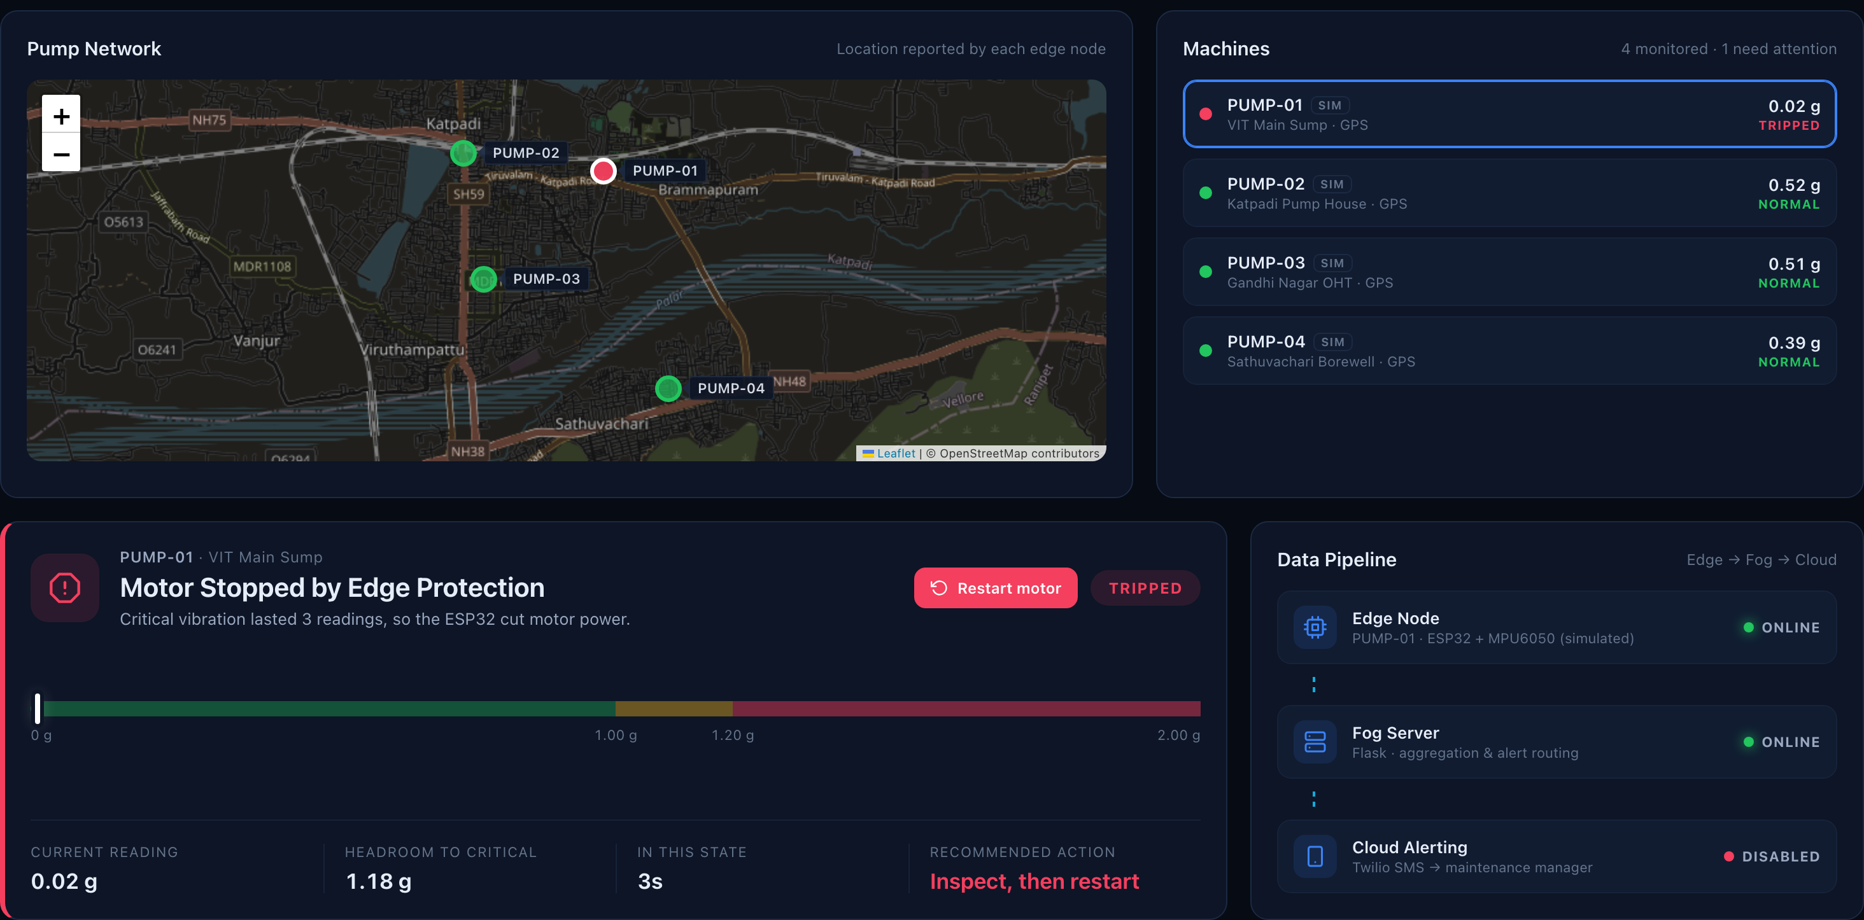
Fog Dashboard: Pump Network
A
Pump network map
Every pump at its reported location, coloured by state
B
Machine list
Reading and state of each pump; click one to open it
C
Status panel
State, severity scale, headroom and recommended action
D
Restart motor
Appears only after a trip; sends the restart command
E
Data pipeline
Online status of edge node, fog server and SMS service
Fig. 1: Dashboard with PUMP-01 tripped (demo run with four pumps)
Notes:
This is the new top of the dashboard. On the left is the map of the pump network; each pump appears where its node says it is, coloured by its state. Next to it is the list of machines with their live readings. In this screenshot PUMP-03 has tripped: its marker is red, and the status panel below explains that the ESP32 cut the motor after three critical readings. The Restart motor button only appears in this state. The pipeline panel shows whether each tier is online. Any browser on the same network can open this page on port 5001.

Slide 16
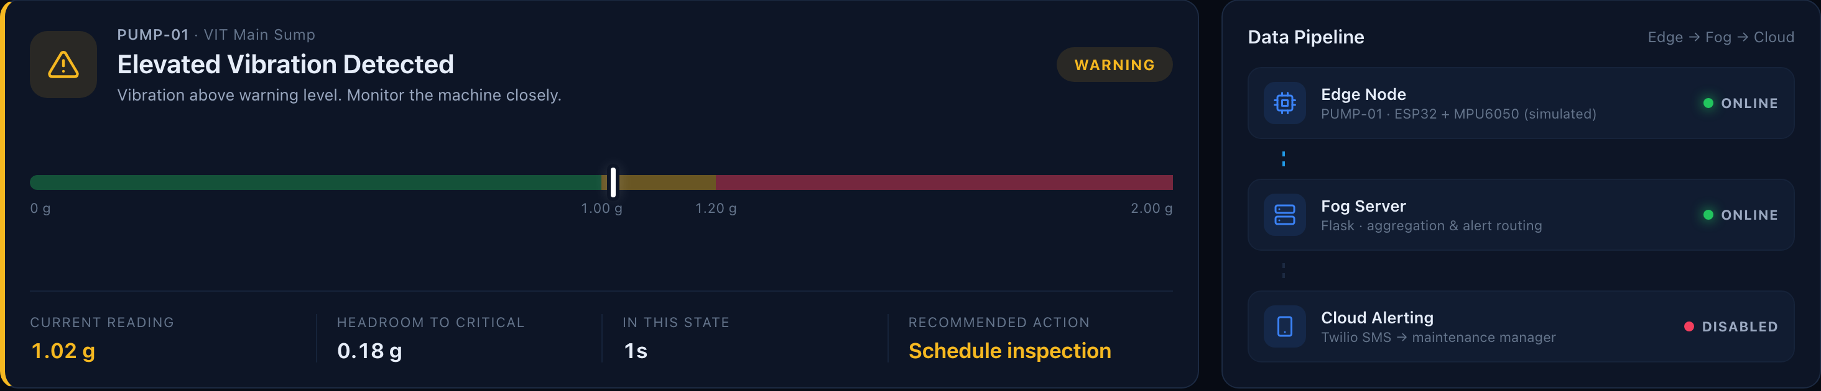
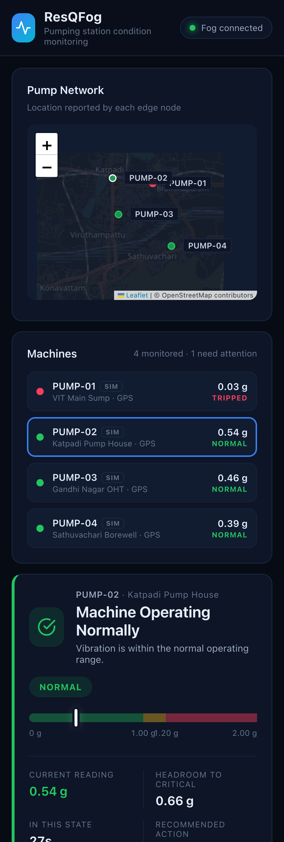
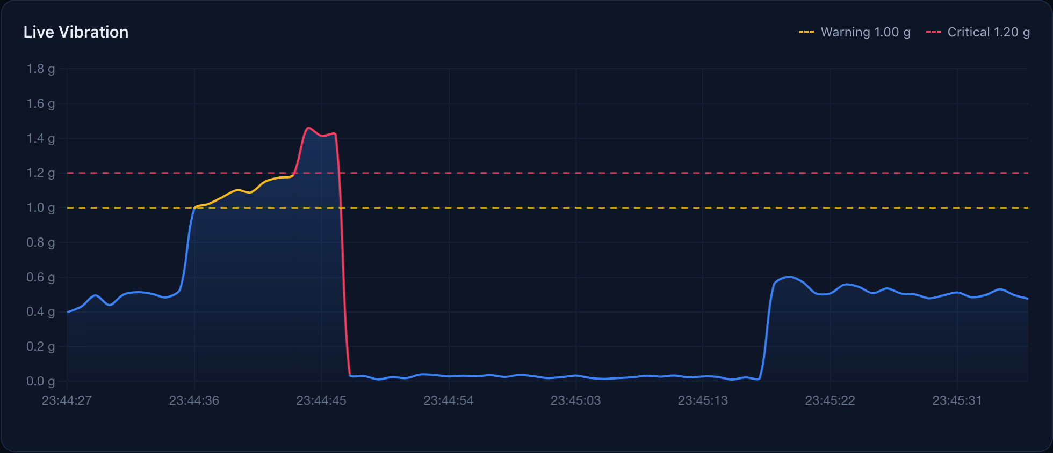
Monitoring States and Mobile Access
Observations
Banner, colour and advice change with the state
Graph turns amber at 1.0 g and red at 1.2 g
Works on any phone on the same network
No data for 5 s shows "Edge Node Offline"
Fig. 2: PUMP-01 in the WARNING state
Fig. 3: Warning ramp, critical readings, trip to zero and restart
Fig. 4: Phone
Notes:
Each pump also has its detailed view. Figure 2 is a pump in the warning state: the banner turns amber and the headroom before critical is shown. Figure 3 is the live graph, with the dashed warning and critical lines; the line changes colour as it crosses them. Figure 4 is the same page on a phone. If a node stops sending for five seconds, its state changes to offline on both the list and the map.

Slide 17
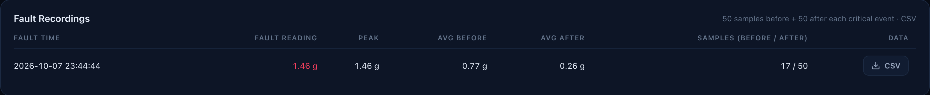
Fault Recording for Defect Analysis
Fig. 5: Fault Recordings panel with a saved recording and CSV download
Procedure
CSV columns
1
The fog keeps the latest 50 readings of each pump in a rolling buffer.
Column | Meaning | Column | Meaning
machine_id | pump ID | vibration_g | v in g
sample | −50 to +50 | motor_pwm | 0 to 255
phase | PRE, FAULT, POST | motor_speed_pct | 0 to 100 %
timestamp | to the millisecond | status | state
offset_s | time from the fault
2
A new CRITICAL event freezes that buffer and collects 50 more readings.
3
The 101 rows are saved as fault_<pump>_<date>_<time>.csv and listed on the dashboard.
Notes:
To analyse a defect we need to see what happened before and after it. For each pump the fog server keeps the latest 50 readings. When a new critical event arrives, that buffer becomes the before data, and the server collects 50 more readings as the after data. The 101 rows are saved as a CSV named with the pump ID and the time of the fault, and listed on the dashboard with a download button. These recordings are also the labelled data we will use to train the model in Phase 2.

Slide 18
Testing and Results
No. | Test case | Expected result | Observed
1 | Edge → Fog telemetry | HTTP 200, one reading per second | Pass, 1.0 msg/s
2 | State classification | Correct state at 1.00 g and 1.20 g | Pass
3 | Local alarm | Buzzer at 1.20 g and above | Pass
4 | SMS alert | Manager receives an SMS | Pass
5 | Fault recording | CSV with 50 + 1 + 50 rows | Pass, 101 rows
6 | Edge offline | Flagged within 5 seconds | Pass
7 | SMS rate limit | At most one SMS per 60 s per pump | Pass
8 | Motor trip | Motor stops after 3 critical readings | Pass (simulated edge)
9 | Remote restart | Command reaches the edge in the next reply | Pass (simulated edge)
10 | Offline buffer | Readings from the outage appear on the graph | Pass (simulated edge)
11 | Location | Pump shown on map; map link in the SMS text | Pass, fixed location
Tests 1 to 7 were run on the hardware rig. Tests 8 to 11 cover the new features and were run against the fog server with a simulated edge node sending the same JSON as the firmware. GPS was tested with the fixed fallback location, since the rig is indoors.
Notes:
We tested every function. The first seven tests were run on the hardware: telemetry at one reading per second, correct classification, the buzzer, SMS delivery, the 101-row fault recording, offline detection within five seconds and the SMS rate limit. The four highlighted rows are the new features. We tested them against the fog server with a simulated edge node that sends exactly the same messages as the firmware: the motor trip, the remote restart, the offline buffer, and the location on the map and in the SMS. GPS was tested with the fixed fallback location because our rig is indoors.

Slide 19
Hardware Extensions for a Field Deployment
Module | What it adds | Why it matters for pumps
ACS712 / SCT-013 current sensor | Motor current | Detects dry running, overload and a locked rotor, which vibration alone can miss
DS18B20 on the motor body | Temperature | Bearing wear and overloading show up as heat
Flow or pressure sensor | Water actually delivered | Pump running but no water means dry running or impeller damage
SIM800L / A7670C GSM-4G module | SMS and data over the mobile network | Remote borewells have no Wi-Fi; the edge could send the SMS itself if the fog is down
LoRa SX1278 | Long-range, low-power radio | Many pumps a few km apart can reach one fog gateway without internet
RC522 RFID reader | Technician tag-in at the pump | Proof of the site visit; closes the fault in the event log
Relay and contactor | Switching a real 230 V pump | Lets the same trip logic protect an actual pump motor
Recommended next: the current sensor (cheap, and it catches dry running, the most common pump failure) and the GSM module (makes alerts independent of Wi-Fi).
Notes:
For a real field deployment, these are the modules we would add. A current sensor is the most useful: dry running, overload and a locked rotor all change the motor current, and some of them do not change vibration much. A temperature sensor on the motor body catches overheating. A flow or pressure sensor shows whether the pump is actually delivering water. For remote sites without Wi-Fi, a GSM module lets the edge send data and even the SMS itself, and LoRa lets many pumps a few kilometres apart reach one fog gateway. An RFID reader lets the technician tag in at the pump to close the fault, and a relay and contactor let the same trip logic switch a real pump. Our first two picks are the current sensor and the GSM module.

Slide 20
Phase 2: From Fixed Thresholds to Learned Detection
Limitations of the threshold method
Upgrades required before training a model
One reading per second captures the level of vibration, not its frequency content
A threshold cannot separate imbalance, misalignment, looseness, cavitation or bearing wear
Thresholds must be re-tuned for each pump and mounting
Slow drift below the threshold goes unnoticed
Area | Change
Sampling | Read the MPU6050 at up to 1 kHz (its maximum accelerometer rate) in 1-second windows
Features | RMS, peak, crest factor, kurtosis and FFT band energies on the ESP32 (ESP-DSP)
Extra inputs | Motor current and temperature from the extension sensors
Dataset | Normal runs at several speeds, induced faults on the rig, plus the public CWRU bearing dataset
Labels | Fault recordings tagged with the fault that was induced
Notes:
The threshold method works, but it has clear limits. One reading per second tells us how strong the vibration is, not its frequency content, and different pump faults have different frequency signatures. A threshold cannot tell them apart, it has to be tuned for every pump, and slow drift below it is missed. Before a model can help, the data must improve: faster sampling, features such as RMS, kurtosis and FFT bands computed on the ESP32, current and temperature as extra inputs, and a labelled dataset from our rig and the public CWRU bearing data.

Slide 21
Comparison of Candidate AI Models
Model | Needs labelled faults | Runs on ESP32 | Detects unseen faults | Names fault type | Fit for ResQFog
Fixed threshold (current) | No | Yes | Severe only | No | Baseline
Isolation Forest | No | No, fog only | Yes | No | Good at the fog
One-Class SVM | No | No, fog only | Yes | No | Moderate
Random Forest on features | Yes | Small models | No | Yes | Selected, stage 2
1D-CNN on raw signal | Yes, many | With TFLite Micro | No | Yes | Later, needs more data
Autoencoder | No | Yes, TFLite Micro | Yes | No | Selected, stage 1
LSTM sequence model | Run-to-failure data | Difficult | Yes | Partly | Trend and RUL, later
Ratings reflect each model's fit with our constraints: few labelled faults, a microcontroller at the edge and a laptop at the fog. Accuracy will be measured on our own dataset in Phase 2. RUL: remaining useful life.
Notes:
We compared seven options against our constraints. Isolation Forest and One-Class SVM need no labels and catch new kinds of faults, but they belong on the fog server. A Random Forest on extracted features needs labels but can name the fault type. A 1D CNN needs a lot of labelled data. An autoencoder is trained only on normal data, flags any deviation, and can run on the ESP32 with TensorFlow Lite Micro. An LSTM could predict remaining useful life but needs run-to-failure data. The two highlighted rows are the ones we selected.

Slide 22
Selected Approach: Two-Stage Hybrid Model
STAGE 1: EDGE (ESP32)
STAGE 2: FOG
1 kHz window from the MPU6050
Features: RMS, kurtosis, crest factor, FFT bands
Autoencoder, int8, on TFLite Micro
Anomaly score above learned limit: alarm and trip
Random Forest names the fault type
Why an autoencoder at the edge
Why a Random Forest at the fog
Trained on normal data only; real faults are rare
Flags any deviation, including faults never seen before
Learns each pump's own normal, replacing manual thresholds
A small dense network fits in ESP32 memory after int8 quantisation
Names the fault type once labelled recordings exist
Works well on small, tabular feature sets
Feature importance explains each decision to engineers
Retrained on the fog as new fault recordings arrive
Notes:
We will use a two-stage model. Stage 1 runs on the ESP32: a one-kilohertz window is reduced to features and passed to a small autoencoder quantised to 8-bit integers. If its anomaly score passes a limit learned from normal running, the alarm and trip work exactly as they do today, so the edge-first design is kept. Stage 2 runs on the fog server: a Random Forest classifies the anomaly into a fault type. It works well on small feature sets, its decisions are explainable, and it can be retrained on the fog as new fault recordings arrive.

Slide 23
Phase 2 Work Plan and Evaluation
Proposed work packages
Evaluation metrics
Work package | Activities | Weeks
1. Data acquisition | 1 kHz sampling and feature extraction on the ESP32 | 1–2
2. Dataset | Normal and induced-fault runs; add CWRU data | 3–5
3. Model training | Train and compare the candidate models in Python | 6–8
4. Edge deployment | int8 autoencoder on the ESP32 with TFLite Micro | 9–10
5. Fog integration | Random Forest service; fault type on the dashboard | 11
6. Validation | Test on the rig, tune, document results | 12
Precision, recall and F1-score on held-out faults
False alarms per hour of normal running
Time from fault onset to alarm
Model size (KB) and inference time (ms) on the ESP32
Tools
Python, pandas, scikit-learn, TensorFlow / Keras, TensorFlow Lite Micro, ESP-DSP
Notes:
This is the plan for Phase 2, over about twelve weeks: faster sampling and features on the ESP32, building the dataset, training and comparing models, deploying the autoencoder to the ESP32, adding the Random Forest to the fog server so the dashboard can show the fault type, and validating on the rig. We will measure precision, recall and F1 on held-out faults, false alarms per hour, detection delay, and the model's size and speed on the ESP32.

Slide 24
Conclusion
What ResQFog does today
Next steps
Monitors every pump continuously for about ₹1,400 per node
Raises the alarm and trips the motor at the edge, with no network needed
Tells the engineer which pump failed and where, by SMS with a map link
Shows the whole pump network live on one fog dashboard
Loses no readings during outages and records every fault
Current and temperature sensors on the rig
GSM module for sites without Wi-Fi
Trial on a real borewell or sump pump
Phase 2: learned anomaly detection and fault classification
Notes:
To sum up: ResQFog gives each pump continuous monitoring for about 1,400 rupees, protects the motor at the edge without depending on the network, tells the engineer exactly which pump failed and where, shows the whole network on one dashboard, and keeps every reading and fault. Next we want to add current and temperature sensing, a GSM module for remote sites, try it on a real pump, and then move to the learned model in Phase 2.

Slide 25
Thank you
Questions and live demonstration
github.com/Arush-O7/ResQFog
Notes:
Thank you. We are happy to take questions, and we can show the system running: the ESP32 on the rig, the dashboard with the pump network, a motor trip and restart, and the offline buffer when the fog server is stopped and started again.

