Slide 1
Turning 988 training feedback into answers EveryMind can act on
EveryMind · Understanding 988 training · BuildFest 2026
A one-command tool that turns each post-training survey export into checked numbers, comment themes and a dashboard staff can share.
Team 17
Notes:
We built a tool EveryMind staff can run on every survey export, used it on 1,299 responses, and turned the results into five recommendations.

Slide 2
EveryMind's question
Is the training working, for whom, and how do we keep improving it?
1
Evaluate
Did people learn, and would they act on it?
2
Compare
Which communities and roles are falling behind?
3
Improve
What do participants ask for, and what should change next season?
Data: 1,299 post-training surveys. Every number in this deck traces to an ID in one findings file.
Team 17 · EveryMind 988 training
2
Notes:
The business question has three parts. The tool answers each of them every time a new export arrives, not just once for this competition.

Slide 3
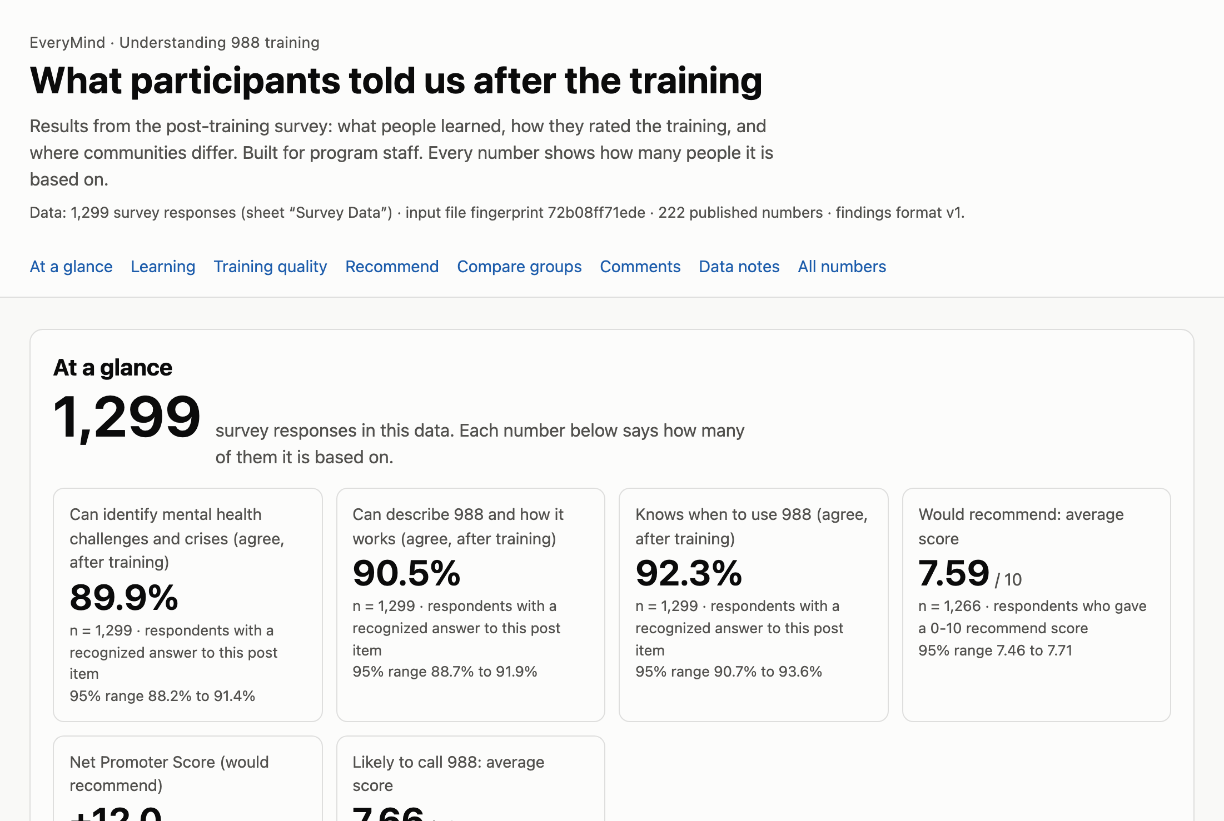
What we built: one command, one dashboard
Export
1
Save the survey export (.xlsx) from the survey platform.
Run one command
2
It cleans the data, codes the comments and checks every number.
Share one file
3
An offline dashboard for staff, presenters and funders.
New counties, answer labels and rows are flagged, never dropped
Every number shows how many people it rests on, with a confidence range
Groups under 10 people are hidden, for privacy and reliability
Team 17 · EveryMind 988 training
3
Notes:
Staff need no coding. The same command works on next month's export. Unknown labels show up in a data-checks panel instead of breaking the tool.

Slide 4
Finding 1: participants leave confident
Share who agree or strongly agree after the training, of 1,299 respondents
89.9%
90.5%
92.3%
can identify a mental health crisis
can describe 988 and how it works
know when to use 988
confidence range 88.2% to 91.4%
confidence range 88.7% to 91.9%
confidence range 90.7% to 93.6%
Presenters are rated highly too: 88.2% to 91.8% agree on engagement, knowledge and organization.
Team 17 · EveryMind 988 training
4
Notes:
Nine in ten leave confident on all three goals. Training delivery isn't the problem either.

Slide 5
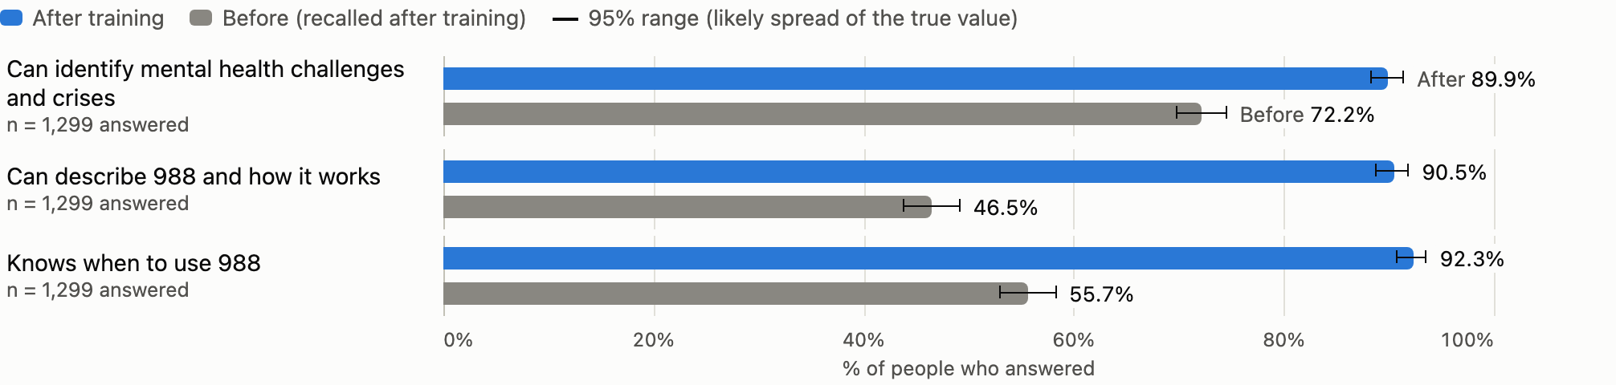
Finding 2: the biggest gains are about 988 itself
46.5% → 90.5%
+1.1 points
could describe 988, before vs. after
average self-rated change on describing 988 (1–5 scale), against +0.5 points for spotting a crisis
Caution: "before" was asked after the training, which tends to overstate change. Read the gap as an upper bound.
Team 17 · EveryMind 988 training
5
Notes:
People already felt able to spot a crisis. What they gained is 988-specific: what it is and when to use it.

Slide 6
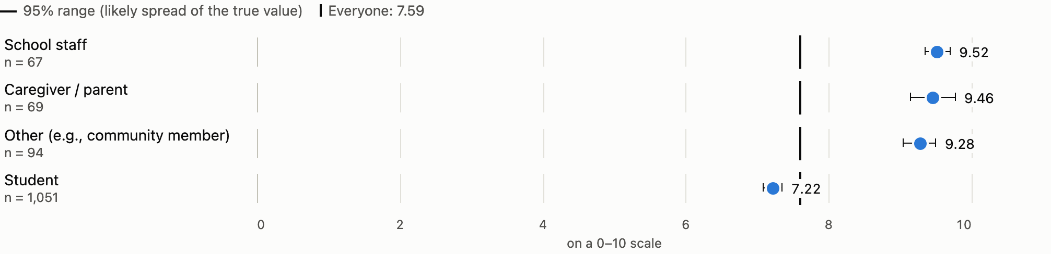
Finding 3: the gap is enthusiasm, not knowledge
7.2 vs. 9.5
7.1 vs. 8.7
89.5%
students vs. school staff, "would recommend" (out of 10)
Anne Arundel vs. Prince George's
of students can identify a crisis: about the same knowledge as everyone else
The confidence ranges don't overlap. Students are 83.1% of respondents, so the county gap may reflect who was trained.
Team 17 · EveryMind 988 training
6
Notes:
Students learn as much as adults but like the session less. That is the clearest gap across groups, and it is well outside the margin of error.

Slide 7
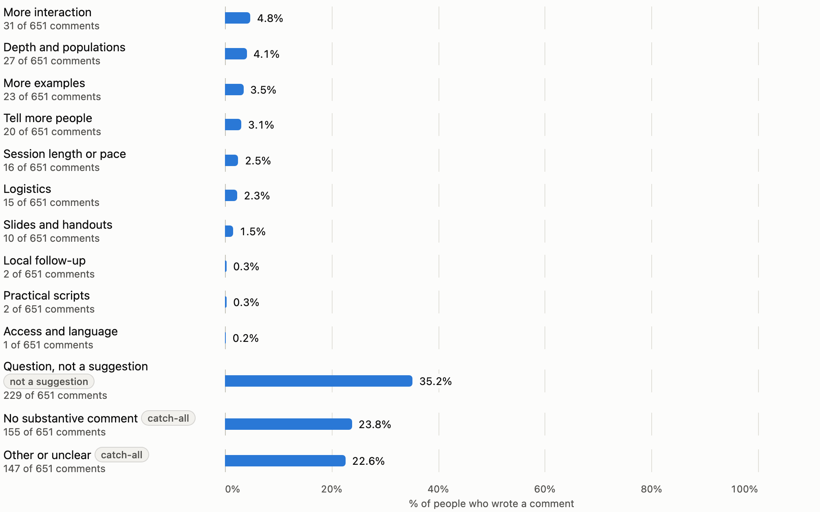
Finding 4: a third of "improve" comments are questions
35.2%
of 651 improvement comments were questions about 988
46.8%
named "what 988 is" as the most valuable lesson
“Are there any opportunity for doing presentations for families??”
“That you don’t have to be in crisis to use 988”
Themes come from an offline, rule-based classifier checked against a hand-coded sample. Quotes were reviewed by a person for personal information.
Team 17 · EveryMind 988 training
7
Notes:
Requests for more interaction are rare, at 4.8%. Unanswered questions are the real signal.

Slide 8
Finding 5: the key outcome is barely measured
"How likely are you to call 988?" is optional, and most people skip it
293
7.7
19
answered the call-988 question
average likelihood (0–10)
Spanish-survey respondents
1,006 skipped it
among those who answered only
too few to compare reliably, like Queen Anne's (12)
Thin findings are flagged everywhere: every group shows its n, and groups under 10 people are hidden or pooled.
Team 17 · EveryMind 988 training
8
Notes:
Behavior intent is the outcome EveryMind cares about, and it is the least measured. That drives recommendation 1.

Slide 9
Recommendations, in priority order
# | Action | Owner · when | Impact measure
1 | Measure intent for everyone: make the call-988 question required and add a 3-question pre-survey | Evaluation lead · once, then every session | Call-988 response rate; gains without recall bias
2 | Redesign the student session: pilot built-in Q&A time in Anne Arundel schools | Training manager · next semester | Student recommend score, pilot vs. non-pilot
3 | Run the dashboard after every training season and use it in grant reports | Program coordinator · monthly and each season | Report turnaround; grant reports citing it
4 | Reach smaller communities: collect 30+ responses before judging a group; offer the Spanish survey actively | Outreach lead · ongoing | Number of groups with 30+ responses
5 | Fix the survey form: county as a dropdown, one answer scale for all items | Evaluation lead · once | Label variants and blanks fall to zero
Team 17 · EveryMind 988 training
9
Notes:
Each recommendation has an owner, a cadence and a measure, so EveryMind can tell whether it worked.

Slide 10
How staff would use it
Built to be run by program staff, not analysts
Who
How often
A program coordinator. No coding: one command, or a double-click to open the dashboard.
Monthly, and at the end of each training season (spring and fall).
What it takes
Privacy
The survey export, a laptop with Python, and about five minutes.
Survey responses never leave EveryMind's computer. The dashboard holds totals only, and groups under 10 people are hidden.
Team 17 · EveryMind 988 training
10
Notes:
The README in the technical artifact walks through it step by step, including how to refresh with next month's export.

Slide 11
How we used AI, and how we checked it
AI did the work; tests, independent code and people checked it
How we used it
Errors we caught
Claude Code ran as four coordinated agents (data, text, tool, narrative) that shared work only through the repository and its issue board.
A wrong missing-date count (0 instead of 3). An unsupported "2.4 points" claim (really 2.2). A comment classifier that missed half the comments. A chart that implied trends across empty months.
Independent checks
Human checks
Separate code recomputed every published number from the raw file, and all matched. Rebuilding on a second machine gave identical results. Synthetic "next month" files are flagged, not crashed on.
A team member recomputed 20 headline numbers in Excel: all matched. A person reviewed every quote for personal information and approved the demo video.
Team 17 · EveryMind 988 training
11
Notes:
Full details, including representative prompts, are in the AI Process Appendix.

Slide 12
Limitations
Self-report
Recalled "before"
Who answered
Ratings measure confidence, not skill or behavior.
Asked after the training, so the gains are likely overstated.
83.1% are students and 72.1% are from Anne Arundel. Results describe them best.
Missing answers
Possible misread scale
No comparison group
1,006 skipped the call-988 question; about 1 in 8 skipped the quality questions.
31 people chose "Strongly disagree" on everything. Without them, crisis identification rises to 92.1%.
There is no group of people who didn't take the training to compare against.
Team 17 · EveryMind 988 training
12
Notes:
None of these change the direction of the findings, but they set how far each one can be pushed.

Slide 13
Next season, in three steps
1
Make the call-988 question required, and add a 3-question pre-survey
2
Pilot built-in Q&A time in student sessions
3
Run the dashboard after every season: one command, about five minutes
Thank you. Questions?
Notes:
Three changes, all low cost, and each with a measure to show whether it worked.

