Slide 1

sprout
Remembers what you know.
Grows as you do.
An adaptive learning partner inside ASI:One
SPROUT · MHACKS 2026
1
Notes:
0:00–0:18 — Students have AI that can answer anything, but every chat still starts at zero. Sprout remembers what you know and grows as you do.

Slide 2
Five experiences. One learner model.
Sprout routes the student; every surface reads and writes the same course state.
CURRICULUM
TUTOR
syllabus → concept graph
lesson → check → adapt
SPROUT
orchestrator + shared memory
persistent learner state
LEARN
GARDEN
next action across courses
mastery made visible
ARCADE
shared practice
A result in Tutor or Arcade changes what Learn recommends and what Garden shows.
SPROUT · MHACKS 2026
2
Notes:
0:18–0:40 — These are not five disconnected features. Curriculum structures the course. Learn chooses the next action. Tutor teaches. Garden visualizes mastery. Arcade turns practice into a shared game. All five share one learner model.

Slide 3
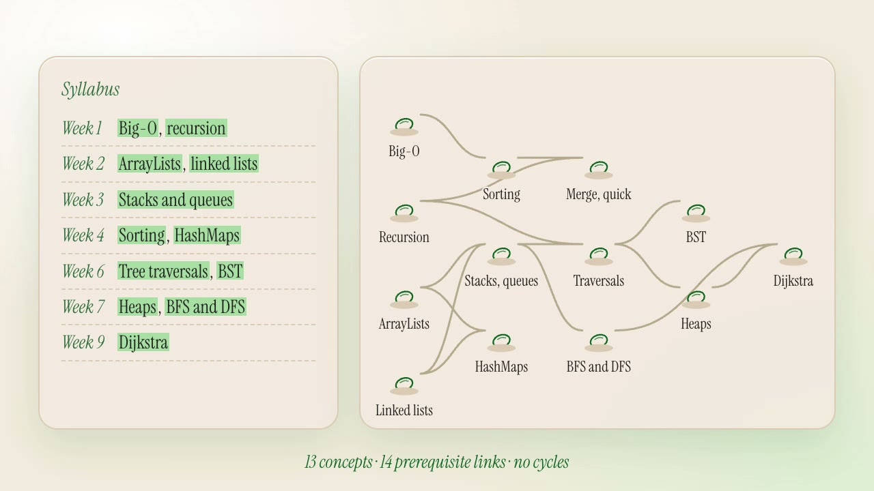
Curriculum turns a file into an executable course graph.
The graph constrains every later decision; the model cannot skip locked prerequisites.
CURRICULUM
extract + validate
DRAFT
student confirms structure
SPACETIMEDB
graph + prerequisites
13 concepts
14 prerequisite links
cycle-checked
confirmed before activation
Generated once. Enforced on every recommendation.
SPROUT · MHACKS 2026
3
Notes:
0:40–1:02 — A syllabus becomes a validated concept graph. The curriculum specialist extracts concepts and prerequisites, checks the graph, and asks for confirmation before activation. That graph now limits what Sprout can recommend.

Slide 4
ASI:One is the front door. Sprout is the system behind it.
A live chat can invoke specialists, tools, cards, and links without losing the learner’s state.
CURRICULUM
ASI:ONE · @sprout-main-cloud
SPROUT
course structure
routes the intent
Make a Data Structures game for my group.
Agent Chat Protocol
TUTOR
questions + teaching
Agentverse discovery
Your game is ready.
interactive cards
ARCADE
Code
WVQZC4
room + results
Open host
Play as you
GARDEN
Every answer grows your garden.
updated mastery
The chat initiates actions; it does not own the learning logic.
SPROUT · MHACKS 2026
4
Notes:
1:02–1:30 — Here is the actual ASI:One flow: one request creates a live game and returns host and player actions. Sprout routes the intent to the right capability. The chat starts the action, but the learning logic and persistent state live behind it.

Slide 5
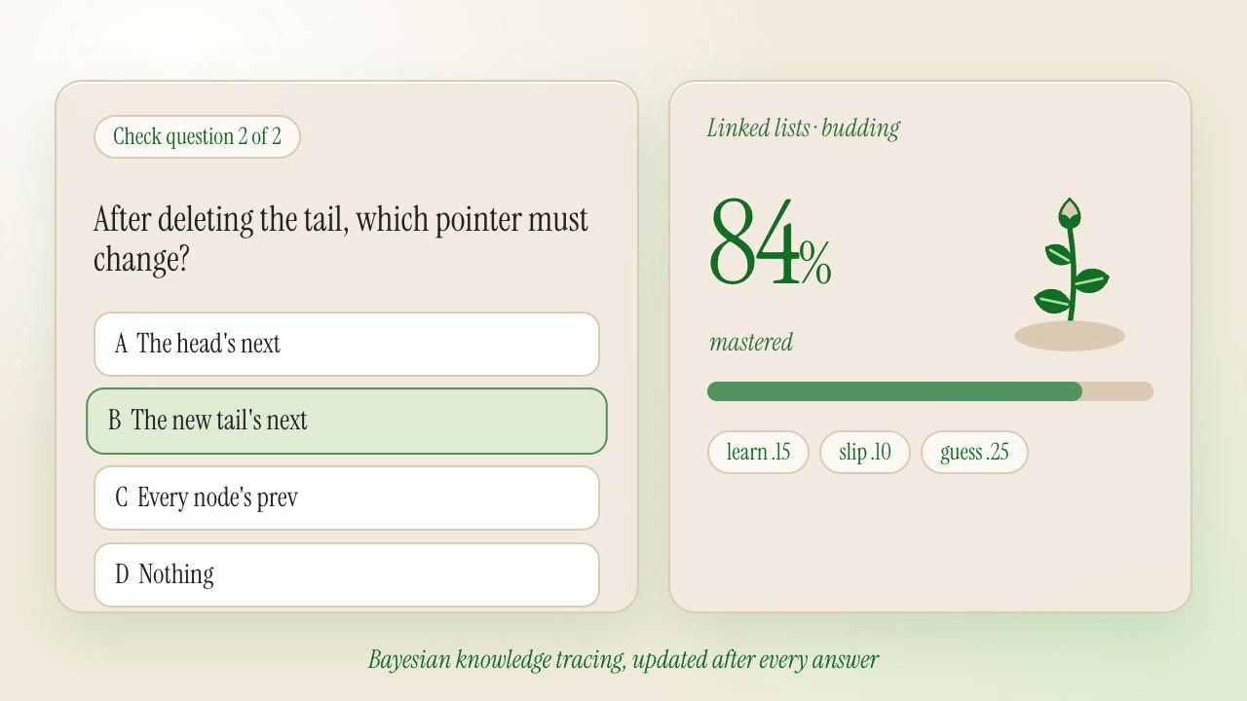
One answer changes the entire system.
Tutor teaches; SpacetimeDB updates the model; Learn and Garden immediately see the result.
BKT
mastery
84%
SM-2
next review
1 day
BANDIT
best format
worked example
ATTEMPT
evidence log
saved
LEARN
GARDEN
TUTOR
chooses the next action
renders the new state
changes the next lesson
This closed loop is the product.
SPROUT · MHACKS 2026
5
Notes:
1:30–1:58 — After every answer, a transaction updates Bayesian mastery, the SM-2 review date, format evidence, and the attempt log. Learn chooses a different next action, Garden grows or wilts the concept, and Tutor changes the next lesson.

Slide 6
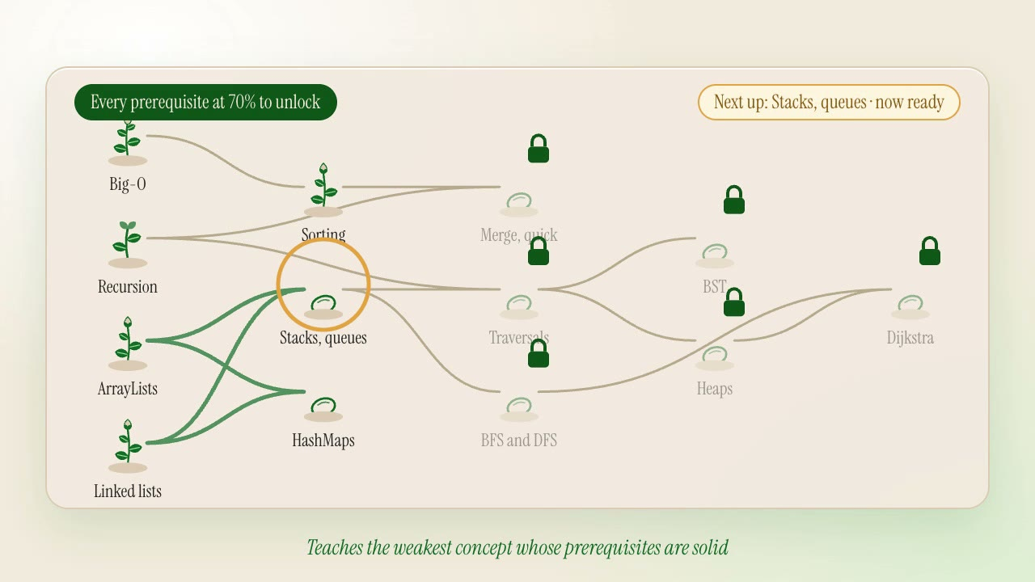
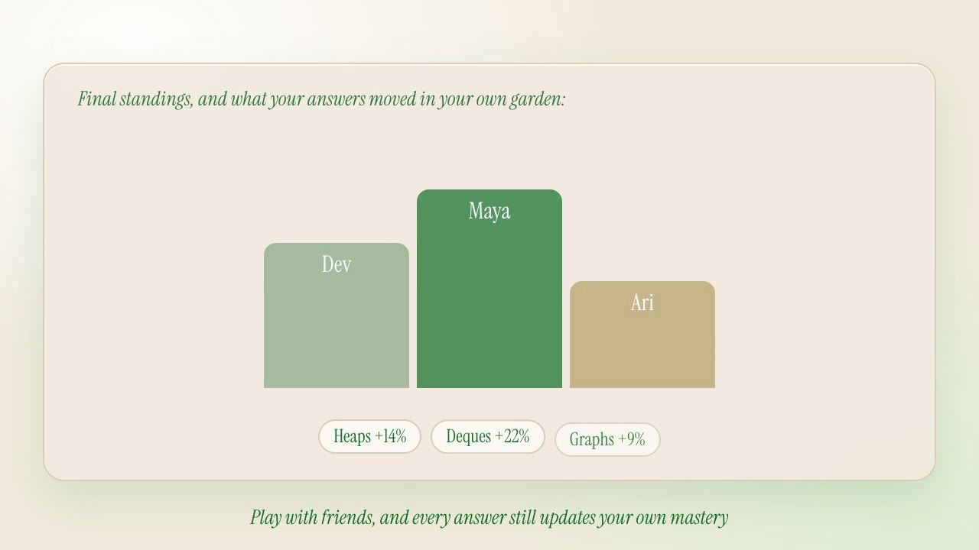
Garden shows the state. Arcade makes it social.
Two different experiences; the same mastery graph underneath.
GARDEN
Prerequisites unlock only when every dependency reaches the threshold.
ARCADE
Rooms, timers, answers, scores, and standings synchronize live.
Arcade results feed back into each player’s own garden.
SPROUT · MHACKS 2026
6
Notes:
1:58–2:24 — Garden makes the course graph visible, including locked concepts and the next eligible node. Arcade uses the same backend for synchronized rooms and scores, and the course owner’s answers feed back into personal mastery.

Slide 7
Why Sprout is more than an LLM wrapper.
The model creates language. The agent network coordinates. The backend decides and remembers.
EXPERIENCE
AGENT NETWORK
DECISION ENGINE
SHARED STATE
ASI:One
Learn · Garden · Arcade
Sprout
Curriculum · Tutor
BKT · SM-2
Bandit · prerequisite policy
Course graph · mastery
Review · rooms · scores
conversation
coordination
transaction
memory
FETCH.AI · agent runtime + ACP + ASI:One
SPACETIMEDB · transactions + subscriptions + state
Sprout turns “What should I study?” into one evidence-based next action.
SPROUT · MHACKS 2026
7
Notes:
2:24–3:00 — This is why Sprout is more than a wrapper. Fetch.ai gives us discoverable agents, the Agent Chat Protocol, ASI:One, and interactive responses. SpacetimeDB owns the learner graph, runs transactional learning algorithms, and synchronizes live games. The model writes content; the backend decides what happens next and remembers why. Sprout turns “What should I study?” into one evidence-based next action.

