Slide 1

3D-Printed Myoelectric Prosthetic HAND
Odisha University of Technology and Research
DEPARTMENT OF ELECTRONIC SCIENCES
Presented by:
Arushi Mallick – 2211100375
Supervised by:
Dr Ananya Dastidar

Slide 2
Introduction
Prosthetic limbs help amputees regain daily functionality and independence.
Conventional prosthetics are expensive and not easily customizable.
3D printing offers a low-cost and flexible alternative for creating prosthetic devices.
This project uses 3D printing, Arduino Uno, and a EMG muscle sensor to design a cost-effective myoelectric hand.
Demonstrates how bio-signals (EMG) can control mechanical movement in real time.
1

Slide 3
Motivation
Millions of amputees worldwide lack access to affordable prosthetic limbs.
Commercial myoelectric prosthetics cost between $10,000–$20,000 (~17 lakh INR), making them inaccessible for many.
3D printing enables rapid, low-cost fabrication and easy customization.
Integrating Arduino and muscle sensors provides a simple, open-source way to replicate basic prosthetic functions.
Aim: To design a cost-effective, customizable, and educational prosthetic prototype
2

Slide 4
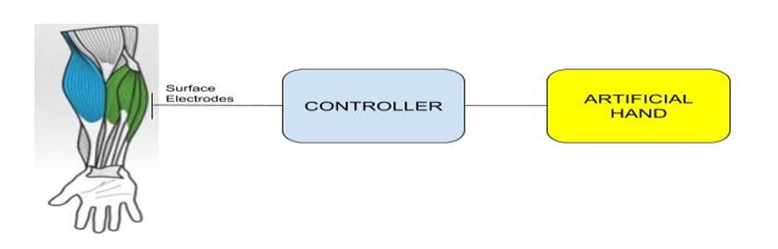
Objectives
To design and develop a 3D-printed prosthetic hand that mimics human hand movement.
To use EMG muscle sensors to detect muscle activity (EMG signals).
To interface the muscle sensor with an Arduino Uno for signal processing and control.
To control servo motors that drive the 3D-printed fingers based on muscle contractions.
To demonstrate a low-cost, customizable, and functional prosthetic prototype.
Fig. 1 Basic block diagram of an EMG-controlled prosthetic hand system [3]
3

Slide 5
Components Used
Sl. No. | Component Name | Specification | Quantity
1 | EMG Muscles Sensor with cable | Muscle sensor V3.0 | 1
2 | EMG Electrodes | EMG surface Ag/AgCl electrodes | 3
3 | Arduino Uno | Rev3 ATmega328P 16MHz | 1
4 | Servo Motor | MG996R (180) metal gear servo motor | 5
5 | 3D Printed Hand | PLA filament | 1
6 | Jumper wires | 20cm M-F , F-F | As required
7 | Fishing wire | 10 m | 1
8 | Screw and bolts |  | As required
4

Slide 6
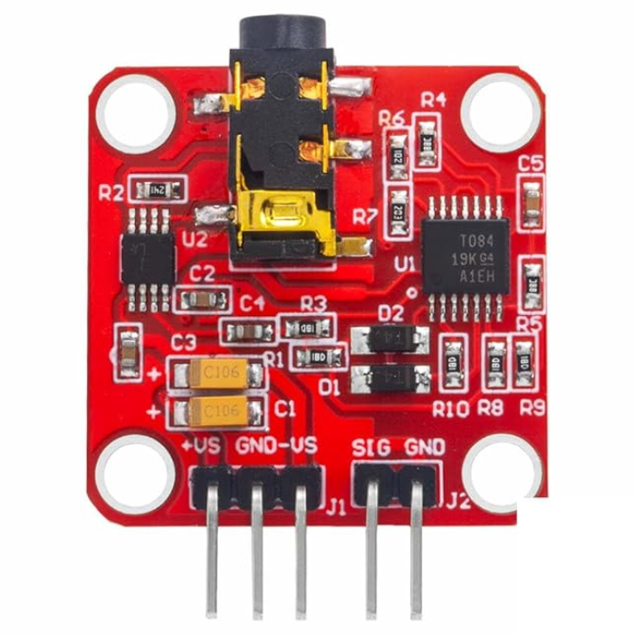
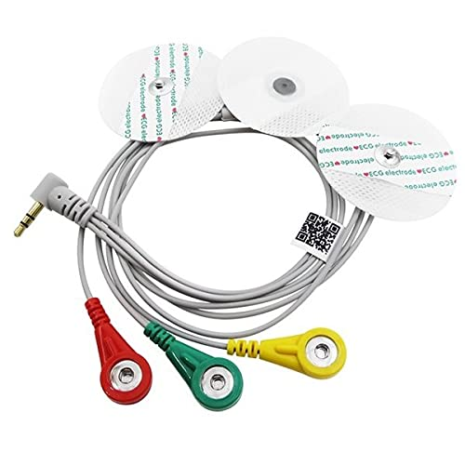
EMG Sensor
EMG Sensor Used: Advancer Technologies EMG Muscle Sensor V3.0
Detects electrical activity (EMG signals) generated during muscle contraction.
Provides an analog output voltage proportional to muscle effort.
Compact and easy to interface with Arduino Uno.
Operates on 3.3V–5V, suitable for wearable and bio-signal applications.
Uses three electrodes:
  Two placed on the target muscle (e.g., forearm).
  One reference electrode placed on a bony or neutral area.
Fig. 2 EMG Muscle Sensor V3.0 Module with Electrodes and connecting cable
5

Slide 7
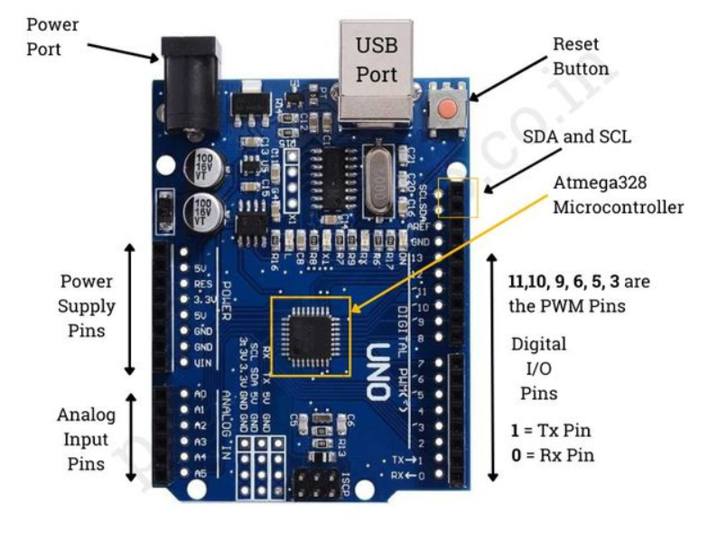
Arduino
Overview:
Operating Voltage: 5 V
Input Voltage: 7–12 V (via external adapter or battery)
Analog Input Pins: 6 (A0–A5)
Digital I/O Pins: 14 (6 PWM outputs)
Clock Speed: 16 MHz
Flash Memory: 32 KB
Role in the Project:
Reads analog EMG signal from the sensor via Analog input.
Compares the input value with a threshold to detect muscle contraction.
Sends PWM signals to control five servo motors.
Powers the sensor and servos from the same supply for synchronized operation.
Fig. 3 Arduino Uno IC pin out
6

Slide 8
Overview of the Working
The EMG muscle sensor detects electrical activity (EMG signals) from the user’s forearm muscles.
The analog signal is sent to the Arduino Uno through pin A3.
The Arduino processes the signal and compares it with a threshold value.
When the muscle flexes (signal > threshold) → Arduino sends PWM signals to servo motors → fingers close.
When the muscle relaxes (signal < threshold) → servos return to their open position.
The servos pull fishing lines attached to each finger, replicating natural hand movement.
The entire system is powered by Lithium Batteries (~ 7.2V ).
7

Slide 9
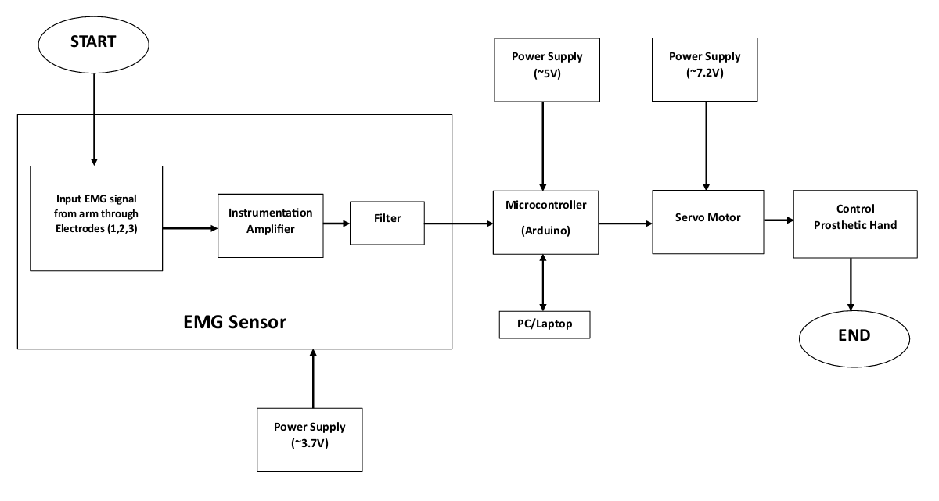
Block Diagram
Fig.4 Block diagram of the EMG-based prosthetic hand control system

Slide 10
Methodology
3D Design & Printing
  Used InMoov open-source STL files to print hand and forearm parts.
  Components assembled using screws, fishing line, and adhesive.
Hardware Integration
  Connected servo motors for finger movement.
  Interfaced EMG muscle sensor with Arduino Nano.
  Linked battery, wires, and electrodes for signal and power distribution.
8

Slide 11
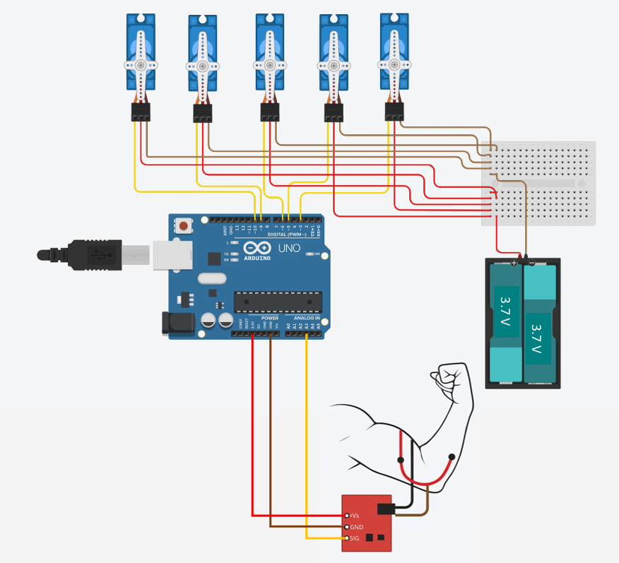
Circuit Connection
Fig. 5 Circuit Connection Diagram. Source: TinkerCAD

Slide 12
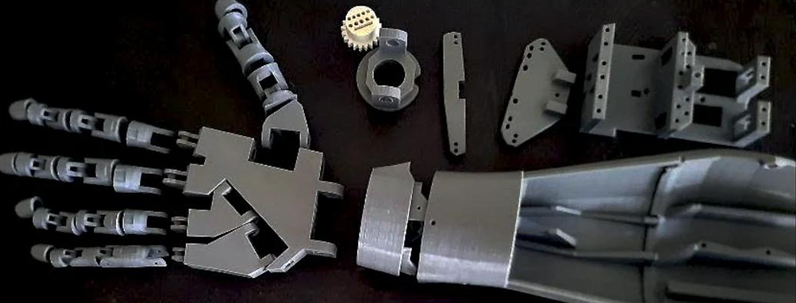
Methodology
Signal Acquisition Process:
When the user flexes a muscle, small EMG signals (in millivolts) are generated.
The sensor amplifies and filters these weak signals to produce a stable analog voltage.
Fig.6 3D-printed components of the prosthetic hand and forearm
9

Slide 13
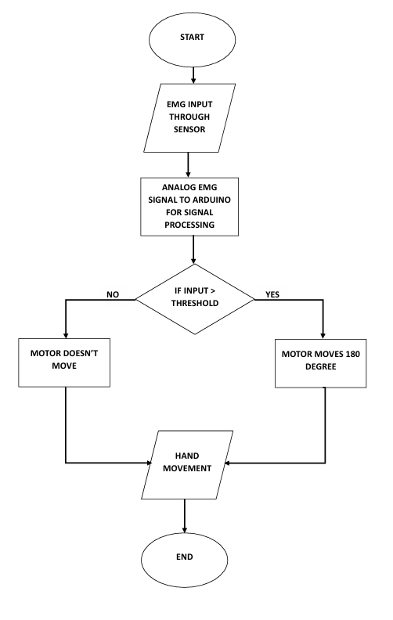
Algorithm workflow
This analog output is read by the Arduino Nano (pin A3).
The Arduino Nano compares the signal value with a threshold to detect muscle activity and drives the servo motors connected to D3, D5, D6, D9, D10.
If signal > threshold → servos close the fingers;
if signal < threshold → servos open the fingers.
This forms the basis of real-time muscle-controlled motion.
Fig. 7 Flowchart of the EMG-based prosthetic hand control system

Slide 14
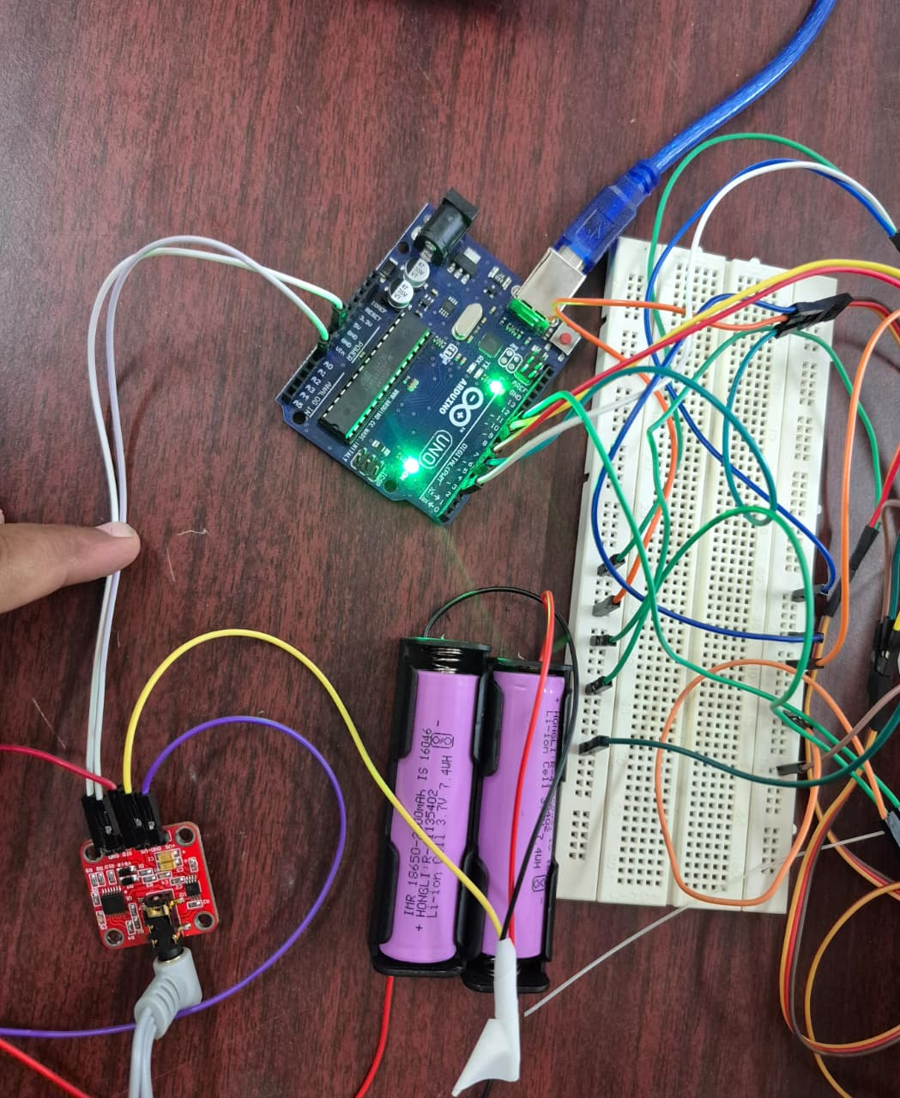
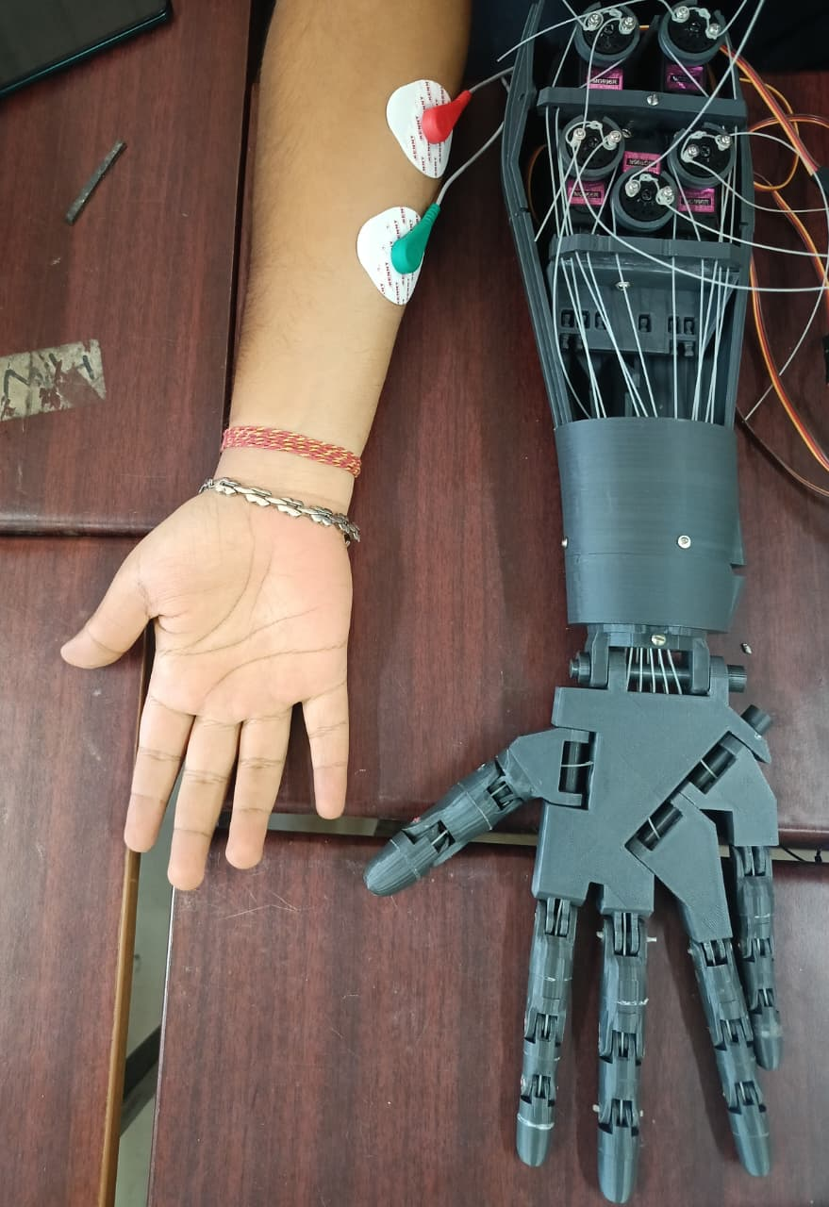
RESULTS
Fig. 8 Hardware circuit connection
Fig. 9 Prosthetic Hand Model

Slide 15
RESULT AnD Discussion
EMG sensor successfully detected muscle contractions and relaxation.
Servos responded correctly by opening (0°) and closing (180°) the prosthetic fingers.
Smooth and stable actuation across all five fingers.
The average response delay was approximately 150–200 ms, mainly due to signal processing and servo actuation time.
Condition | Average EMG Value (ADC units) | Observed Hand Motion
Resting muscle | 0–250 | Fingers remain open
Full flexion | 700–750 | Full grip (fingers fully closed)
Table 1: Experimental EMG readings and corresponding hand movement

Slide 16
CoST ANALYSIS
Cost of Existing Prosthetic Arms
Advanced bionic/myoelectric arms cost ₹16–17 lakh in India.
High-end imported models exceed ₹20–30 lakh depending on features.
Most available prosthetic arms in India provide limited finger movement and lack natural dexterity.
Maintenance and replacement parts are expensive and not easily available.
Cost of Developed EMG-Based Prosthetic Hand
3D Printing + PLA Material: ~₹1500–2000
Servo Motors (MG996R × 5): ~₹1,200–1,500
EMG Sensor (MyoWare): ~₹1,600–2,200
Arduino UNO Controller: ~₹300–400
Battery + Wiring + Miscellaneous: ~₹300–500
Total Estimated Cost: ~₹5000 – ₹6,500

Slide 17
Conclusion
A low-cost 3D-printed prosthetic arm was successfully developed using MyoWare EMG sensor, Arduino Nano, and servo motors.
The system effectively translated muscle contractions into finger movements through threshold-based control.
Demonstrated smooth, real-time, and reliable performance during testing and calibration.
Proved that affordable and customizable prosthetic solutions can be built using open-source hardware and 3D printing.
Provides a strong foundation for future enhancements such as multi-channel EMG or AI-based motion prediction.

Slide 18
Future work
Improve signal processing using advanced filtering and machine learning to detect multiple gestures.
Integrate wireless connectivity (Bluetooth/Wi-Fi) for remote calibration and control.
Add haptic feedback to allow users to feel pressure or touch sensations.
Replace mechanical servos with lightweight, high-torque actuators for smoother motion.
Develop a fully functional prosthetic arm with wrist and elbow movement.
Conduct clinical testing to evaluate usability and comfort for real amputees.

Slide 19
Reference
Korai, A., Jamali, A. A., & Ahmed, A. (2022). Using 3D Printing Technology to Develop Electromyography Signals Based Prosthetic Arm. Materials Today: Proceedings, 58, 510–515.
Xu, Y., Yin, X., Fan, Y., & Qian, Y. (2014). Tendon-drive finger mechanisms for an EMG prosthetic hand with two motors. Mechanism and Machine Theory, 78, 79–93.
Ali, A., Gaur, M., & Reddy, R. (2020). Design and Development of EMG Based Prosthetic Arm. International Research Journal of Engineering and Technology (IRJET), 7(5), 3253–3258.
Unanyan, A., & Belov, D. (2021). Low-Price Prosthetic Hand Controlled by EMG Signals. Materials Today: Proceedings, 45, 4422–4428.

