Slide 1
Recommendation System
Recommendations for Movies, TV Shows & Books
Arushi Agarwal
TL96099
Fall 2023

Slide 2
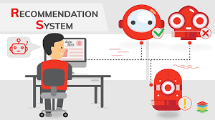
Introduction
A recommendation system is an application of information filtering.
It studies the user’s interests and preferences, and imply some algorithms to find the user’s personalized needs and actively and efficiently recommend information and content to users.

Slide 3

Importance of Recommendation System
In today's information-rich environment, it is hard for a person to find useful information from vast amounts of data.
In many cases, users don’t fully realize their own needs, or their demand is difficult to express in words.
Recommendation systems enhance user experience and engagement by providing personalized suggestions.
Helps in saving user’s time as well.

Slide 4
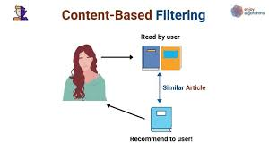
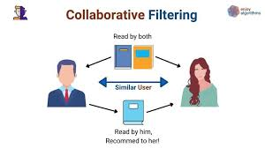
Types of Recommendation Systems
Content-Based Filtering
Recommends items similar to those a user has liked/selected in the past.
Focuses on Item characteristics.
Collaborative Filtering
Recommends items based on the preferences of users with similar tastes.
Focuses on other users’ ratings and opinions.

Slide 5
Datasets Description
Movies Dataset
https://www.kaggle.com/datasets/akshaypawar7/millions-of-movies
Contains 722710 rows and 20 columns
Time period:- 1970 to 2023
350 MB
TV Shows Dataset
https://www.kaggle.com/datasets/bourdier/all-tv-series-details-dataset/data
152970 rows and 188 columns
250 MB
Books Dataset
https://www.kaggle.com/datasets/ishikajohari/best-books-10k-multi-genre-data
10000 rows and 8 columns
11.75 MB

Slide 6
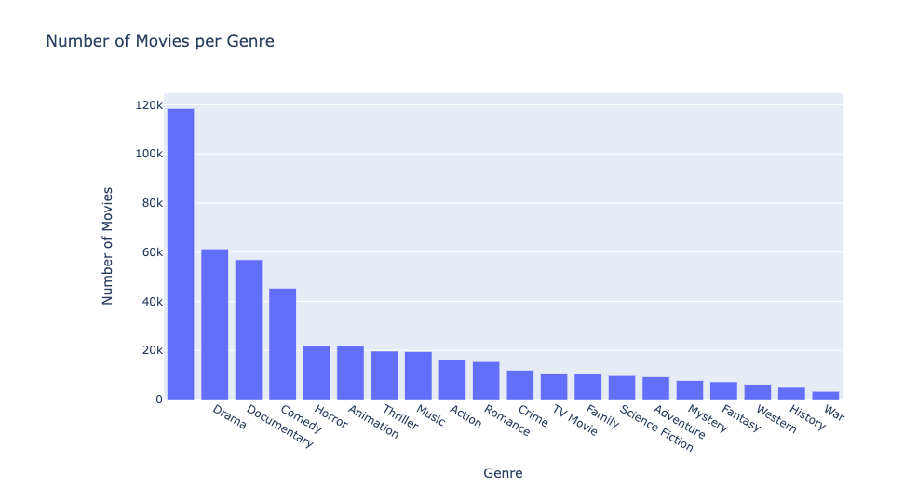
Movies Dataset EDA
This shows that this dataset contains movies from all genres. So there will be no bias and there is ample amount of movie genres for the user to select a movie from.

Slide 7
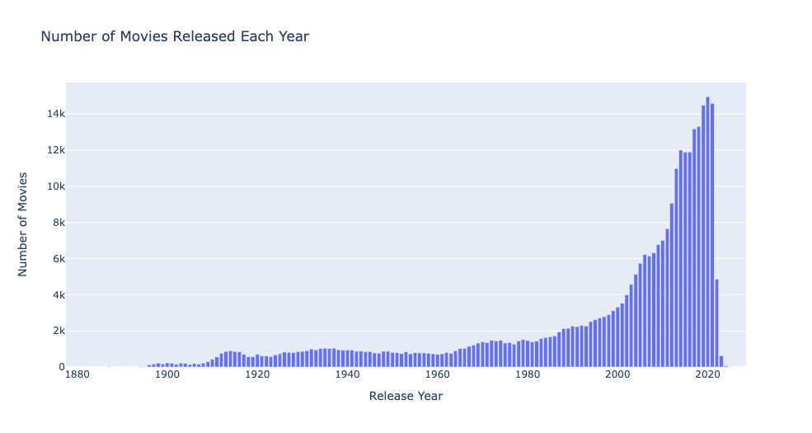
Movies Dataset EDA
This dataset contains movies from 1890s to 2023. After looking at this plot, I decided to take movies from 1970 to 2023 since usually people are not interested in very old movies.

Slide 8
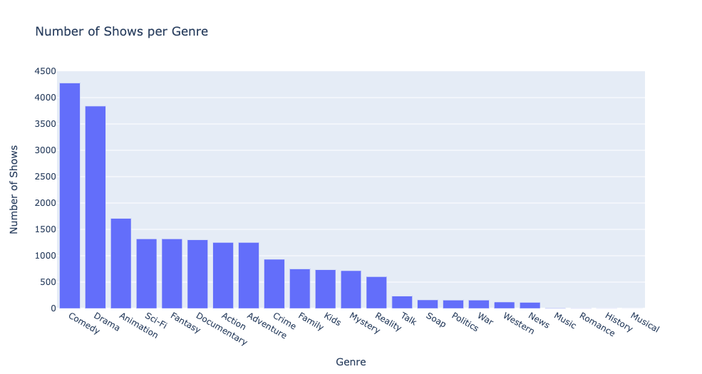
TV Shows Dataset EDA
This dataset contains TV shows from all the genres.

Slide 9
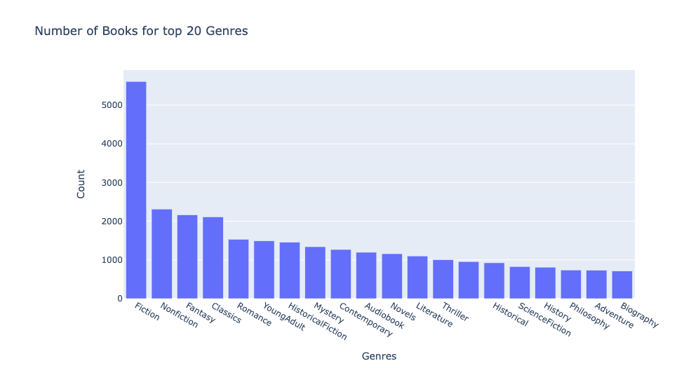
Books Dataset EDA
This dataset contains all genre books. Mostly are fiction books.

Slide 10
Techniques Used
Count Vectorization
Technique to convert a collection of text documents into numerical feature vectors. It works by counting the frequency of words in each document and constructing a matrix representing the entire corpus.
How it works:
Tokenization: First, the text data is tokenized into individual words or terms.
Counting: For each document, a count of the occurrences of each word in the vocabulary is recorded.
Vectorization: Each document is represented as a vector where each element corresponds to the count of a specific word in the vocabulary.
Cosine Similarity is used where items with similar count vectors are considered more related.
Limitation of Count Vectorization is that it doesn't take into account the importance of words in the documents.

Slide 11
2. TFIDF (Term Frequency-Inverse Document Frequency)
TFIDF is a numerical statistic that reflects the importance of a word in a document relative to a collection of documents. It is calculated based on two components:
Term Frequency (TF): Measures how frequently a word appears in a document. It is calculated as the number of times a term appears in a document divided by the total number of terms in the document.
Inverse Document Frequency (IDF): Measures how important a term is across all documents in the corpus.
TFIDF Score: The TFIDF score for a word in a document is obtained by multiplying its TF and IDF values.
After this, cosine similarity is used, and the system recommends items with high similarity scores to the user based on their selected movie.
TFIDF takes into account not only the frequency of terms in a document (TF) but also how unique these terms are across the entire corpus (IDF).

Slide 12
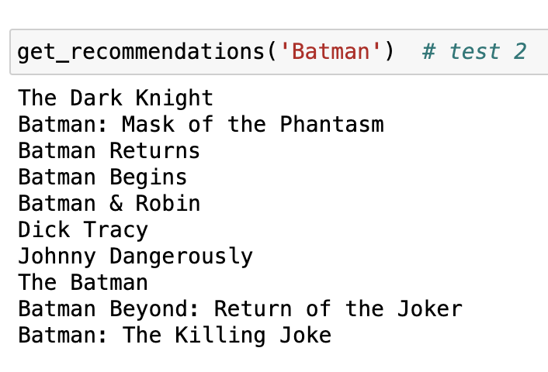
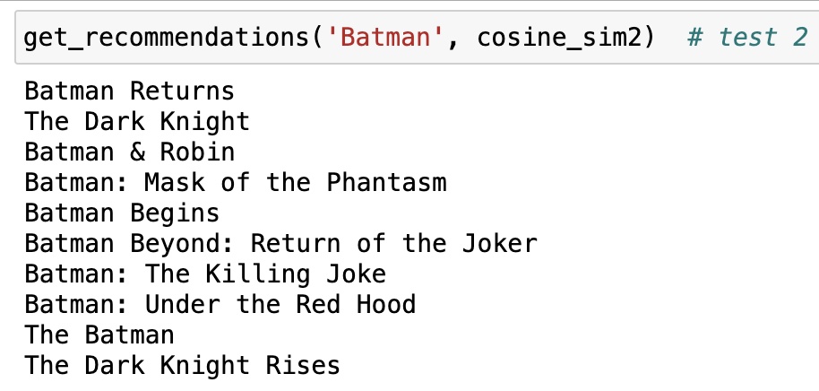
Example of results for Batman Movie
Count Vectorization
TFIDF
Here we can see results of TFIDF are better than Count Vectorizer. Hence for main model, TFIDF as been selected.

Slide 13
Potential Applications
The developed recommendation system has the potential to enhance user experiences on platforms offering movies, shows, and books. It can be integrated into streaming services, online bookstores, and media platforms to provide personalized content suggestions tailored to individual tastes.

Slide 14
Lesson Learned
The importance of quality data became evident.
Ensuring completeness and lack of bias in the dataset is fundamental for accurate recommendations.
The iterative nature of system development taught the value of continuous refinement and adaptation to changing requirements.

Slide 15
Limitations
The system does not consider user interactions or feedback, which could further enhance recommendation accuracy.
No evaluation matrix is used. Results are evaluated manually only.

Slide 16
Future Research Scope
Conducting in-depth research on advanced evaluation techniques could provide deeper insights into the system's performance.
Deploying user surveys and feedback forms will enable us to gather direct opinions from users, shaping our understanding of their experiences and preferences.
Exploring quantitative metrics, such as Click-Through Rate (CTR), would offer a data-driven perspective on user engagement.

Slide 17
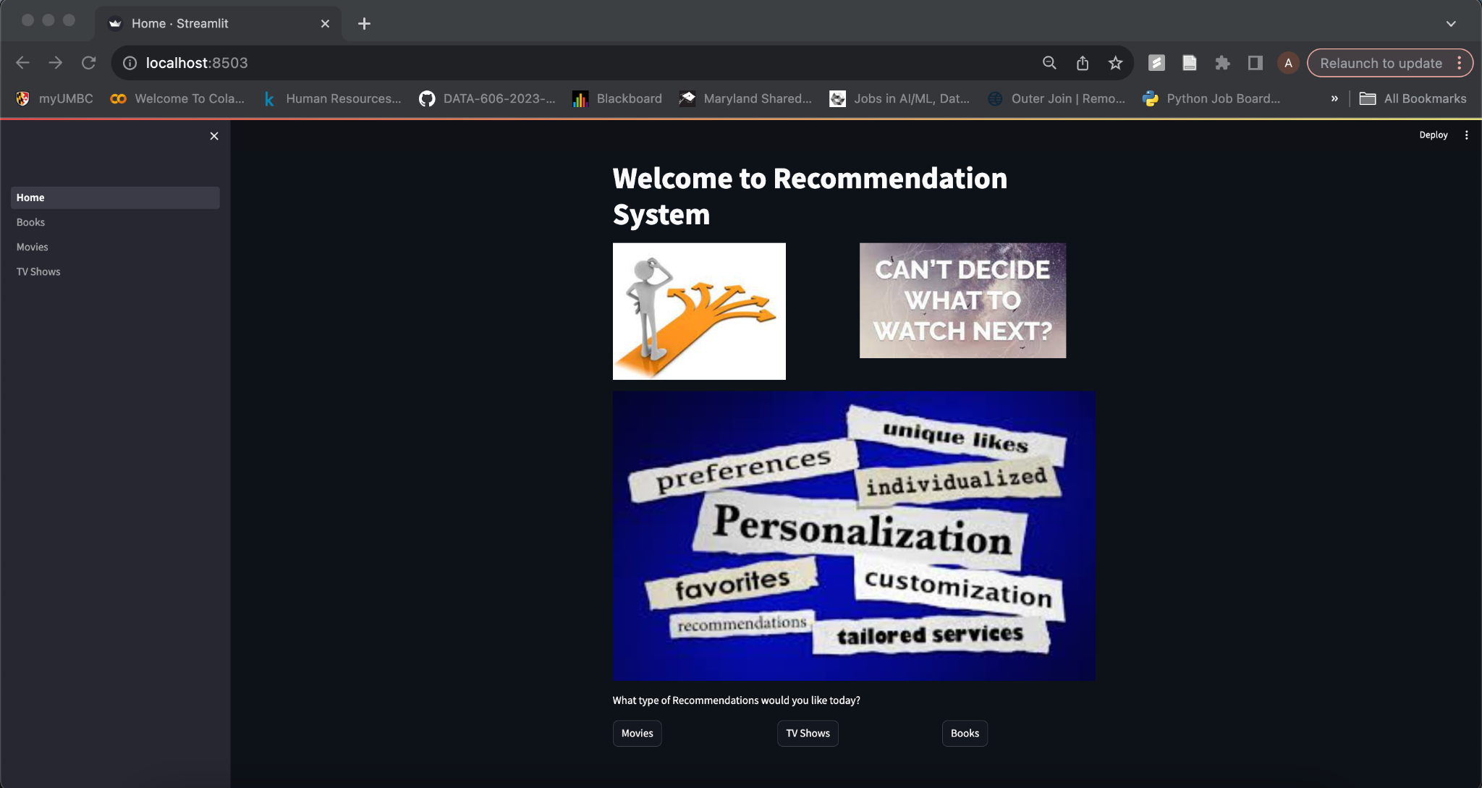
Web App Demo
Tech Stack:
Python
Streamlit
Pandas
Plotly
Home Page

Slide 18
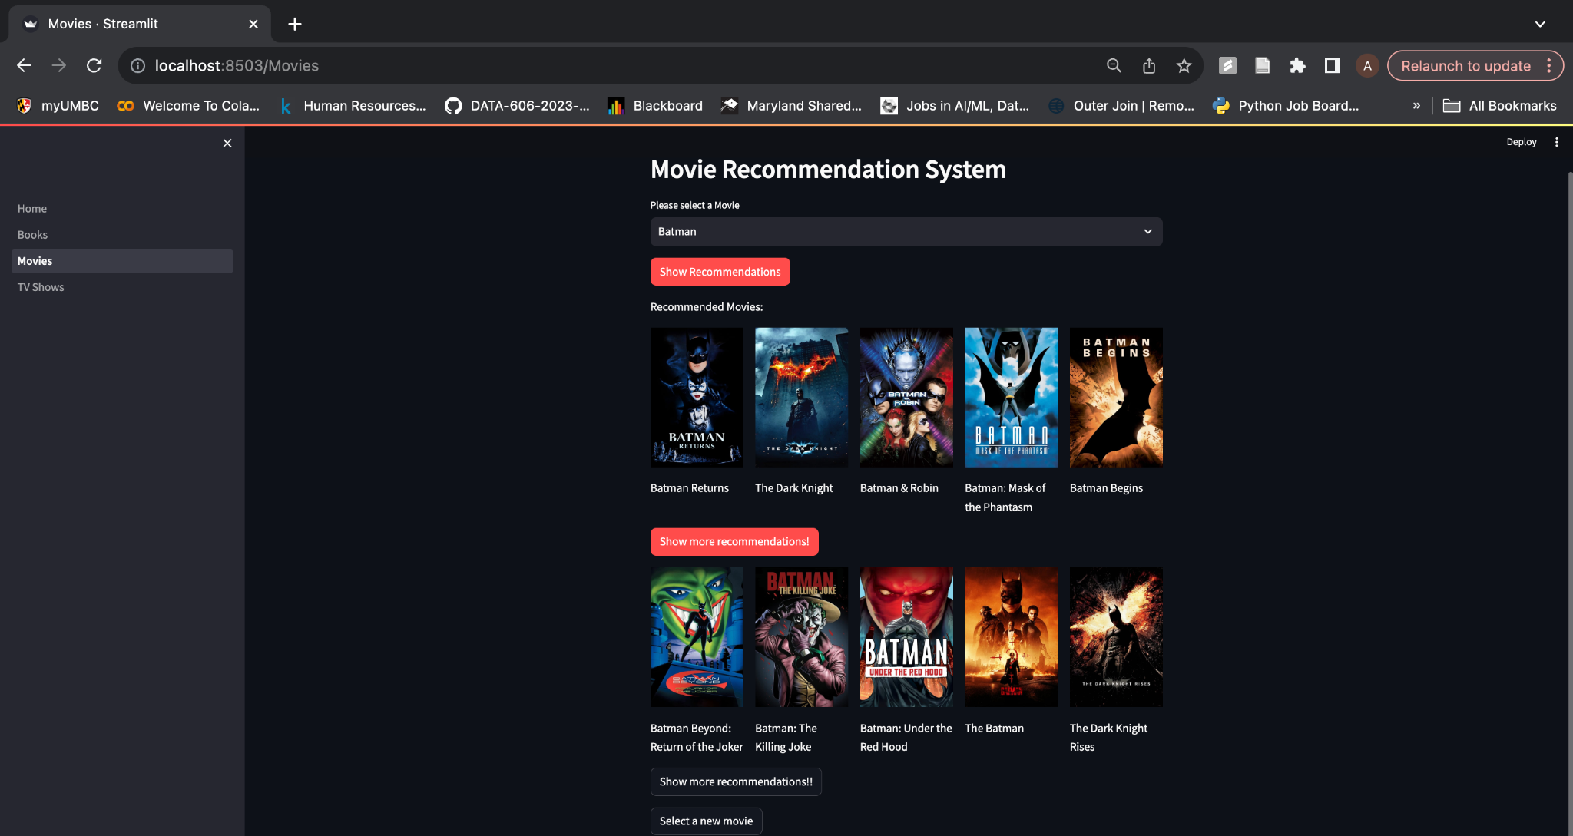
Movie Recommendation Page

Slide 19
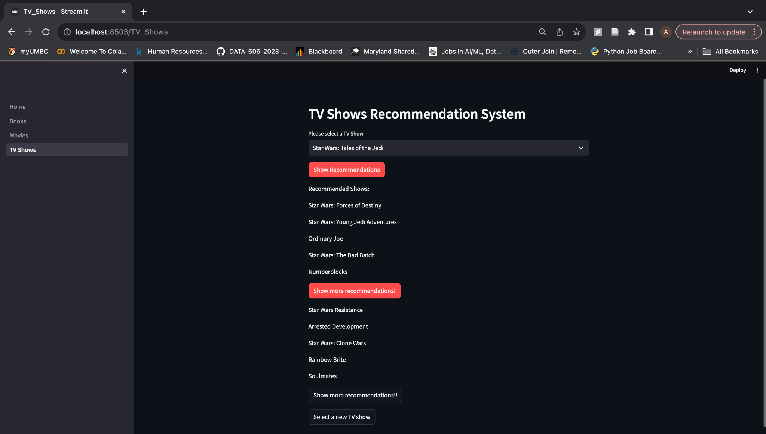
TV Show Recommendation Page

Slide 20
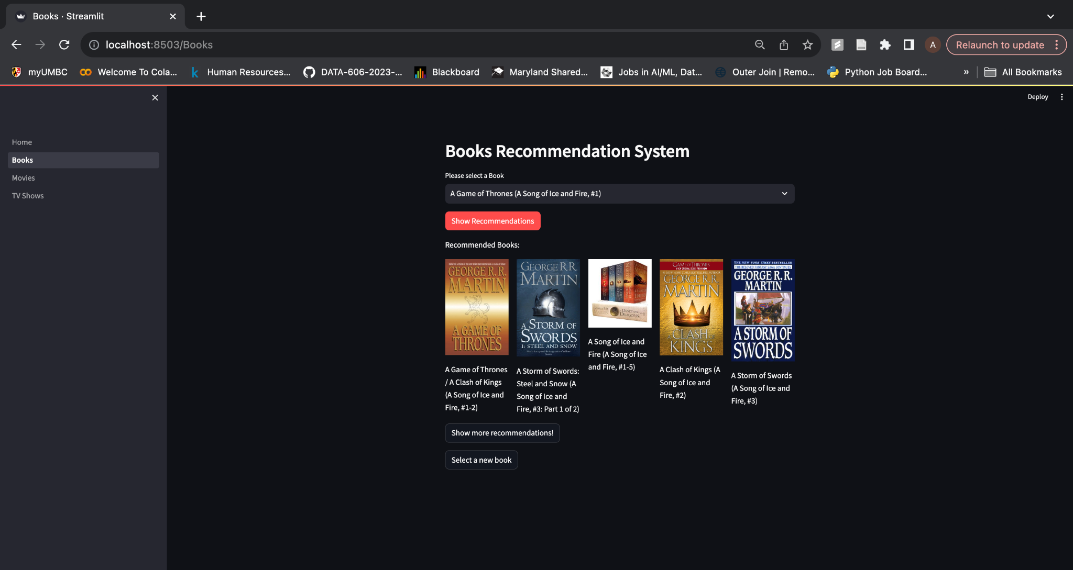
Book Recommendation Page

