Slide 1
Predictive Modelling to determine Vehicle Prices
Regression

Slide 2
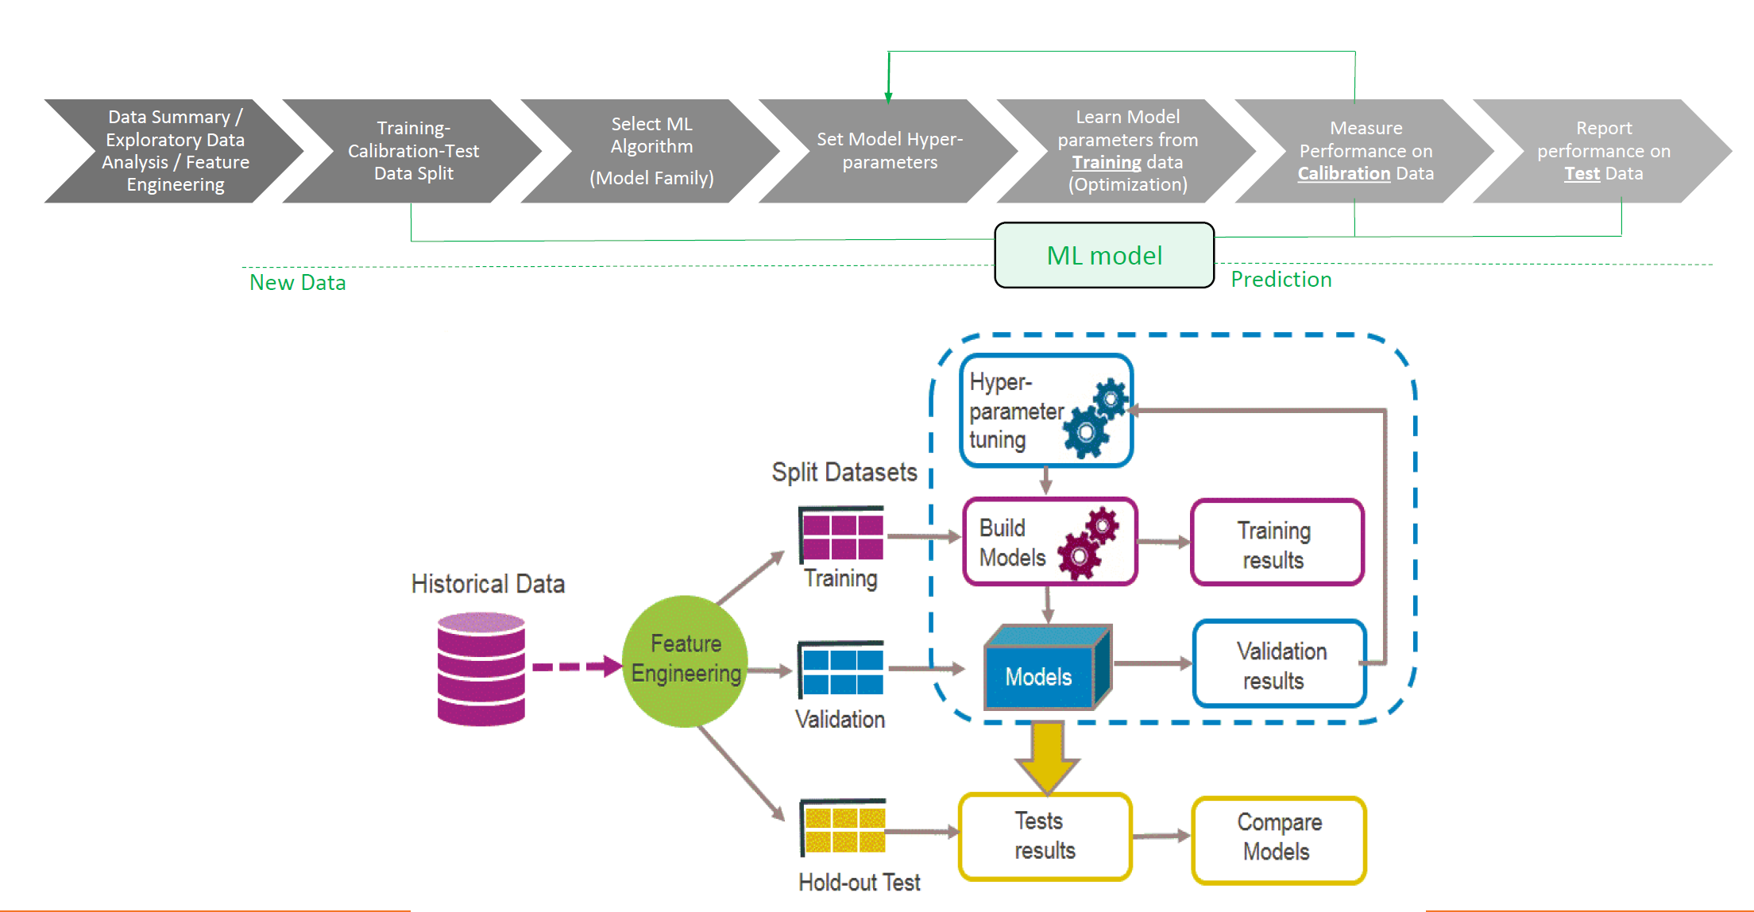

Slide 3
Problem Statement
Given the historical data, the aim is to build a predictive model to determine the price of used car vehicles in India.
From the problem statement it is evident that it is a regression problem.
Segments benefitted : Car manufacturers, car dealers, banks, individuals

Slide 4
Data Preprocessing
Changed the data types to numeric, factors, and Strings as per given data description.
Removed the Data columns
Removed the NameOfTheVehicle String column
Removed the columns exhibiting NearZero Variance
Removed the ID and Zipcode columns

Slide 5
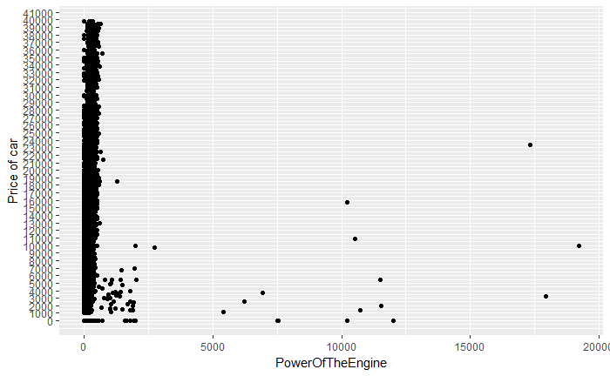
Data Exploration
Most of the Engine Powers associated with higher power don’t have higher price range. ➔ Outliers

Slide 6
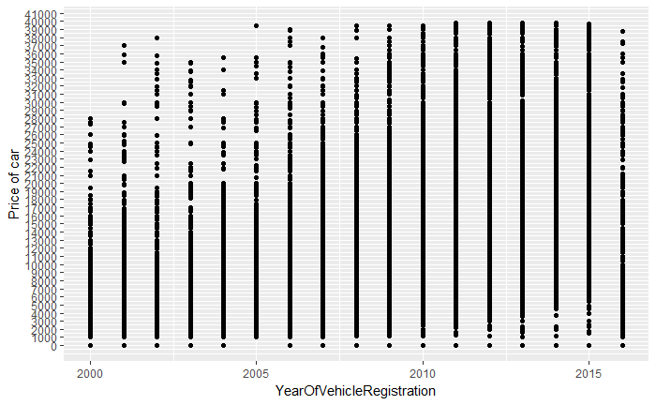
Data Exploration
Older the Vehicle Registration, lower the price

Slide 7
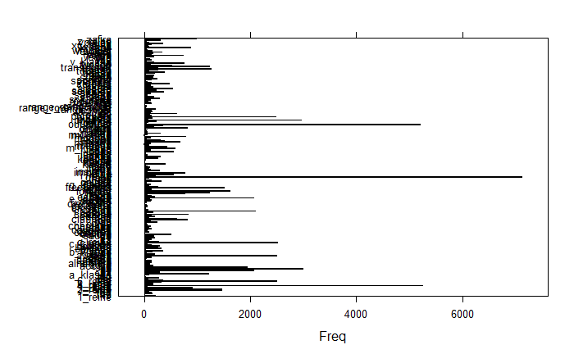
Data Exploration
ModelOfTheVehicle Frequency distribution. => Decided to make factors, and combine those with frequency < 3% to reduce the levels.

Slide 8
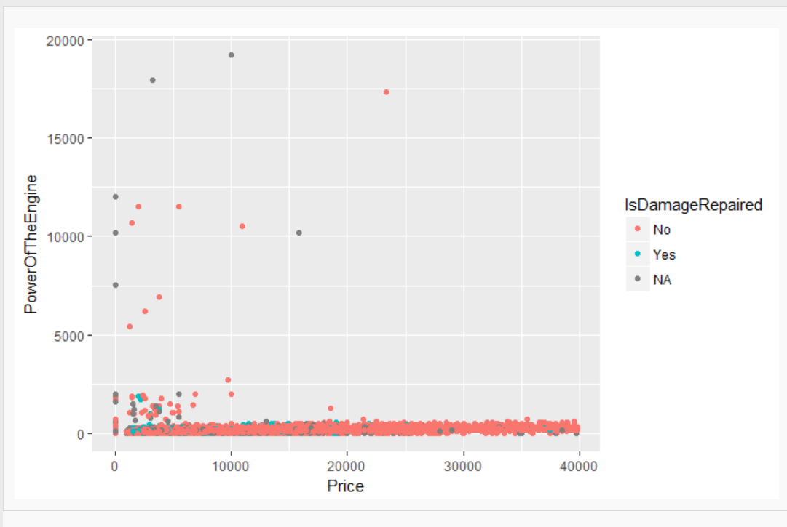
Data Exploration
Very few observations with IsDamageRepaired as “Yes” => But decided to keep this attribute

Slide 9
Data Cleaning
Dataset (train + test) split into numeric and categorical separately.
Checked for numeric predictors having high correlations (>0.80)
No missing value was found in numerical attributes
Created a new factor for missing categorical attributes
Combine categorical variables which have several levels with low frequencies ( <=3% ) and created new factor “Other”
Standardized the numeric data

Slide 10
Preparation of Train/Test Data
Test data : New Test data
Train/Valid Data : Combined the old test data and original training data, and randomly split the data into ratio 70-30 using library caTools
Created entire data into numeric format, using model.matrix
Final Dimesions : 44

Slide 11
Model Intuition
I decided to adopt a workflow testing several different models and check the respective error metrics.
Models Built :
Linear Regression
CART
Random Forest
XGBoost
After that I used stacking to check if model MAPE improves.

Slide 12
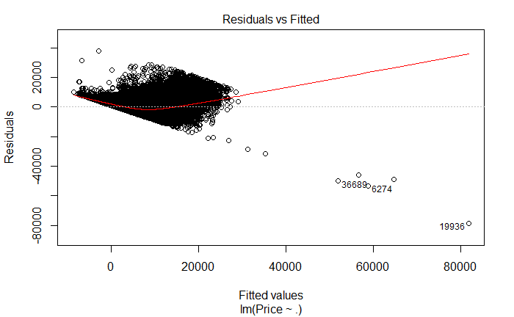
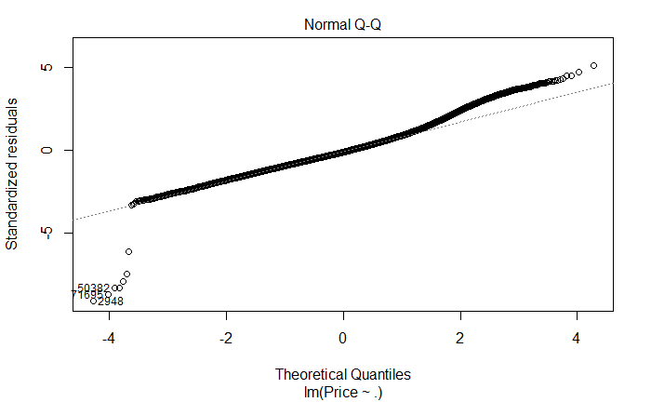
Linear Regression
The model was firstly built and then updated by removing observations based on cooks distance.
The linearity assumptions didn’t hold valid.

Slide 13
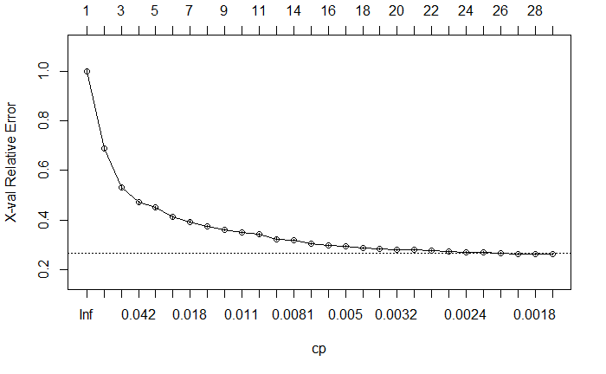
CART
Built and tuned the cp parameter to prune the tree

Slide 14
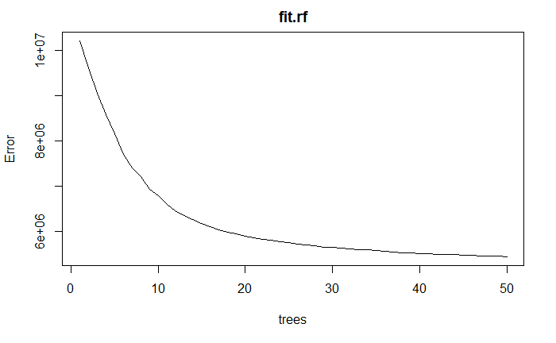
Random Forest
Tuned the ntree and mtry parameters to obtain optimal metrics.
% Var explained: 88.09

Slide 15
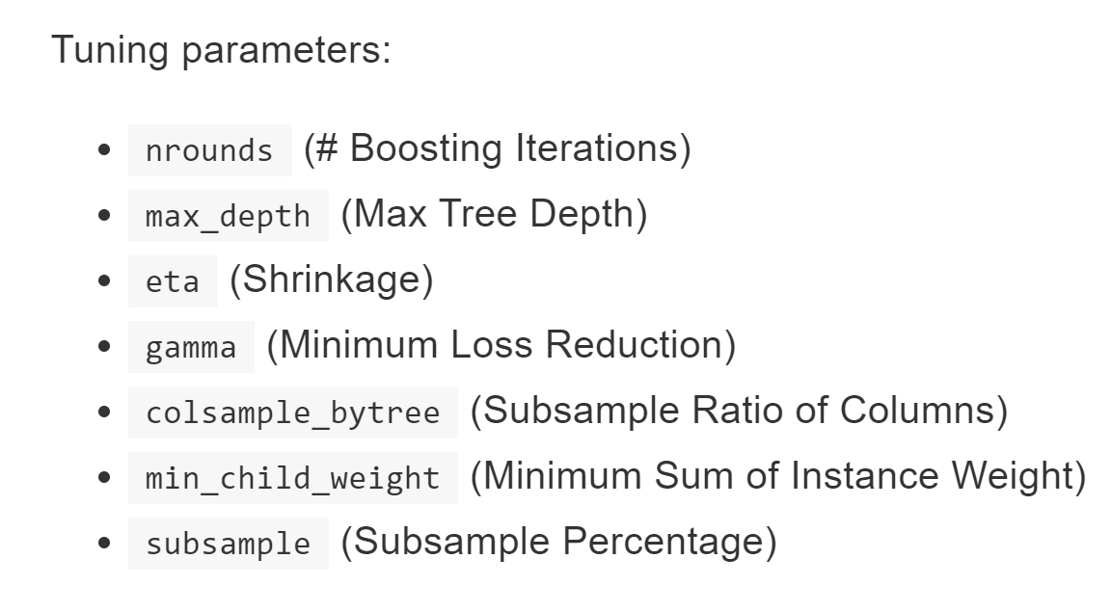
Extreme Gradient Boosting using DT
Firstly did a random grid search, and then manually gave range of hyperparameters for model to find best combination.
The later gave better results.

Slide 16
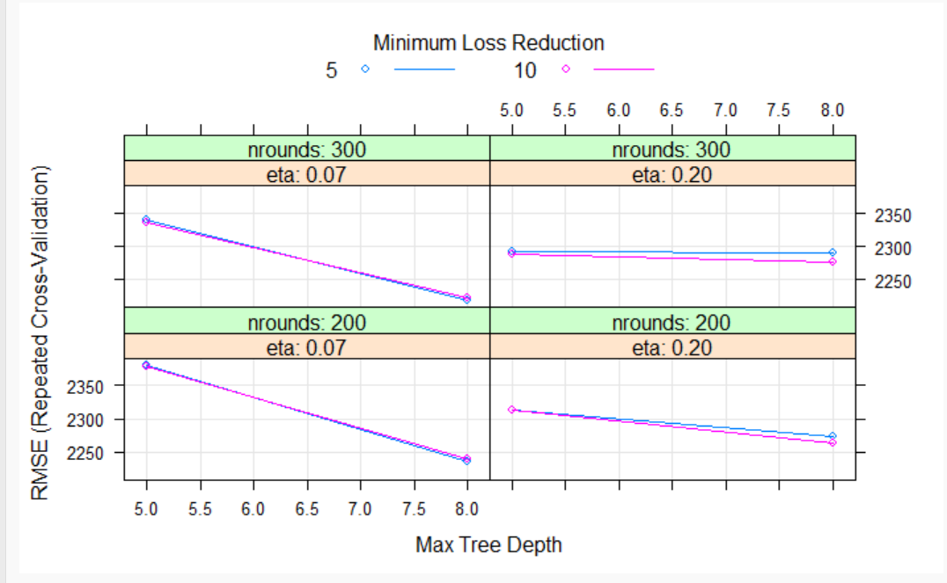
Extreme Gradient Boosting using DT
Hyper parameter Tuning
Best Tune

Slide 17
Stacking
After that I employed Stacking to combine the results.
The correlations in stacked predictors were quite high. So I did not expect a significant improvement after stacking.
However I gave it a try, and see if error metrics improve. Models tried as meta learners : RF, Linear Regression and CART

Slide 18
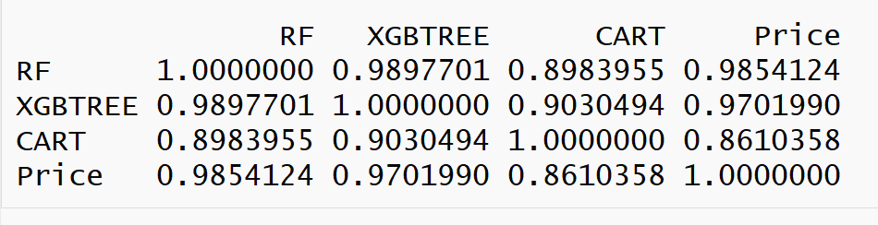
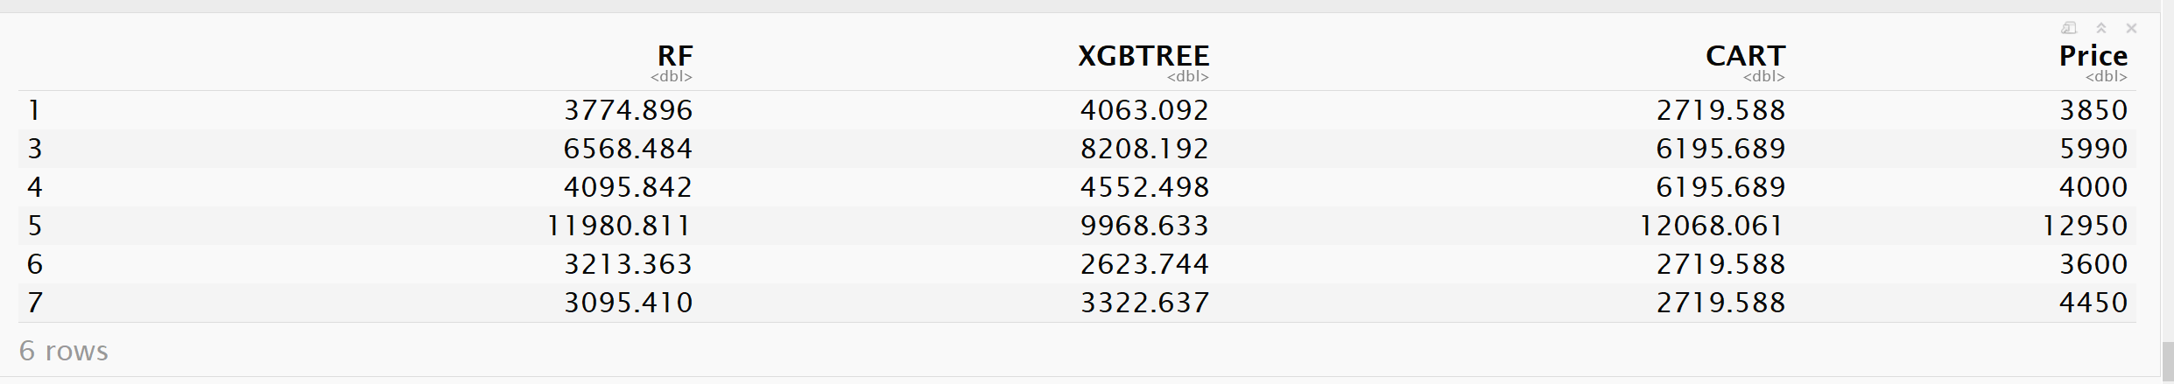
Stacking
Correlations
Head of data

Slide 19
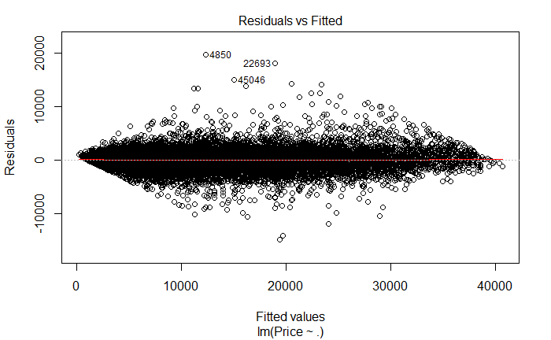
Stacking using Linear Regression
Adjusted R-squared: 0.9747

Slide 20
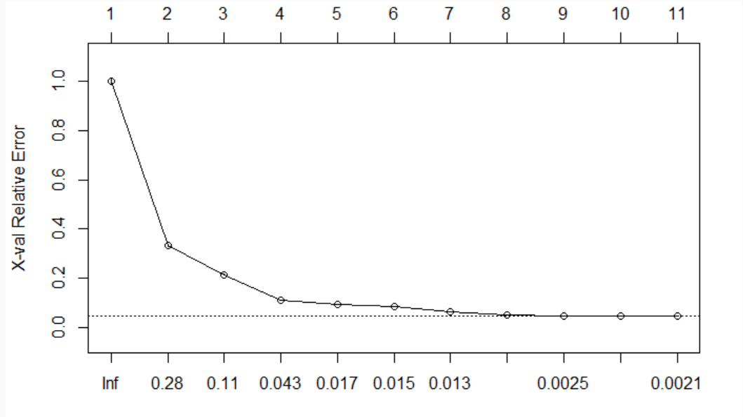
Stacking using CART
Cp tuning

Slide 21
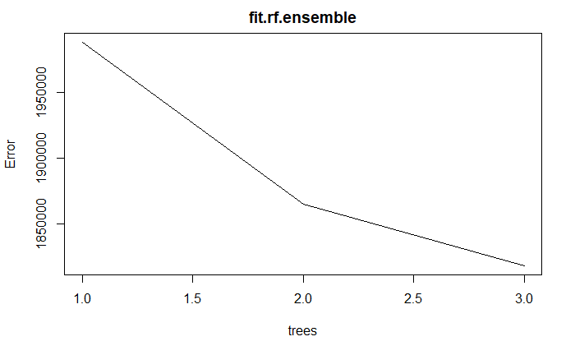
Stacking using Random Forest
% Var explained: 96.02

Slide 22
Comparison of standalone models
MAPE | Train Error | Validation Error
Linear Regression | 1.521916e+00 | 1.962097e+00
CART | 4.424521e-01 | 4.469816e-01
Random Forests | 1.264031e-01 | 2.476127e-01
XGBoost (Random Grid Search) | 2.054038e-01 | 2.397260e-01
XGBoost (Manual Grid Search) | 2.612451e-01 | 2.657679e-01
Stacking using CART | 1.991522e-01 | 2.854830e-01
Stacking using Linear Regression | 1.140418e-01 | 2.535492e-01
Stacking using RF | 1.060275e-01 | 2.532537e-01

Slide 23
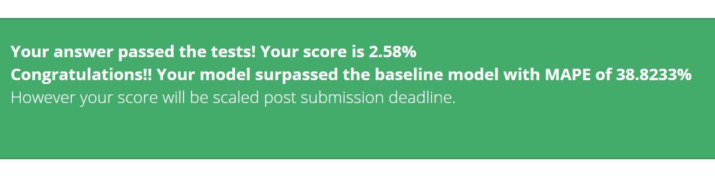
Results
I got best results using Random Forest standalone model.
Stacking improved the train error, but test error didn’t decrease
Least Test Data MAPE came approximately 39%

Slide 24
Further Improvements
I would like to later work on this data to improve the model. Some of the ideas I have are
Clean the “NameOfTheVehicle” attribute using string regex techniques and add into model
Use the date columns in the model

