Slide 1

CA II: Capstone Presentation
AI – Based Traffic Management System
Presented By:
Devyani Balki, 22070521051, Sec A
Sanskruti Nerkar, 22070521028, Sec A
Arushi Shivhare, 22070521062, Sec A

Slide 2

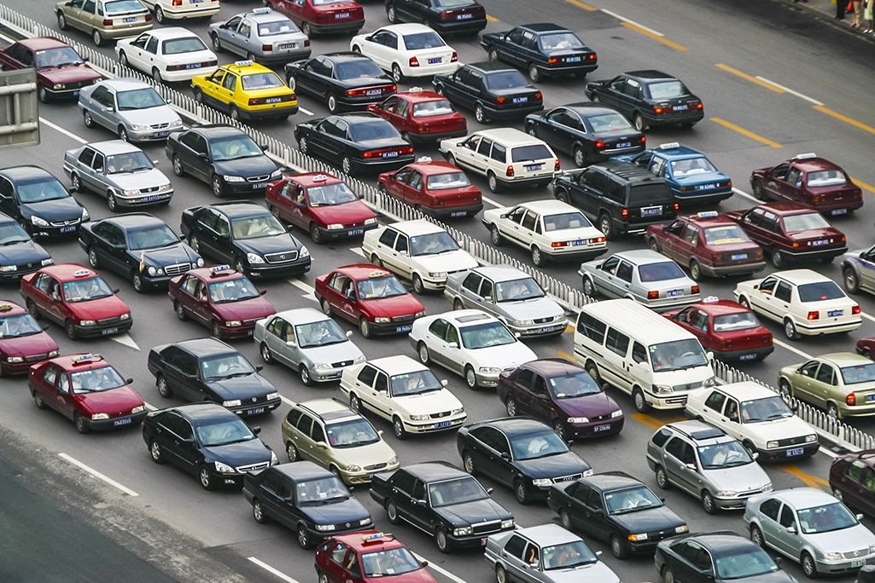
Introduction
Urbanization has led to a sharp increase in vehicle numbers, causing heavy traffic congestion, longer commute times, and rising pollution levels.
Traditional traffic systems operate on fixed timers and are not capable of adapting to real-time traffic flow.
With advancements in Artificial Intelligence, we now have the opportunity to build smarter systems that can make data-driven decisions to improve urban mobility.

Slide 3
Problem Statement
Static traffic signals cause unnecessary delays and congestion.
Emergency vehicles often get stuck due to uncoordinated traffic flow.
There is no real-time analysis or response to changing traffic conditions.
This calls for an AI-based solution that can monitor, analyze, and manage traffic efficiently.

Slide 4
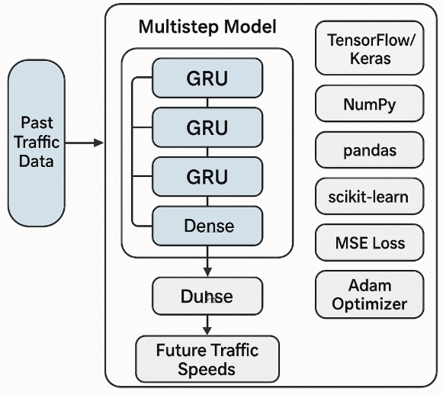
Objectives
Develop an AI-based Traffic Management System: Create a smart system capable of analyzing real-time traffic data using computer vision and machine learning.
Dynamic Signal Control: Automatically adjust traffic light durations based on the number and type of vehicles detected at intersections.
Emergency Vehicle Priority: Detect emergency vehicles (e.g., ambulances, fire trucks) and give them immediate passage by altering signal patterns.
Reduce Congestion and Waiting Time: Minimize idle time at signals, reduce overall traffic congestion, and improve fuel efficiency.
Enhance Urban Mobility: Support smoother traffic flow, better route planning, and improved user experience for daily commuters.

Slide 5
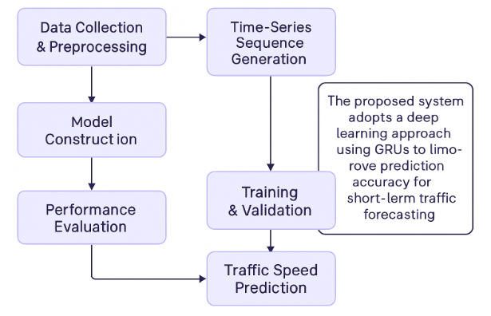
Methodology
Data Collection: Traffic videos were used to simulate real-world traffic scenarios.
Vehicle Detection: Implemented YOLOv8 (You Only Look Once) algorithm to detect and classify vehicles in real-time.
Image Processing: Used OpenCV to analyze traffic density and movement from video frames.
Dynamic Signal Control: Signal durations were adjusted based on the number of vehicles detected in each lane.
Emergency Detection: Special logic included to identify emergency vehicles and give them priority passage.
Simulation Testing: Entire system tested using Python to demonstrate effectiveness in various traffic conditions.

Slide 6
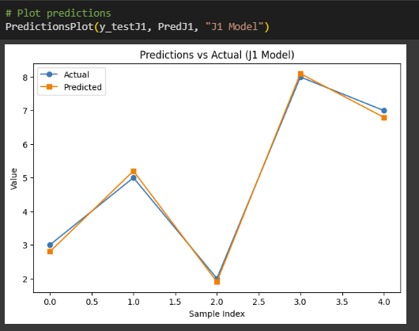
Results
High Detection Accuracy: YOLOv8 achieved accurate real-time detection and classification of multiple vehicle types (cars, buses, bikes) with low latency.
Adaptive Signal Timing: The AI model successfully adjusted traffic light durations in real-time based on vehicle density, improving overall traffic throughput.

Slide 7
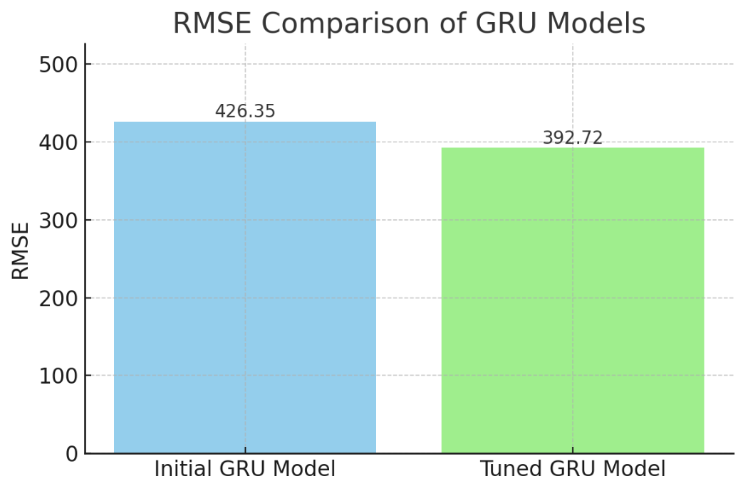
Key Findings
Emergency Vehicle Prioritization: The system identified emergency vehicles and dynamically reconfigured signal timings to allow immediate clearance.
Reduced Idle Time: Compared to fixed-time systems, the proposed model significantly reduced vehicle waiting time at intersections.
Efficient Simulation Results: Python-based simulation showed effective traffic flow optimization across various traffic volumes and conditions.
Scalability: The modular design allows integration with existing traffic infrastructure and future extension to smart city platforms.

Slide 8
Conclusion
The proposed AI-based Traffic Management System effectively addresses the limitations of traditional signal systems by using real-time traffic data and intelligent decision-making.
Through machine learning and image processing, the system adapts signal durations based on actual traffic conditions, improving flow and reducing congestion.
Emergency vehicle detection ensures faster response times and prioritization, enhancing road safety and emergency services.
Simulation results confirm the system's capability to enhance traffic efficiency and urban mobility.
Future Scope
Real-World Deployment: Integrate the system with live CCTV feeds and smart traffic controllers in cities.
IoT Integration: Use IoT sensors for additional data like vehicle speed, air quality, and road conditions.
Cloud-Based Data Management: Implement cloud infrastructure for centralized traffic data analysis and reporting.
Mobile App Integration: Notify users about traffic congestion and provide optimized route suggestions.
Pedestrian & Cyclist Detection: Extend the model to account for non-vehicular road users for safer intersections.

Slide 9
References
Redmon, J., & Farhadi, A. (2018). YOLOv3: An incremental improvement. arXiv preprint arXiv:1804.02767. https://arxiv.org/abs/1804.02767
Wang, Y., Zheng, Y., Xue, Y., & Dong, C. (2014). A traffic congestion prediction model for big data applications. IEEE Transactions on Intelligent Transportation Systems, 16(2), 865–873. https://doi.org/10.1109/TITS.2014.2338284
Zhang, J., Zheng, Y., & Qi, D. (2017). Deep spatio-temporal residual networks for citywide crowd flows prediction. Proceedings of the AAAI Conference on Artificial Intelligence, 31(1). https://doi.org/10.1609/aaai.v31i1.11201
Chen, L. C., Papandreou, G., Kokkinos, I., Murphy, K., & Yuille, A. L. (2017). DeepLab: Semantic image segmentation with deep convolutional nets, atrous convolution, and fully connected CRFs. IEEE Transactions on Pattern Analysis and Machine Intelligence, 40(4), 834–848. https://doi.org/10.1109/TPAMI.2017.2699184
Ma, X., Tao, Z., Wang, Y., Yu, H., & Wang, Y. (2015). Long short-term memory neural network for traffic speed prediction using remote microwave sensor data. Transportation Research Part C: Emerging Technologies, 54, 187–197. https://doi.org/10.1016/j.trc.2015.03.014

