Slide 1
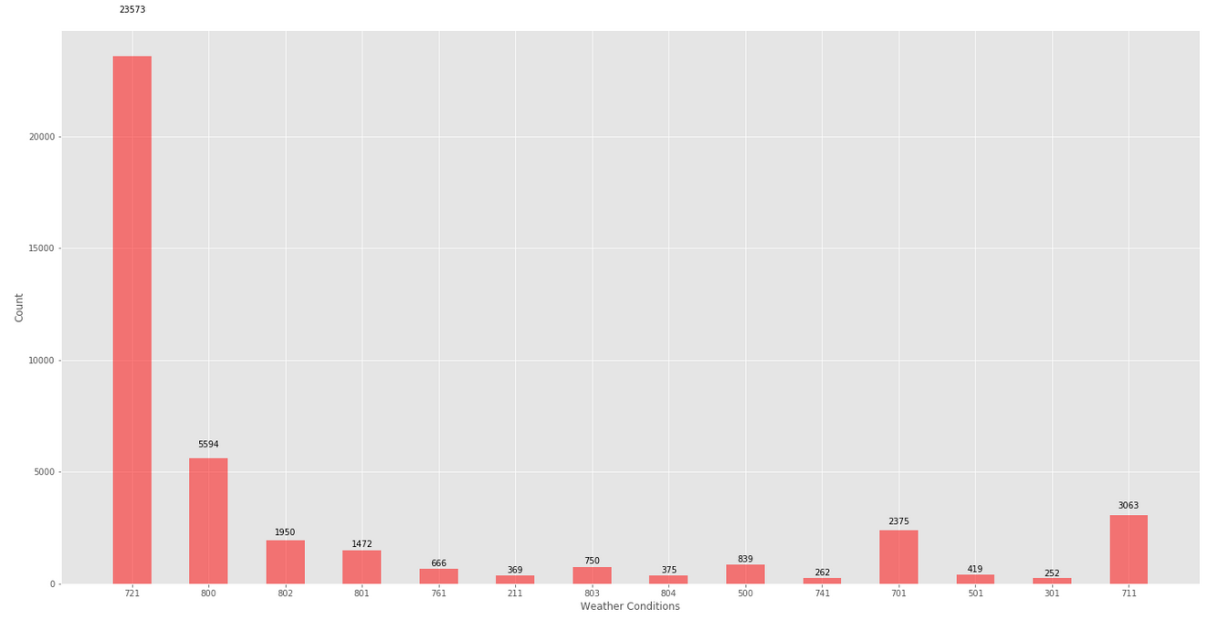
Frequency of each weather_id over the period of 5 years (2013-05-03 05:30:00 to 2018-07-09 05:30:00) for every one hour.

Slide 2
Weather_id | Climate_type1 | Climate_type2 | Frequency
721 | Haze | Haze | 23573
800 | Clear | Sky is clear | 5594
802 | Clouds | scattered clouds | 1950
801 | Clouds | Few Clouds | 1472
761 | Dust | Dust | 666
211 | Thunderstorm | Thunderstorm | 369
803 | Clouds | Broken clouds | 750
804 | Clouds | Overcast clouds | 375
500 | Rain | Light Rain | 839
741 | Fog | Fog | 262
701 | Mist | Mist | 2375
501 | Rain | Moderate Rain | 419
301 | Drizzle | Drizzle | 252
711 | Smoke | Smoke | 3063

Slide 3
29-June-2018 at morning 6’o clock to 8’o clock active power is zero.
28-June 2018 (11:20 am) to 2-7-2018 (9:44 am) data missing.
30TH MAY, meter id= 16, 6:30 PM to 7:00 PM data missing
7th June, 9th June, 19th June, 27th June, meter id = 16, 6:30 PM to 7:00 PM data missing.
10, 11 meter ids are roof mounted and 8, 9 are ground mounted.

Slide 4
Self Generation
Connecting modules (more number of solar panels connected to it).
They don’t clean the solar panels well.
Something gone wrong with hardware.

Slide 5
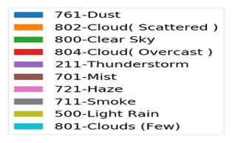

Slide 6
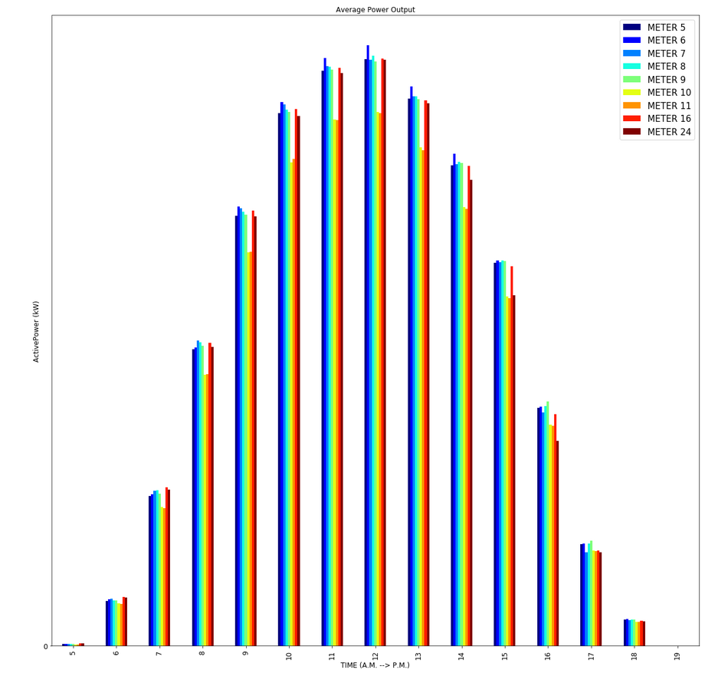
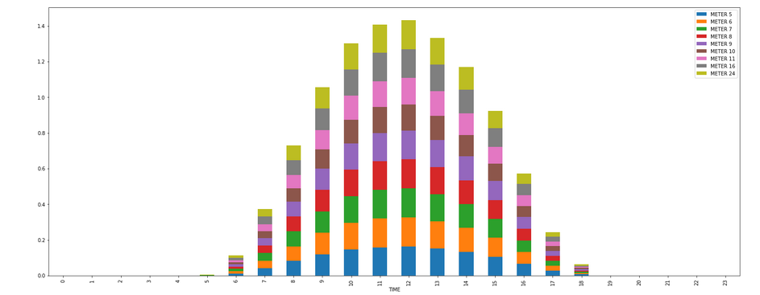
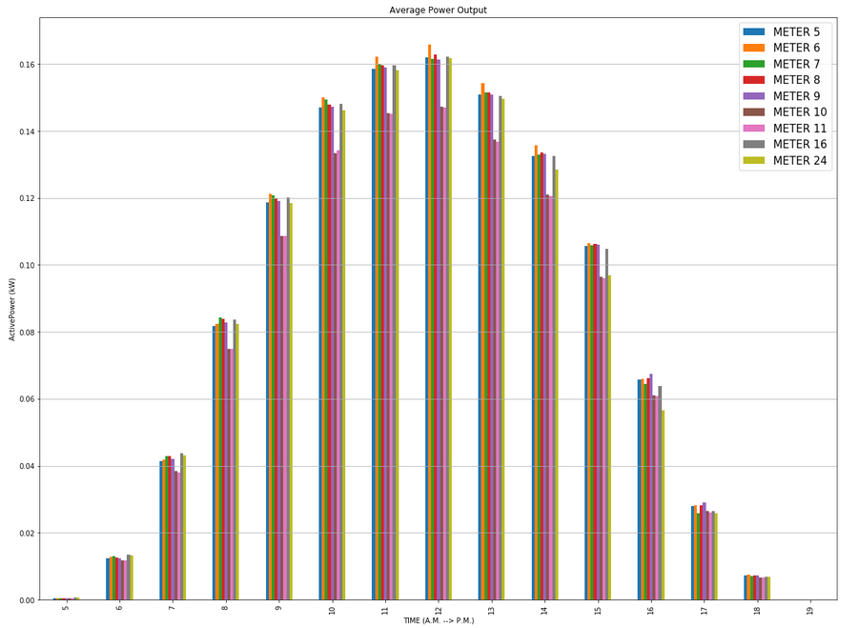
Average power output of each meter id.

Slide 7
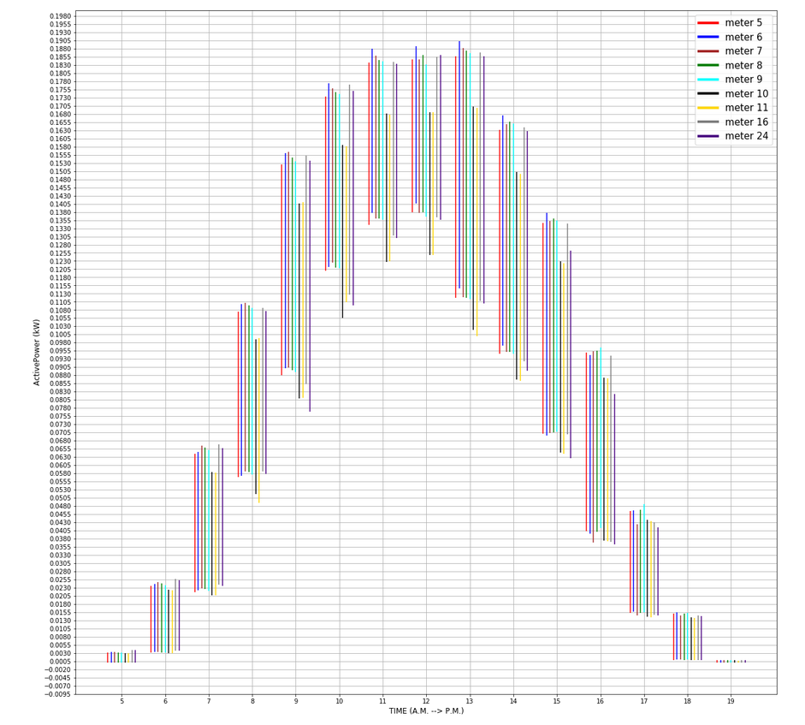
Average Min and max active power

Slide 8
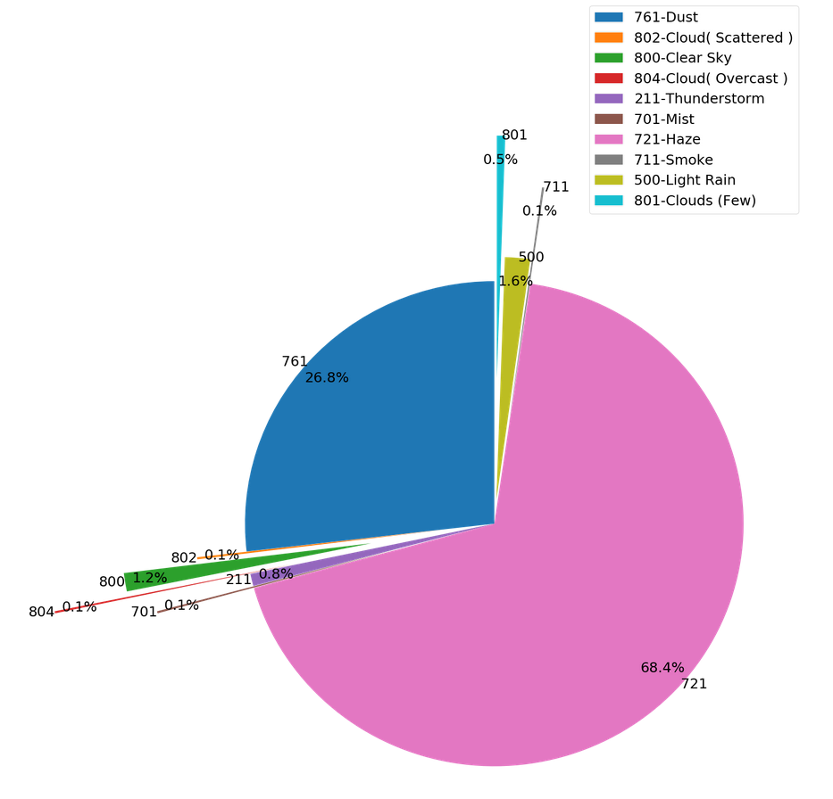
Pie chart showing percentage of each type of weather condition at Jaipur in month of June.

Slide 9
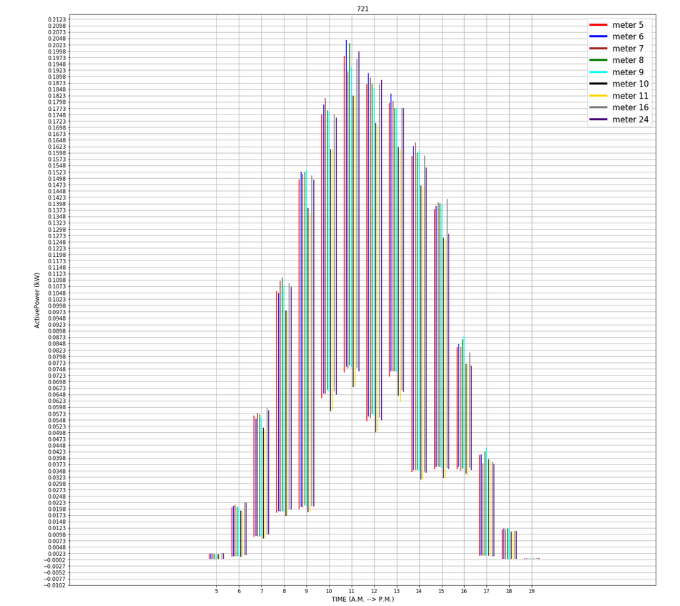
Average min and max for all the meter id when Jaipur is experiencing Haze condition in the month of June.

Slide 10
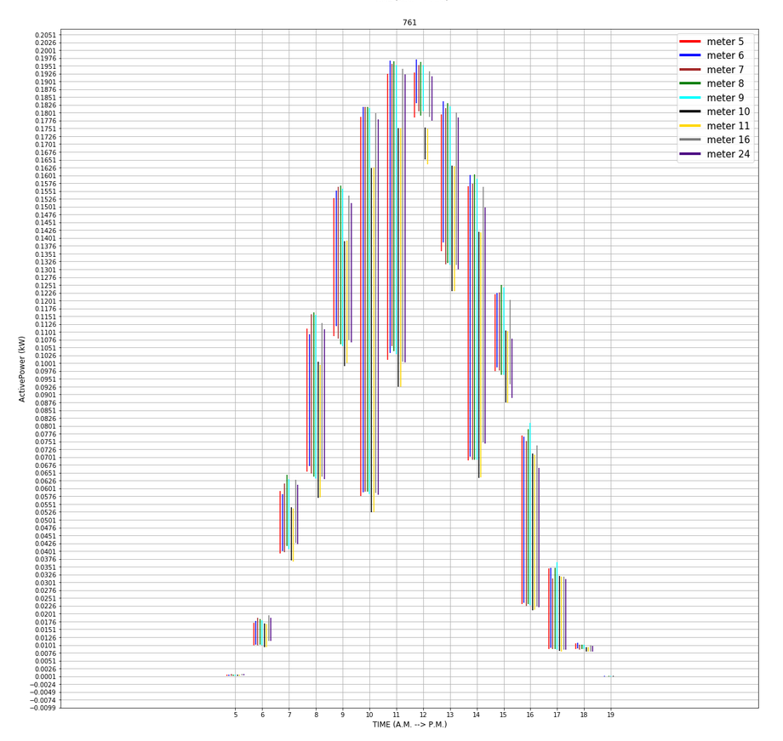
Average min and max for all the meter id when Jaipur is experiencing Dust condition in the month of June.

