Slide 1
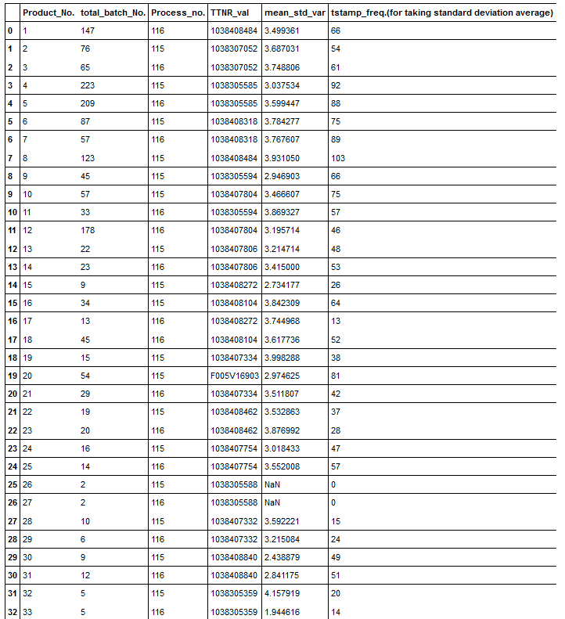
Details of product number for SMT 5 machine.

Slide 2
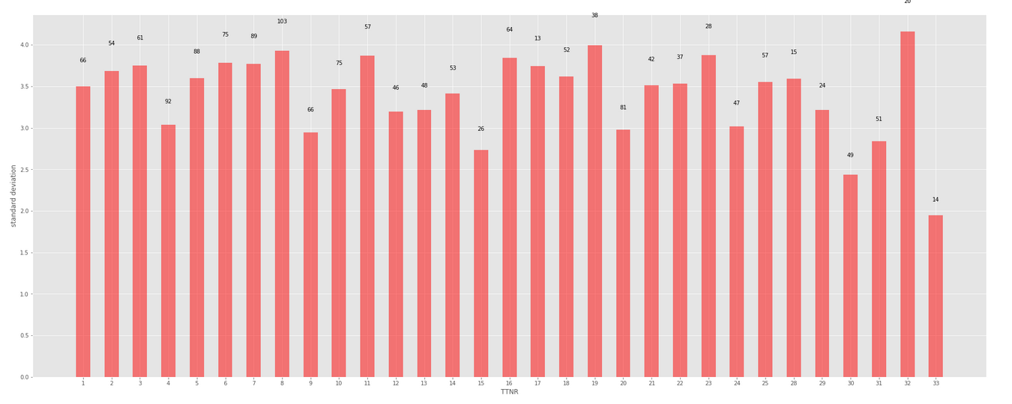
Product number
Product number and the corresponding “mean standard Deviation of Power” from the mean value. (Label showing is the value of maximum time-range among the batch for particular TTNR)

Slide 3
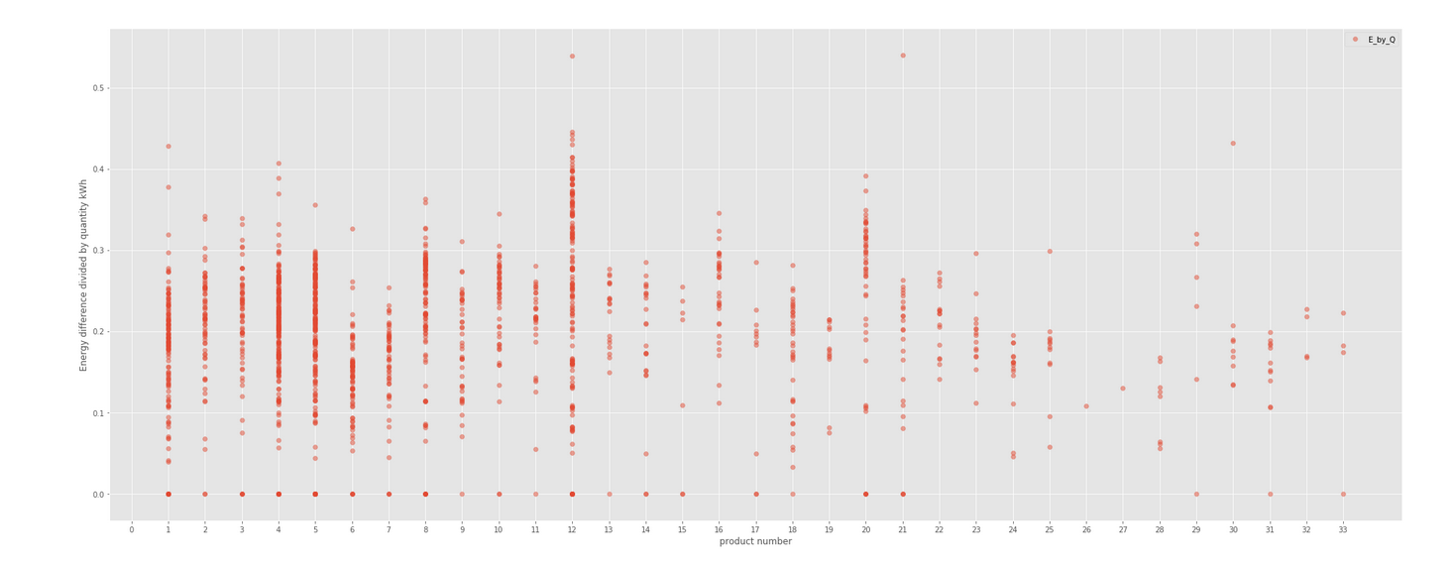
Spread of E/Q for each product number.

Slide 4
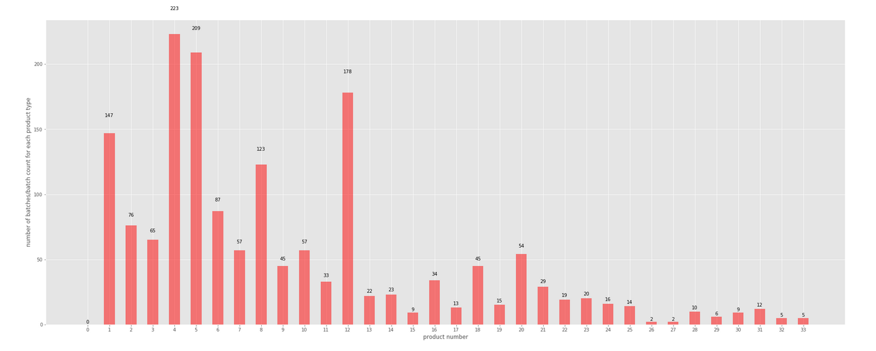
Count of batches corresponding to each product number.

Slide 5
OBSERVATION
Product number 4 is better among all the other products (also it is produced more and also for long duration as batch size and time-range is more).
Product number 12 and 5 is also showing better output and less deviation.

