Slide 1
CS4432: Database Systems II
Query Processing- Part 3

Slide 2
Covered So Far…
One-Pass Operator Evaluation
  Join, Duplicate Elimination, Group By, Set Union
Two-Pass Evaluation (Sort-Based)
  Sort, Duplicate Elimination, Join [Sort-Join, Sort-Merge-Join]
What’s Next…
Two-Pass Evaluation (Hash-Based)
  Duplicate Elimination, Join
Index-Based Evaluation
  Join
Nest-Loop Join

Slide 3
Two-Pass Hash-Based Algorithms

Slide 4
Hash-Based Algorithms: Main Idea
Data is too large to fit in memory
Partition the data (using hashing) into buckets
Work on each bucket individually
  Either One-Pass or Two-Pass

Slide 5
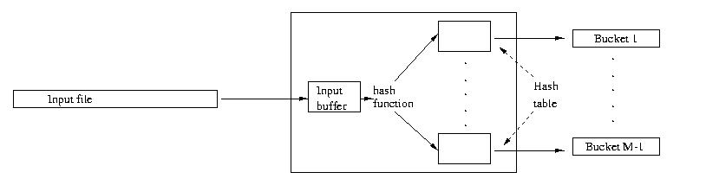
Partitioning a Relation
Read one block at a time ➔ (1 Buffer)
Keep M-1 buffers for the hash table (M-1 buckets)
Hash each tuple to its bucket’s buffer
If buffer of bucket X is full ➔ write it to disk
Good Hash function ➔ Each bucket size = B(R) / M-1
R on disk
1 buffer (block at a time)
Hash Table (M-1 Buffers)

Slide 6
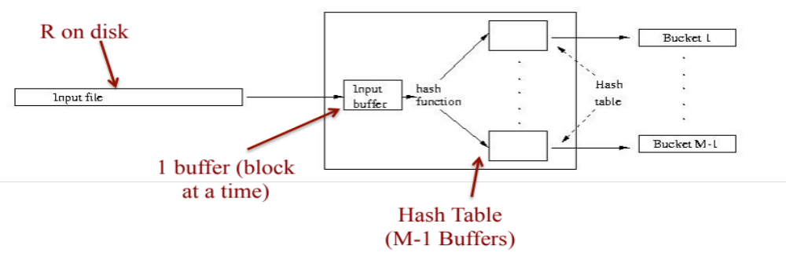

Distinct
Hash-Based Two-Pass Duplicate Elimination
R
Pass 1: Partition R using Hashing
Each bucket size = B(R) / M-1
Pass 2: Load each bucket into memory and eliminate duplicates
  Identical tuples must exist in the same bucket
What are the constraints for this algorithm to work in two pass?
What is the I/O Cost
A bucket must fit in memory
B(R)/M-1 <= M ➔ B(R) < M²
Pass 1 ➔ 2 B(R), Pass 2 ➔ B(R)
Total ➔ 3 B(R)

Slide 7
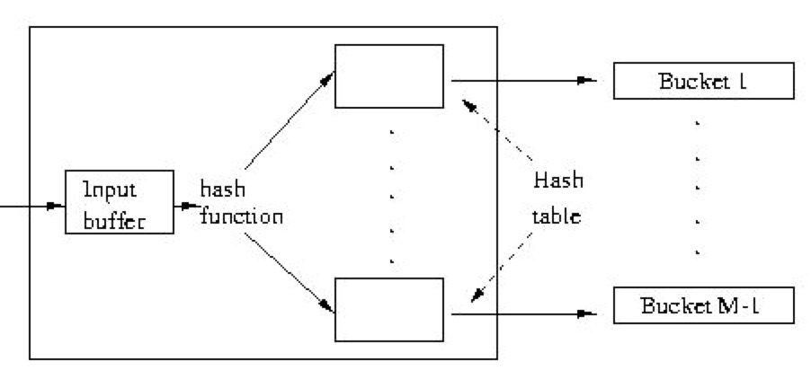
Hash-Based Two-Pass Join
Join
R
S
Phase 1: Partition each relation using the same hash function into buckets
  Hash function must be on join key
Phase 2: Join Bucket x from R with Bucket x from S
Phase 1: Partition
R
R’s buckets
S
S’s buckets

Slide 8
Hash-Based Two-Pass Join (Cont’d)
Join
R
S
Phase 2: Join Buckets R.x and S.x
Move the smaller bucket to memory ➔ (M-2) buffers
Read from the other bucket one block at a time and join ➔ 1 buffer
Build hash table or search tree for S’s bucket (M-1 buffers)
Join Result
S’s bucket
R’s bucket
Input buffer
for R’s bucket
Output
buffer
Disk
M main memory buffers
Disk
What are the constraints for this algorithm to work in two pass?
What is the I/O Cost

Slide 9
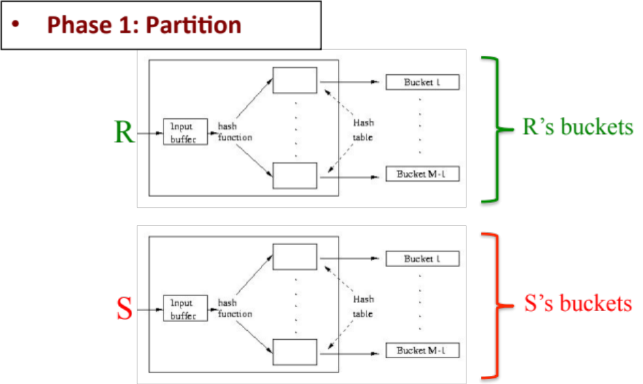
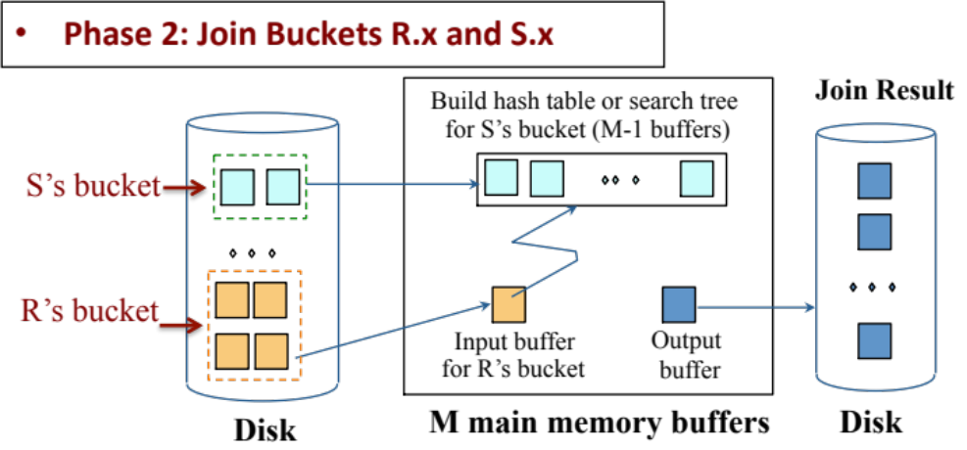
Hash-Based Two-Pass Join
Join
What is the I/O Cost
R
S
2 B(R)
Total I/O cost =
3(B(R) + B(S))
2 B(S)
B(R) + B(S)

Slide 10
Hash-Based Two-Pass Join
Join
What are the constraints?
R
S
No constraints
No constraints
Smaller bucket must fit in memory
➔ B(S)/M <= M (approximation)
B(S) <= M²
Or Min(B(R), B(S)) <= M²

Slide 11
Index-Based Evaluation

Slide 12
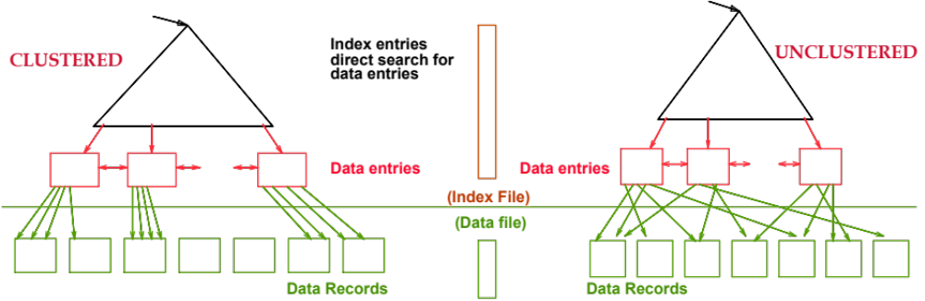
Clustered vs. Un-Clustered Index
Data records are sorted on the index key
If index returns N tuples, how many I/Os?
  N/(number of tuples per block)
➔ Number of tuples per block = T(R)/B(R)
Data records are randomly stored
If index returns N tuples, how many I/Os?
  N

Slide 13
Index-Based Algorithms
Very useful and effective for selection & join
Important property
  If read R by following its indexing pointers
    ➔ tuples will be sorted on the indexed column
  Can be used to Sorting, Duplicate Elimination, Grouping operators

Slide 14
Need to Remember…
B(R): # of blocks to hold all R tuples
T(R): # tuples in R
S(R): # of bytes in each of R’s tuple
V(R, A): # distinct values in attribute R.A
M: # of memory buffers available
R is “clustered” ➔ R’s tuples are packed into blocks
➔ Accessing R requires B(R) I/Os
R
R is “not clustered” ➔ R’s tuples are distributed over the blocks
➔ Accessing R requires T(R) I/Os

Slide 15
Index-Based Join
Join
R
S
Assume Joining R & S on column Y
What is the I/O Cost?
Assume S.Y has an index
R (the one with No index)
becomes the outer relation
S (the one with index)
becomes the inner relation
For each r ∈ R do
[ X ← index-on-S.Y-lookup(r.Y)
For each s ∈ X do
Output (r,s) pair]
Follow the pointers from the index and retrieve the data tuples X from S

Slide 16
Index-Based Join
Join
What is the I/O Cost?
R
S
Read R block at a time
  B(R) if R is clustered
  T(R) if R is not clustered
How many lookups we do?
➔ T(R)
What is the expected size of X?
➔ T(S) / V(S,Y)
(we assume uniform dist.)
For each r ∈ R do
[ X ← index-on-S.Y-lookup(r.Y)
For each s ∈ X do
Output (r,s) pair]
Translates to how many I/Os?
T(S)/ V(S,Y) if unclustered index
B(S)/V(S,Y) if clustered index
What is the index I/O cost? (Index height = H)
0 if the index in memory
H if entirely not in memory
(H-z) if the 1st z-levels of index are in memory

Slide 17
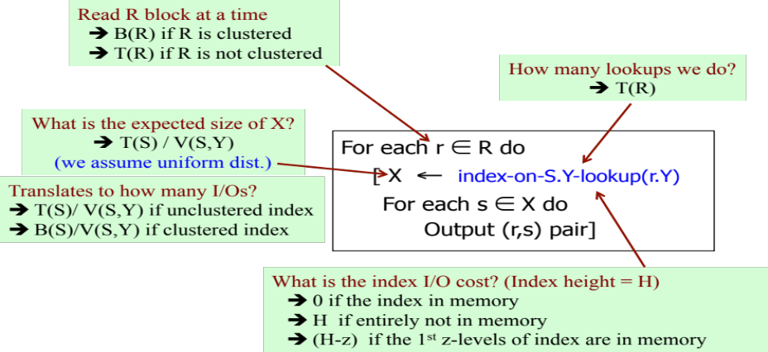
Index-Based Join
Join
What is the I/O Cost?
R
S
Assume R is clustered, S.Y index in memory, and the index is clustered….What is the cost? ➔ B(R) + T(R) (B(S)/ V(S,Y))
Assume R is un-clustered, S.Y height = 3, the root is in memory, and the index is clustered….What is the cost? ➔ T(R) + T(R) (2 + B(S)/ V(S,Y))

Slide 18
Block Nested-Loop Join

Slide 19
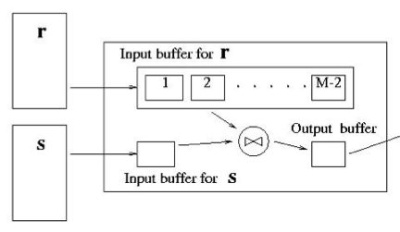
Block Nested-Loop Join
Join
R
S
Sometimes other techniques do not help
Examples:
  Join based on R.x <> S.x
  Join based on R.x = F(S.x), F is black-box func.
S
S
M-1
R
R
If the smaller relation fits in memory
Use “One-Pass Iteration Join” covered before
If not…
Allocate M-1 buffers for the smaller relation S (outer relation)
For each (M-1) blocks from S
  Use 1 buffer to scan R (inner relation) one block at a time, and join with the M-1 blocks of S
Repeat with the next (M-1) blocks of S until all is done.

Slide 20
Block Nested-Loop Join
Join
R
S
Sometimes other techniques do not help
Examples:
  Join based on R.x <> S.x
  Join based on R.x = F(S.x), F is black-box function
Exercise: Compute the cost if R is the outer relation??
What is the I/O Cost?
S will be read once ➔ B(S)
For each M-1 blocks from S, R is read once
➔ (B(S)/M-1) x B(R)
Total = B(S) + (B(S)/M-1) x B(R)
If the smaller relation fits in memory
Use “One-Pass Iteration Join” covered before
If not…
Allocate M-1 buffers for the smaller relation S (outer relation)
For each (M-1) blocks from S
  Use 1 buffer to scan R (inner relation) one block at a time, and join with the M-1 blocks of S
Repeat with the next (M-1) blocks of S until all is done.

Slide 21
Covered So Far…
One-Pass Operator Evaluation
  Join, Duplicate Elimination, Group By, Set Union
Two-Pass Evaluation (Sort-Based)
  Sort, Duplicate Elimination, Join [Sort-Join, Sort-Merge-Join]
Two-Pass Evaluation (Hash-Based)
  Duplicate Elimination, Join
Index-Based Evaluation
  Join
Nest-Loop Join

