Slide 1
Hydrological Modelling
Swapnil Nayan (201516245)
Arushi Singhal (201516178)

Slide 2
PCRASTER DYNAMIC MODEL
A dynamic model represents the behaviour of an object over time.
Representing simplified hydrological runoff model of hilly catchment.
Model is used for analysis of rainfall-runoff with time-step.
ILWIS software for producing input maps for PCRaster.

Slide 3
TERMINOLOGIES
Raster - A raster consists of a matrix (data-structure) of cells (or pixels) organized into rows and columns (or a grid) where each cell contains a value representing geographic data, such as temperature or rainfall etc.
A hydraulic model is a mathematical model of a water/sewer/storm system and is used to analyse the system's hydraulic behaviour.

Slide 4
Runoff Model
The catchment area considered contains 3 raingauges installed.
The rainfall data is available for all 3 raingauges over a period of 168 hours.
It is divided into 28 time-steps with each time-step of duration 6 hours.
The catchment area consists of three types of soil i.e. sandy, loam and clay.
The DEM ( Digital Elevation Model) map of the area is taken.
The model is a runoff model in hilly catchment.

Slide 5
EQUATIONS
Curve number is a runoff curve number depends on land use and land cover and soil type found in the region concerned and other factors affecting runoff and retention in a watershed. curve number is a dimensionless number defined such that 0≤CN≤100. For impervious and water surface CN=100.
Potential Maximum retention depends on Curve Number

Slide 6
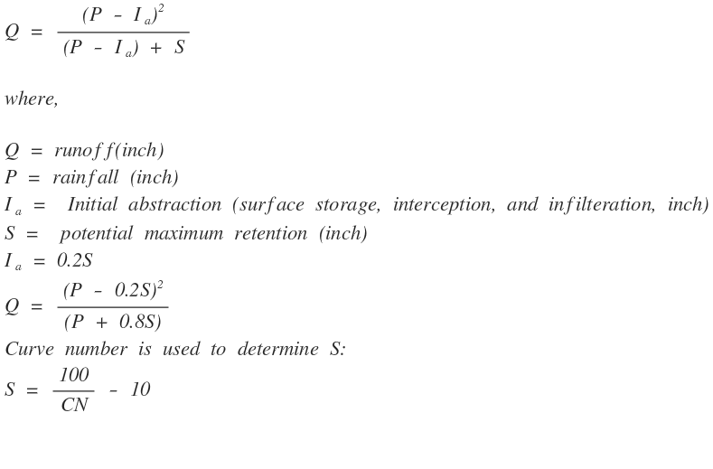

Slide 7
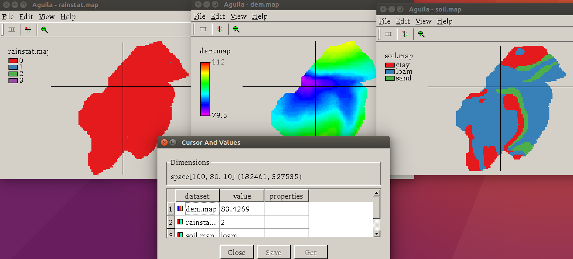
dem.map: a Digital Elevation Map (DEM) of the study area, in metres above sea level.
rainstat.map: map with the location of three rainfall measurement stations.
soil.map: map of soil types occurring in the study area.

Slide 8
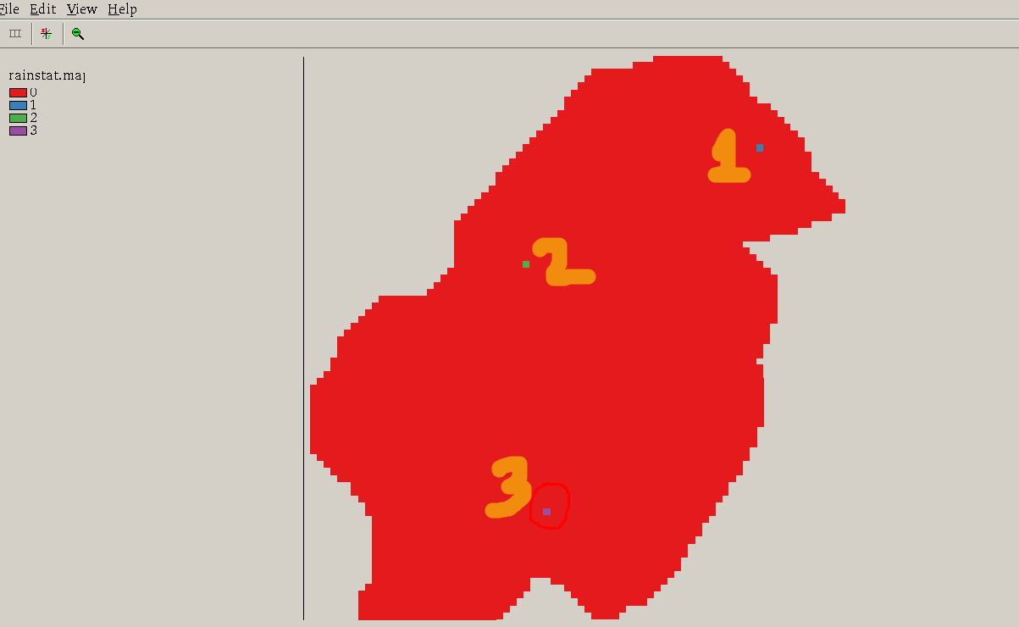

Slide 9
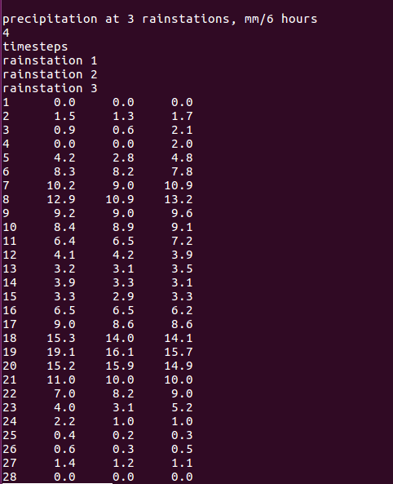
Precipitation (mm) at three rain-station at different timestamps taken at an interval of 6 hrs.

Slide 10
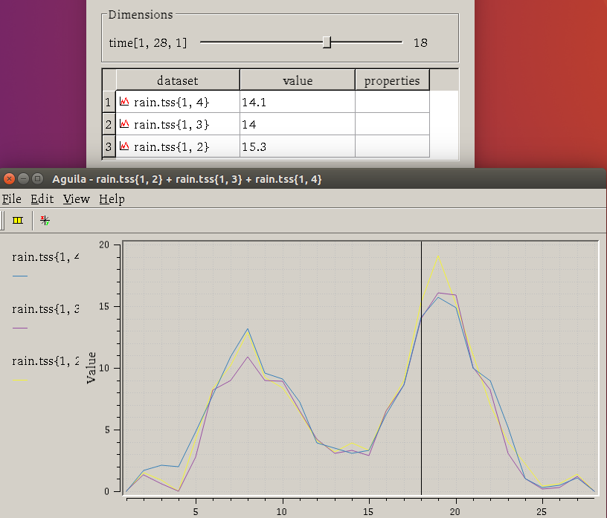
The precipitation values shown are for different station at time-stamp 18.
Yellow gives the variation of rainfall at station 1 red at 2 and blue at 3.
The peak values of rainfall(mm) for various stations are:
19.1 for station 1
16.1 for station 2
15.7 for station 3

Slide 11
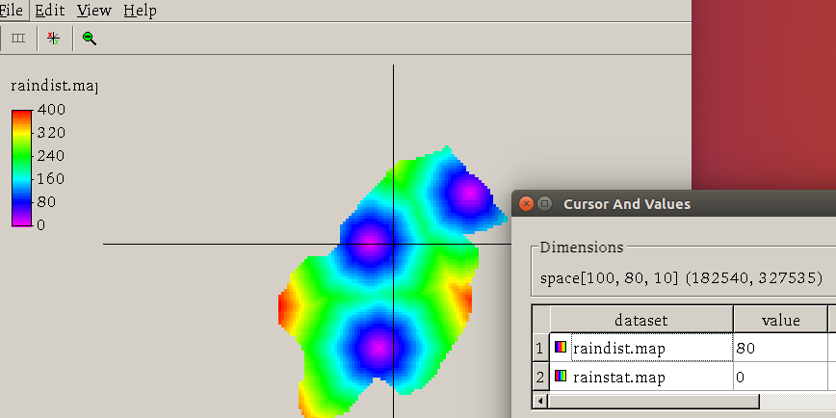
Map is showing distance of zero points from nearest non zero points.
Regions with dark blue are closest from their nearest non-zero point.
This is a relative distance plot. Red marked regions are far from their closest non-zero points as compared to other regions.

Slide 12
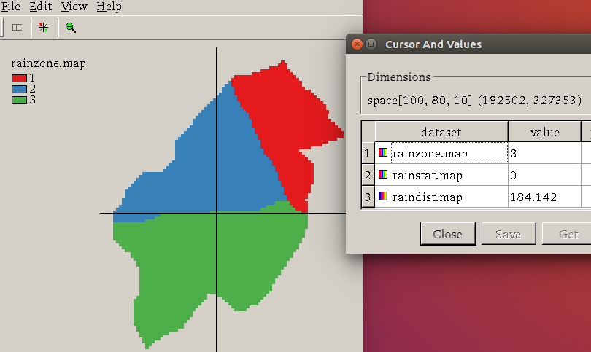
Rain-zones is allocated to each zero points.
Zoning is done based on the distance of zero points and nearest non-zero points.
Region marked blue is under zone2(Rainstation-2).

Slide 13
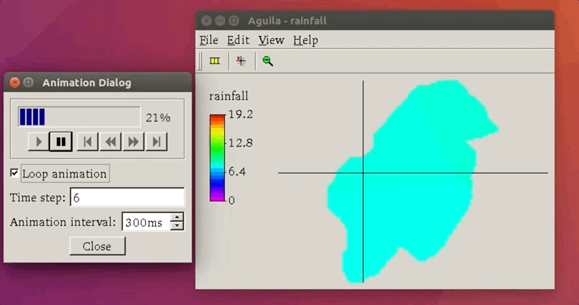
Notes:
Animation is showing precipitation(rainfall) of each zone at different time-stamp.
Rainfall is varying from 0 (purple) to 19.2 mm (Red).

Slide 14
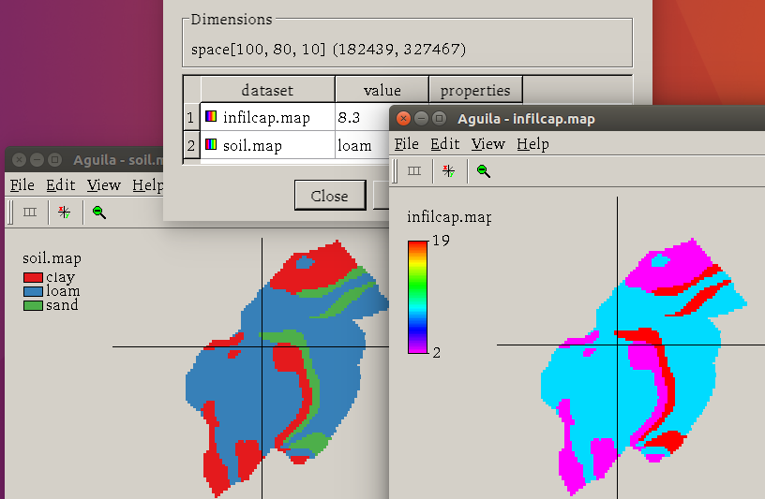
Soil map showing the different soil types in the catchment area.
The infiltration capacity (the maximum amount of water that can infiltrate during one timestep of 6 hours, mm/6 hours) is different for each soil type.
Clay has a very low infiltration capacity, sand a high capacity and loam a medium capacity.
The infiltration capacity of sand is 19.3, for loam it is 8.3 and for clay it is 2.1.
Notes:
Infilteration capacity of the study area is shown for different type of soils.

Slide 15
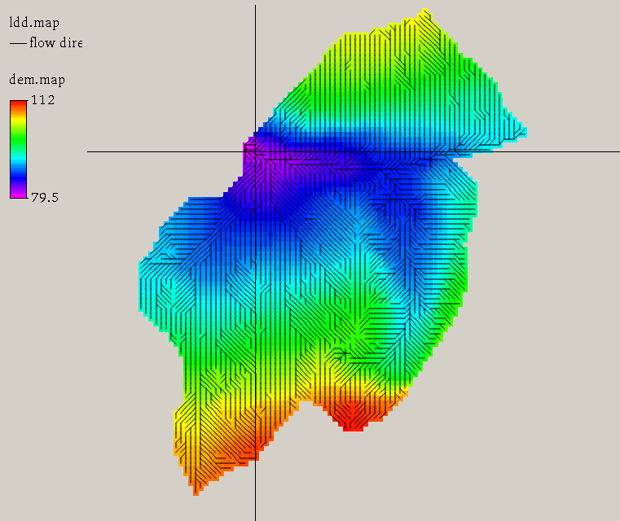
The map shows the elevation of regions. The region with lowest elevation is marked with purple.
Less the elevation of the region more will be runoff.
In most areas the infiltration capacity is exceeded and runoff of excessive water occurs.
If soil reaches its saturated point, if infilteration capacity is exceede than .

Slide 16
INFILTRATION, RUNOFF, PRECIPITATION
As infiltration capacity is exceeded(saturation of soil) , runoff of excessive water occur.
The sandy soils have an infiltration capacity of 19 mm while the amount of rain nowhere exceeds 15.3 mm. So at the sandy soils runoff will only occur when a great amount of water is supplied from upstream areas with lower infiltration capacities.
Sandy soil at the top of a hill does not have upstream areas that supply water. As a result the infiltration capacity is not exceeded here and no runoff occurs.
Actual infiltration of soil at particular timestamp will always be less than equal infiltration capacity.
Notes:
As infiltration capacity is high, elevation is also high then no runoff will occur.

Slide 17
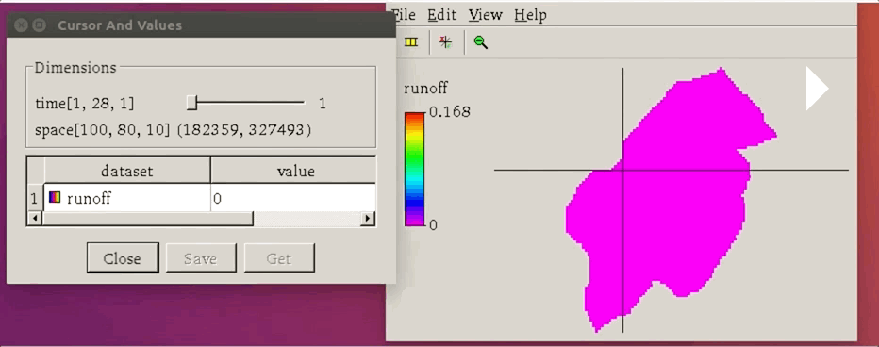
Runoff With timestamp
Notes:
More the rainfall, more will be runoff.
Runoff at lower elevation is higher as compared to higher elevations.

Slide 18
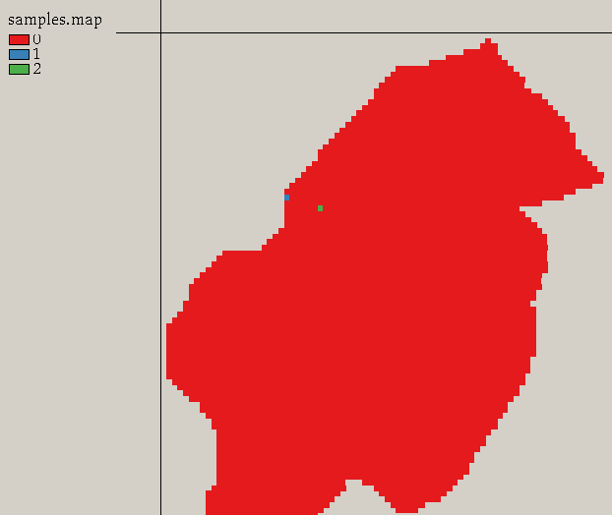
RUNOFF CALCULATION SAMPLE POINTS
For calculating runoff, two sample points are selected.
These points are lowest elevation points where runoff is maximum at each timestamp. Water will move from higher elevation points to these lower elevation points.

Slide 19
RUNOFF AND RAINFALL AT DIFFERENT TIMESTEPS
Video
Value of run-off of two sampling location for different timestamp and rainfall is shown in the video.
Helps us to:-
  Analyze the rain-runoff and infiltration at hilly catchment.
  Different factors responsible for runoff and infiltration like soil type, elevation etc.

Slide 20
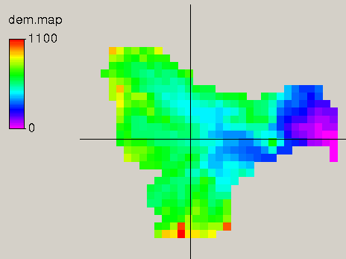
CASE STUDY KRISHNA RIVER BASIN of Year 2015
DEM MAP:-

Slide 21
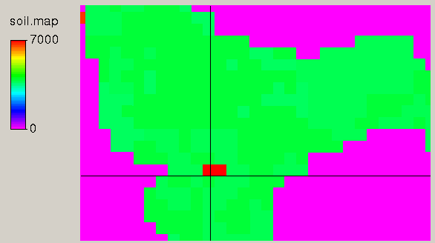
SOIL MAP

Slide 22
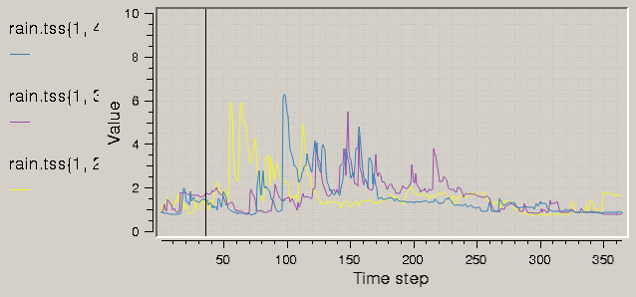
Rainfall
Precipitation at various rainstations vs time step

Slide 23
Rain fall video/ Infiltration values
Considered 5 infiltration values
0
0.83
1.10
1.50
1.75
1.95

Slide 24
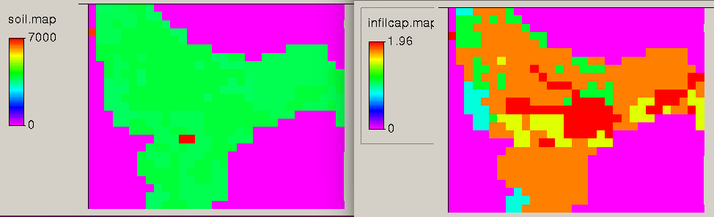

Slide 26
REFERENCES
http://pcraster.geo.uu.nl/downloads/latest-release/
http://pcraster.geo.uu.nl/pcraster/4.1.0/doc/python/pcraster/quickstart.html
http://pcraster.geo.uu.nl/
http://pcraster.geo.uu.nl/quick-start-guide/
https://books.google.co.in/books?id=z1qignvz7YkC&pg=PA311&lpg=PA311&dq=some+good+modelling+softwares+like+pc+raster&source=bl&ots=7Xxmm-XuEC&sig=mO_DnfW28pNldUeyMikaYjc81Qs&hl=en&sa=X&ved=0ahUKEwiXyuGyv7PWAhXKMY8KHefVDXIQ6AEIQjAG#v=onepage&q=PC-Raster&f=false
http://pcraster.geo.uu.nl/documentation/Demo/DynamicModellingDemo.html
http://www.carthago.nl/__miracle/doc/thesis1.pdf (theory chapter-4)
https://www.itc.nl/library/papers_2005/msc/ereg/harssema.pdf (search PCR aster in file)

Slide 27
THANK-YOU

