Slide 1
COPYRIGHT
On
PROJECT
Foodie
Arushi Gupta 2210991371
Harleen Kaur 2210990365
Tanvi Thakur 2210990906
Shivansh Gupta 2210992322
Supervised By
Dr. Lalit K. Sharma
Department of Computer Science and Engineering,
Chitkara University, Punjab

Slide 2
Abstract
Foodie was developed to resolve some of the current issues in food ordering and delivery services. This integrated various restaurant operations into a single coherent platform, where order management was included, along with delivery tracking, payment processing, and customer feedback. In this regard, Foodie represents an automated environment that enhances operational efficiency, reduces errors, and improves customer experiences.
Foodie, built on the MERN stack, provides scalability, security, and ease of use to satisfy the variable needs of restaurants and customers alike.
Moreover, it allows real-time tracking of orders and offers customized food recommendations to the users for timely and precise information that adds value to their dining experience. The modular architecture of the platform ensures flexibility in features that restaurants can adjust according to their unique needs.

Slide 3
TABLE OF CONTENTS
Introduction
Problem Statement
Technical Details
Key Features
Our Design
Future Scope
Conclusion
References/Links used

Slide 4
INTRODUCTION
Foodie is an all-in-one software solution for effective management of operations involved in food ordering and delivery. This platform simplifies the entire process, from order placement and delivery to payment processing, thus ensuring that the overall experience is hassle-free for both the customer and the restaurant operator.
By digitizing and automating these processes, Foodie is looking at improving the overall efficiency and quality of all food service operations so that restaurants can accelerate their service and improve customer satisfaction.
It offers a wide range of features that includes easy order management, real-time order tracking, secured payment processing, delivery route optimization, and even integration of customer feedback.
This is engineered with scalability in mind, making the system suit any size of restaurant operations, be it small local restaurants or big chain franchises.

Slide 5
Introduction
Objective
Foodie is aimed at improving the service quality and efficiency of food ordering and delivering by providing a holistic platform for restaurant management.
With Foodie, manual tasks and errors will be minimized because of the streamlining of processes, from the place order through to payment processing and even the tracking of deliveries. In addition, the processes will contribute towards better customer satisfaction by ensuring timely, secure, and error-free order processing for proper decision-making and increased coordination between restaurants and delivery personnel.
Simplifying restaurant operations: Foodie eases operational burdens by reducing manual labor, cutting the chance for human error, and streamlining key functions such as order taking, payment, and delivery tracking.
Customer Experience Improvement: Foodie ensures customers get timely, safe, and accurate service to offer them personalized food recommendations with real-time tracking of orders. These technologies improve communication between restaurant staff and delivery teams to facilitate better customer satisfaction and improvement in performance.

Slide 6
PROBLEM STATEMENT
Operational Challenges: Managing tasks such as order processing, payment handling, and delivery logistics can be complex and time-consuming for restaurants, leading to operational inefficiencies.
Inefficient Systems: Many restaurants rely on outdated software or manual processes, resulting in inaccurate order tracking, slow service, and increased chances of errors. To provide timely and accurate service, there is a need for modernization.
Impact on Revenue and Customer Satisfaction: Inefficiencies in traditional systems can lead to delayed deliveries, incorrect orders, and increased operational costs, ultimately affecting customer satisfaction and revenue. These challenges can be addressed by an integrated platform that streamlines operations and improves customer experience.
Issues with Coordination and Communication: Lack of effective integration between order management, kitchen operations, and delivery services can hinder communication and coordination, leading to mistakes and delays. An integrated system will streamline workflows and improve communication across all departments.

Slide 7
Significance
Foodie is very important because it revolutionizes the way restaurants manage their businesses and interact with customers. Foodie consolidates numerous functions into a single platform, thereby increasing overall efficiency, reducing errors, and easing administrative burdens. This leads to improved resource utilization, accelerated response times, and enhanced levels of customer satisfaction. Finally, Foodie is indispensable in modernizing food service operations so that restaurants can keep up with customers whose demands are changing at an increasingly fast pace.

Slide 8

Software requirements
Frontend Development:
HTML, CSS, JavaScript: The frontend user interface will be developed using HTML for structure, CSS for styling, and JavaScript for interactivity and dynamic content generation.
React.js: React.js will serve as the core frontend framework, enabling the creation of reusable UI components, efficient state management, and seamless integration with backend APIs.
React Router: React Router is a popular routing library for React applications, allowing developers to manage navigation and URL changes within a single-page application (SPA). It provides a declarative way to define routes and associate them with specific components.
Why React JS?
React.js, renowned for its simplicity, efficiency, and flexibility, emerged as the natural choice for our project. Its component-based architecture allows us to create dynamic and interactive user interfaces, ensuring a smooth and engaging experience for our users. By harnessing the power of React.js, we're able to deliver a feature-rich real estate platform that meets the evolving needs of today's consumers.

Slide 9
Software requirements
Backend Development
Node.js and Express.js: The backend will be developed using Node.js with Express.js as the framework. Node.js is chosen for its non-blocking, event-driven architecture, which is well-suited for handling multiple requests efficiently. Express.js simplifies the process of building web applications and APIs. The Node.js API documentation and Express.js documentation will be used as key references.
Database Management
MongoDB with Mongoose: MongoDB will serve as the NoSQL database for storing unstructured data. Mongoose will be used to provide a schema-based solution for MongoDB, making it easier to enforce data validation and relationships. The MongoDB documentation and Mongoose guide will be essential resources.
API Testing
Postman: Postman will be employed to test the APIs developed for the project. It allows for easy testing and debugging of endpoints, ensuring they function as expected before deployment. The Postman documentation will guide the setup and usage of Postman.

Slide 10
KEY FEATURES
User-Friendly Interface: This is designed for easy operation, hence it provides an easy course of action and placing orders by the customers, improving their experience while on the platform.
Order Management: An effective administration of centralized system orders assures that restaurants can handle large volumes efficiently and with less likelihood of errors.
Order Real-time Tracking: Real-time updates to customers about the status of their order gives them transparency and reduces uncertainty in the delivery process.
Payment Integration: Secure payment gateways are integrated efficiently so that multiple modes of payment can be in place, thereby gaining consumer trust.
Restaurant Dashboard: Through an extended dashboard, restaurants can manage menu items, track orders, and manage delivery at their fingertips; hence, seamless and effective service.
Delivery Optimization: Optimizes delivery routes using real-time data, reducing delivery times and improving overall efficiency in getting orders to customers quickly.

Slide 11
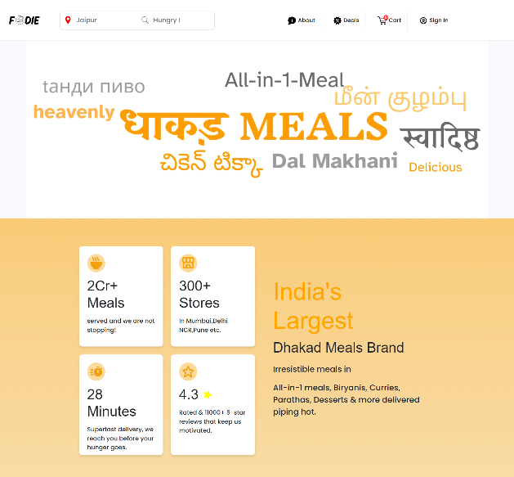
Our Design

Slide 12
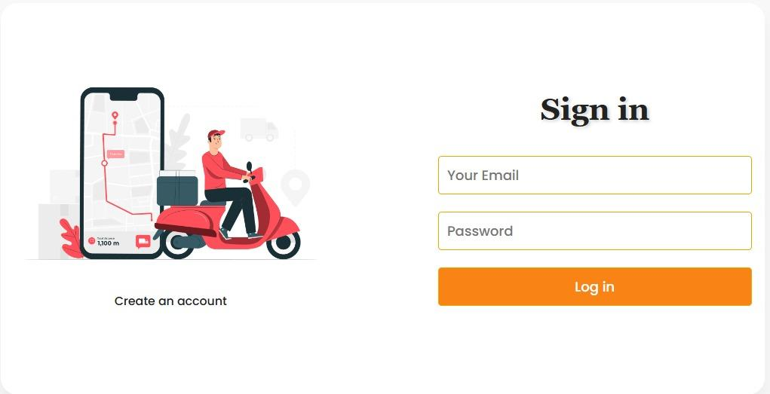
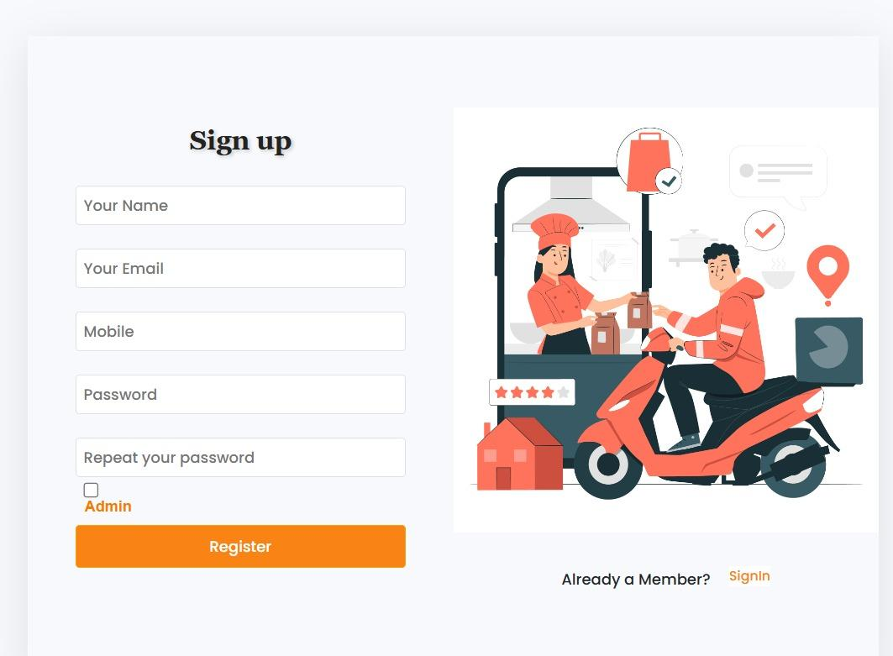
Our Design

Slide 13
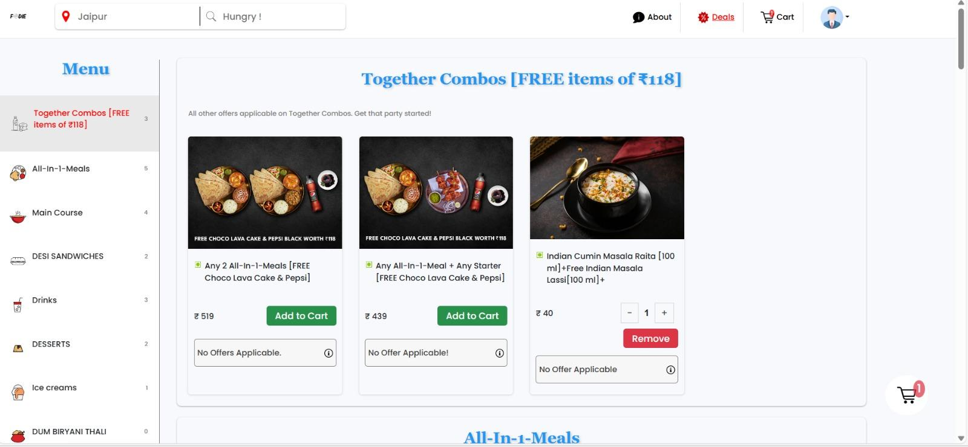
Our Design

Slide 14
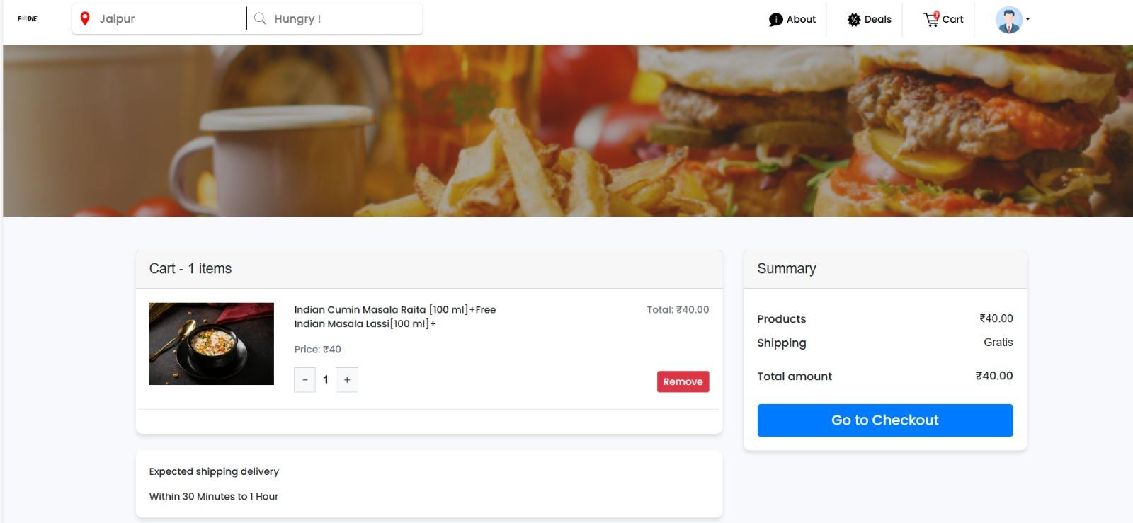
Our Design

Slide 15
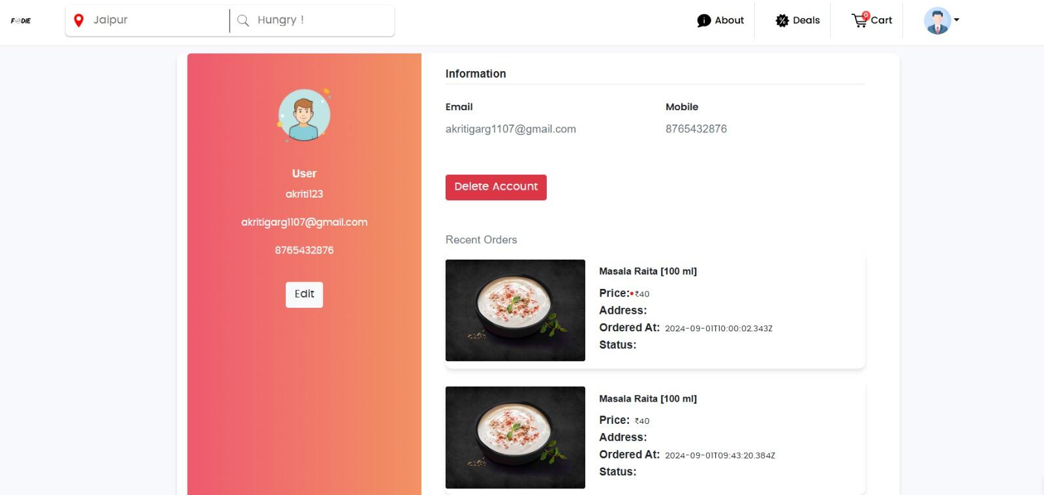
Our Design
User Profile

Slide 16
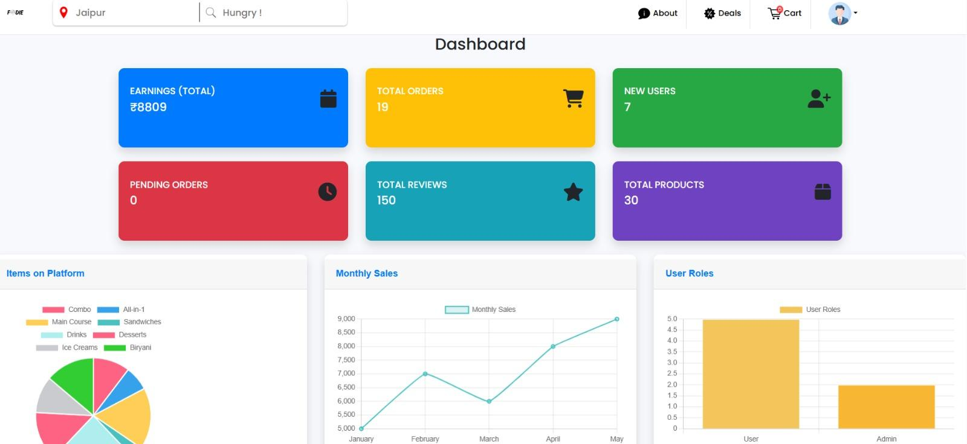
Our Design
Admin Dashboard

Slide 17
Future Scope
Mobile Application: Develop mobile applications to enable users to place orders and track deliveries on the go, which enhances the convenience and accessibility of customers.
AI-Powered Recommendations: Implement AI-powered algorithms that make personalized food recommendations to customers according to their preferences, resulting in higher customer satisfaction and greater revenue.
Multi-language Support: Multiple language options so that the platform can be used by a wide array of customers from different demographics.
Reward System: Design a rewards system tailored for frequent customers, targeted to increase repeat business and build customer loyalty with incentives and special offers.

Slide 18
CONCLUSION
Foodie consolidates essential components of food ordering and delivery into one efficient platform, which signifies a huge leap forward in the food service industry. It offers easy order management, payment processing, and tracking of delivery, therefore ensuring better operational efficiency and heightened customer satisfaction.
With impending enhancements like mobile accessibility, AI-based suggestions, and a loyalty program in the pipeline, Foodie is only about to become more powerful and pervasive. As the food service industry continues to change and evolve, Foodie will help restaurants adapt to customers' needs for speedier service, improved communication, and a more personalized experience.
Foodie will enable restaurants to expect an enhancement in resource management, customer satisfaction, and competitive advantage due to the increasingly expanding market. The platform is an invaluable instrument that enables treading through the complex contemporary food service and thus helps to give efficient and responsive operations.

Slide 19
References/Links used
● https://www.mongodb.com/docs/
● https://expressjs.com/
● https://legacy.reactjs.org/docs/getting-started.html
● https://nodejs.org/docs/latest/api/
● https://redux.js.org/
● https://nodemailer.com/
● https://www.youtube.com
● Node.js Official Site
● https://redux.js.org/introduction/getting-started
● https://getbootstrap.com/docs/5.0/getting-started/introduction/
● https://mongoosejs.com/docs/guide.html
● https://webpack.js.org/concepts/
● https://learning.postman.com/docs/getting-started/introduction/

Slide 20


