Slide 1
CareWay

Slide 2

CareWay (…Health is our first priority…)
This application is when the user in uncomfortable or danger situation you can share some connectivity to others/relations.
This is helpful to communicate with others.
This is very easy to share our details including our location.

Slide 3
Specification
This app is now only made about
Set alarm
Send messages
Shake to call
Share your location
Notes
Web links

Slide 4
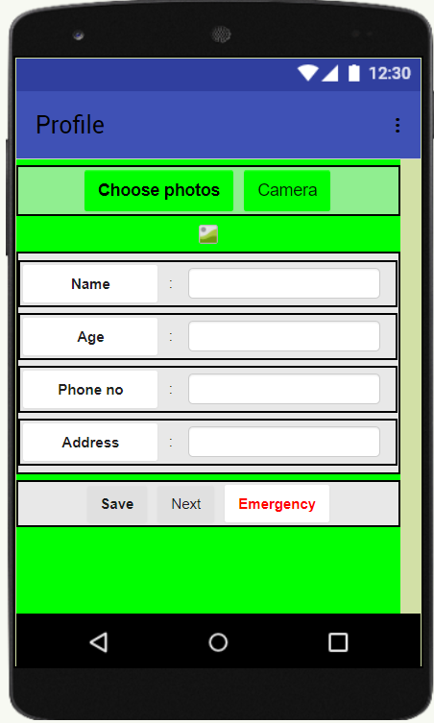
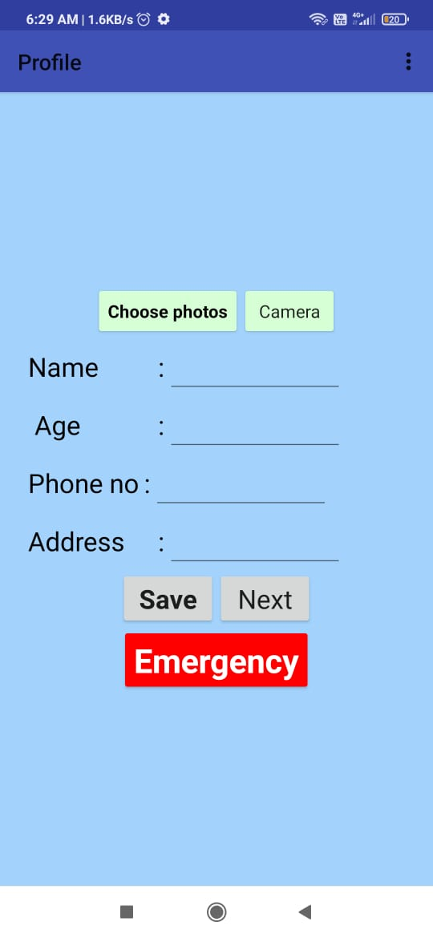
To create your profile:
This screen is for your personal details:
Enter your Name, Age, Phone no and Address.
And click “save” button.
You can set your profile picture.
Now your details are save in app’s profile screen.
The important feature, emergency option is available.

Slide 5
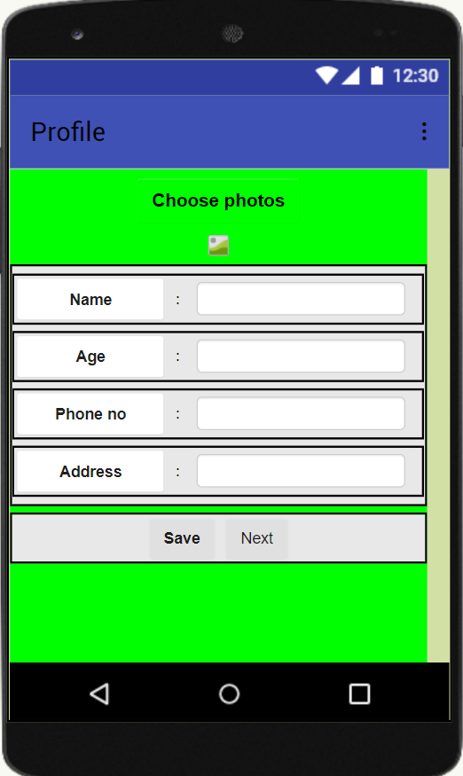
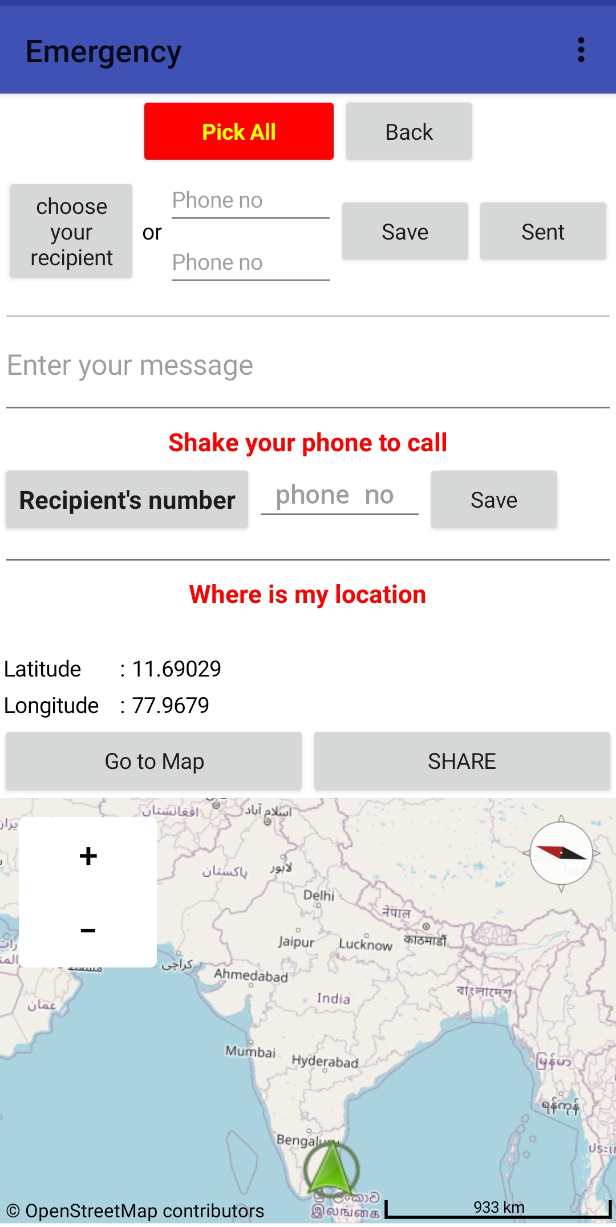
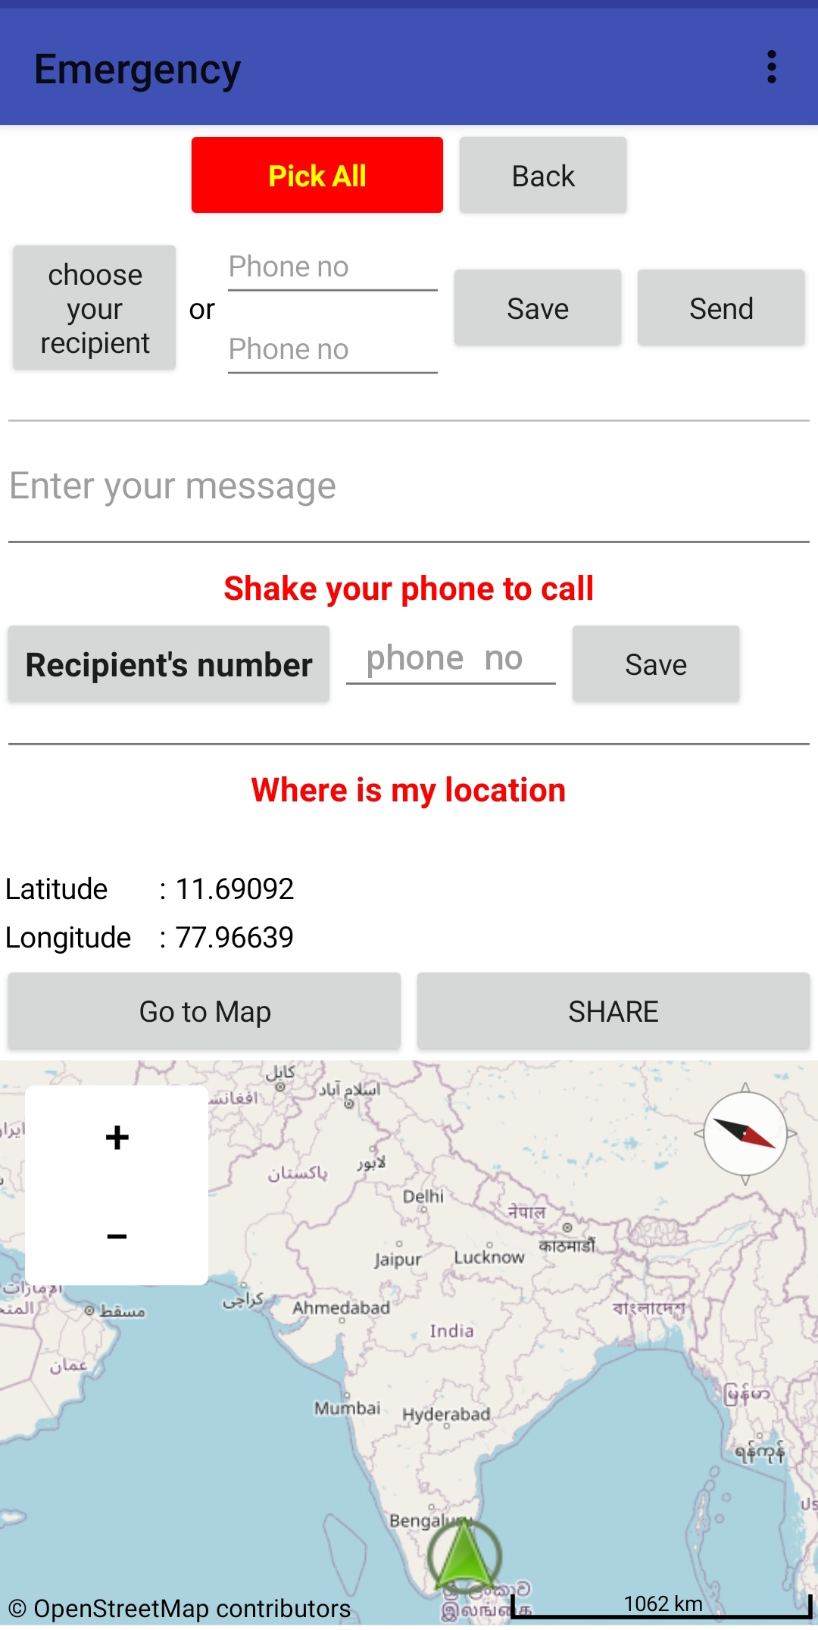
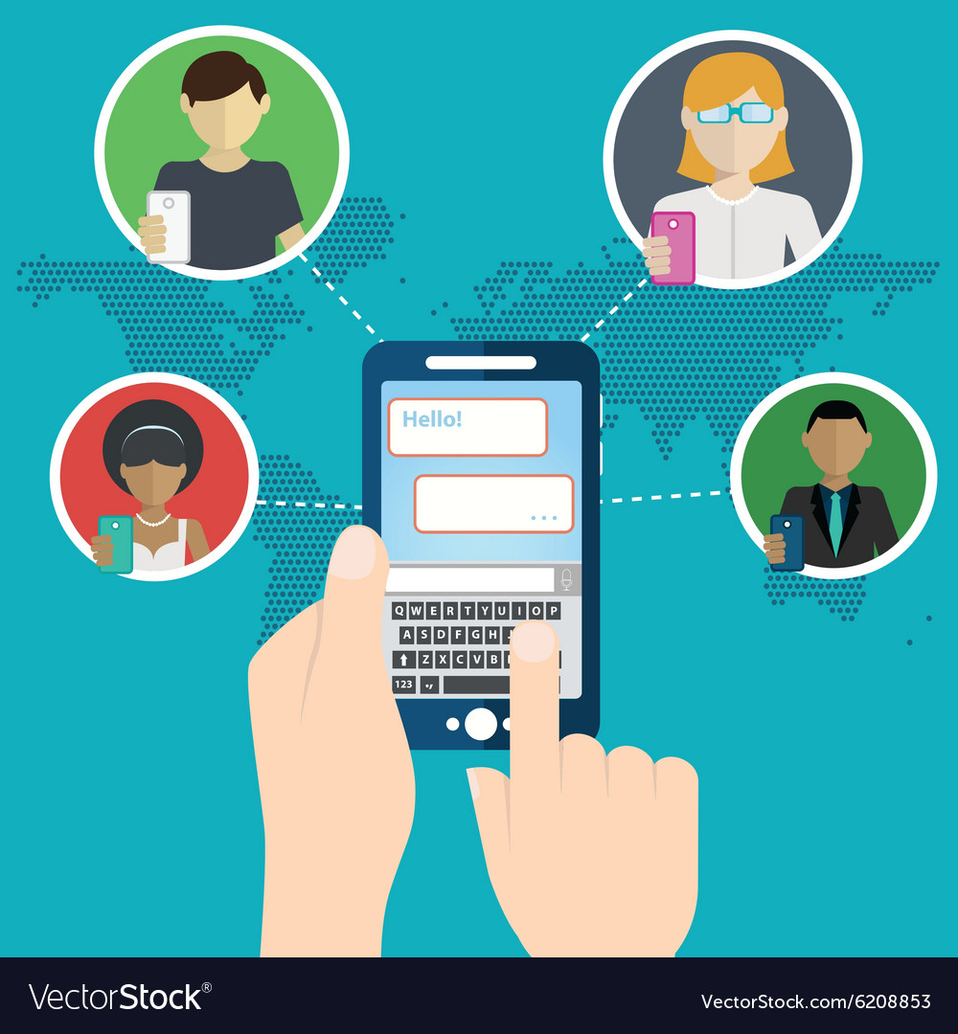
EMERGENCY HOW TO SEND EMERGENCY ALERT TO OUR GUARDIAN
There are three ways to send emergency alert to others.
Send Messages
Shake your phone to call
Share your location
1)Send Message
You can able to send emergency text to your recipient in contact list(Choose your contact or give phone number).
Click “send” your message will send
three peoples.

Slide 6


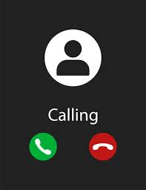

2) Shake your phone to call
You can already saved your number that textbox(phone no)
In the pandemic situation you can just shake your mobile to call.
3) Share your location
You can able to send your location to your guardian/relation from this app.
You can share your location instantly and easily within a second.

Slide 7

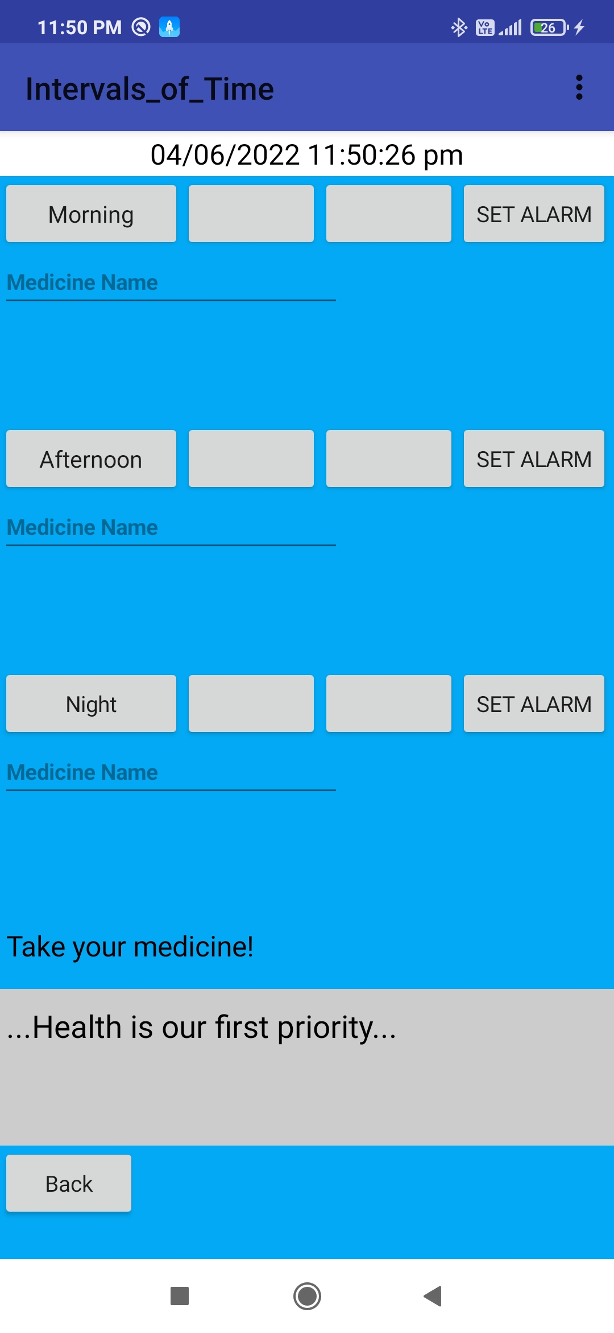
Set Alarms
This page the alarm setting page in the app.
The main moto of this page is to set alarm for taking medicine by patients, those who forget some time.
In first set the hour time in the first box.
In next set the minute time in second box.
Then enter the medicine name ,that you want to take at that time.
Finally click the “set alarm” button.

Slide 8
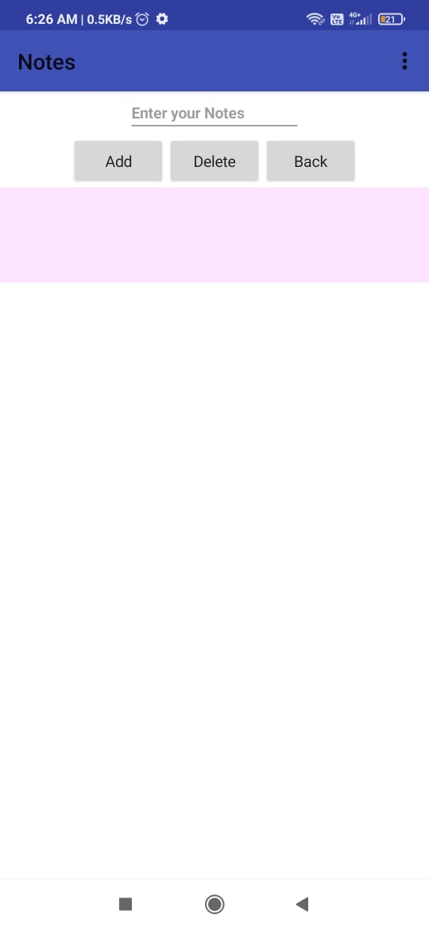
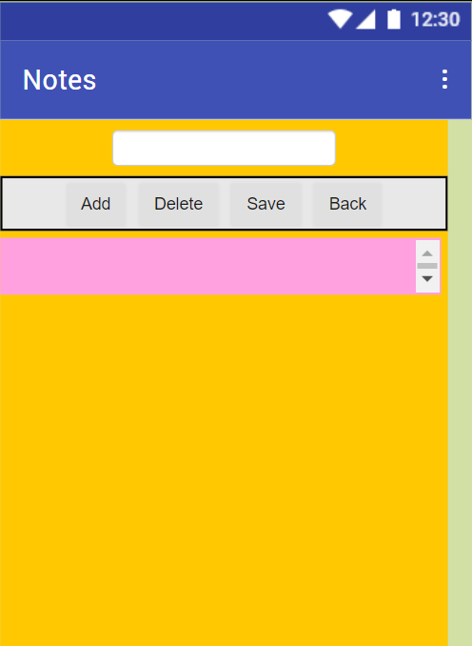

Notes
When you fill the information click “Add” that information is added in below box.
And also you can “Delete” the selected items.
If you click “Save”, that information is updated and save.
If you click “Back”, go back the feature screen.

Slide 9
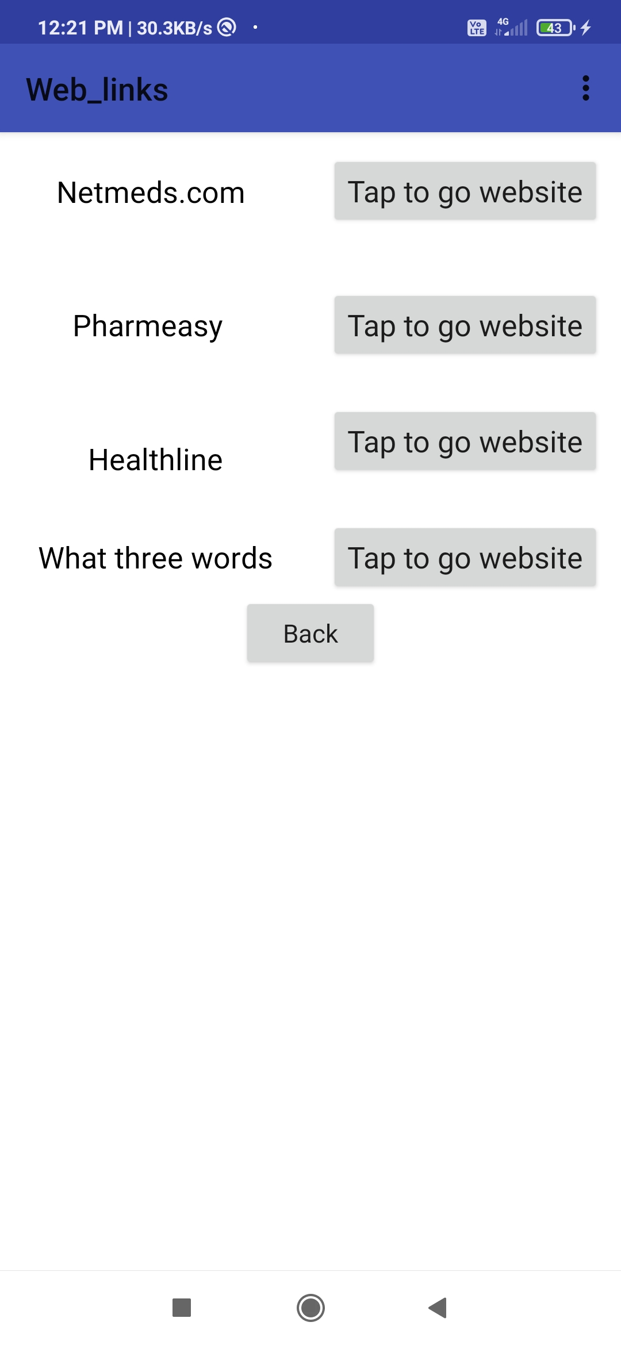

Web links
In this page,four links are available. The first three links is useful for orderIng medicines.
What3words is a really quick and simple way to find, share and save exact locations. The system converts GPS coordinates into 3 word addresses.

Slide 10

Source
Privacy Policy
Terms and condition
https://pages.flycricket.io/careway-0/privacy.html
https://pages.flycricket.io/careway-0/terms.html

Slide 11
Thank you

