Slide 1

Well-Life Hospital
Data Report 2021–2024
A comprehensive analysis of patient admissions, demographics, diagnoses, and 2025 forecasts to guide strategic resource planning.
Prepared by Aruya

Slide 2

ADMISSIONS OVERVIEW
Total Patient Admissions: 10,000
Fact
10,000 patients admitted between 2021 and 2024, rising from 1,409 to 3,266.
Insight
Admissions more than doubled over four years, reflecting substantial patient volume growth.
Recommendation
Use four-year volume as a baseline for staffing, beds, medications, and supplies planning.
Expected Outcome
Better resource allocation and improved preparedness for future admission increases.

Slide 3
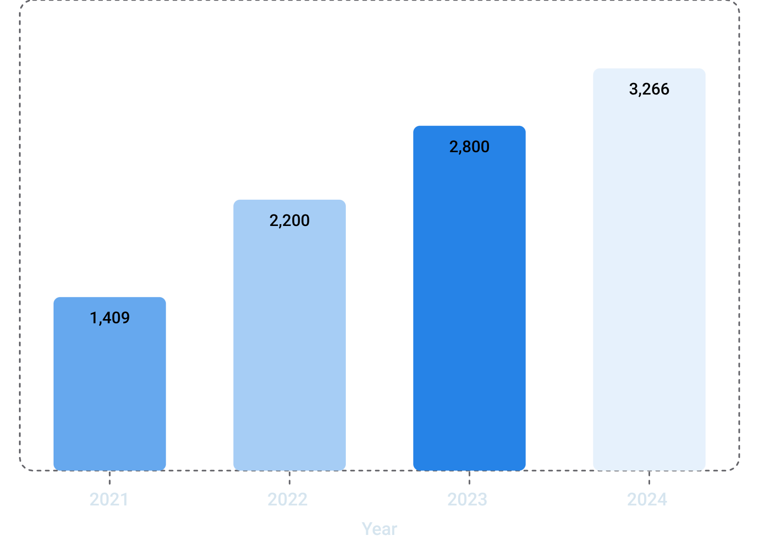
ANNUAL TRENDS
Year-by-Year Admissions Growth
Fact
Admissions rose every year: 1,409 (2021) → 3,266 (2024). Largest jump occurred 2021–2022; growth slowed in 2024.
Insight
Admissions more than doubled. Slower 2024 growth warrants monitoring.
Recommendation
Adjust staffing and supplies based on recent patterns, not just historical averages.
Expected Outcome
Accommodate rising demand without pressure on staff, beds, or supplies.

Slide 4
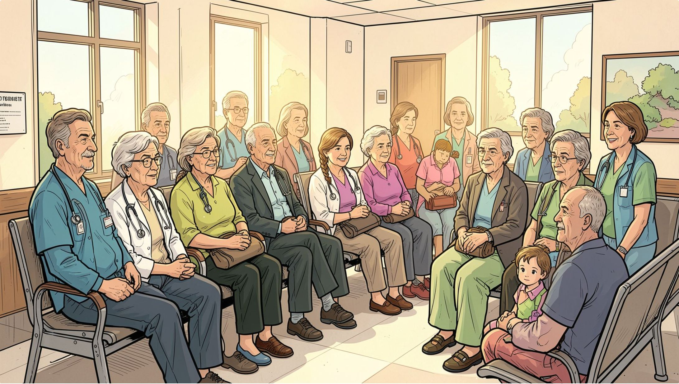
PATIENT DEMOGRAPHICS
Average Patient Age: 44 Years
Fact
The average age of admitted patients was 44 years, centered on middle-aged adults.
Insight
The patient population is primarily working-age adults, requiring strong adult-care services.
Recommendation
Maintain robust adult-care services while ensuring adequate capacity for younger and older patients.
Expected Outcome
More balanced healthcare resource allocation and improved access across all major age groups.

Slide 5
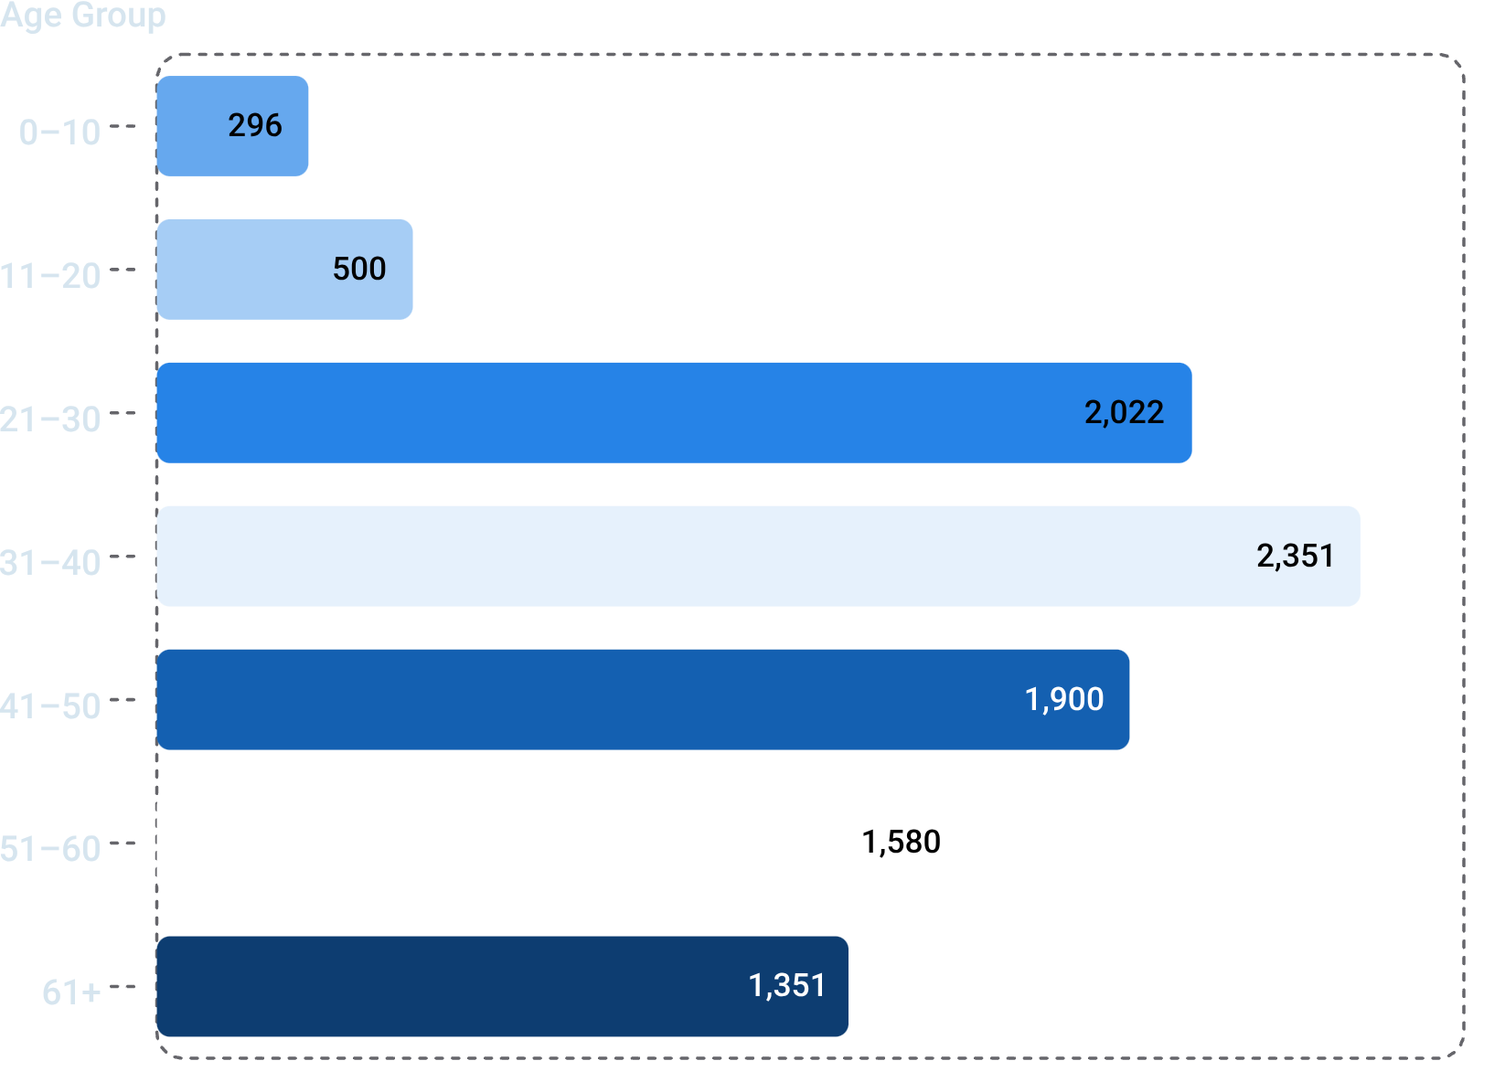
PATIENT DEMOGRAPHICS
Admissions by Age Group
Fact
31–40 age group led with 2,351 admissions (23.51%), followed by 21–30 at 2,022 (20.22%). Ages 21–60 account for ~79.6% of all admissions.
Insight
Working-age adults are the dominant patient population.
Recommendation
Prioritize adult healthcare resources while maintaining services for elderly patients (61+).
Expected Outcome
Improved delivery for the largest patient group while maintaining care across all age groups.

Slide 6

PATIENT DEMOGRAPHICS
Gender Distribution of Admissions
Male Patients
5,681 admissions — 56.81%
Female Patients
4,319 admissions — 43.19%
Fact
Male admissions exceeded female by 13.62 percentage points.
Insight
Male admissions were approximately 13.62 percentage points higher than female admissions.
Recommendation
Maintain quality care for both genders while investigating factors behind lower female admissions.
Expected Outcome
Improved healthcare access and better understanding of gender-based admission patterns.

Slide 7
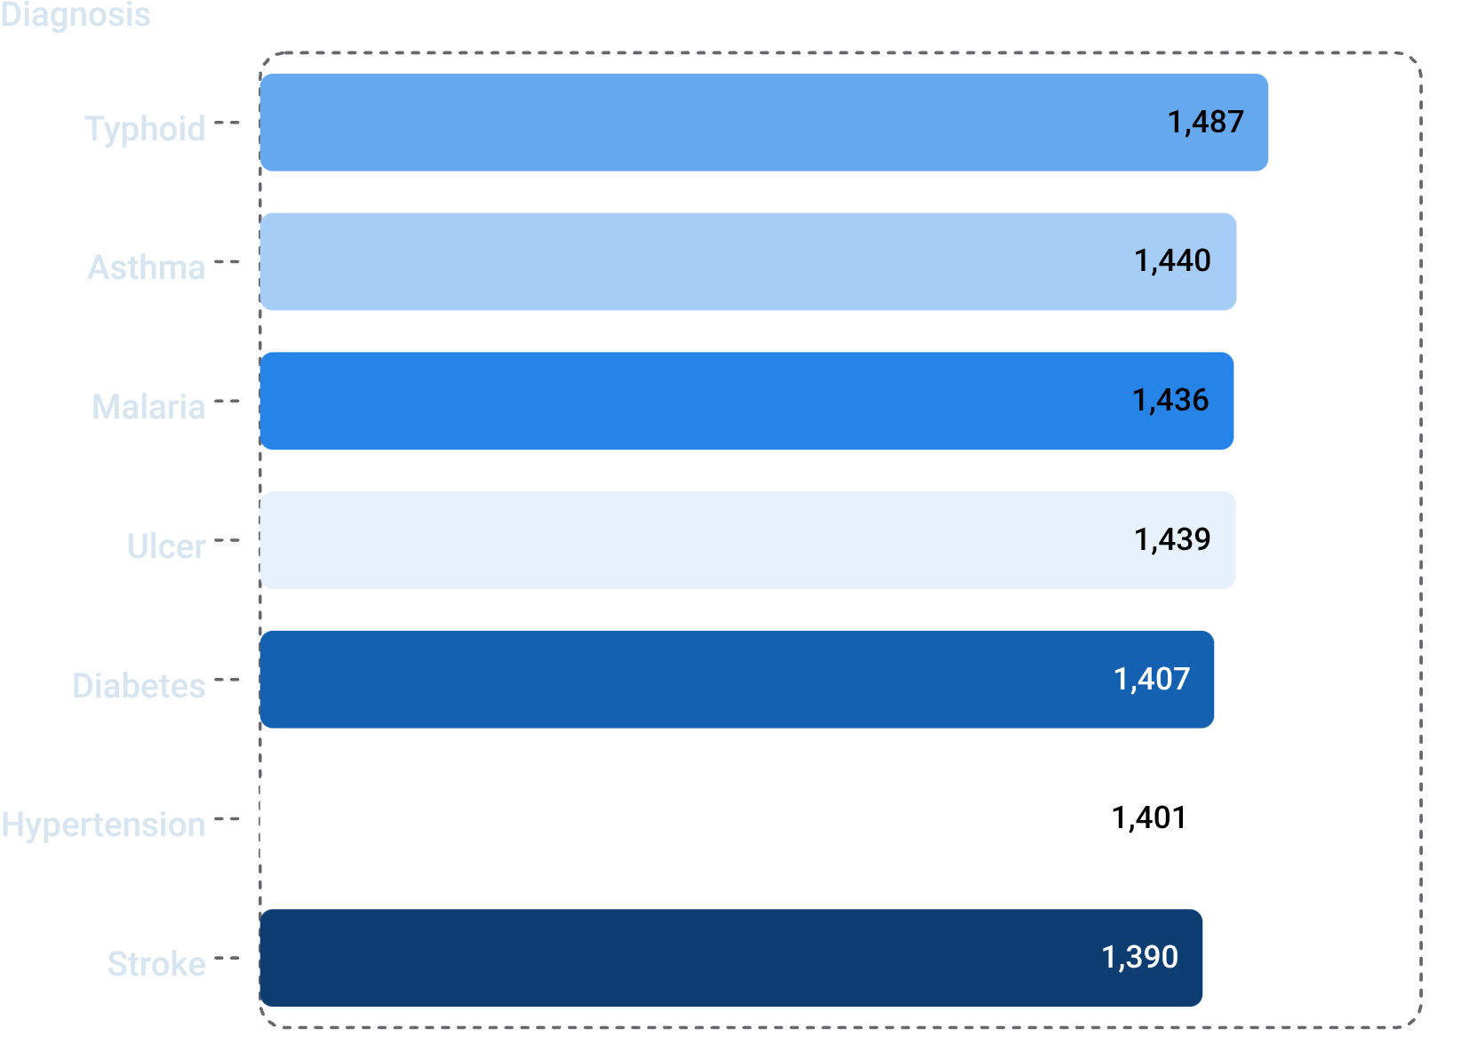
DIAGNOSIS ANALYSIS
Seven Unique Diagnoses Recorded
Fact
7 unique diagnoses recorded. Typhoid led (1,487); Stroke was lowest (1,390) — only 97 patients apart.
Insight
Admissions are evenly distributed across all seven conditions.
Recommendation
Maintain adequate medication, equipment, and trained staff across all seven conditions.
Expected Outcome
Improved ability to respond effectively to demand across all major diagnosis groups.

Slide 8
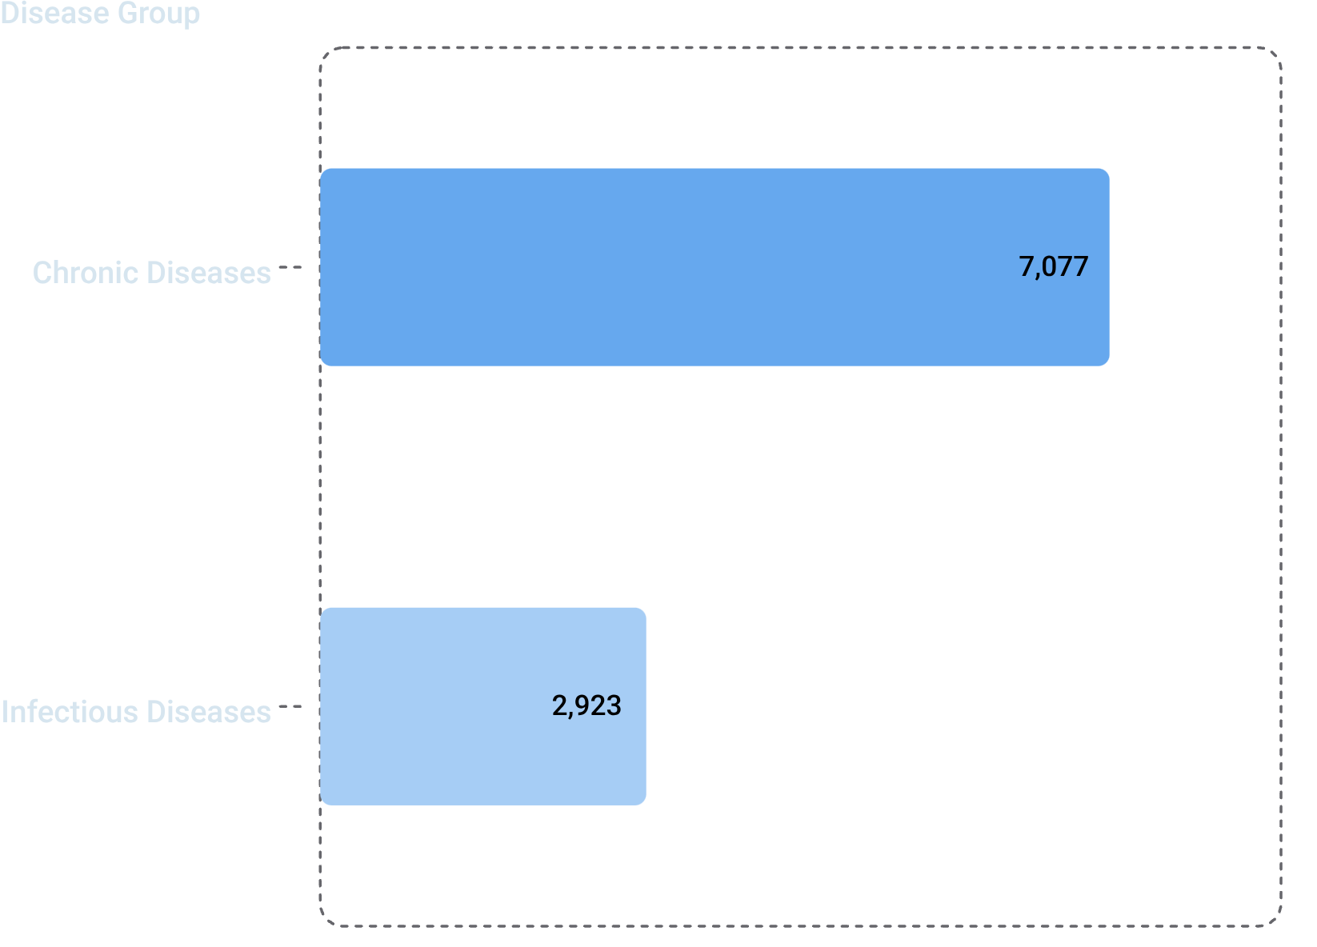
DIAGNOSIS ANALYSIS
Chronic vs. Infectious Diseases
Fact
Chronic diseases (Diabetes, Hypertension, Stroke, Asthma, Ulcer): 7,077 admissions (70.77%). Infectious diseases (Malaria, Typhoid): 2,923 admissions (29.23%).
Insight
Chronic conditions generated more than twice the admissions of infectious diseases.
Recommendation
Allocate more resources to chronic disease care while maintaining infectious disease capacity.
Expected Outcome
Improved management of both chronic and infectious diseases.

Slide 9

2025 FORECAST
Q1 2025 Admission Forecast
752
567
Estimated Admissions
Lower Bound
Forecast for Q1 2025
95% confidence interval minimum
937
Upper Bound
95% confidence interval maximum
Fact
Forecast estimates 752 admissions for Q1 2025, with a 95% confidence interval of 567–937 patients.
Insight
Actual demand could reasonably range between 567 and 937 patients.
Recommendation
Prepare staffing, medications, and beds for 752 patients while maintaining capacity for up to 937.
Expected Outcome
Better preparedness, reduced resource pressure, and efficient allocation in Q1 2025.

Slide 10

STRATEGIC RECOMMENDATIONS
Resource Planning for 2025
1
Volume Planning
Plan for 3,300–3,500 admissions (~800–900/quarter) with a 10–15% capacity buffer.
2
Chronic Disease Capacity
Allocate more staff, medications, and equipment for diabetes, hypertension, and asthma.
3
Infectious Disease Readiness
Stock sufficient medications, test kits, and supplies for malaria and typhoid.
4
Adult Services Priority
Strengthen staffing, screening, and treatment capacity for adults aged 21–60.
5
Balanced Diagnosis Coverage
Maintain adequate supplies, equipment, and clinical capacity across all seven diagnoses.
Prepared by Aruya — Well-Life Hospital Data Report, 2021–2024

