Slide 1
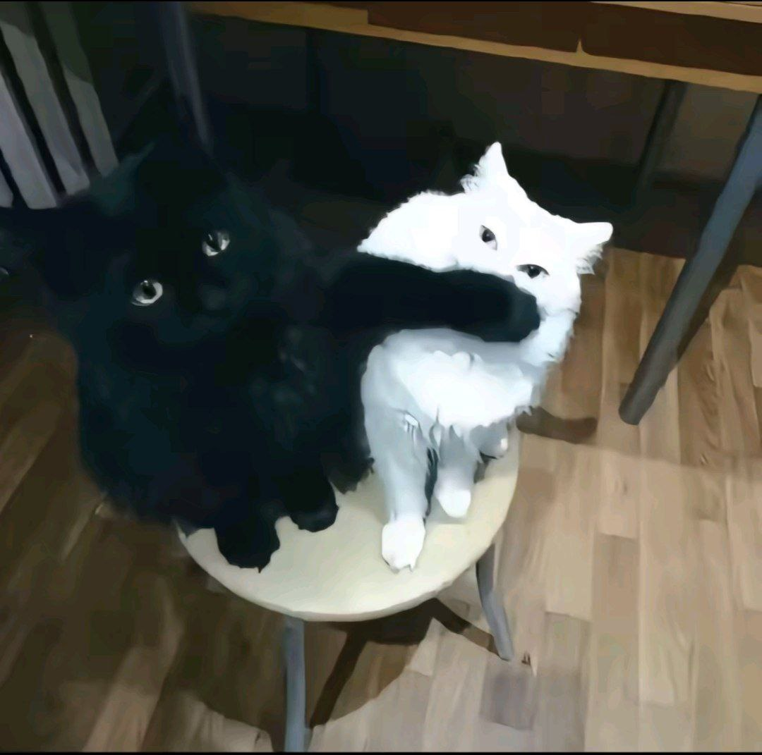
Sample
cats

Slide 2
123
Cats cats cats

