Slide 1
Multimodal Artificial Intelligence
Practical training 02 – connect 4 and pygame
Prof. Dr. René Peinl
Notes:
Ca 25 Teilnehmer in der ersten Stunde, fast alle waren auch in der ersten Übung

Slide 2
Agenda
Aufgabe 1 10 min
Aufgabe 2 20 min
Aufgabe 3 15 min
Aufgabe 4 10 min

Slide 3
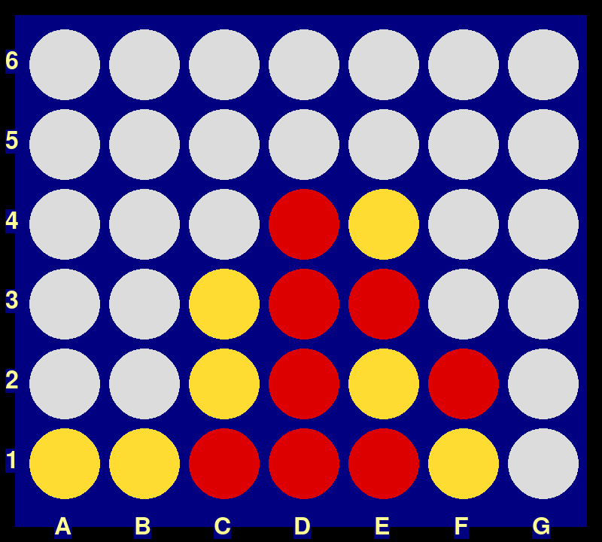
The connect four game
Here is a typical callout
The game has a grid-layout with columns and rows.
Columns are labeled with letters, rows with numbers
This should be similar for your games
The action is very simple. State the letter for the column of your next piece
For the human player, you can simply type the letter on the keyboard

Slide 4
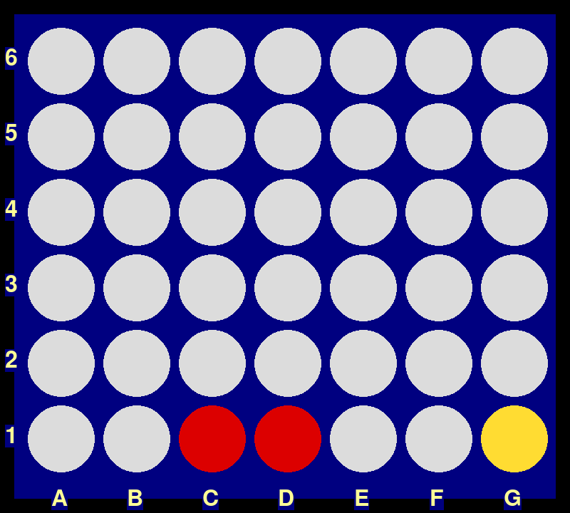
Computer opponent
The algorithm for the bot is rather primitive
It tries to find potential winning situations for the opponent and prevent them.
If no such situation is recognized, it simply uses a random column.
It has no own „winning“ algorithm implemented.
In the example, it will put a piece in B or E to prevent three in a row with both ends clear for the winning stone.

Slide 5
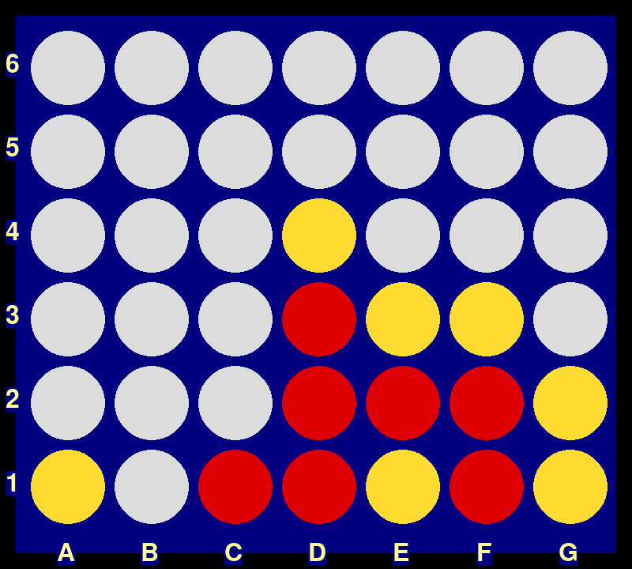
Task #1
Clone the git repository and run the game
git clone https://github.com/renepeinl/connect_four.git
Play a few rounds against the bot
Determine which strategies are not yet countered by the bot

Slide 6
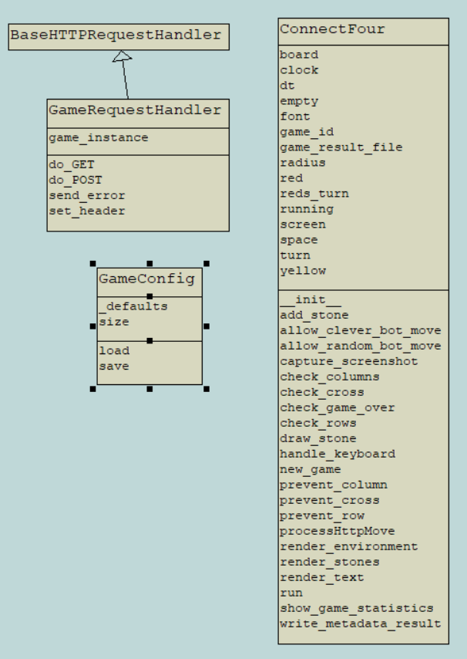
Task #2
Inspect the Code, especially the connect_4_game.py (and the GameConfig.py)
Have a closer look at
add_stone
draw_stone
render_environment
render_stones
render_text
List all pygame functions used there https://www.pygame.org/docs/

Slide 7
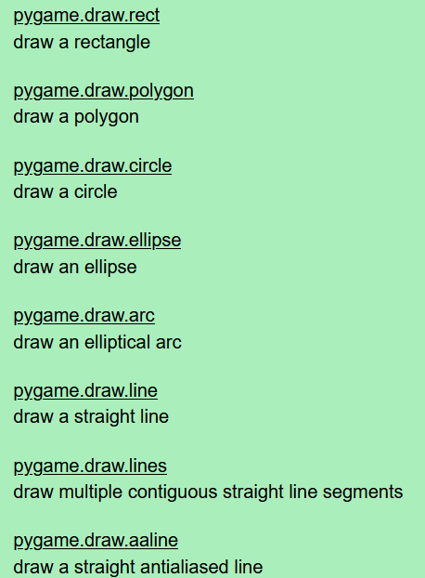
Solution for Task #2
screen.fill(„color“)
pygame.Rect()
pygame.draw.circle()
pygame.draw.rect()
pygame.font.Font()
font.render()
screen.blit()
https://www.pygame.org/docs/ref/draw.html

Slide 8
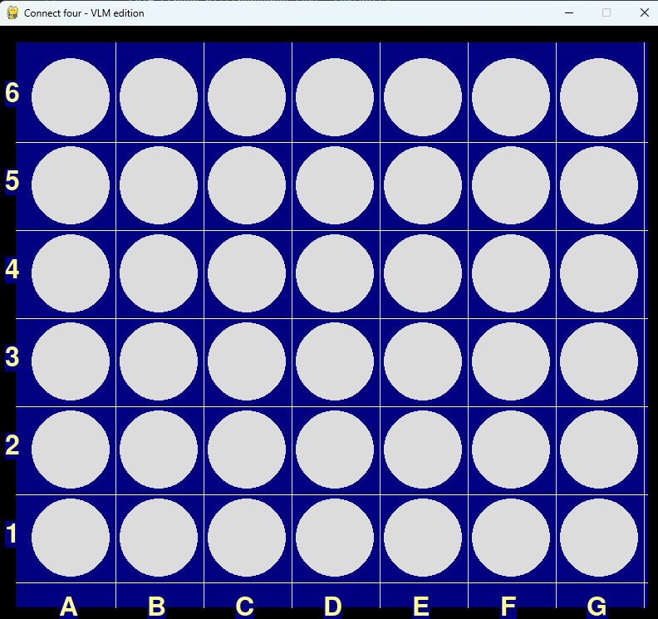
Task #3
Dia-
Venn
gramm
One slide with a lot of shapes
Rectangle with rounded corners
Database
Arrow
Wolke mit
verdeckt
Start
next step
Wolke ohne
Sechs-eck
Acht-eck
Stern
Dreieck
Kreis
Image source: own screenshot of own connect-four game

Slide 9





The vision / goal: putting it all together
Text Tokenizer
Text Decoder
Text
Image Encoder
Image Input Projection
LLM
Image Output Projection
Image Diffusion
Image
Audio Encoder
Audio Input Projection
Audio Output Projection
Audio Diffusion
Audio
3D Input Projection
3D point encoder
3D mesh output proj.
3D world creation
3D data

Slide 10
Connect four – results of own finetunes and experiments
finetune level 0 | finetune coords | finetune coords2 | finetune threat | finetune final | finetune final fix | finetune r64 | Question type | num train questions | num test questions
95.2% | 68.4% | 100.0% | 100.0% | 100.0% | 97.5% | 100.0% | board state | 799 | 40
0.0% | 10.3% | 6.9% | 2.5% | 12.5% | 17.5% | 72.5% | legal moves | 635 | 40
0.0% | 0.0% | 5.3% | 52.5% | 7.5% | 40.0% | 72.5% | threats | 607 | 40
0.0% | 11.8% | 11.8% | 20.0% | 75.0% | 40.0% | 77.5% | next move | 341 | 40
0.0% | 0.0% | 0.0% | 0.0% | 0.0% | 6.3% | 36.4% | win / loose | 200 | 16
100.0% | 90.6% | 81.3% | 65.0% | 62.5% | 100.0% | 100.0% | row | 764 | 40
74.3% | 68.8% | 87.5% | 88.2% | 47.5% | 80.0% | 100.0% | column | 774 | 40
0.0% | 2.6% | 5.1% | 52.5% | 100.0% | 77.5% | 27.5% | diagonal | 735 | 40
9.8% | 64.9% | 67.6% | 60.0% | 60.0% | 57.5% | 92.5% | coordinate | 764 | 40
56.7% | 58.8% | 67.6% | 80.0% | 82.5% | 80.0% | 87.5% | count | 767 | 40
33.6% | 37.6% | 43.3% | 52.1% | 54.8% | 59.6% | 76.6% | avg / total | 6403 | 376
Notes:
7 iterationen hier dargestellt. Davor nochmal 3-4

Slide 11
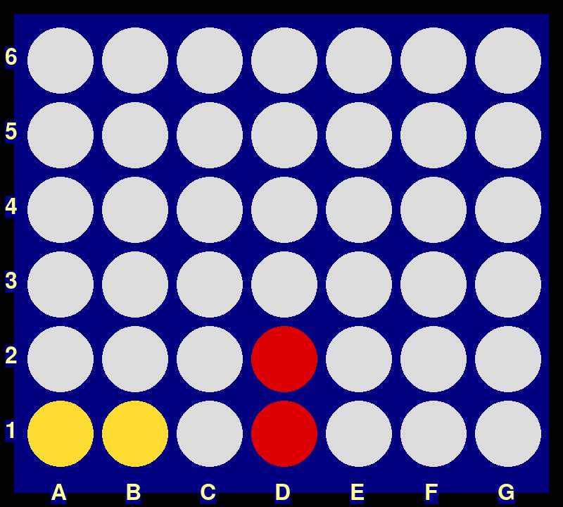
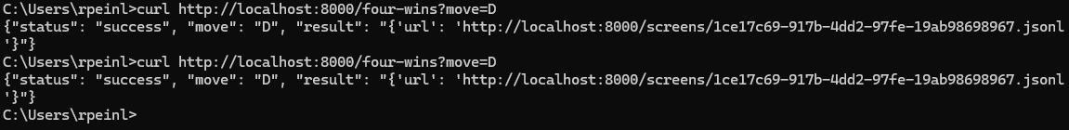
Task #4
Try to play the game using the http API
Base URL is http://localhost:8000
GET /four-wins?move=<Letter> to make your move
POST /four-wins to start all over with a new game
Note that the game is not multi-player ready.
Inspect the jsonl file and the screenshots

Slide 12
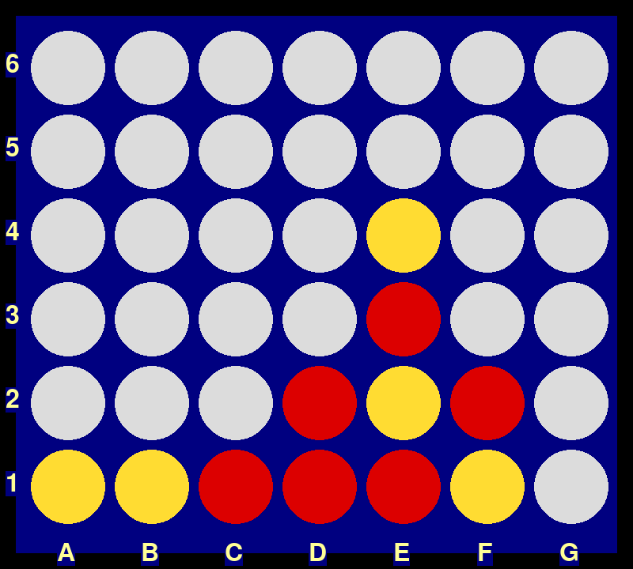
Task #5
Create a few question templates (3-5) for training of a VLM to get better at playing the connect four game
Parse the jsonl files and generate image / question + answer pairs based on the question templates and the raw data recorded. Use JSONL for your results
What other kind of metadata would you wish for in order to generate better questions or to more easily generate questions?
How easy / hard would it be to log that kind of metadata in the game?

Slide 13
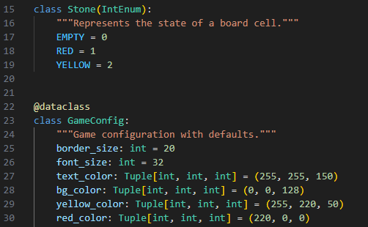
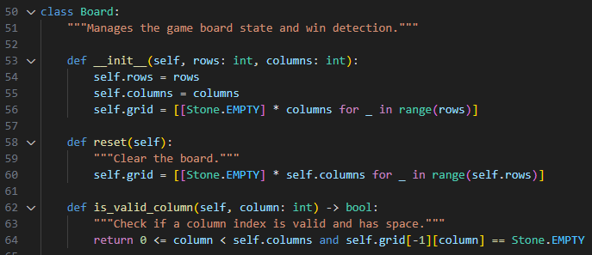
Task #6
Review the refactored version of the game and think about the benefits of the changes

