Slide 1



VIRTUAL CONTACT BOOK
Team Members :
Esha Shelar – 16010120136
Arva Kachwala - 16010120152

Slide 2


Problem statement – To create a virtual contact book
Virtual contact book is a small application developed for mini project. In olden days, we stored all our important contact details in books. Here we proposed a new system, by which we can store all the details in a central repository.
By using this application, we can see our contacts anywhere in the world. It also allows us to add, view, delete and edit a contact as per need.

Slide 3

System Architecture
This mini project in python allows us to perform simple Phonebook operations like in our mobiles. You can add, modify, view and delete Phonebook-related records. OOP, data structure and exception handling concepts have been extensively used for almost all functions in this mini project.
The source code for this project is just over 170 lines.
Personal information such as name, number and email id are asked while adding a record into the Phonebook. These records can then be modified, viewed and removed. All changes made are permanent and stored in a database.
This mini project is an application made by using graphics.
The source code is complete and compiled using Spyder.

Slide 4

Adding a contact:
The add_contacts() method is used to add a new contact to our database.
The user first enters the contact details in the entry boxes.
After filling all the boxes, the user must click on the add button.
When the add button is clicked,
add_contacts method is invoked.
These new details in the entry boxes are fetched by using StringVar and get method of the tkinter module.
After adding the new contact, the entry boxes are again set to null.Lastly the function insert_list() is invoked which updates the listbox on the GUI window
These fetched details are then added to the database using the execute method and Insert statement of the SQlite module
*INCASE OF ANY EXCEPTIONS, PASS STATEMENT IS EXECUTED*

Slide 5



Deleting a contact:
The delete_contacts method is used to delete a record from the database.
For the deletion of a contact the user must first select the contact from the listbox on the GUI window.
After selecting the contact the user must click on the delete button.This button invokes delete_contacts() method.
This function first fetches the record of the selected contact name using execute method,select statement and fetchall method.
This function deletes a record on basis of the contact name.Lastly insert_list() function is called to update the listbox on the GUI window.
This selected contact is then deleted from the database using the execute method and the delete statement.
*INCASE OF ANY EXCEPTIONS, PASS STATEMENT IS EXECUTED*

Slide 6
Editing a contact:
The program breaks down the edit process into two halves .First half is handled by the edit_contacts() and the second half by the edit() method.
First the user must select the contact from the listbox, which he wishes to edit
After selecting, he must click on the edit button.This button is used to invoke edit_contacts() method.
When this function is executed , other buttons like add,delete, view and reset get disabled, while the ok button gets enabled.
This function first fetches the original details of the selected contact and then sets the entry boxes with these fetched details.
After all the updates the disabled buttons are restored back to their enabled state and the ok button is again set to disabled state
Lastly the function insert_list() is called which ensures that the contact details also get edited in the GUI window.
The edit method fetches the edited details and then using the execute and update statements, the new data is modified into the database
The user must now make the desired changes to the contact details and click on the 'ok' button.The control now gets directed to the edit() function

Slide 7

Viewing a contact:
The view_contacts method is used to view the details of the selected contact.
The user first selects the contact from the listbox whose contact details he wishes to view.
After selecting the contact the user must click on view button.This then invokes view_contacts() method.
The record details of the contact are first fetched using execute method, select statement and fetchall method.
*INCASE OF ANY EXCEPTIONS, PASS STATEMENT IS EXECUTED*
Once the user is done viewing the contact, he can click reset. This button will clear the data present in the entry boxes.
The fetched details are then set to the respective entry boxes.

Slide 8
Features of designed system
Following application uses :
1. Concepts of OOP.
2. Tkinter module
3. SQLite3 module
4. RE module
5. Exception handling

Slide 9
Object Oriented Programming
The basic concepts of OOP used in our application are as follows:
1. Class : Our application uses a class called contactBook. It is used to make our code more manageable.
2. Objects : the class contactBook has an object ‘obj’ to access its attributes.
3. Class methods : Our application has various methods like add_contacts, delete_contacts, view_contacts etc. These methods are used to perform specific tasks and ensure code reusability.

Slide 10
Tkinter Module
Tkinter is the standard GUI library for Python. Python when combined with Tkinter provides a fast and easy way to create GUI applications.
Tkinter provides a powerful object-oriented interface to the Tk GUI toolkit.
Our application uses widgets like labels, buttons, textboxes, frame, listbox, scrollbar and a main tkinter window.

Slide 11
SQLite3 module
SQLite is a software library that provides a relational database management system.
To use sqlite3 module, our application first creates a connection object, ‘conn’ that represents the database
Additionally, a cursor object, ‘c’ is created which helps in executing all the SQL statements.
Our application uses this module to insert, select, delete and update the information in the database.

Slide 12
RE module
Python has a built-in package called re, which can be used to work with Regular Expressions.
A RegEx, or Regular Expression, is a sequence of characters that forms a search pattern.
Our application uses findall function provided by the module. It is used to return a list containing all matches.

Slide 13
Exception handling
The try and except block in Python is used to catch and handle exceptions. Python executes code following the try statement as a “normal” part of the program.
The code that follows the except statement is the program’s response to any exceptions in the preceding try clause.
Our application uses pass statement in except block.
In Python programming, the pass statement is a null statement. It results in no operation (NOP).

Slide 14
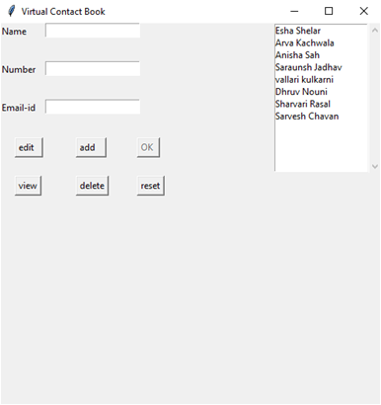
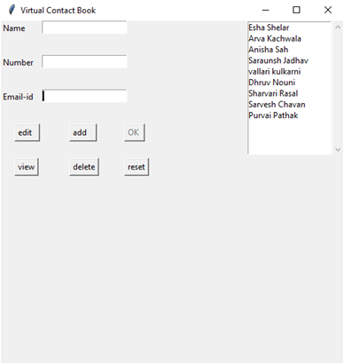
Adding a contact
Result:
BEFORE
AFTER

Slide 15
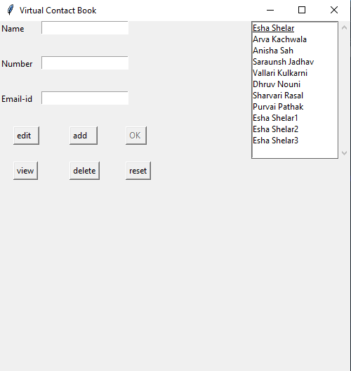
Handling of additional copies
Just like our computer handles multiple copies by adding a number in front of the file name.Similarly ,our code also adds a number in front of the contact to distinguish the multiple copies present in the database under that particular name.

Slide 16
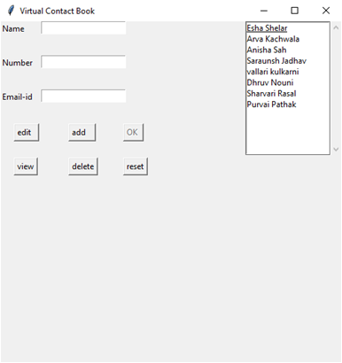
Deleting a contact
BEFORE
AFTER

Slide 17
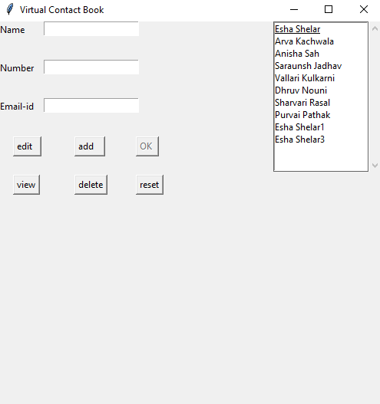
Deletion of multiple copies
As discussed, our code automatically adds a number in front of a repeating contact name.This ensures that during deletion only the intended record is deleted and avoids any unnecessary outcomes.

Slide 18
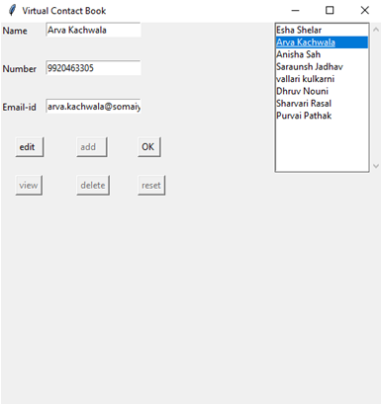
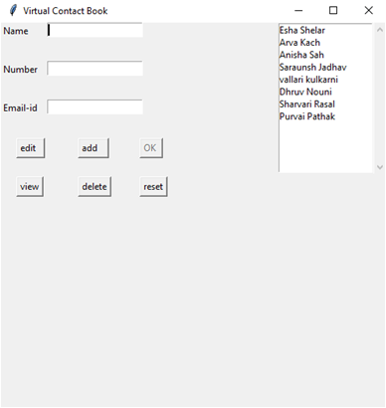
Editing a contact
BEFORE
AFTER

Slide 19

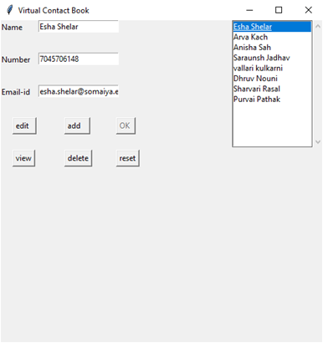
Viewing a contact
BEFORE
AFTER

Slide 20
Conclusion
We have successfully developed a virtual Contact Book.We have used tkinter for rendering graphics.We have used SQlite3 module to create a database that stores all our information.We have also understood how to create button widgets and how to call the function using the same.In addition to that , we have implemented the concepts of object oriented programming, wherever required.Our application uses re module for searching copies of a contact name and modifying them to avoid any possible errors.We have tried to handle all the scenarios after thorough testing.

Slide 21
References
https://www.tutorialspoint.com/python/python_gui_programming.htm#:~:text=Tkinter%20is%20the%20standard%20GUI,to%20the%20Tk%20GUI%20toolkit.&text=Import%20the%20Tkinter%20module.
https://youtu.be/pd-0G0MigUA
https://www.javatpoint.com/python-oops-concepts
https://www.programiz.com/python-programming/object-oriented-programming
https://www.tutorialspoint.com/sqlite/sqlite_python.htm#:~:text=SQLite3%20can%20be%20integrated%20with,x%20onwards.
https://www.digitalocean.com/community/tutorials/how-to-use-the-sqlite3-module-in-python-3
https://youtu.be/YXPyB4XeYLA
https://pynative.com/python-sqlite/
https://youtu.be/yQSEXcf6s2I
https://www.w3schools.com/python/python_regex.asp
https://www.programiz.com/python-programming/regex

Slide 22
Link for git-hub
https://github.com/Esha-Shelar/MiniProject-VirtualContactBook

Slide 23
THANK YOU

