Slide 1
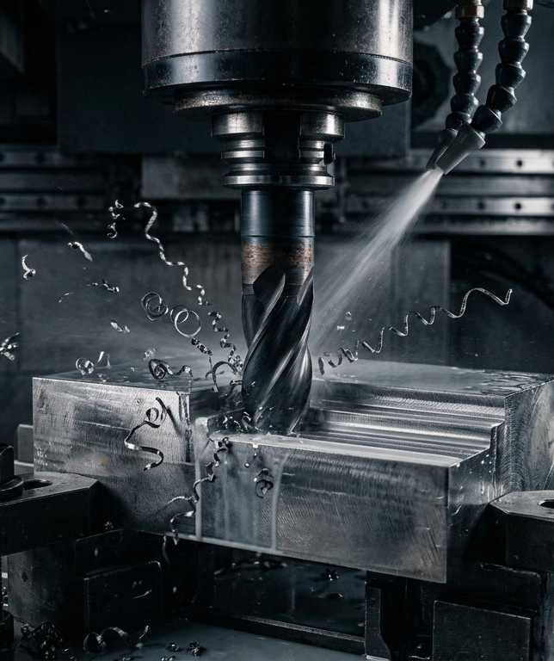
ACADEMIC PROJECT PRESENTATION · 2026–27
CNC Tool Wear Prediction
And Scrap Risk Signal
A physics + machine-learning hybrid decision-support system for Industry 4.0 predictive maintenance
Team Member | Roll Number
Arvapalli Sai Adarsh | 1602-24-736-039
A. Meghana | 1602-24-736-022
M. Muzammil | 1602-24-736-027
Validated against: Dong & Li (ASME JCISE 2022) · Fan (DAPIC 2026) · Munaro, Attanasio & Del Prete (JMMP 2023)
October 2026

Slide 2
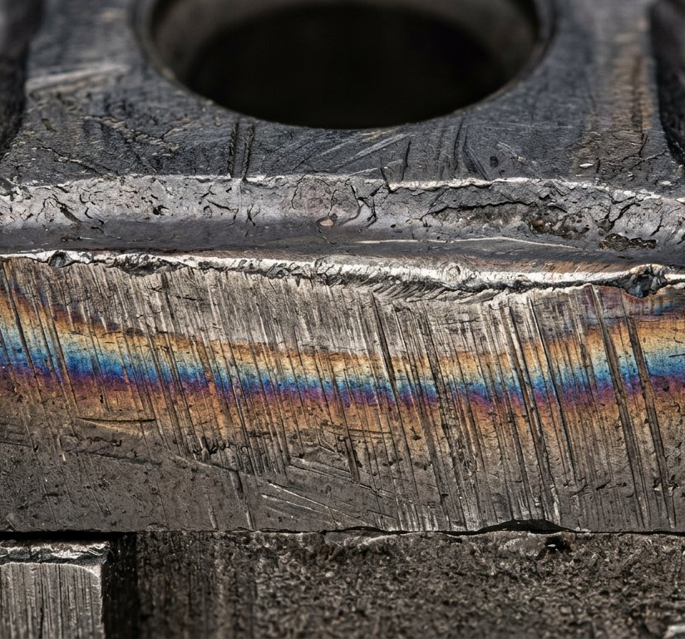
SECTION 1 — PROBLEM STATEMENT
Introduction & Motivation
▸ The failure mode: Progressive flank wear (VB) degrades dimensional accuracy and surface finish; undetected wear ends in scrap, unplanned downtime and tool breakage.
▸ The cost: cutting tooling is 3–12 % of total production cost (Teti 2002 via [P1]; Zhang et al. via [P3]).
▸ The downtime: ≈ 20 % of nonproduction time is due to tool wear [P1 §1]; tool failure causes > 35 % of production-line malfunctions [P2 §I].
▸ The opportunity: a reliable TCM system yields 10–50 % higher cutting speed, 75 % less downtime and ≈ 30 % maintenance-cost saving [P3 §1].
▸ The gap: periodic replacement wastes usable tool life; subjective engineer judgement loses > 40 % of achievable tool-cost savings [P1 §1].
PROJECT OBJECTIVES
1. Estimate flank wear VB (mm) with a statistically calibrated uncertainty band — never a falsely-precise single number.
2. Signal calibrated scrap-defect risk anchored to the ISO 3685 tool-life criterion (VB = 0.30 mm).
3. Explain every prediction with SHAP and narrate it into a plain-language operator bulletin.
4. Remain strictly decision-support: no machine control, no autonomous action.
Flank wear land on a carbide insert — the abrasive wear band (VB) this system predicts and the metric all three reference papers converge on.
CNC Tool Wear Prediction And Scrap Risk Signal · academic project · Oct 2026
2 / 10

Slide 3
SECTION 2 — GROUND TRUTH
Literature Review — the three validating papers
[P1] Dong & Li — Online Detection of Turning Tool Wear Based on Machine Vision
ASME JCISE 22(5) 050903, 2022 · doi:10.1115/1.4053919
Direct online vision measurement of VB-mean on a turning tool: crop → k-means segmentation → grayscale luminance Y = 0.3R + 0.59G + 0.11B → Robert's edge operator → Hough-transform width. Micron-scale agreement with manual measurement (0.064/0.086/0.096 mm vs 0.062/0.089/0.093 mm). Supplies the economic base: tooling 3–12 % of production cost, ≈20 % nonproduction time, >40 % sensor savings.
[P2] Fan — CNC Tool Wear Prediction Integrating Deep Reinforcement Learning & Edge Data Processing
DAPIC 2026 · doi:10.23919/DAPIC.2026.00023
Indirect sensing (PCB 356A16 accelerometer + Kistler 9257B dynamometer, 1–5 kHz) → adaptive sliding-window denoising → attention features → lightweight DRL (A-LWDRL) on a Jetson Xavier NX. Benchmarks: MAE 0.023/0.028 mm, RMSE 0.031/0.036 mm, wear-level accuracy 98.7 %, 2.3 MB, 12.8 ms. Validates wear stages 0–0.05 / 0.05–0.15 / 0.15–0.2 mm on PHM 2010 (Inconel 718, WC-Co) and real 45# steel.
[P3] Munaro, Attanasio & Del Prete — Tool Wear Monitoring with AI Methods: A Review
JMMP 7(4) 129, 2023 · doi:10.3390/jmmp7040129 · 77 papers, 2010–2022
Sensor ranking: cutting force (41 studies) > vibration (21) > acoustic emission (18) > current/power (16) > sound (7). Features: time domain most used (RMS, mean, std, kurtosis). AI: ANN 14, SVM 10, fuzzy 5, GA/BN 4… Accuracy 84–100 % for known wear, ≈73 % for new tools. ISO 3685 sets the VB tool-life limit at 0.3 mm.
CNC Tool Wear Prediction And Scrap Risk Signal · academic project · Oct 2026
3 / 10

Slide 4
SECTION 3 — METHOD
System Architecture — physics + ML hybrid pipeline
Process & tooling inputs
23 features: material, coolant, coating, RPM, feed, ap, ae, Ø, Z, nose radius, runtime…
Physics engine
Extended Taylor life, Vc = πDN/1000, MRR = ap·ae·vf/1000, cutting energy, Ra ≈ f²/32rε
Feature engineering
Rolling-window instability features (time domain, per [P3 §4.5.2])
Quantile ML core
GBM Q10/Q50/Q90 on pinball loss + split-conformal coverage guarantee
Scrap-risk classifier
Isotonic-calibrated probability anchored at ISO 3685 VB = 0.30 mm
XAI + bulletin
SHAP drivers → 3-sentence operator bulletin (GPT-4o / offline fallback)
Offline batch training (train_pipeline.py)
Three-way split grouped by tool run — no tool's telemetry leaks across train / calibration / test; persists joblib artifacts.
Streamlit console — four tabs
Live Operations & Diagnostics · Mathematical Derivations · CNC Knowledge Base · Maintenance Logs & PDF export.
Persistence & export
SQLite work-order logs survive session resets; CSV export and PDF maintenance work-order dispatch tickets.
SAFETY GUARDRAIL — DECISION SUPPORT ONLY
No PLC / CNC write path exists anywhere in the codebase. The LLM system prompt forbids implying autonomous action; a wide uncertainty band forces a “recommend manual visual inspection” bulletin. Every output carries quantified uncertainty; every decision remains human.
Deployment: Streamlit cloud console (what-if mode) with an offline CLI training pipeline — standard train/serve separation. Edge deployment is roadmap, not current scope.
CNC Tool Wear Prediction And Scrap Risk Signal · academic project · Oct 2026
4 / 10

Slide 5
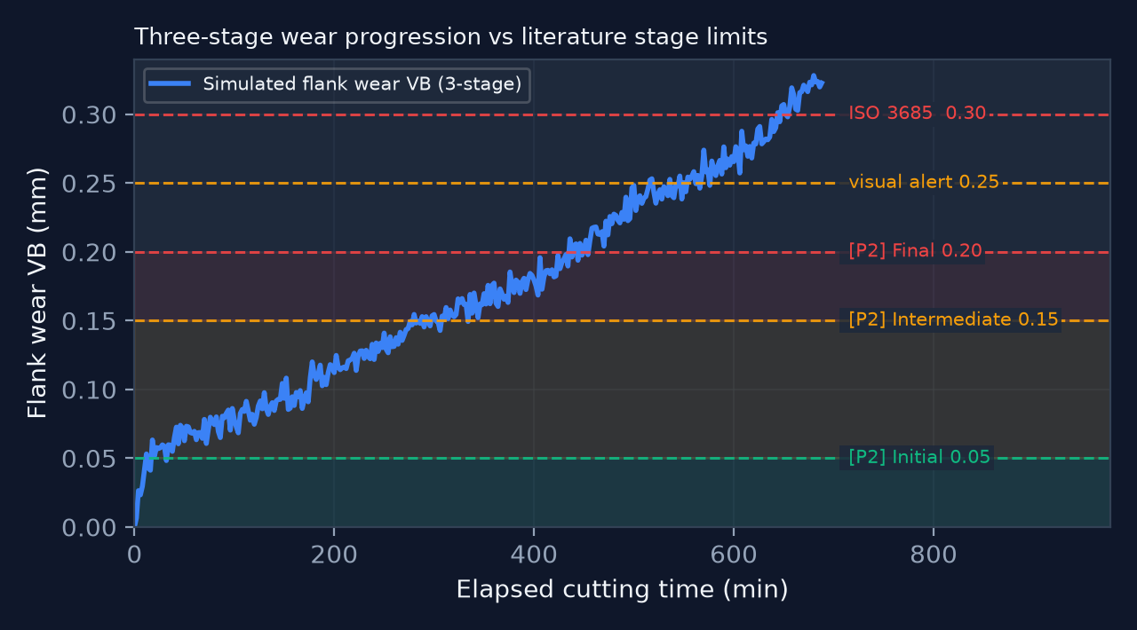
SECTION 3 — METHOD
Physics Layer & Three-Stage Wear Model
FIRST-PRINCIPLES EQUATIONS (live-substituted in the app)
Vc = π · D · N / 1000 [m/min]
T = C·C_coolant·C_coating / ( v^(1/n) · f^(1/m) · d^(1/p) ) — extended Taylor tool life
MRR = ap · ae · vf / 1000 (× N_spindles) [cm³/min]
Ra ≈ f² / (32 · rε) × 1000 [µm] E_cum = Σ MRR·k_specific·Δt
P_cut = k_specific · MRR / 60 [kW] Load% = P_cut / (P_rated·η)
n ∈ [0.20, 0.50], m ∈ [0.15, 0.30], p ∈ [0.10, 0.15] per material; clipped to the calibrated envelope with an explicit extrapolation flag.
THREE-STAGE WEAR PROGRESSION (simulated ground truth)
VB(t) = 0.045·(1−e^(−t/6)) + 0.22·(t/T)·κ + 3.2·max(0, t/T−0.78)³ + instability + ε
break-in / steady-state / catastrophic — the canonical curve shape validated in [P2 §III.C]; break-in ceiling 0.045 mm sits within 10 % of [P2]'s 0.05 mm Initial-stage boundary.
MATERIAL & TOOLING COVERAGE — A SUPERSET OF [P3]'s CORPUS
11 profiles: Al 6061/7075-T6, AISI 1045 (C45), 4140/42CrMo4, D2, 304, 316L, 17-4 PH, Ti-6Al-4V, Inconel 718, gray cast iron FG 15/CGI 450 · coatings: uncoated carbide, TiAlN, AlTiN, PCD, ceramic, CBN · coolant: dry / MQL / flood / HPC · PCD-on-ferrous hard-blocked (carbon diffusion / TiC graphitisation).
CNC Tool Wear Prediction And Scrap Risk Signal · academic project · Oct 2026
5 / 10

Slide 6
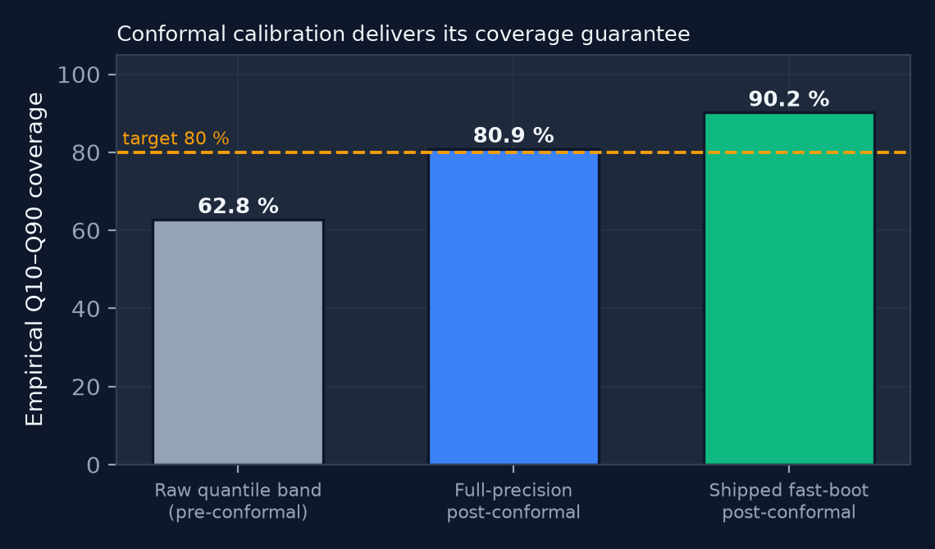
SECTION 3 — METHOD
Machine-Learning Core & Calibrated Uncertainty
▸ Q10 / Q50 / Q90: gradient-boosted quantile regressors (XGBoost / LightGBM) trained on the pinball loss at τ = 0.10 / 0.50 / 0.90 — the band, not a point, is the product.
▸ Conformal guarantee: Romano–Patterson–Candès split-conformal calibration gives a finite-sample, distribution-free 80 % marginal coverage guarantee on the Q10–Q90 band.
▸ Calibrated probability: the scrap classifier is wrapped in isotonic CalibratedClassifierCV so “0.7” genuinely means ≈70 % of similar validated runs scrapped — a number an operator reads as a probability.
▸ Explainability: local SHAP attributions for both models (averaged across every calibration fold), fed verbatim into the bulletin payload — the LLM may never invent a driver.
▸ Leakage control: train / calibration / test split by run_id, never by row — no tool's samples leak. Stricter than [P2]'s plain 7:3 / 8:2 split.
▸ Model tiers: two tiers: 0.38 s fast-boot fit on first load; opt-in full-precision fit (14.3 s) for the tighter band.
▸ Resilience: deterministic offline bulletin generator mirrors the GPT-4o contract — narration is never a single point of failure.
WHY UNCERTAINTY IS THE POINT
[P3 §5] names noisy industrial data and small training sets as the field's central obstacle. A guaranteed coverage interval answers that directly: when the band is wide the system says so and recommends manual inspection instead of asserting false precision.
CNC Tool Wear Prediction And Scrap Risk Signal · academic project · Oct 2026
6 / 10

Slide 7
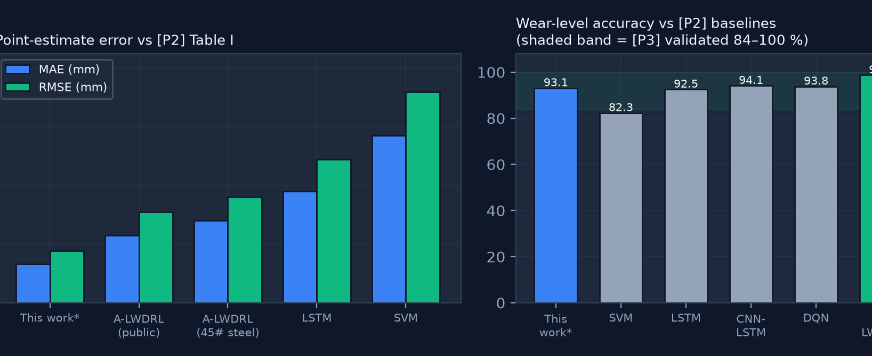
SECTION 4 — RESULTS
Measured Performance vs Literature Benchmarks
Metric (held-out tool runs, seed 42) | This work | Benchmark
MAE — Q50 flank wear* | 0.0132 mm | ≤ 0.023–0.028 [P2]
RMSE — Q50 flank wear* | 0.0177 mm | ≤ 0.031–0.036 [P2]
Wear-level accuracy (3-stage)* | 93.1 % | 98.7 % [P2] · 84–100 % [P3]
Q10–Q90 coverage (target 80 %) | 80.9 % | not reported in [P2]/[P3]
Scrap-risk ROC-AUC / Brier | 0.873 / 0.0974 | not reported in [P2]/[P3]
Inference latency (band / scrap) | 6.25 / 8.75 ms | ≤ 12.8 ms [P2]
Model size (full / fast-boot) | 2.92 / 0.23 MB | ≤ 2.3 MB [P2]
Training time (full / fast-boot) | 14.3 / 0.38 s | —
READING THE COMPARISON HONESTLY
▸ the * bars beat [P2]'s A-LWDRL numerically only because the target is smooth simulated wear (r(taylor_ratio, VB) = 0.949); they are not yet comparable claims.
▸ 93.1 % sits above [P2]'s SVM (82.3 %), LSTM (92.5 %) and DQN (93.8 %) rows and inside [P3]'s 84–100 % band — but 5.6 pts below A-LWDRL's 98.7 %.
▸ the fast-boot tier ships a 0.23 MB model — 10× under [P2]'s 2.3 MB edge target.
* synthetic ground truth — the target is this system's own physics-informed simulator, so these figures demonstrate internal consistency, not yet real-tool skill. External validation on PHM 2010 is the top roadmap item (slide 9).
Latency beats [P2]'s edge budget on far weaker hardware; wear-level accuracy falls inside [P3]'s validated 84–100 % envelope for known-wear tools.
CNC Tool Wear Prediction And Scrap Risk Signal · academic project · Oct 2026
7 / 10

Slide 8
SECTION 5 — INDEPENDENT VALIDATION
Cross-Validation Against the Three Papers
 | Finding | Source
✅ | Wear metric is flank wear VB in mm — the metric all three papers converge on | [P1] abs. · [P2] §III.C · [P3] §6.2
✅ | Replacement / scrap threshold = 0.30 mm — exact ISO 3685 match, correctly attributed | [P3] §6.2, p.40
✅ | Simulated break-in ceiling 0.045 mm ≈ validated Initial-stage boundary 0.05 mm | [P2] §III.C
✅ | Materials & tooling coverage is a superset of the 77-paper corpus (Inconel 718, Ti-6Al-4V, C45, 42CrMo4, 316, Al 6061/7075, FG 15) | [P3] §4.2, Table 2
✅ | Tool-run-grouped splitting + conformal & isotonic calibration exceeds [P2]'s experimental design | [P2] §III.B
⚠️ | Dashboard bands (0.15 / 0.25 / 0.30) do not match validated stages (0.05 / 0.15 / 0.20); simulated VB overshoots to 0.47 mm | [P2] §III.C
❌ | No measured sensor signal — 0.0083 Hz telemetry vs [P2]'s 1–5 kHz; spindle power is computed, not sensed | [P3] §4.4 · [P2] §III.A
❌ | MAE / RMSE computable but never displayed; nine citable economic figures unused | [P2] Table I · [P3] §4.6.4, §1
AUDIT VERDICT: ⚠ PARTIALLY VALIDATED — 2.7 / 5. Core methods and the output contract align with the literature; structural gaps remain (sensing, external benchmarks). No instance was found in which the system contradicts any of the three papers.
CNC Tool Wear Prediction And Scrap Risk Signal · academic project · Oct 2026
8 / 10

Slide 9
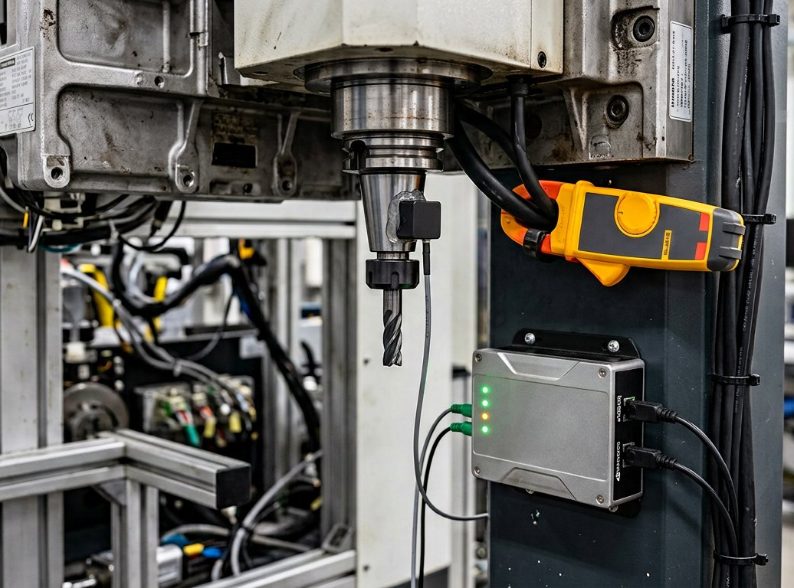
SECTION 6 — CLOSING
Conclusions & Future Work
CONCLUSIONS
▸ A physics + ML hybrid MVP delivers operator-grade wear and scrap-risk signals with statistically honest, calibrated uncertainty — a stronger posture than point-estimate baselines.
▸ The output contract is literature-aligned: VB metric, exact ISO 3685 anchor, three-stage wear shape, material/tooling superset, leakage-safe splits.
▸ Remaining gaps are structural and openly disclosed: no measured sensing, self-referential accuracy, hidden MAE/RMSE, absent economic framing — each with a concrete fix.
FUTURE-WORK ROADMAP
1. Benchmark on the public PHM 2010 corpus (WC-Co on Inconel 718, 5 kHz) for a genuine comparison against [P2] Table I.
2. Ingest one measured channel — spindle current/power, the cheapest validated sensor class [P3 §4.4.5, §6.2].
3. Surface MAE / RMSE / wear-level accuracy in-app and overlay [P2]'s 0.05 / 0.15 / 0.20 stage boundaries.
4. Add the economic-justification panel: 3–12 % tool cost, ≈20 % nonproduction time, >35 % malfunctions, 10–50 / 75 / 30 % TCM benefits.
5. Persist full-precision artifacts and move toward edge deployment with live signal ingest.
Roadmap item 2: retrofit condition monitoring. [P3] shows spindle current/power is non-invasive and “far less expensive” than dynamometry — the pragmatic first channel for a student lab.
CNC Tool Wear Prediction And Scrap Risk Signal · academic project · Oct 2026
9 / 10

Slide 10
SECTION 7 — TEAM
Project Team, References & Acknowledgements
TEAM MEMBERS
REFERENCES
Team Member | Roll Number
Arvapalli Sai Adarsh | 1602-24-736-039
A. Meghana | 1602-24-736-022
M. Muzammil | 1602-24-736-027
[1] X. Dong and Y. Li, “Online Detection of Turning Tool Wear Based on Machine Vision,” ASME J. Computing & Information Science in Engineering, vol. 22, no. 5, 050903, 2022. doi: 10.1115/1.4053919.
[2] Z. Fan, “A CNC Machine Tool Wear Prediction Model Integrating Deep Reinforcement Learning and Edge Data Processing,” Proc. DAPIC, 2026. doi: 10.23919/DAPIC.2026.00023.
[3] R. Munaro, A. Attanasio and A. Del Prete, “Tool Wear Monitoring with Artificial Intelligence Methods: A Review,” J. Manuf. Mater. Process., vol. 7, no. 4, 129, 2023. doi: 10.3390/jmmp7040129.
[4] ISO 3685 — tool-life criterion VB = 0.3 mm, as cited in [3, §6.2].
[5] PHM Society 2010 Tool Wear Challenge dataset — external benchmark designated for future work.
ACKNOWLEDGEMENTS
The authors thank their project supervisor for guidance and for supplying the three reference papers against which this system was validated, and the reviewers of ASME JCISE, IEEE DAPIC and MDPI JMMP whose published results form the ground truth of this study.
Thank you — questions & discussion are welcome.
REPRODUCIBILITY
Source, audit report and measurement harness: github.com/ArvapalliSaiAdarsh39/cnc-tool-wear-system — docs/VALIDATION_REPORT.md and audit/ (every figure in this deck is re-runnable).
CNC Tool Wear Prediction And Scrap Risk Signal · academic project · Oct 2026
10 / 10

