Slide 1
1
Break a Monolith Application into Microservices
Docker, AWS ECS, ECR
Severyn Maksym
<EPAM> DevOps courses 2019

Slide 2

Why this Matters
2
The entire node.js application is run in a container as a single service and each container has the same features as all other containers. If one application feature experiences a spike in demand, the entire architecture must be scaled.
Each feature of the node.js application runs as a separate service within its own container. The services can scale and be updated independently of the others.

Slide 3

Application Architecture
3
Within a microservices architecture, each application component
runs as its own service and
communicates with other services
via a well-defined API.

Slide 4


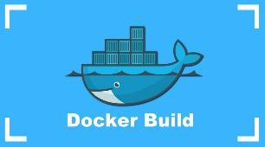
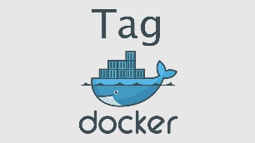

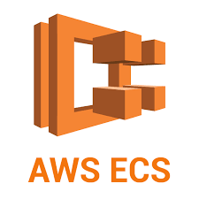
Technology Stack
4

Slide 5
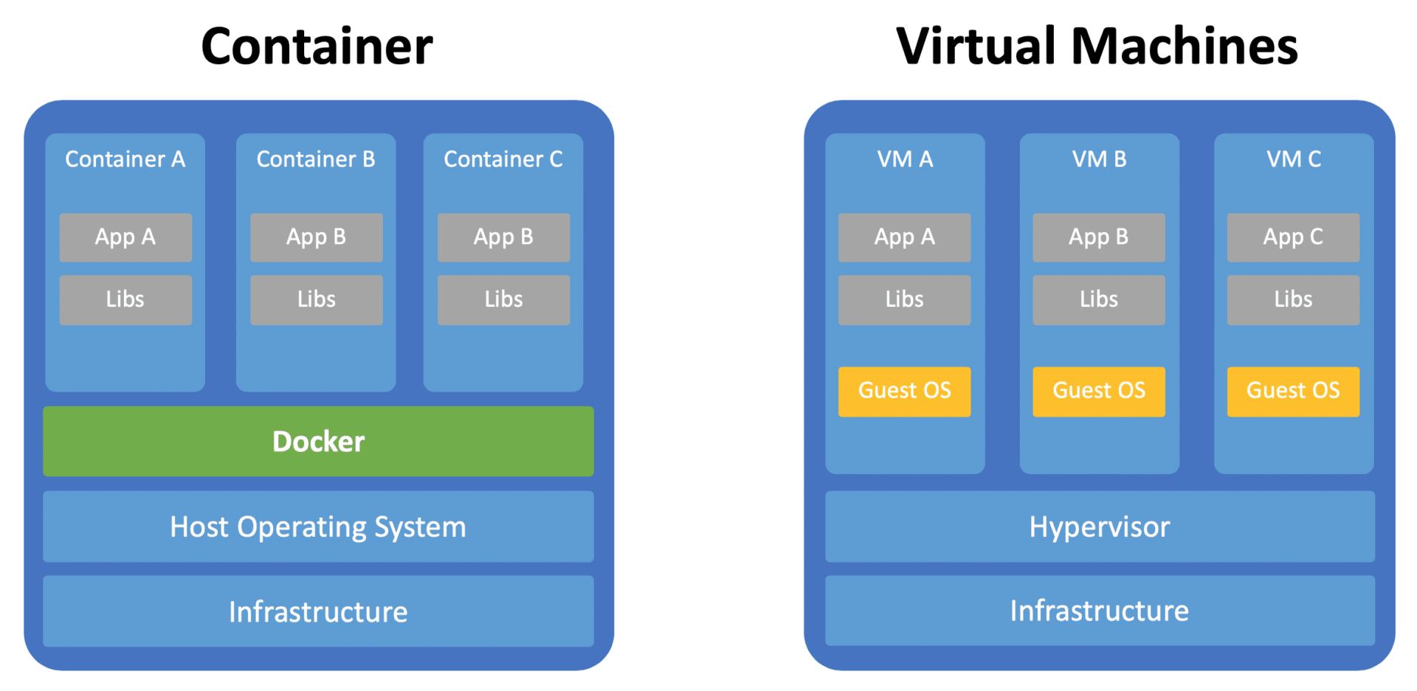
Containerize the Monolith
5

Slide 6

Containerized nodejs Monolith
6
Cluster
Users
Client
Load
Balancer
Threads
Port 80
Posts
Cluster
Users
Target Groups
Threads
Posts

Slide 7
Break the Monolith
7
/api/users/*
Users
Client
Load
Balancer
Port 80
/api/threads/*
Threads
/api/posts/*
Posts
Target Groups

Slide 8

Let’s check it on Youtube
8

