Slide 1
DBMS=DB+MS
DBMS is a software system that allow us to
manage the data base.
DATA:- A data is Raw martial, fact, figure that give the meaningful information i.e. require foe some form of processing.

Slide 2
DATA BASE:- It is a group of information or A collection of data may be organized in the form of files or tables.
Examples:-
1. Oracle 9i, 10G, 10Gi, 11G, 11Gi
2. SQL-server-2005, 2010
3. DB2,Sybase,forpro, Ms-access2003,
2007, 2010,
Application
DBMS
O.S.
Data Base

Slide 3
Application of DBMS:- 1. Banking Sector
2. Universities
3. Railway Reservation
4. Finance
5. Sales

Slide 4
Advantages of DBMS:-
1.Reduce the redundancy from Database.
2. Sharing of data.
3. Important in data security.
4. Better interaction with user.
Disadvantages of DBMS:-
1. Cost of Software.
2. Cost of Hardware.
3. Complexity of back-up of recovery.

Slide 5
Difference
DBMS
RDBMS
In DBMS relationship between two table or file are maintained programmatically.
DBMS does not support client-server architecture.
DBMS does not support distributed.
No security.
In RDBMS relationship between two table or file can be specified at the time of table creation.
RDBMS supports client-server architecture.
RDBMS supports distributed.
Multiple level of security
Log in at O.S. level
Commend level
Object level

Slide 6
Keys in RDBMS
Primary Key
An attribute that is used to access the table data is called primary key. It must
Contain Unique values. It uniquely identifies a record in a table.
Candidate Key
It is set of attributes from which primary key is selected. One of them is made as
Primary key and rest are candidate keys. They are candidate for primary key.
It uniquely identifies a record.
Composite key
When more than one attributes are used to uniquely identify a record in a table
It becomes composite key.

Slide 7
Keys in RDBMS
Super Key
It is a set of attributes that uniquely identifies each record in a table. It is a
superset of candidate key.
Secondary Key
The candidate keys which are not selected as primary key , are called as
secondary key or alternate key.

Slide 8
Advantages of 3-Tier Architecture
The need for less expensive hardware because the client is thin.
Application maintenance is centralized.
The added modularity makes it easier to modify or replace one tier without affecting others.
Load balancing is easier with the separation of the core business logic from the database functions.

Slide 9
Traditional File-based Systems
Contract Files
Lease(leaseno,propertyno,clientno,rent,paymentmethod,deposit,paid,rentstart,rentfinish,duration)
PropertyForRent(propertyno,street,city,postcode,rent)
Client(clientno,fname,lname,address,telno)

Slide 10
Functional Dependency
Was invented by Armstrong in 1967.
He came up with 6 rules called as Axioms
They form the basis for deriving the relationship between data in normalization.

Slide 11
Functional Dependency
Axiom Name | Axiom | Example
Reflexivity | if a is set of attributes, b ⊆ a, then a →b | SSN,Name → SSN
Augmentation | if a→ b holds and c is a set of attributes, then ca→cb | SSN → Name then SSN,Phone → Name, Phone
Transitivity | if a →b holds and b→c holds, then a→ c holds | SSN →Zip and Zip → City then SSN →City
Union or Additivity * | if a → b and a → c holds then a→ bc holds | SSN→Name and SSN→Zip then SSN→Name,Zip
Decomposition or Projectivity* | if a → bc holds then a → b and a → c holds | SSN→Name,Zip then SSN→Name and SSN→Zip
Pseudotransitivity* | if a → b and cb → d hold then ac → d holds | Address → Project and Project,Date →Amount then Address,Date → Amount

Slide 12
Keys in RDBMS
Primary Key
An attribute that is used to access the table data is called primary key. It must
Contain Unique values. It uniquely identifies a record in a table.
Candidate Key
It is set of attributes from which primary key is selected. One of them is made as
Primary key and rest are candidate keys. They are candidate for primary key.
It uniquely identifies a record.
Composite key
When more than one attributes are used to uniquely identify a record in a table
It becomes composite key.

Slide 13
Keys in RDBMS
Super Key
It is a set of attributes that uniquely identifies each record in a table. It is a
superset of candidate key.
Secondary Key
The candidate keys which are not selected as primary key , are called as
secondary key or alternate key.

Slide 14
CONSTRUCTING AN ER MODEL
Before beginning to draw the ER model, read the requirements specification carefully.
Document any assumptions you need to make.
1.Identify entities
list all potential entity types. These are the object of interest in the system. It is better to put too many entities in at this stage and them discard them later if necessary.

Slide 15
2.Remove duplicate entities
Ensure that they really separate entity types or just two names for the same thing
Also do not include the system as an entity type
e.g. if modelling a library, the entity types might be books, borrowers, etc.
The library is the system, thus should not be an entity type.

Slide 16
3.List the attributes of each entity
Ensure that the entity types are really needed.
Are any of them just attributes of another entity type?
If so keep them as attributes a nd cross them off the entity list.
Do not have attributes of one entity as attributes of another entity!

Slide 17
4.Mark the primary keys
Which attributes uniquely identify instances of that entity type?
This may not be possible for some weak entities.
5.Define the relationships
Examine each entity type to see its relationship to the others.

Slide 18
6.Describe the cardinality and optionality of the relationships
Examine the constraints betwee n participating entities.
ER modelling is an iterative process, so draw several versions, refining each one until you are happy with it. Note that there is no one right answer to the problem, but some solutions are better than others!
7.Remove redundant relationships
Examine the ER model for redundant relationships.

Slide 19
EXAMPLE
“A Country Bus Company owns a number of busses. Each bus is allocated to a particular route, although some routes may have several busses. Each route passes through a number of towns. One or more drivers are allocated to each stage of a route, which corresponds to a journey through some or all of the towns on a route. Some of the towns have a garage where busses are kept and each of the busses are identified by the registration number and can carry different numbers of passengers, since the vehicles vary in size and can be single or double-decked. Each route is identified by a route number and information is available on the average number of passengers carried per day for each route. Drivers have an employee number, name , address, and sometimes a telephone number.”

Slide 20
ENTITIES
Bus - Company owns busses and will hold information about them.
Route - Buses travel on routes and will need described.
Town - Buses pass through towns and need to know about them
Driver - Company employs drivers, personnel will hold their data.
Stage - Routes are made up of stages
Garage - Garage houses buses, and need to know where they are.

Slide 21
RELATIONSHIPS
A bus is allocated to a route and a route may have several buses.
Bus-route (m:1) - is serviced by
A route comprises of one or more stages.
route-stage (1:m) comprises
One or more drivers are allocated to each stage.
driver-stage (m:1) is allocated
A stage passes through some or all of the towns on a route.
stage-town (m:n) passes-through

Slide 22
A route passes through some or all of the towns
route-town (m:n) passes-through
Some of the towns have a garage
garage-town (1:1) is situated
A garage keeps buses and each bus has one `home' garage
garage-bus (m:1) is garaged

Slide 23
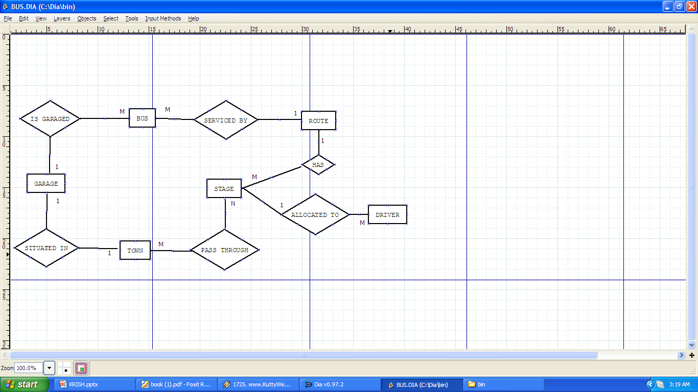
ER DIAGRAM

Slide 24
ATTRIBUTES
Bus (reg- no,make,size,deck,no-pass)
Route (route-no,avg-pass)
Driver (emp - no,name,address,tel-no)
Town (name)
Stage (stage - no)
Garage (name,address)

Slide 25
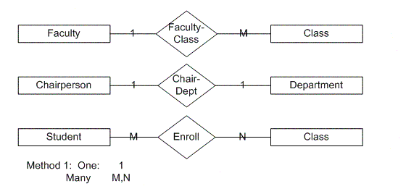
ALTERNATIVE DIAGRAMATIC NOTATIONS FOR ER MODELS

Slide 26
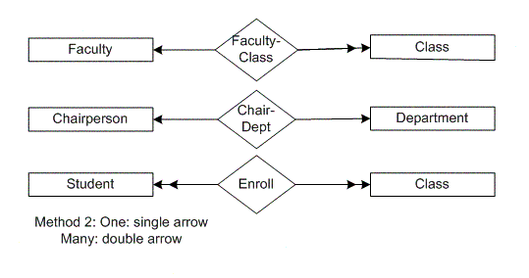

Slide 27
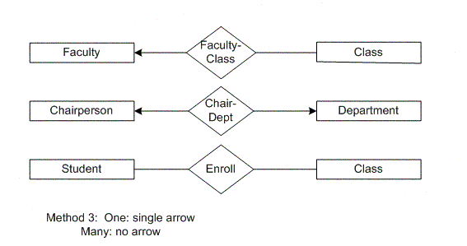

Slide 28
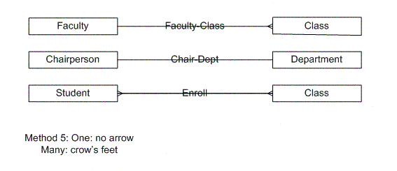

Slide 29

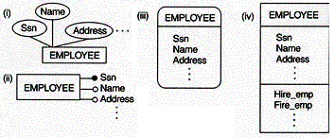
Symbols for entity type attribute and relationship
Displaying attributes

Slide 30
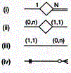
Various (min, max) notations

Slide 31
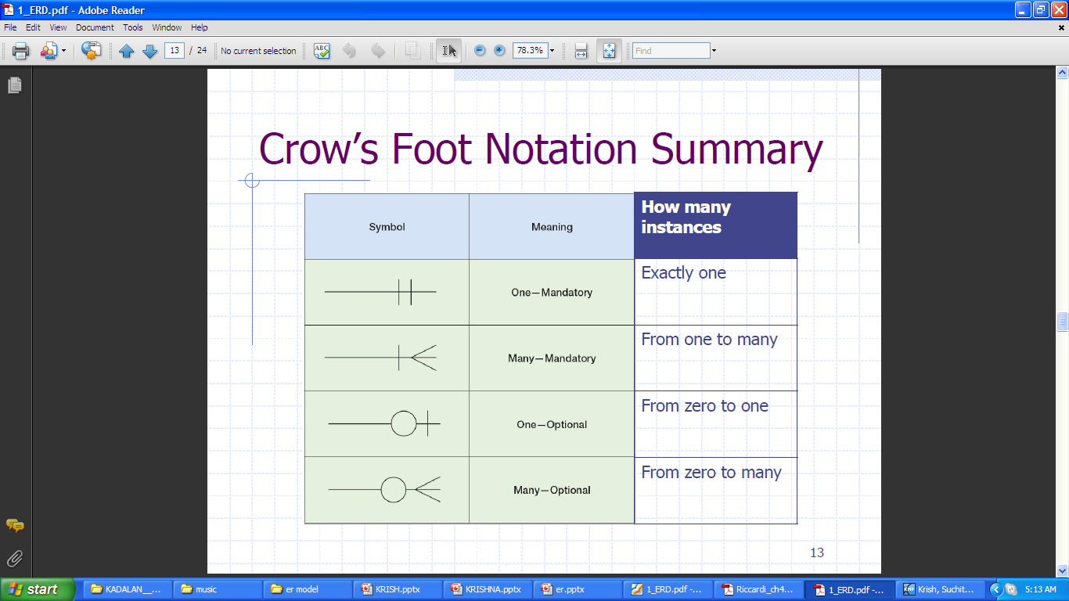
CROW-FOOT NOTATION

Slide 32
ENHANCED ER DIAGRAM
The EER diagram includes the concepts of
Subclass and super class
Specialization and Generalization
Categorization
Attribute and relationship inheritance.

Slide 33
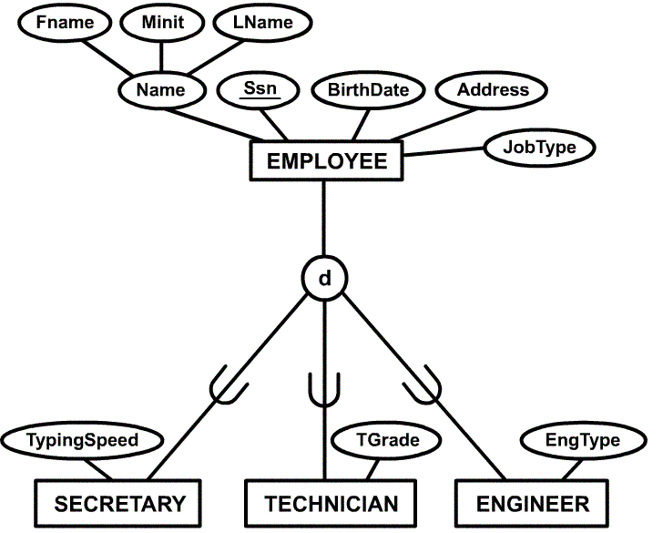
SUBCLASS SUPERCLASS AND INHERITANCE
In many cases entity types has numerous sub grouping of it’s entities that are meaningful and need to be represented explicitly because of their significance to database application.

Slide 34
Here each of the sub groupings is called subclass of the EMPLOYEE entity type.
EMPLOYEE entity type is called super class for each of these subclasses
The relationship between super class and any one of it’s subclass is called the super class/subclass or simply class/subclass relationship.
Member entity of the subclass represents the same real world entity as some member of superclass and the Subclass entity has specific distinct role

Slide 35
An entity that is a member of subclass is also a member of super class and can optionally be member of any number of subclasses.
Important concept associated with subclass is type inheritance.
Subclass entity possess it’s own attributes as well inherits all the attributes possessed by it’s superclass.
The entity also inherits the relationships that superclass participtes

Slide 36
SPECIALIZATION
Specialisation is a process of defining set of subclasses of an entity type.
This entity type is called superclass of the specialisation.
Set of subclasses that form specialisation is defined based on some distinguishing characters of entities in the superclass.
Ex: Job type , method-of-pay

Slide 37
The subclass that defines a specialisation are attached by line to circle to represent the specialisation,which is connected to superclass.
The subset symbol on each line connecting a subclass to the circle indicates direction of the superclass/subclass relationship.
Attributes that apply only to entities of particular entity types – specific/local attributes.
Subclass also participates in specific relationships.

Slide 38
WHY INCLUDE SPECIALISATION CONCEPT?
1. Certain attributes may apply only to specific entity.
A subclass is defined to group the entities to which the attributes apply.
2. Some relationship types may be participated in by only specific entities.

Slide 39
IN SPECIALISATION:
1.Define a set of subclass of entity type
2. Establish additional specific attributes with each subclass
3.Establish additional specific relationship types between each subclass and other entity types or other subclass

Slide 40
GENERALISATION
The reverse process of abstraction in which we suppress the differences among several entity types, identify their common features and generalize them in to single super class of which original entity types are special subclasses.
Vehicle-id
Price
Vehicle-id
Price
No-of-pass
CAR
TRUCK
License-no
License-no
Max-speed
No-of-axles
Tonnage

Slide 41
License-no
Vehicle-id
Price
VEHICLE
d
U
U
No-of-pass
CAR
TRUCK
Max-speed
No-of-axles
Tonnage

