Slide 1
RDBMS

Slide 2
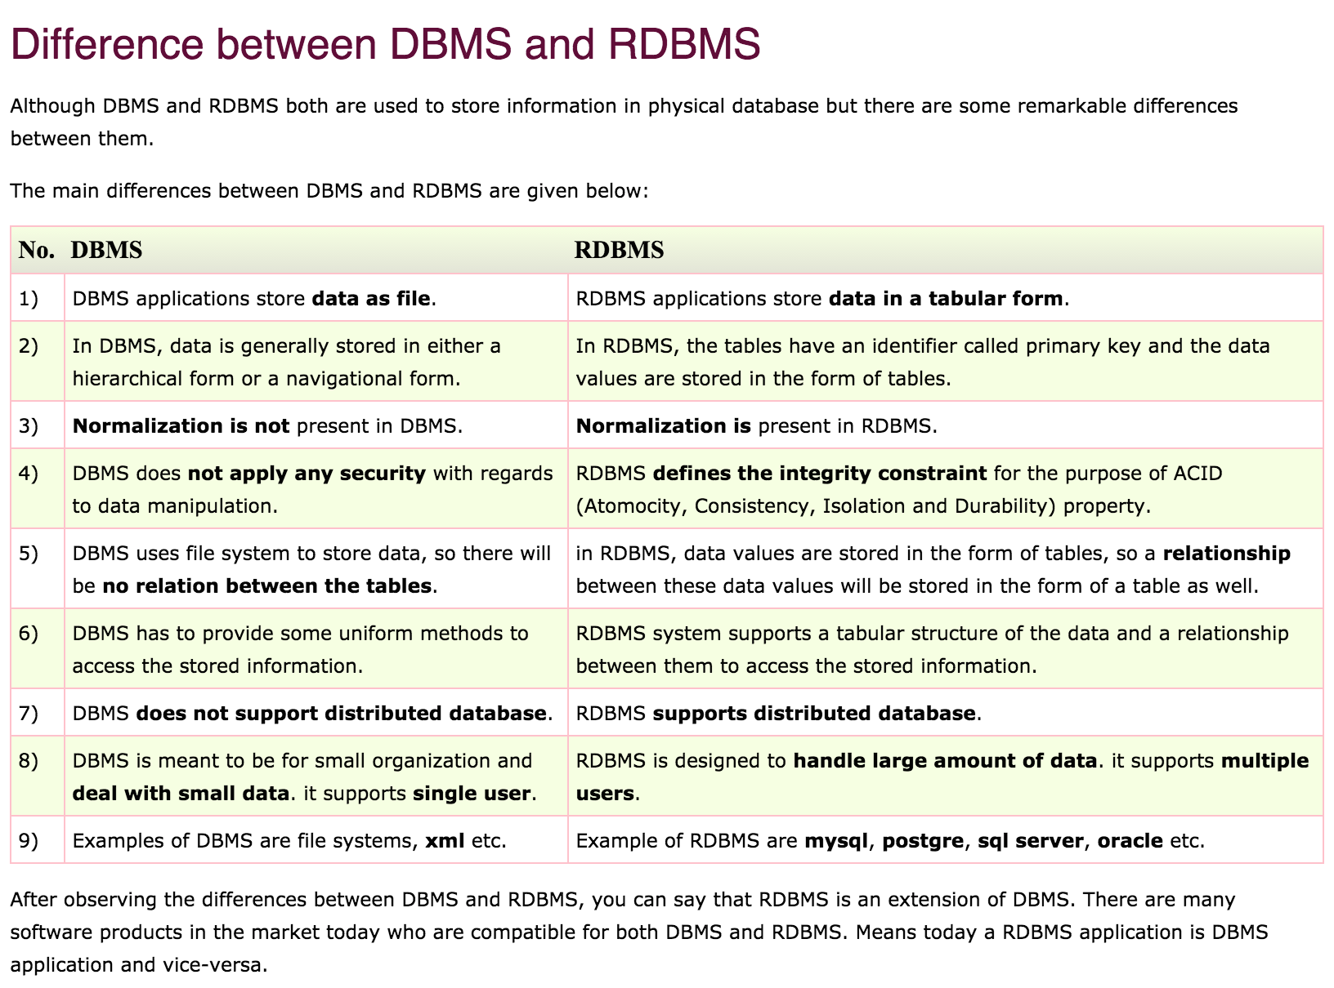
DBMS VS RDBMS

Slide 3
Relationship
Relationship defines how two tables are linked
to each other.

Slide 4
Relationship Types
There are three types of relationships: One-to-one: Both tables can have only one record on either side of the relationship. Each primary key value relates to only one (or no) record in the related table. They're like spouses—you may or may not be married, but if you are, both you and your spouse have only one spouse. Most one-to-one relationships are forced by business rules and don't flow naturally from the data. In the absence of such a rule, you can usually combine both tables into one table without breaking any normalization rules.
One-to-many: The primary key table contains only one record that relates to none, one, or many records in the related table. This relationship is similar to the one between you and a parent. You have only one mother, but your mother may have several children.
Many-to-many: Each record in both tables can relate to any number of records (or no records) in the other table. For instance, if you have several siblings, so do your siblings (have many siblings). Many-to-many relationships require a third table, known as an associate or linking table, because relational systems can't directly accommodate the relationship.

Slide 5
Keys in RDBMS
Primary Key
An attribute that is used to access the table data is called primary key. It must
Contain Unique values. It uniquely identifies a record in a table.
Candidate Key
It is set of attributes from which primary key is selected. One of them is made as
Primary key and rest are candidate keys. They are candidate for primary key.
It uniquely identifies a record.
Composite key
When more than one attributes are used to uniquely identify a record in a table
It becomes composite key.

Slide 6
Keys in RDBMS
Super Key
It is a set of attributes that uniquely identifies each record in a table. It is a
superset of candidate key.
Secondary Key
The candidate keys which are not selected as primary key , are called as
secondary key or alternate key.

Slide 7
Constraints
Constraints enforce limits to the data or type of data that can be inserted/updated/deleted from a table. The whole purpose of constraints is to maintain the data integrity during an update/delete/insert into a table. In this tutorial we will learn several types of constraints that can be created in RDBMS.

Slide 8
Constraints Contd..
PRIMARY KEY:
Primary key uniquely identifies each record in a table. It must have unique values and cannot contain nulls. In the below example the ROLL_NO field is marked as primary key, that means the ROLL_NO field cannot have duplicate and null values.
CREATE TABLE STUDENT( ROLL_NO INT NOT NULL, STU_NAME VARCHAR (35) NOT NULL UNIQUE, STU_AGE INT NOT NULL, STU_ADDRESS VARCHAR (35) UNIQUE, PRIMARY KEY (ROLL_NO) );
FOREIGN KEY:
Foreign keys are the columns of a table that points to the primary key of another table. They act as a cross-reference between tables.
Domain constraints:
Each table has certain set of columns and each column allows a same type of data, based on its data type. The column does not accept values of any other data type. Domain constraints are user defined data type and we can define them like this:
Domain Constraint = data type + Constraints (NOT NULL / UNIQUE / PRIMARY KEY / FOREIGN KEY / CHECK / DEFAULT)

Slide 9
Codd Rules
Dr. Edgar Frank Codd (August 19, 1923 – April 18, 2003) was an computer scientist, while working for IBM he invented the relational model for database management ( theoretical basis for relational databases). Codd proposed thirteen rules (numbered zero to twelve) and said that if a Database Management System meets these rules, it can be called as a Relational Database Management System. These rules are called as Codd's12 rules. Hardly any commercial product follows all

Slide 10
Codd Rules contd..
Rule 1: The information rule: All information in the database is to be represented in one and only one way, namely by values in column positions within rows of tables.
Rule 2: The guaranteed access rule: All data must be accessible. This rule is essentially a restatement of the fundamental requirement for primary keys. It says that every individual scalar value in the database must be logically addressable by specifying the name of the containing table, the name of the containing column and the primary key value of the containing row.
Rule 3: Systematic treatment of null values: The DBMS must allow each field to remain null (or empty). Specifically, it must support a representation of "missing information and inapplicable information" that is systematic, distinct from all regular values (for example, "distinct from zero or any other number", in the case of numeric values), and independent of data type. It is also implied that such representations must be manipulated by the DBMS in a systematic way.

Slide 11
Codd Rules Contd..
Rule 4: Active online catalog based on the relational model: The system must support an online, inline, relational catalog that is accessible to authorized users by means of their regular query language. That is, users must be able to access the database's structure (catalog) using the same query language that they use to access the database's data.
Rule 5: The comprehensive data sub language rule: The system must support at least one relational language that
1. Has a linear syntax
2. Can be used both interactively and within application programs,
3. Supports data definition operations (including view definitions), data manipulation operations (update as well as retrieval), security and integrity constraints, and transaction management operations (begin, commit, and rollback).
Rule 6: The view updating rule: All views those can be updated theoretically, must be updated by the system.

Slide 12
Codd Rules Contd..
Rule 7: High-level insert, update, and delete: The system must support set-at-a-time insert, update, and delete operators. This means that data can be retrieved from a relational database in sets constructed of data from multiple rows and/or multiple tables. This rule states that insert, update, and delete operations should be supported for any retrievable set rather than just for a single row in a single table.
Rule 8: Physical data independence: Changes to the physical level (how the data is stored, whether in arrays or linked lists etc.) must not require a change to an application based on the structure.
Rule 9: Logical data independence: Changes to the logical level (tables, columns, rows, and so on) must not require a change to an application based on the structure. Logical data independence is more difficult to achieve than physical data independence.

Slide 13
Codd rules Contd..
Rule 10: Integrity independence: Integrity constraints must be specified separately from application programs and stored in the catalog. It must be possible to change such constraints as and when appropriate without unnecessarily affecting existing applications.
Rule 11: Distribution independence: The distribution of portions of the database to various locations should be invisible to users of the database. Existing applications should continue to operate successfully:
1. When a distributed version of the DBMS is first introduced; and
2. When existing distributed data are redistributed around the system.
Rule 12: The non subversion rule: If the system provides a low-level (record-at-a-time) interface, then that interface cannot be used to subvert the system, for example, bypassing a relational security or integrity constraint

Slide 14
END

