Slide 1
Terminology

Slide 2
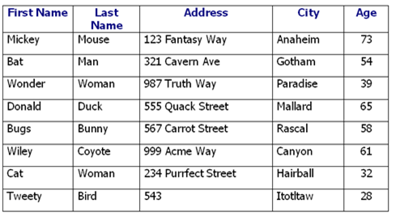
Entity
Entity are principle data objects about which information is to be collected.
Employee Entity

Slide 3
Attribute
All instances of entity have some common properties called attributes.
Types of Atrributes
Single valued Attributes : An attribute, that has a single value for a particular entity is known as single valued attributes. For example, age of a employee entity.
Multi valued Attributes : An attributes that may have multiple values for the same entity is known as multi valued attributes. For example colors of a car entity.
Compound Attribute/Composite Attribute : Attribute can be subdivided into two or more other Attribute. For Example, Name can be divided into First name, Middle name and Last name.
Derived Attribute : Attributes derived from other stored attribute. For example age from Date of Birth and Today’s date.

Slide 4
Attribute Contd..

Slide 5
Tuple
A row in the table is called a tuple

Slide 6
Degree
Number of columns in the relation is called
Degree.

Slide 7
Cardinality
Number of tuples is called Cardinality.

Slide 8
Relational Database
A relational database is a collection of data items organized as a set of formally-described tables from which data can be accessed or reassembled in many different ways without having to reorganize the database tables. The relational database was invented by E. F. Codd at IBM in 1970.

Slide 9
END

