Slide 1
Introduction
Database
Uses of Database
History of Database
Database Architecture
Database Concepts

Slide 2
Database
Is a Collection of related information.

Slide 3
Database Uses
Application of DBMS
Banking
Universities
Railway Reservation
Finance
Sales

Slide 4
Data Models
Data Model is an abstract model that defines how data is stored and related to one another.

Slide 5
Flat File Model
A flat file database is a database stored as an ordinary unstructured file called a "flat file".
To access the structure of the data and manipulate it on a computer system, the file must be read in its entirety into the computer's memory.
Upon completion of the database operations, the file is again written out in its entirety to the host's file system.
In this stored mode the database is said to be "flat", meaning that it has no structure for indexing and there are usually no structural relationships between the records.
A flat file can be a plain text file or a binary file.

Slide 6
Hierarchical Data Model
A hierarchical database model is a data model in which the data is organized into a tree-like structure.
The data is stored as records which are connected to one another through links.
A record is a collection of fields, with each field containing only one value.
The entity type of a record defines which fields the record contains.
A record in the hierarchical database model corresponds to a row (or tuple) in the relational database model and an entity type corresponds to a table (or relation).

Slide 7
Hierarchical Model Contd..
The hierarchical structure was developed by IBM in the 1960s, and used in early mainframe DBMS.

Slide 8
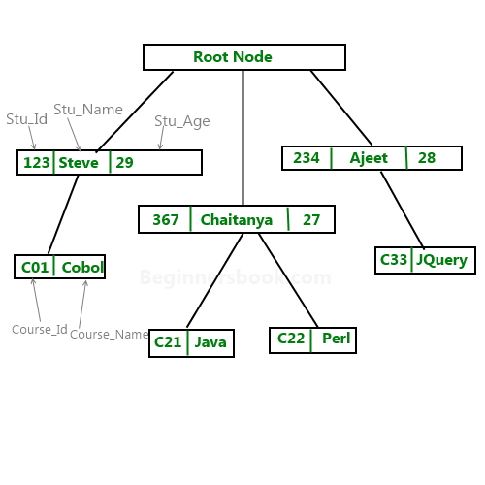
Hierarchical Model Contd..

Slide 9
Hierarchical Model Contd..
Examples of hierarchical data represented as
relational tables
Employee Table Computer table
EmpNo | FNAME | LNAME | DEPTNO | SLNO | Type | EmpNo
101 | Mahwish | Faki | 10-L | 3009734-4 | Computer | 101
102 | Nirun | Ar | 20-B | 2-22-723423 | Monitor | 102

Slide 10
Hierarchical Model Contd..
Advantages of Hierarchical Model
It provides simplicity and it is easy to design.
It also provides data integrity. Since, it is based on parent-child relationship. So, there is always a link between these segments.
It is more efficient when the database contains more 1:M relationships.

Slide 11
Hierarchical Model Contd..
Dis-Advantages of Hierarchical Model
There exist operational anomalies in this model.
Implementation Complexity
It is easy to design but very difficult to implement.
Database Management System-If you make any change in the database structure then you need to make all the necessary changes in all the application program that access the database

Slide 12
Network Data Model
The network model's original inventor was Charles Bachman and it was developed into a standard specification published in 1969 by the Conference on Data Systems Languages (CODASYL) Consortium.
This was followed by a second publication in 1971, which became the basis for most implementations.
Subsequent work continued into the early 1980s, culminating in an ISO specification, but this had little influence on products.

Slide 13
Network Model Contd..
An enhanced form of the hierarchical data model, the network model represents data in a tree of records.
Relationships between tables (records) are expressed as sets.
A set has one parent record (owner) and one or more child records (members).
Related records in a set are directly linked by pointers, rather than by matching duplicate columns as is the case in the relational data model.

Slide 14
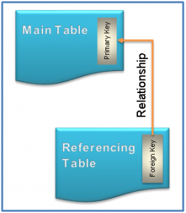
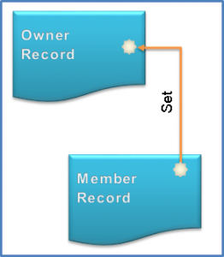
Network Model Contd..

Slide 15
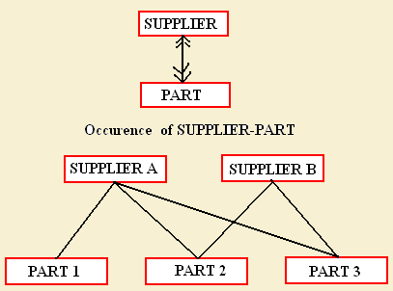
Network Model Contd..

Slide 16
Advantages of Network Model
The benefits of the network model include:
Simple Concept: Similar to the hierarchical model, this model is simple and the implementation is effortless.
Ability to Manage More Relationship Types: The network model has the ability to manage one-to-one (1:1) as well as many-to-many (N: N) relationships.
Easy Access to Data: Accessing the data is simpler when compared to the hierarchical model.
Data Integrity: In a network model, there's always a connection between the parent and the child segments because it depends on the parent-child relationship.
Data Independence: Data independence is better in network models as opposed to the hierarchical models.

Slide 17
Dis -Advantage of Network Model
The drawbacks of the network model include:
System Complexity: Each and every record has to be maintained with the help of pointers, which makes the database structure more complex.
Functional Flaws: Because a great number of pointers is essential, insertion, updates, and deletion become more complex.
Lack of Structural Independence: A change in structure demands a change in the application as well, which leads to lack of structural independence.

Slide 18
Relational Data Model
In this model, data is organized in two-
dimensional tables called relations. The tables
or relation are related to each other.

Slide 19
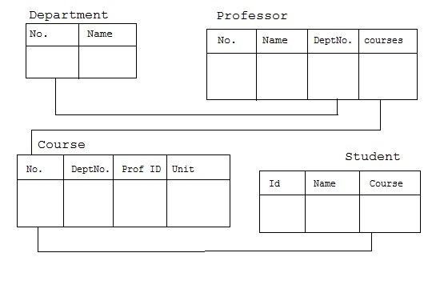
Relation Data Model Contd..

Slide 20
Relational Data Model Contd..
Relational model stores the data in the form of table. It consists of three major components.
The set of relations and set of domains that defines the way data can be represented.
Integrity rules that defines the procedure to protect the data.
The operations that can be performed on the table.

Slide 21
Relational Data Model Contd..
Characteristics of relational database are:-
All data is conceptually represented as an orderly arrangement of data into rows and column called a relation or table.
All the values are scalar i.e. at any given row or column position there is one and only one value.
All operations are performed on the entire relation and the result is an entire relation

Slide 22
Object Relational Model
An ORDBMS supports an extended form of SQL called SQL3 that is still in the development stages. The extensions are needed because ORDBMSs have to support ADT's.
The ORDBMS has the relational model in it because the data is stored in the form of tables having rows and columns and SQL is used as the query language and the result of a query is also table or tuples (rows).

Slide 23
Object Relational Model Contd..
Characteristics of an ORDBMS:
Base data type extension
Support complex objects
Inheritance
Rule Systems.

Slide 24
Object Relational Model Contd..
Users define data types:
Object-Relational Database Management Systems (ORDBMSs) allow users to define data types, functions and operators. As a result, the functionality of the ORDBMSs increases along with their performance.

Slide 25
Object Relational Model Contd..
An example schema of a student relation which
ORDBMS supports
STUDENT(fname, lname,ID ,sex, major, address,dname,location,picture)
Notice: extra attributes "location" and "picture"
which are not present in the traditional EMPLOYEE
relation of RDBMS. The data type of "location" is
"geographic point" and "picture" is "image".

Slide 26
Client Server Architecture
To Overcome an increasingly decentralized business environment , the client server architecture was developed.
It as two components the client and the server.
The client request the resource to the server and the server provides the resource requested by the client.

Slide 27
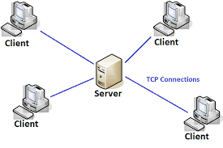
Client server Architecture Cond ..
The client is tier1 and the server is tier2.
The application logic , business logic , user interface reside on the tier 1 and database transaction logic resides on the tier2.

Slide 28
Advantages of Client Server Architecture
It enables wider access to existing databases .
Increased Performance
Hardware cost is reduced. It is only the server that requires storage and processing power sufficient to store and manage the database.
Communication cost is reduced.
Increased Consistency.

Slide 29
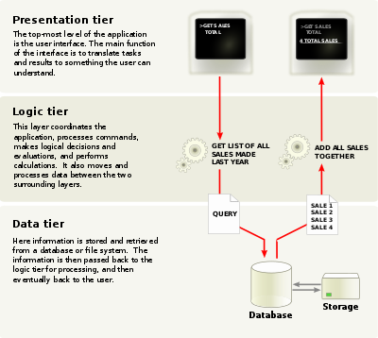
Three-Tier Architecture
The need for enterprise scalability challenged the traditional 2-tier architecture model.

Slide 30
Traditional File-based Systems
File-based System (Predecessor to the DBMS) = A collection of application programs that perform services for the end-users such as the production of reports. Each program defines and manages its own data.

Slide 31
Traditional File-based Systems
Information are stored in data files
Each file is a sequence of records
Sno Lname Position NIN Bno
SG14 Ford Deputy WL220658D B3
SG37 Beech Snr Asst WL432514C B3
SL21 White Manager WK440211B B5
Eg., if each record contains 100 bytes of data, then the 1st record occupies the 1st 100 bytes in the file, the 2nd record occupies the 2nd 100 bytes in the file.

Slide 32
Traditional File-based Systems
A student record reporting program:
Struct STUDENT_RECORD { char StudentID[8]; char Tutorial[3]; int Mark; }; /*totally 15 bytes*/ STUDENT_RECORD std_recs[50]; … fread(stud_recs, 15,50,file); /*read 50 student records*/ …

Slide 33
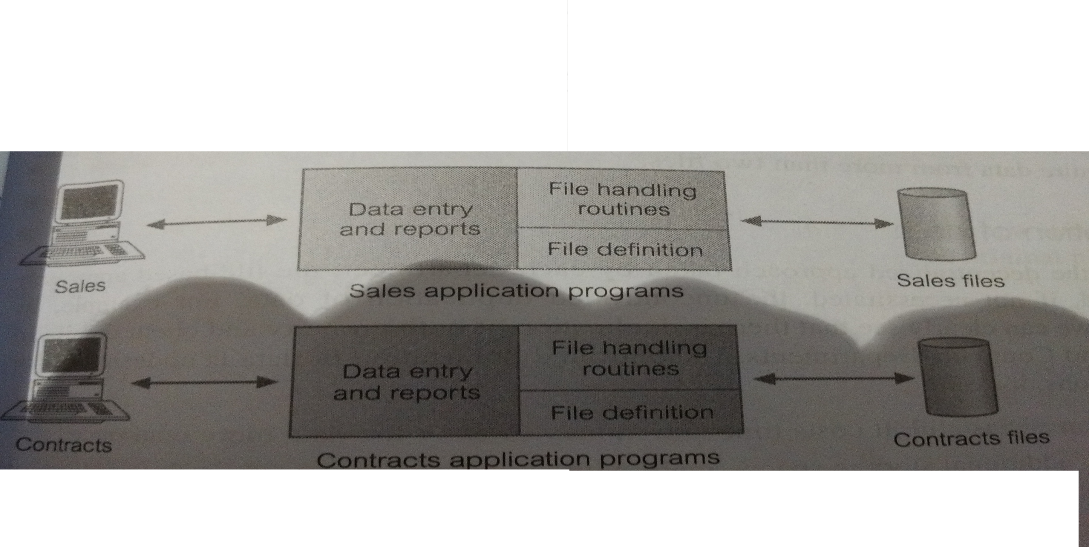
Traditional File-based Systems
An example: DreamHome, A property agent company

Slide 34
Traditional File-based Systems
Sales Files
PropertyForRent(propertyNo,Street,city,postcode,type,rooms,rent,ownerno)
PrivateOwner(ownerno,fname,lname,address,telno)
Client(clientNo,fname,lname,address,telno,prefType,maxrent)

Slide 35
Traditional File-based Systems
Limitations of File-Based Approach:
Separation and isolation of data
Duplication of data o Data dependence
Incompatibility of files
Fixed queries / proliferation of application programs

Slide 36
Database Approach
All the limitations of the file-based approach can be attributed to two factors for database approach:
The definition of data is embedded into the application programs, rather then being stored separately and independently.
There is no control over the access and manipulation of data beyond that imposed by the application programs.

Slide 37
END

