Slide 1
DATA BASE MANAGEMENT SYSTEM

Slide 2

ACID PROPERTIES:
Atomicity
Consistence
Isolation
Durability

Slide 3

Terminologies:
Entity, Attribute, Tuple,
What is RDBMS and Relational database

Slide 4
What is rdbms
Entity relational ship Modeling

Slide 5
CODDS RULES

Slide 6

Rule 0: The foundation rule:
Rule 1: The information rule:
Rule 2: The guaranteed access rule:
Rule 3: Systematic treatment of null values:
Rule 4: Dynamic online catalog based on the relational model:
Rule 5: The comprehensive data sublanguage rule:
Rule 6: The view updating rule:
Rule 7: High-level insert, update, and delete:
Rule 8: Physical data independence:
Rule 9: Logical data independence:
Rule 10: Integrity independence:
Rule 11: Distribution independence:
Rule 12: The nonsub version rule:

Slide 7
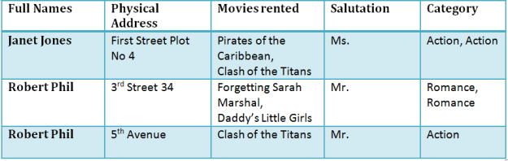
NORMALIZATION

Slide 8
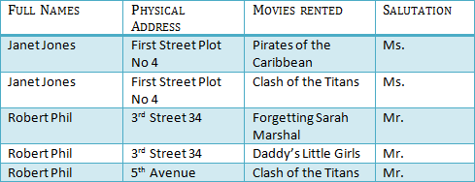
1NF (First Normal Form)
Rule 1- Each table cell should contain a single value.
Rule 2- Each record needs to be unique.

Slide 9

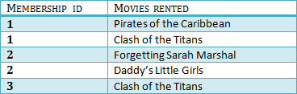
2NF (Second Normal Form)
Rule 1- Be in 1NF
Rule 2- Single Column Primary Key

Slide 10

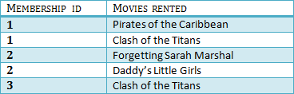

3NF (Third Normal Form) Rules
Rule 1- Be in 2NF
Rule 2- Has no transitive functional dependencies

Slide 11
Boyce-Codd Normal Form (BCNF)
Boyce-Codd Normal Form (BCNF) is one of the forms of database normalization.
A database table is in BCNF if and only if there are no non-trivial functional dependencies of attributes on anything other than a superset of a candidate key.
Sometimes is BCNF is also referred as 3.5 Normal Form.

