Slide 1
DATA BASE MANAGEMENT SYSTEM

Slide 2
Data base and its needs.
History of database.

Slide 3
What is dbms and its advantages ?

Slide 4
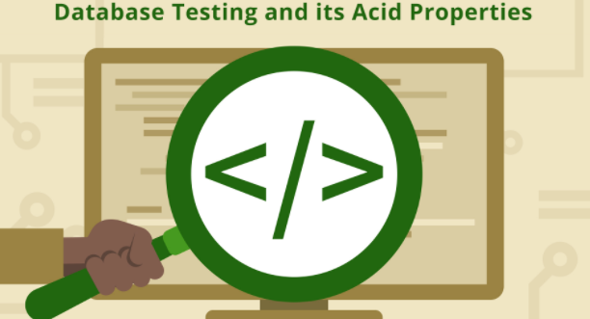
ACID PROPERTIES:
Atomicity
Consistence
Isolation
Durability

Slide 5

Terminologies:
Entity, Attribute, Tuple,
What is RDBMS and Relational database

Slide 6
What is rdbms
Entity relational ship Modeling

Slide 7
CODDS RULES

Slide 8

Rule 0: The foundation rule:
Rule 1: The information rule:
Rule 2: The guaranteed access rule:
Rule 3: Systematic treatment of null values:
Rule 4: Dynamic online catalog based on the relational model:
Rule 5: The comprehensive data sublanguage rule:
Rule 6: The view updating rule:
Rule 7: High-level insert, update, and delete:
Rule 8: Physical data independence:
Rule 9: Logical data independence:
Rule 10: Integrity independence:
Rule 11: Distribution independence:
Rule 12: The nonsub version rule:

Slide 9
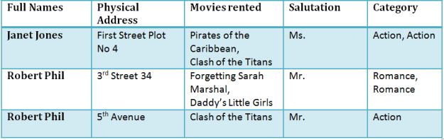
NORMALIZATION

